Slide 1
COMPCART
GUIDE: UMA DEANISH M.A.
JISHA.C.RAMADAS
NIKITHA V.K.
SANDEEP K.N.

Slide 2
ABOUT COMPCART
Comp Cart is a web based application which offers online services to all computer components.
The main objective of this application is that all the components are categorized and searched on the basis of cost and type of user.
Comp Cart provides the services at Personal, Business and gaming level.
Comp Cart is a user friendly interface as it provides key features and specifications of each component.

Slide 3
TECHNOLOGIES USING
Front end : HTML, CSS
Middle ware : JSP, PHP
Back end : MYSQL
Server : WAMP
Coding purpose : Notepad++, Dreamweaver
Browser : Google Chrome

Slide 4

MODULES
Hardware
Software
Customized
Gaming
Network
Personal
Business
Laptop Accessories

Slide 5
HARDWARE
This module contains all the hardware components which are necessary on the daily basis. The description and the usage of the components are provided and are categorized based on the price.

Slide 6
SOFTWARE
This module contains all the software related information. They contain softwares based on the current technology and other application based softwares are also available. It also provides the software for gaming and the updated patchcards released by the company.

Slide 7
NETWORK
This module contains all the network components which are required by the system for connectivity. Availability of all the physical components as per the need.

Slide 8
PERSONAL
This module mainly concentrates on the system which are of home based. They are categorized on the price levels. These system do not require more storage and graphics is inbuilt for these systems.

Slide 9
BUSINESS
This module mainly concentrates on the business related systems which mainly focuses on high speed and highly visualized softwared with more graphics card.

Slide 10
GAMING
This module has focus on the system designed for gaming purpose with high storage and graphical supported system for the special effects. It also provides many Gaming accessories as well.

Slide 11
CUSTOMIZED
This module is specially designed for people who are specific with their requirements and they get the final version of products as per the requirement specifications.

Slide 12
LAPTOP ACCESSORIES
This module provides the description of all the laptop accessories which are available to enhance the features, It has many other devices which can be used for the protection of devices.

Slide 13
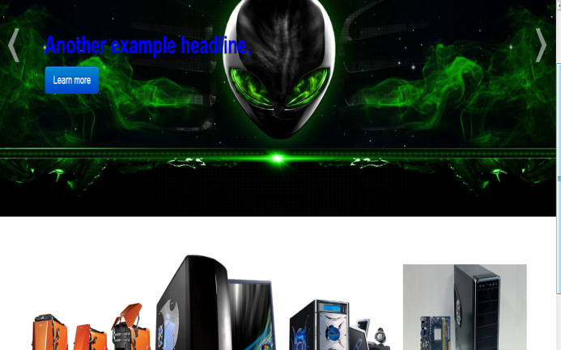
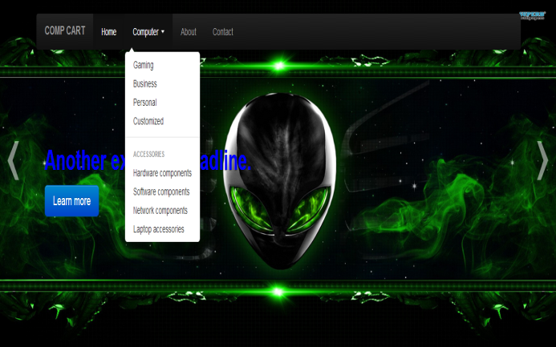

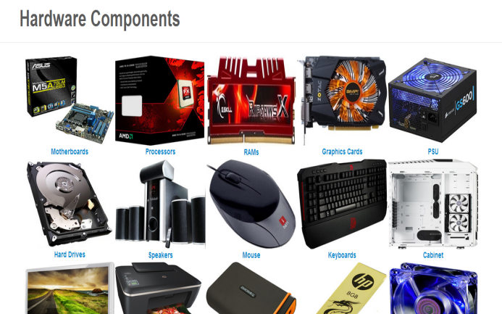
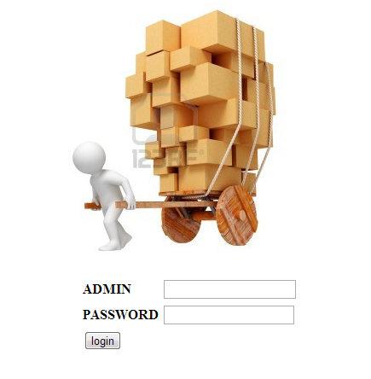

CONTROL FLOW

Slide 14
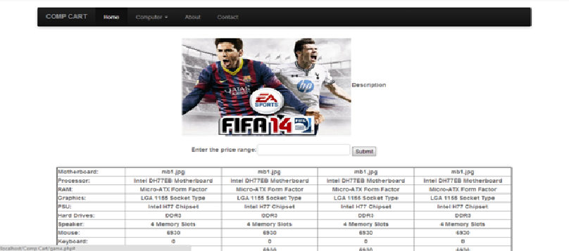
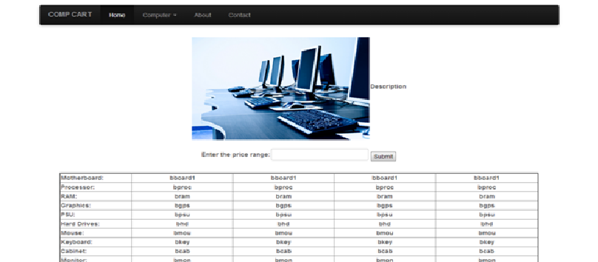
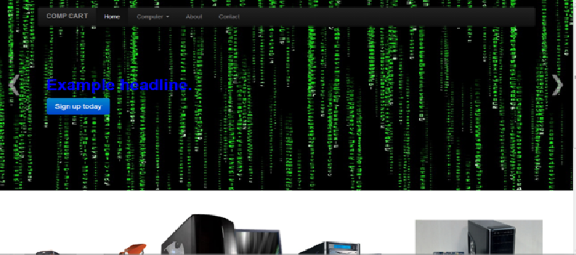
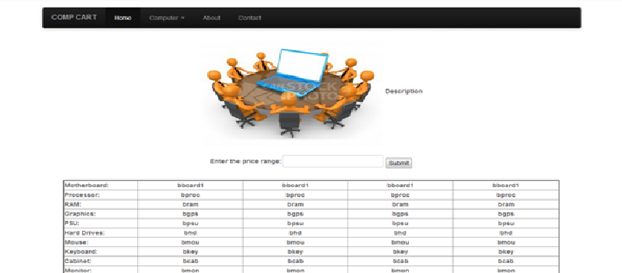
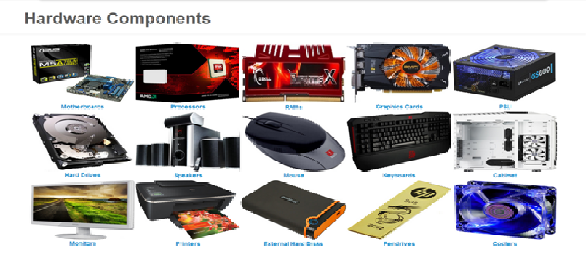
SCREEN SHOTS

Slide 15
Place order with
contact details

Slide 16
THANK YOU

