Slide 1
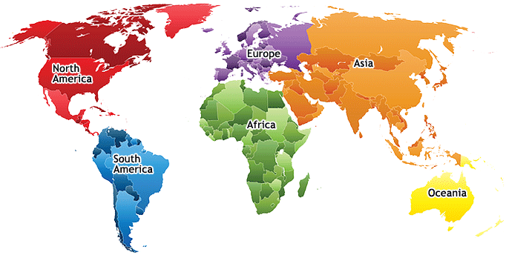
Marketwise
About Newsletter
Market Insights for those on the go!

Slide 2
(Region name)
Bonds
Commodities
Currencies
Guardian article thumbnail
Guardian article title (link)
Article summary
Published date
Guardian article thumbnail
Guardian article title (link)
Article summary
Published date
Guardian article thumbnail
Guardian article title (link)
Article summary
Published date
NYTimes article thumbnail
NYTimes article title (link)
Article summary
Published date
NYTimes article thumbnail
NYTimes article title (link)
Article summary
Published date
NYTimes article thumbnail
NYTimes article title (link)
Article summary
Published date
Equities
Property
Guardian article thumbnail
Guardian article title (link)
Article summary
Published date
Guardian article thumbnail
Guardian article title (link)
Article summary
Published date
NYTimes article thumbnail
NYTimes article title (link)
Article summary
Published date
NYTimes article thumbnail
NYTimes article title (link)
Article summary
Published date

Slide 3
About
Maybe a little info on us/this site?
Could include documentation of how we created it so it’s easy for them to judge?

Slide 4
Newsletter
Sign up for our newsletter – for daily insights right to your email!
(Sign in form asking for: email, and selection of regions)

