Slide 1
JINI(Virtual Assistant)
Department of Information Technology
Galgotias College of Engineering and Technology Greater Noida
(Supervisor: Mr. Ranjit Kumar )
Group Members
Name of Member | Roll Number | Role
Devansh Vats | 1900970139004 | Documentation , Back End
Devansh Tiwari | 1809713035 | GUI Designing , Testing
Lakshay Kumar | 1900970139005 | Back End

Slide 2

Index
Introduction
Working
Library Description
Functionality
Features
Hardware /Software Requirement
Design
Conclusions & future enhancements
References

Slide 3
Introduction
We are all well aware about Cortana , Siri , Google Assistant and many other virtual assistants which are designed to aid the tasks of users in Windows, Android and iOS platforms.
We also developed one such type of virtual assistant named as “JINI” for windows platform . It will communicate to the user via text/voice option.
The main purpose of the software is to perform the tasks of the user at certain commands, provided in either of the ways, speech or text. It will ease most of the work of the user as a complete task can be done on a single command.
It will first understand the query entered by the user,then analyze it and generate response according to the query and give it back to the user in the form of text or voice.

Slide 4
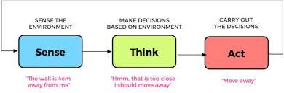
Working
There are Mainly three steps of its working:-
Lexical Analysis:-It involves in analyzing of word.Lexical analysis is dividing the whole chunk of txt into paragraphs,sentences and words.
Recognition:-It involves in understading the intent of the user. It is used to check word arrangements, and shows the relationship among the words.
Allocation:-It involves in genertaing the response. It simply fits the actual objects/events, which exist in a given context with object references obtained during the last phase

Slide 5
Library Description
SPEECH RECOGNITION:-Speech recognition has its roots in research done at Bell Labs in the early 1950s. Early systems were limited to a single speaker and had limited vocabularies of about a dozen words. Modern speech recognition systems have come a long way since their ancient counterparts.
PYTTSX3:- Pyttsx3 is a text-to-speech conversion library in Python. Unlike alternative libraries, it works offline, and is compatible with both Python 2 and 3.In addition, this module has been tested and is known to work on the following systems.SAPI5 on Windows XP, Windows Vista, and Windows 8, 8.1, 10.
PYQT5:- PyQt5 is a set of Python bindings for v5 of the Qt application framework from The Qt Company.Qt is a set of C++ libraries and development tools that includes platform independent abstractions for graphical user interfaces, networking, threads, regular expressions, SQL databases, SVG, OpenGL, XML, user and application settings, positioning and location services, short range communications.

Slide 6
Functionality
Presently, Jini is being developed as an automation tool and virtual assistant. Among the Various roles played by Jini are:
Give information about any person or object
Tell date and time
Launching application
Play music
Weather forecast
Crack jokes

Slide 7
Features
Conversational Maturity:-It have advanced conversational capabilities and can proactively seek out information, and can also ask clarifying questions, even if the conversation isn’t linear.
Free to Explore:-It can reach, consume, and process vast amounts of data– both structured and unstructured–to surface insights from any source - to gather relevant data to solve customer issues quickly.
Multi Language Support:-User can interact with assistant in multiple language like english and hindi .Language can be easily changed by simply giving command to it.

Slide 8
Hardware/Software Requirements
SOFTWARE REQUIREMENTS
Language->Python 3
Software->Pycharm,QT Designer,VS code
LIBRARY->Pyttsx3,Speech
Recognition , PyQt5,Sys, Os,
Web Browser ,Datetime, Wikipedia,
Pywhatkit , Pyjokes, Random
HARDWARE REQIREMENTS
Os->Window 7 Or Above
Processor->i3 Or Above
RAM->4GB Or Above
HDD->1GB Or Above
Microphone
Speaker

Slide 9
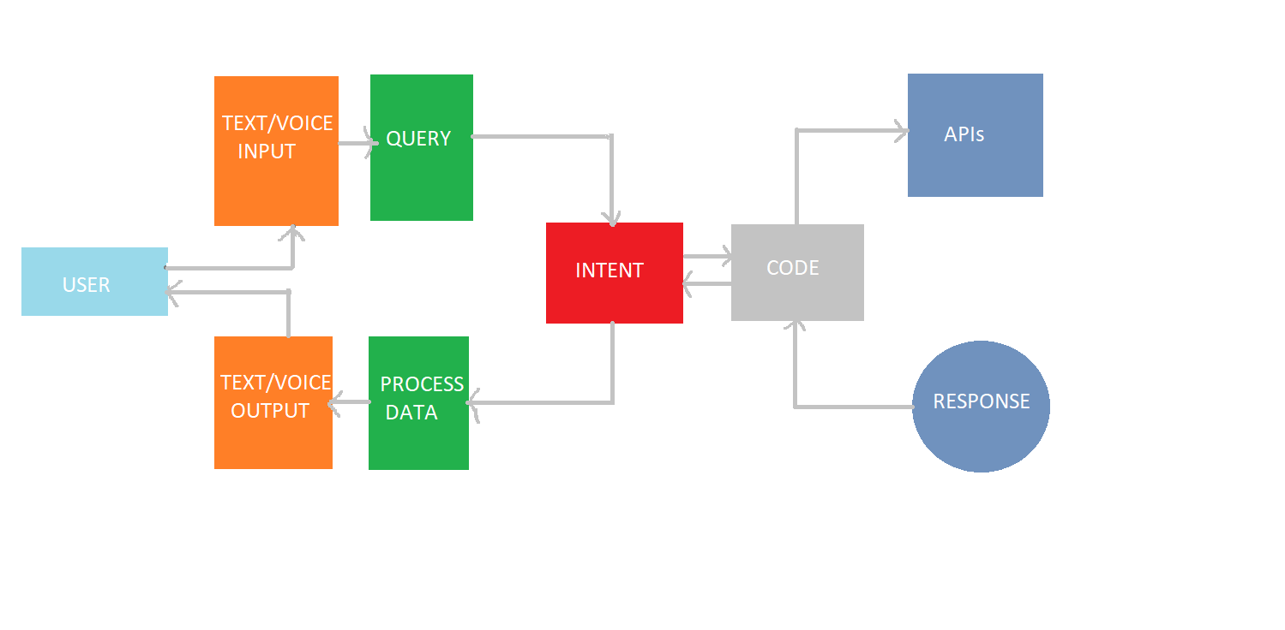
Design
Data Flow Diagram
Pytts3

Slide 10
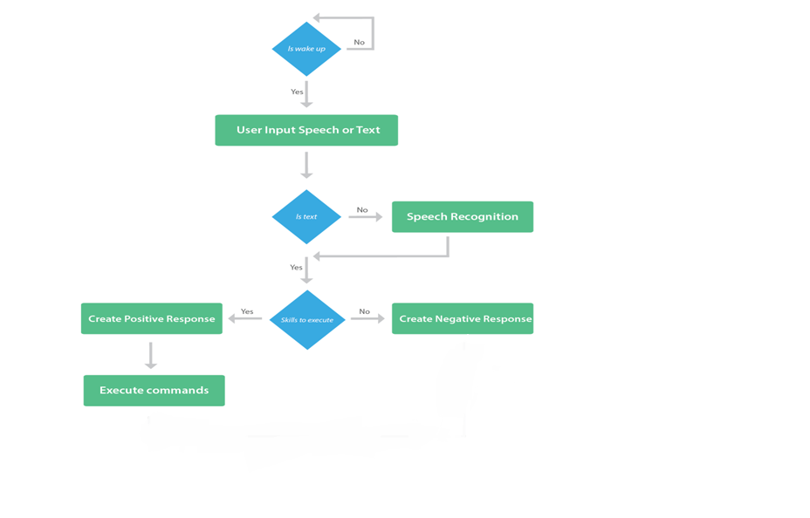
Flow Chart

Slide 11
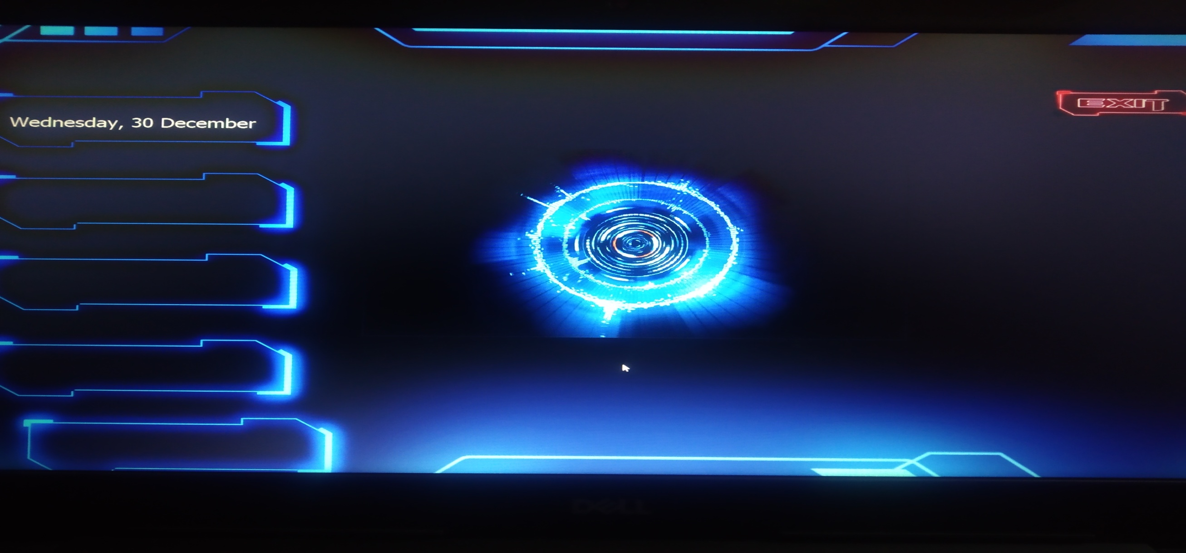
GUI Interface

Slide 12
Conclusions & future enhancements
Through this voice assistant, we have automated various services using a single line command. It eases most of the tasks of the user like searching the web, retrieving weather forecast details, vocabulary help and general queries.
We aim to make this project a complete server assistant and make it smart enough to act as a replacement for a general server administration.
The future plans include to make Jini as android application with some extra commands like sending mails,controling hardware etc.

Slide 13
References
[1]Guide to NLP:-https://towardsdatascience.com/your-guide-to-natural-language-processing-nlp-48ea2511f6e1
[2] Learning concepts of Machine Learning:-https://www.geeksforgeeks.org/introduction-machine-learning-using-python/#:~:text=Machine%20learning%20is%20a%20type,when%20exposed%20to%20new%20data.
[3]Tutorial help:- https://www.youtube.com/watch?v=Lp9Ftuq2sVI&t=2472s

Slide 14
Thank You

