Slide 1
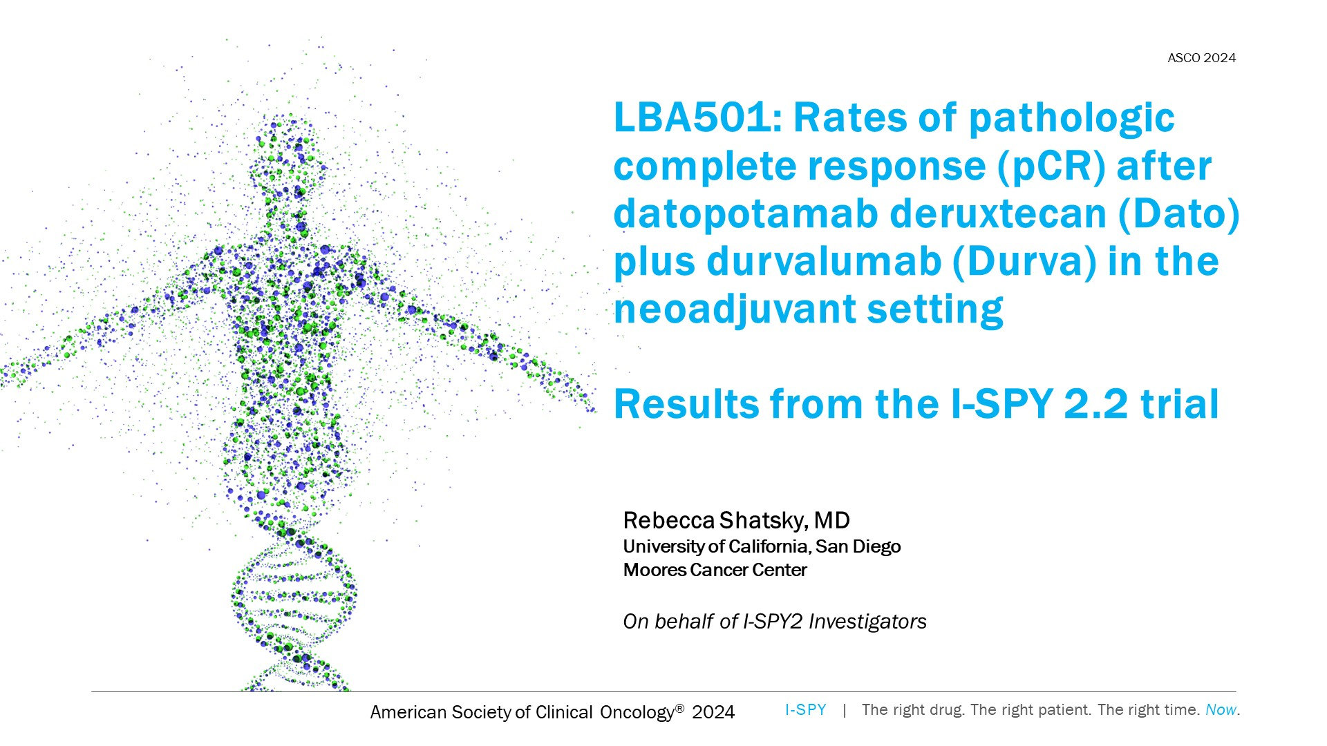
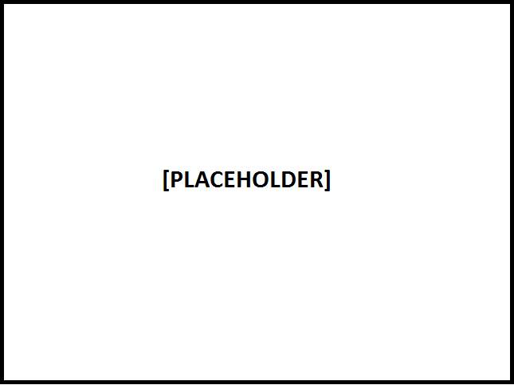
LBA501: Rates of pathologic complete response (pCR) after datopotamab deruxtecan (Dato) plus durvalumab (Durva) in the neoadjuvant setting <br /><br />Results from the I-SPY 2.2 trial
Content of this presentation is the property of the author, licensed by ASCO. Permission required for reuse.

Slide 2
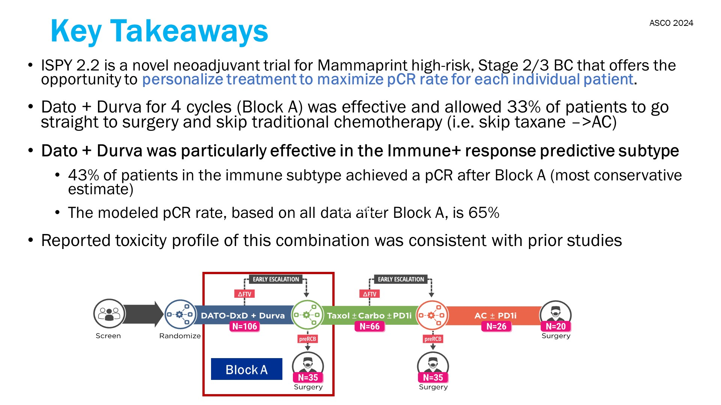
Key Takeaways
Content of this presentation is the property of the author, licensed by ASCO. Permission required for reuse.

Slide 3
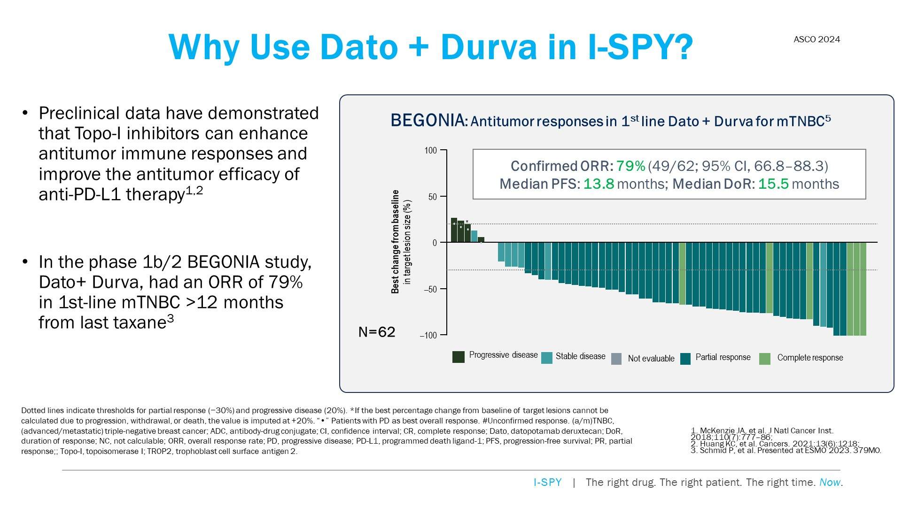
Why Use Dato + Durva in I-SPY? <br />
Content of this presentation is the property of the author, licensed by ASCO. Permission required for reuse.

Slide 4
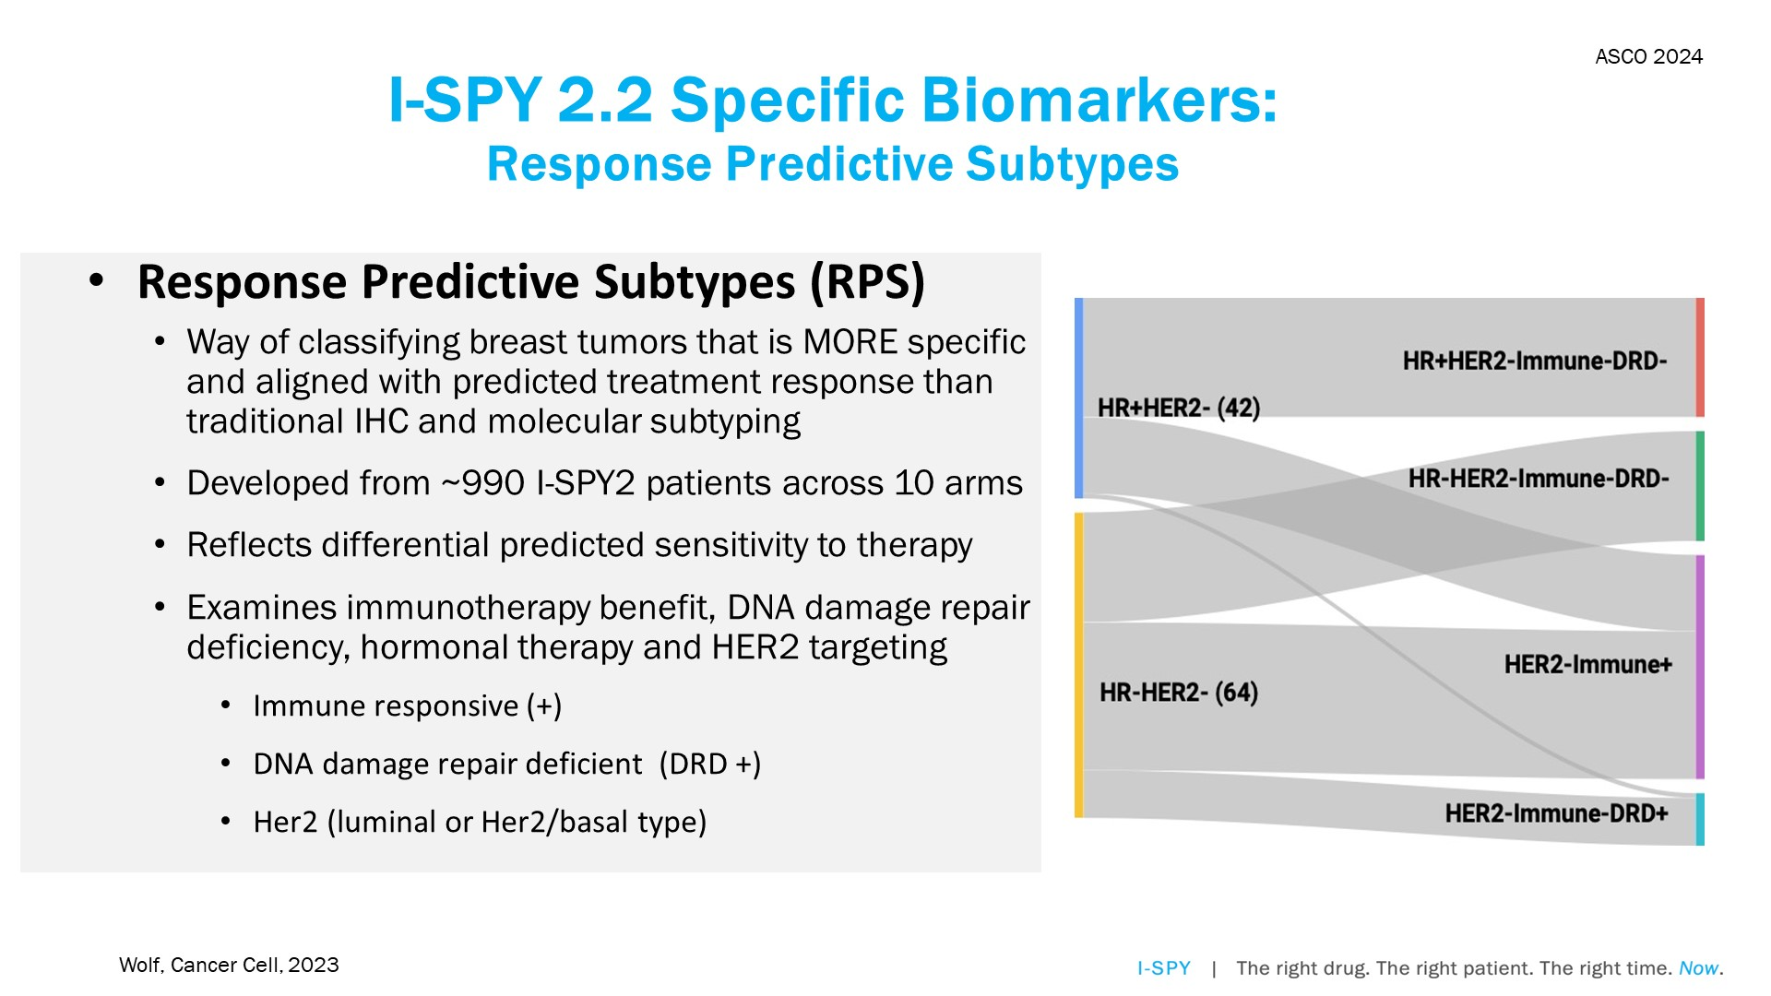
I-SPY 2.2 Specific Biomarkers: <br />Response Predictive Subtypes
Content of this presentation is the property of the author, licensed by ASCO. Permission required for reuse.

Slide 5
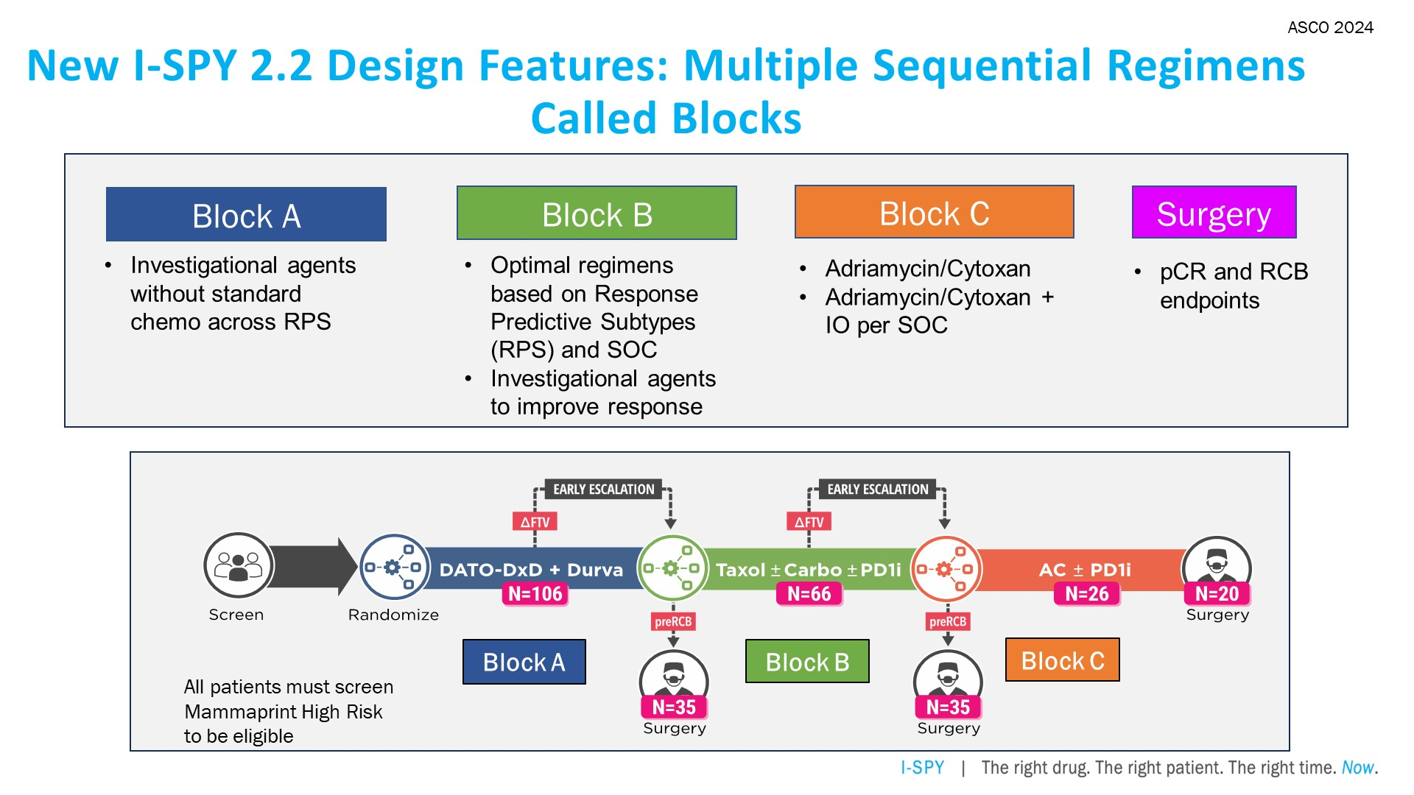
<br />New I-SPY 2.2 Design Features: Multiple Sequential Regimens Called Blocks
Content of this presentation is the property of the author, licensed by ASCO. Permission required for reuse.

Slide 6
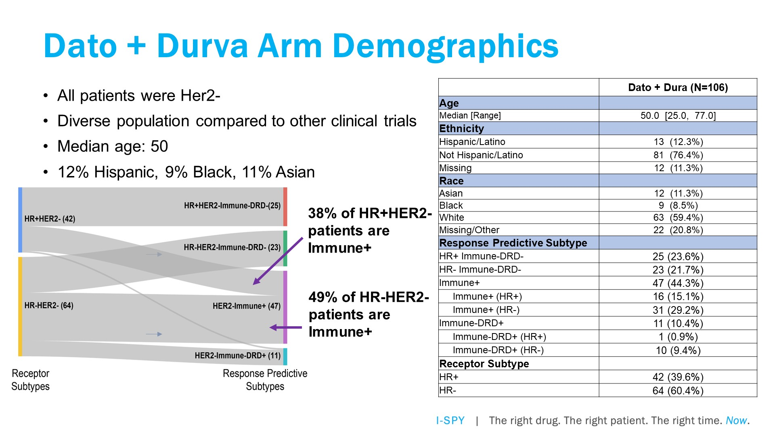
Dato + Durva Arm Demographics
Content of this presentation is the property of the author, licensed by ASCO. Permission required for reuse.

Slide 7
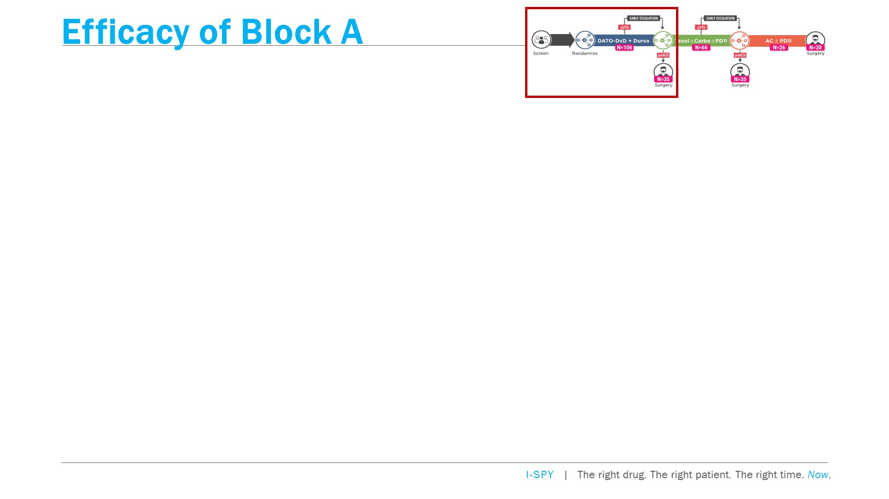
Efficacy of Block A
Content of this presentation is the property of the author, licensed by ASCO. Permission required for reuse.

Slide 8
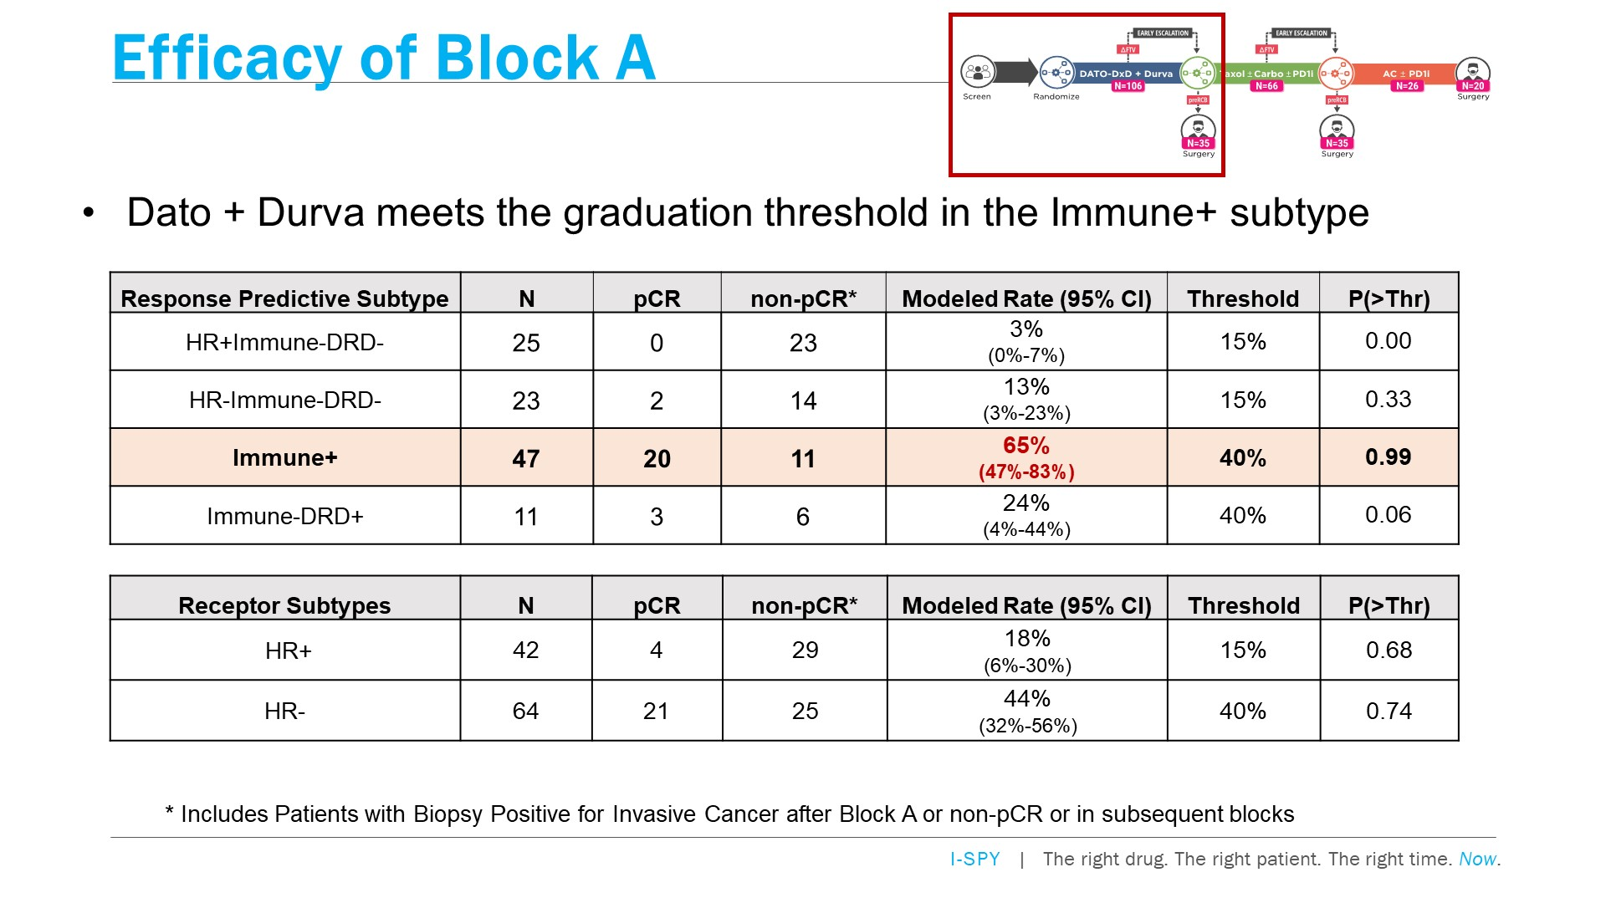
Efficacy of Block A
Content of this presentation is the property of the author, licensed by ASCO. Permission required for reuse.

Slide 9
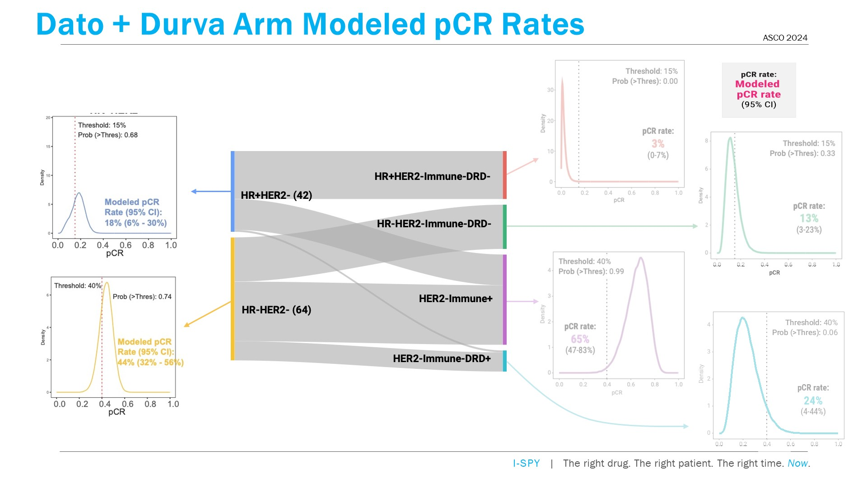
Dato + Durva Arm Modeled pCR Rates
Content of this presentation is the property of the author, licensed by ASCO. Permission required for reuse.

Slide 10
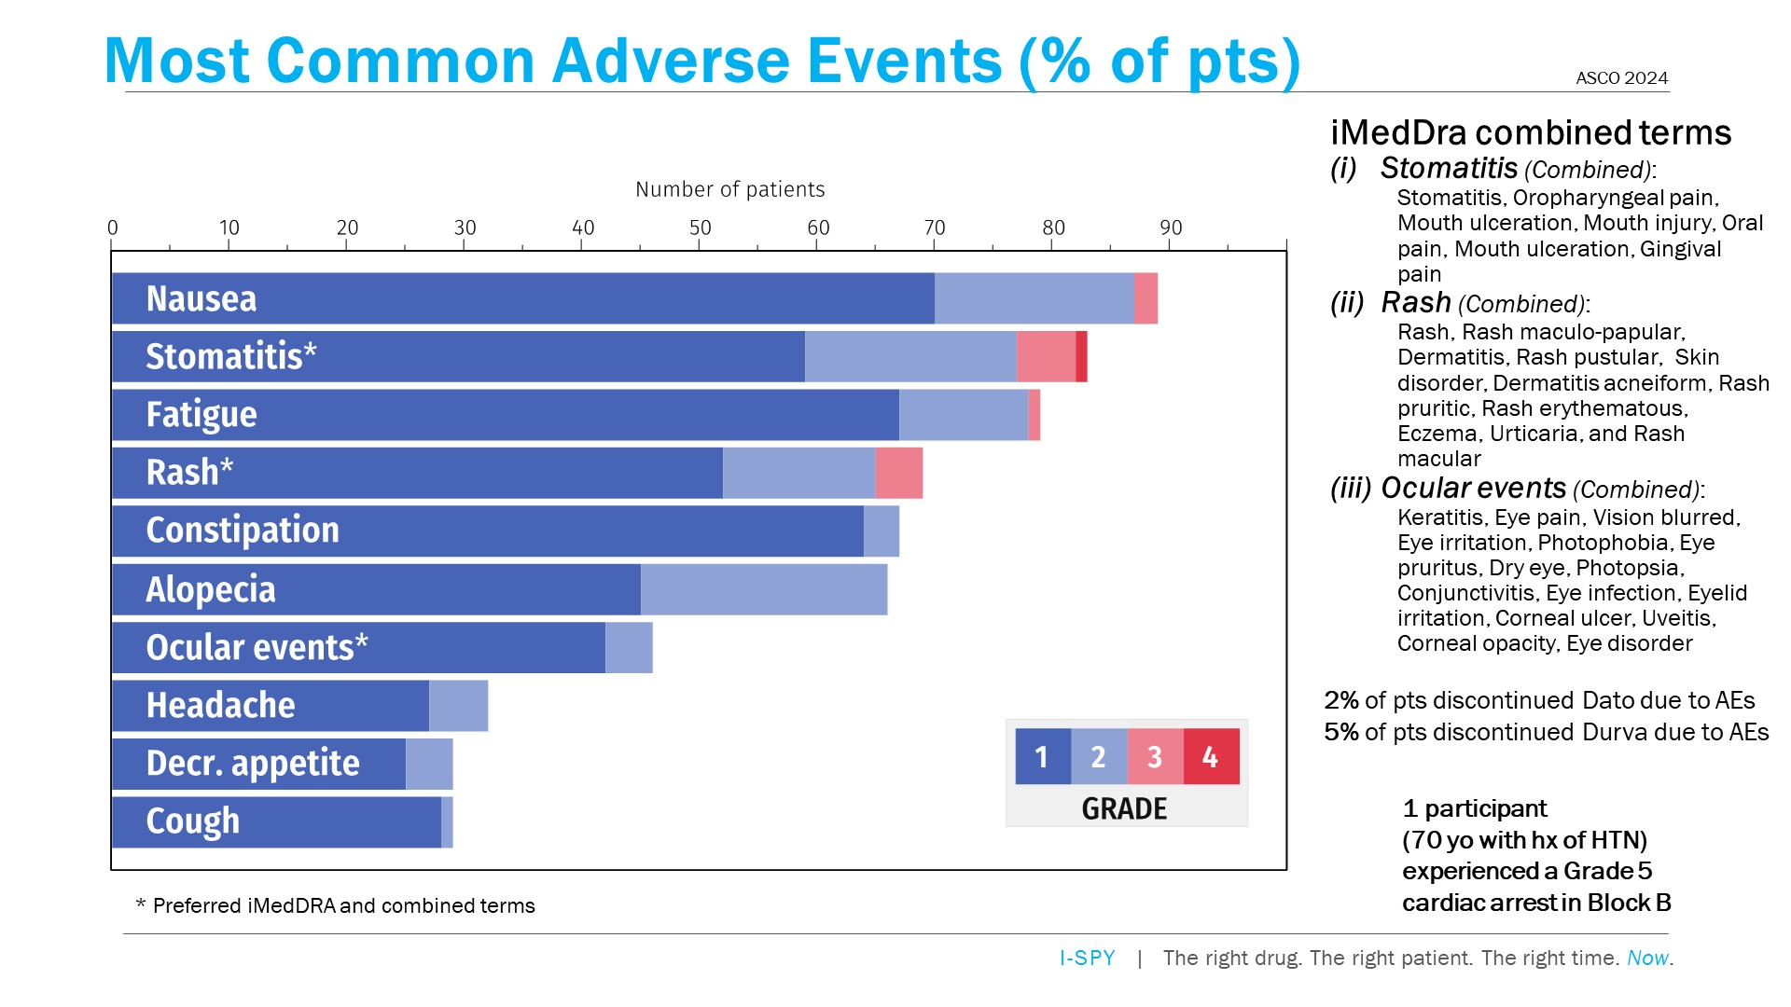
Most Common Adverse Events (% of pts)
Content of this presentation is the property of the author, licensed by ASCO. Permission required for reuse.

Slide 11
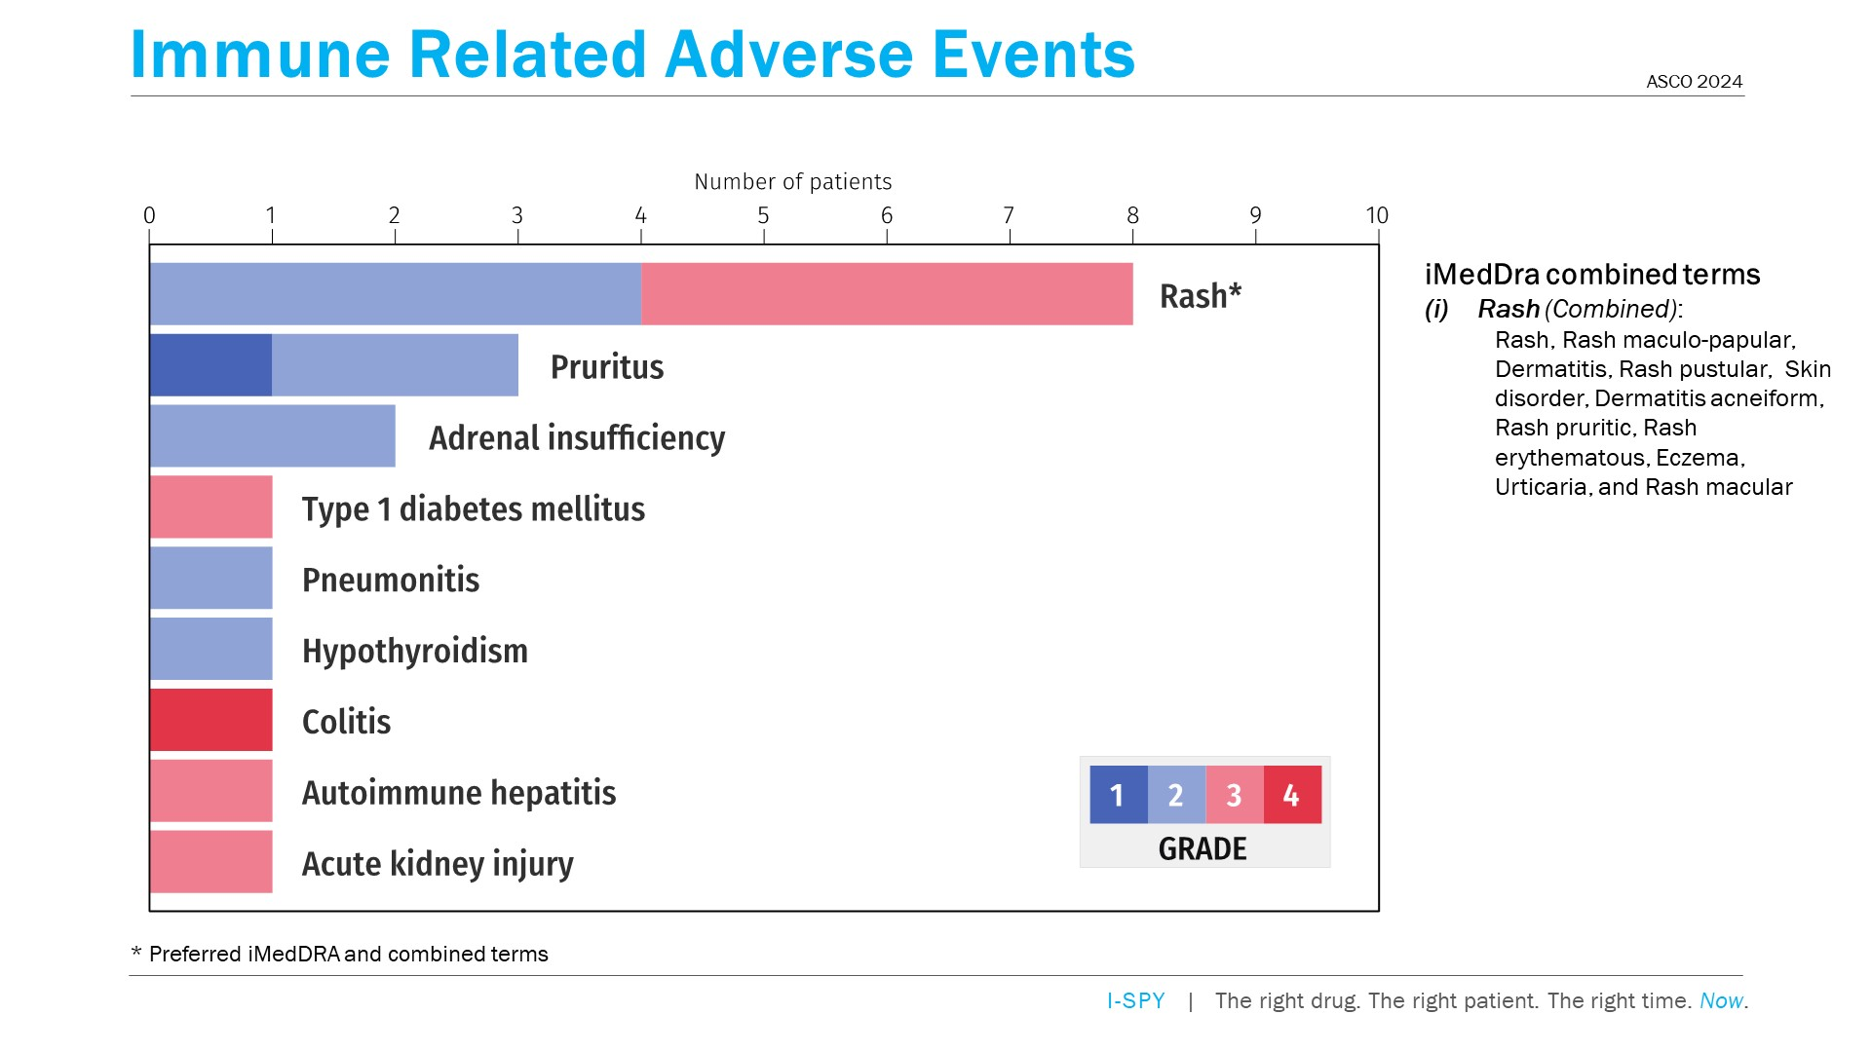
Immune Related Adverse Events
Content of this presentation is the property of the author, licensed by ASCO. Permission required for reuse.

Slide 12
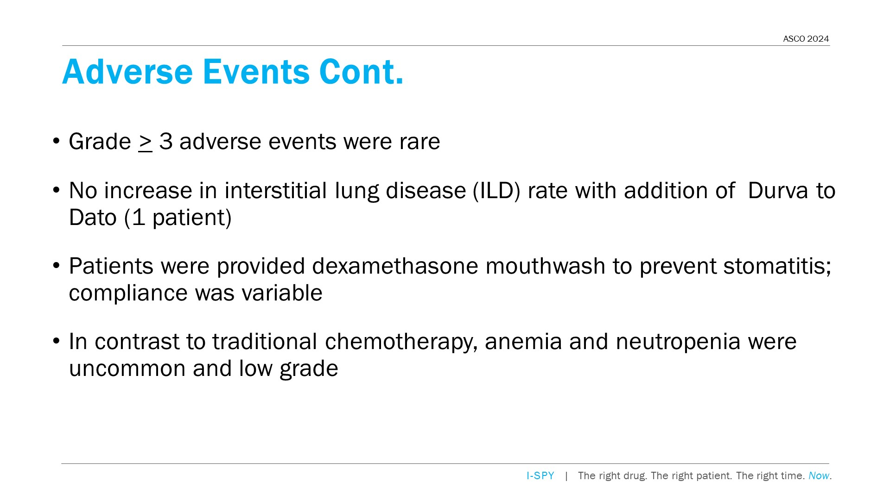
Adverse Events Cont.
Content of this presentation is the property of the author, licensed by ASCO. Permission required for reuse.

Slide 13
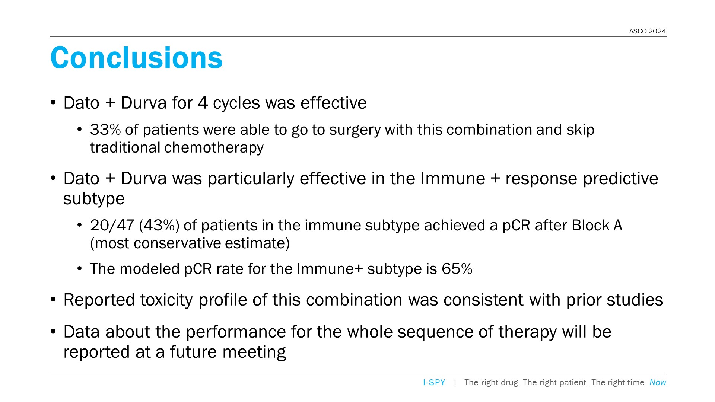
Conclusions
Content of this presentation is the property of the author, licensed by ASCO. Permission required for reuse.

Slide 14
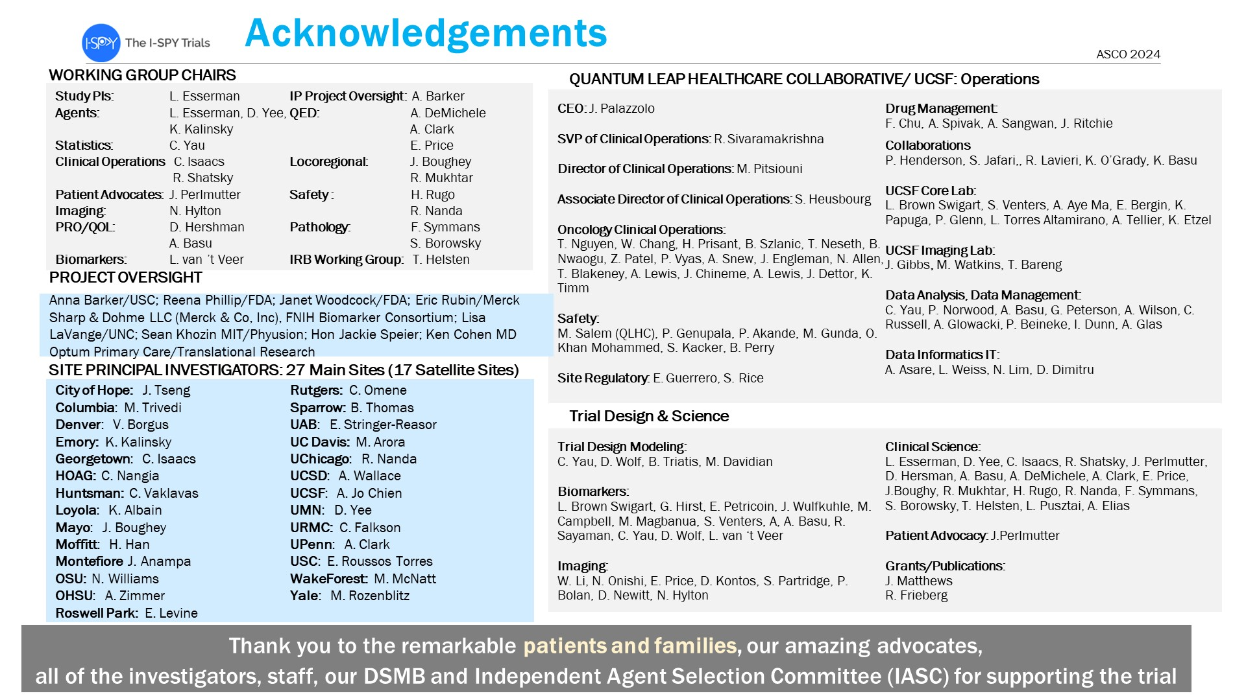
Acknowledgements
Content of this presentation is the property of the author, licensed by ASCO. Permission required for reuse.

Slide 15
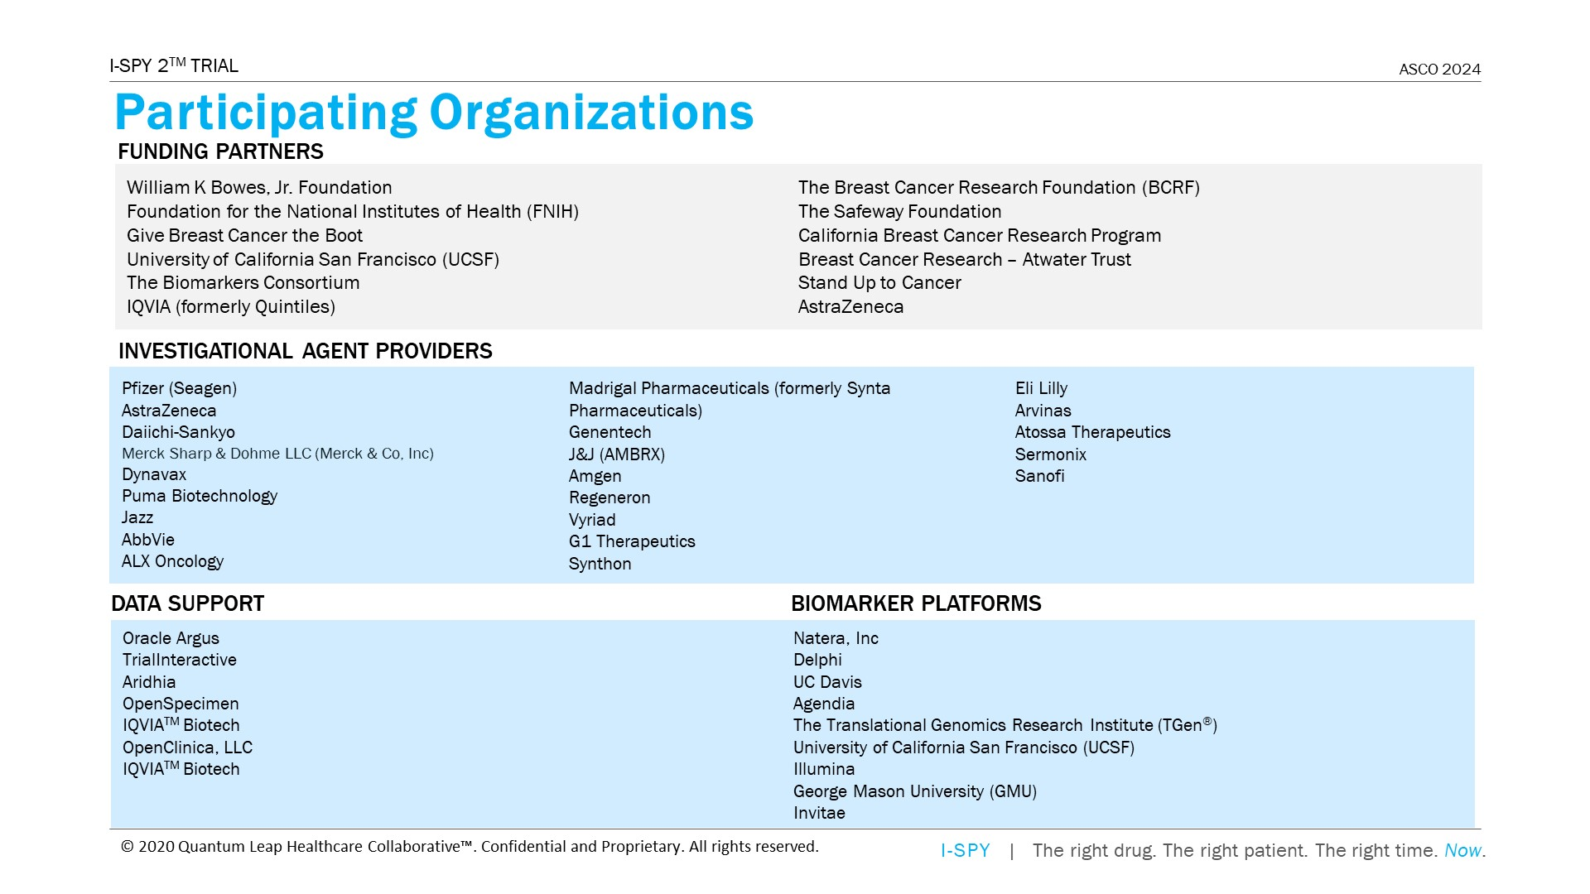
Participating Organizations
Content of this presentation is the property of the author, licensed by ASCO. Permission required for reuse.

