Slide 1
Django
Introduction

Slide 2
What's Django?
High-level Python Web framework that encourages rapid development and clean, pragmatic design.
Open sourced
Suitable for any web application you care to build

Slide 3
This talk...
Background and philosophy
Architectural overview
Django components (and Code!)
And a demo to finish up

Slide 4
Quick look
Object-relational mapper
Automatic admin interface
Elegant URL design
Template system
Cache system
i18n

Slide 5
Django philosophy
Less code, DRY
Loose coupling of components
Explicit is better than implicit (less magic)
Consistency
Models include all relevant domain logic
Efficient SQL, raw SQL encouraged where needed
Cool URLs

Slide 6
Django components
Core
  Manages web server integration, URL to viewmapping, errors, configuration, “middleware”
Models
  Object relational mapper, handles domain logic
Views
  Functions containing application logic
Templates

Slide 7
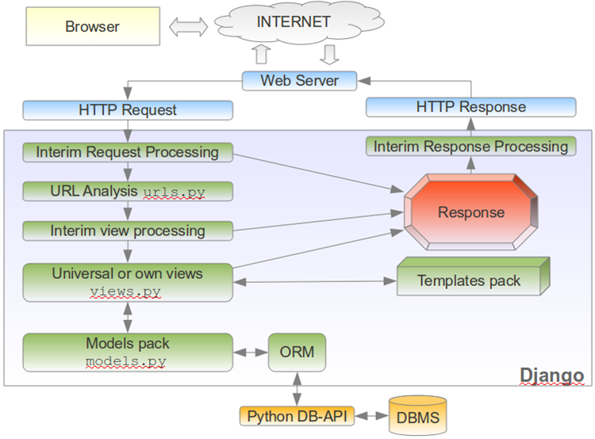

Slide 8
Django core
Integrates with the web server
Creates a Django Request object
Maps the requested URL to a view function
Views must return a Response object - can use templates if they want to (most do)
Also deals with configuration, error handling and middleware classes.

Slide 9
URL mapping
urlpatterns = patterns('',
(r'^polls/$', 'mysite.polls.views.index'),
(r'^polls/(?P<poll_id>\d+)/$', 'mysite.polls.views.detail'),
(r'^polls/(?P<poll_id>\d+)/results/$', 'mysite.polls.views.results'),
(r'^polls/(?P<poll_id>\d+)/vote/$', 'mysite.polls.views.vote'),
(r'^admin/', include(admin.site.urls)),
)

Slide 10
Models
Object-relational mapper
Database-agnostic schema definitions in Python code
Tables are created for you using the ‘install’ tool
Handles many-to-many, many-to-one, one-to-one relationships
Provides a pleasant API for CRUD operations and most SELECTs
Encourages custom SQL where it makes sense
Can hold extra information for Magic Admin stuff

Slide 11
Model definitions
from django.db import models
class Poll(models.Model):
question = models.CharField(max_length=200)
pub_date = models.DateTimeField('date published')
class Choice(models.Model):
poll = models.ForeignKey(Poll)
choice = models.CharField(max_length=200)
votes = models.IntegerField()

Slide 12
Model API
>>> from mysite.polls.models import Poll, Choice
>>> Poll.objects.all()
[]
>>> import datetime
>>> p = Poll(question="What's up?", pub_date=datetime.datetime.now())
>>> p.save()
>>> p.id
1
>>> p.question
"What's up?"
>>> p.pub_date
datetime.datetime(2007, 7, 15, 12, 00, 53)
>>> p.pub_date = datetime.datetime(2007, 4, 1, 0, 0)
>>> p.save()
>>> Poll.objects.all()
[<Poll: Poll object>]

Slide 13
More Model API
>>> from mysite.polls.models import Poll
>>> Poll.objects.all()
[<Poll: What's up?>]
>>> Poll.objects.filter(id=1)
[<Poll: What's up?>]
>>> Poll.objects.filter(question__startswith='What')
[<Poll: What's up?>]
>>> Poll.objects.get(pub_date__year=2007)
<Poll: What's up?>
>>> Poll.objects.get(id=2)
Traceback (most recent call last)
DoesNotExist: Poll matching query does not exist.
>>> Poll.objects.get(pk=1)
<Poll: What's up?>

Slide 14
View functions
Developers spend most of their time writing view functions and templates
A view function takes a response object and one or more named parameters (extracted from the URL) as arguments, and either returns a response object or raises an HTTP error exception of some sort
Which view is executed depends on a list of regular expressions against which incoming requests are compared

Slide 15
Example view function
from django.template import Context, loader
from mysite.polls.models import Poll
from django.http import HttpResponse
def index(request):
latest_poll_list = Poll.objects.all().order_by('-pub_date')[:5]
t = loader.get_template('polls/index.html')
c = Context({
'latest_poll_list': latest_poll_list,
})
return HttpResponse(t.render(c))

Slide 16
Generic views
Some view functions are so common that Django includes them as generic views - easily reused components
With models and generic views, it’s possible to create an entire application without writing any application code at all!

Slide 17
Templates
Template language design goals:
  Safe and secure
  Not just for HTML/XML
  Extensible
    Easy creation of custom template tags / filters
  Decoupled
  Easy to bypass or swap for something else entirely

Slide 18
Template concepts
Replacement variables
  {{ article.title }}
Tags
  {% if article.published %}...{% endif %}
Filters
  {{ article.title|upper }}
  {{ article.body|truncatewords:”50”|escape }}
Template inheritance

Slide 19
Example template
<h1>{{ poll.question }}</h1>
{% if error_message %}<p><strong>{{ error_message }}</strong></p>{% endif %}
<form action="/polls/{{ poll.id }}/vote/" method="post">
{% csrf_token %}
{% for choice in poll.choice_set.all %}
<input type="radio" name="choice" id="choice{{ forloop.counter }}" value="{{ choice.id }}" />
<label for="choice{{ forloop.counter }}">{{ choice.choice }}</label><br />
{% endfor %}
<input type="submit" value="Vote" />
</form>

Slide 20
Middleware
Classes that modify the request handling process
Django ships with a number of middleware classes:
  Locale detection (part of i18n)
  GZip compression
  etc...

