Slide 1
HTML. W3C. HTTP.

Slide 2
Agenda
W3C
  About
  Mission
  Standards
HTTP
  About
  GET
  POST
HTML
  About
  Example
  Element attributes
  Character references
  Elements
  Common errors
  Useful links
  Practical task

Slide 3

W3C - About
The World Wide Web Consortium (W3C) is an international community that develops open standards to ensure the long-term growth of the Web. Read about the W3C mission.

Slide 4
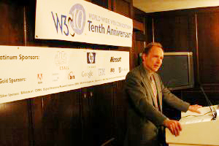
W3C - Mission
Principles
Web for All
  Web Accessibility Initiative
  Internationalization
  Mobile Web for Social Development
Web on Everything
  Web of Devices
  Mobile Web Initiative
  Browsers and Other Agents
Vision
Web for Rich Interaction
  Web Design and Applications
  Web Architecture
Web of Data and Services
  Essential XML Technologies
  Semantic Web
  Web of Services
Web of Trust
  Semantic Web
  XML Security, Web of Services Security
  Privacy

Slide 5
W3C - Standards
Most usable on Web UI:
  HTML
  XHTML
  CSS
  Javascript APIs
  All standards on August 2011 is 104

Slide 6
HTTP - About
HTTP (Hyper Text Transfer Protocol) – is a networking protocol for distributed, collaborative, hypermedia information systems.
HTTP is the foundation of data communication for World Wide Web.
Request message
  The request message consists of the following:
  Request line, such as GET /images/logo.png HTTP/1.1, which requests a resource called /images/logo.png from server
  Headers, such as Accept-Language: en
  An empty line
  An optional message body
Most usable HTTP request methods in Web UI: GET and POST

Slide 7
HTTP - GET
Example:
http://www.google.com.ua/search?hl=uk&q=HTTP
URL: http://www.google.com.ua/search
URL & Parameters delimiter: ?
Parameter: hl
Value: uk
Parameters delimiter: &

Slide 8
HTTP - POST
For example, the key-value pairs
Name: Jonathan Doe
Age: 23 Formula: a + b == 13%!
are encoded as
Name=Jonathan+Doe&Age=23&Formula=a+%2B+b+%3D%3D+13%25%21
Tips:
Parameters of POST method never don`t appear in URL link.
Through HTTP methods GET and POST you can send or request only textual data.

Slide 9
HTML - About
Hyper Text Markup Language (HTML) is the predominant markup language for web pages. HTML elements are the basic building-blocks of webpages.
Syntax:
Document type: <! DOCTYPE … >
Tags: <tag> … content … </tag>
Comments: <!-- Comment -->
Attributes: <tag name=“value”> </tag>

Slide 10
HTML - Example
<!DOCTYPE html PUBLIC "-//W3C//DTD XHTML 1.0 Transitional//EN" "http://www.w3.org/TR/xhtml1/DTD/xhtml1-transitional.dtd">
<html>
<head>
<title>Web page title.</title>
</head>
<body bgcolor=red>
<!-- Web page body -->
</body>
</html>

Slide 11
HTML – Element attributes
Empty attribute syntax:
<input disabled>
<input disabled="">
Unquoted attribute-value syntax:
<input value=yes>
Single-quoted attribute-value syntax:
<input type='checkbox'>
Double-quoted attribute-value syntax:
<code title="U+003C LESS-THAN SIGN">&lt;</code>

Slide 12
HTML – Character references
Named character reference:
&dagger; → †
Decimal numeric character reference:
&#8224; → †
Hexadecimal numeric character reference:
&#x2020; → †

Slide 13
HTML – Elements
The root element: <html> … </html>
Document metadata: <head>…</head>, <title>…</title>, <base />,
<link />, <meta />, <style />
Scripting: <script>…</script>, <noscript>…</noscript>
Sections: <body>…</body>, <section>…</section>, <nav>…</nav>, <h[1-6]>…</h[1-6]>
Grouping: <p>…</p>, <br />, <ul>…</ul>, <ol>…</ol>, <li>…</li>, <div>…</div>
Text-level semantics: <a>…</a>, <span>…</span>, <em>…</em>, <strong>…</strong>, <small>…</small>, <q>…</q>, <i>…</i>, <b>…</b>, <u>…</u>, <sab>…</sab>, <sup>…</sup>
Embedded content: <img />, <iframe>…</iframe>
Tables: <table>…</table>, <tr>…</tr>, <td>…</td>
Forms: <form>…</form>, <input>…</input>, <select>…</select>, <option>…</option>

Slide 14
HTML – Common errors
No closing tag.
Wrong tag name.
Wrong attribute name or value.
Use of invalid characters.
Bad document structure.

Slide 15
Useful links
W3C:
http://www.w3.org/
HTTP:
http://www.w3.org/TR/#tr_HTTP
http://www.w3.org/TR/1999/REC-html401-19991224/index/attributes.html
HTML:
http://www.w3.org/TR/#tr_HTML
All:
http://www.academictutorials.com/
http://www.w3schools.com/

Slide 16
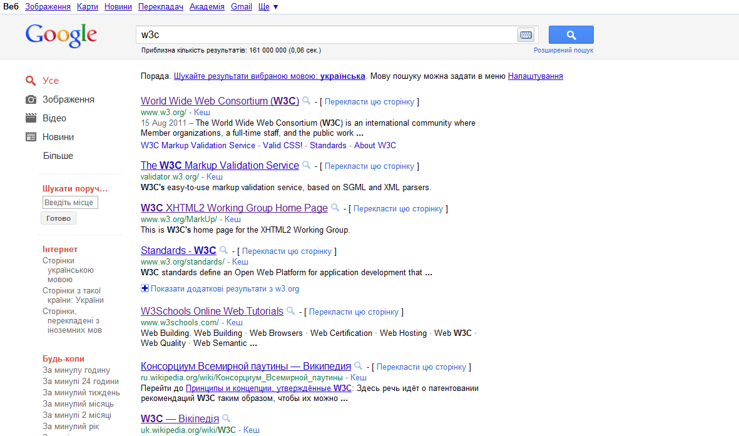
Practical Task
You should create this page without using CSS.
Link to compare: http://www.google.com.ua/search?hl=uk&q=w3c&oq=w3c

Slide 17

Questions?

Slide 18
Contacts
Iaroslav Porodko
E-mail: iporod@softserveinc.com
Skype: yporodko
Thank You!
Copyright © 2010 SoftServe, Inc.

