Slide 1
HTML & CSS
Best Practice
Vasyl Lupynis

Slide 2
Agenda
Zen Coding
Sass+Haml
Layouts
Feature

Slide 3
Zen Coding
Div → <div></div>
Span → <span></span>
Form → <form action=’’></form>

Slide 4
Zen Coding
div.search
or
.search
<div class=”search”>
</div>

Slide 5
Zen Coding
p+p
or
p*2
<p></p>
<p></p>

Slide 6
Zen Coding
<div class="search">
<p></p>
</div>
div.search>p

Slide 7
Zen Coding. Selectors
form.search>p>input:text+input:submit
<form action="" class="search">
<p>
<input type="text" name="" id="" />
<input type="submit" value="" />
</p>
</form>

Slide 8
Support
Notepad++
TopStyle
Visual Studio
Coda, Espresso, Textmate
Komodo, Aptana
IntelliJ IDEA

Slide 9
Links
http://code.google.com/p/zen-coding/

Slide 10
Sass+Haml
SASS
CSS
$blue: #3bbfce;
$margin: 16px;
.content-navigation {
border-color: $blue;
color: darken($blue, 9%);
}
.border {
padding: $margin / 2;
margin: $margin / 2;
border-color: $blue;
}
.content-navigation {
border-color: #3bbfce;
color: #2b9eab;
}
.border {
padding: 8px;
margin: 8px;
border-color: #3bbfce;
}

Slide 11
Links
Sass - Syntactically Awesome Stylesheets
http://compass-style.org/

Slide 12
Layouts

Slide 13
Two Columns

Slide 14
Three Columns

Slide 15
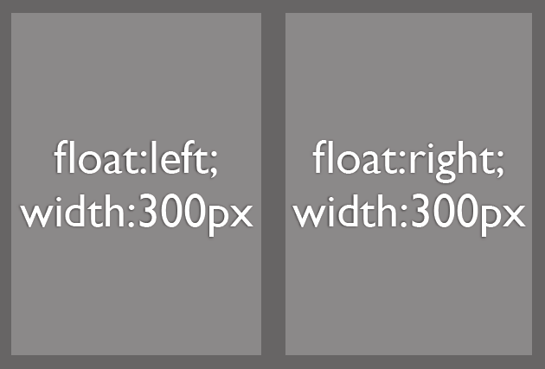
General way

Slide 16
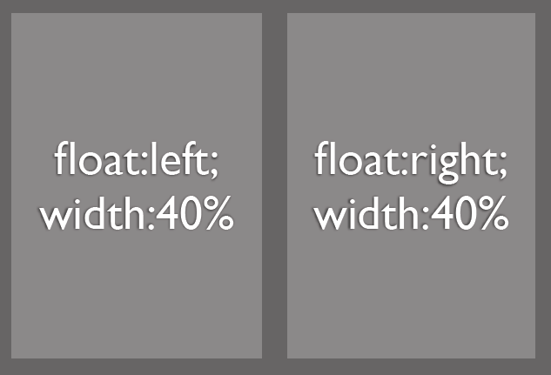
Fluide way

Slide 17
Fixed+Fluid?

Slide 18
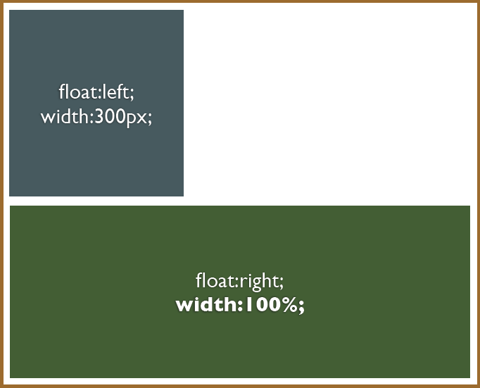
Fixed + Fluid

Slide 19
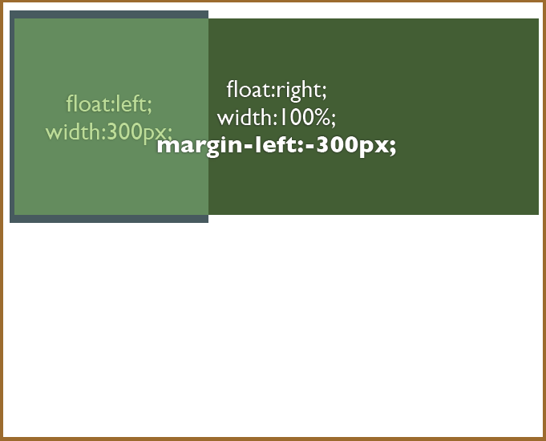
Fixed + Fluid

Slide 20
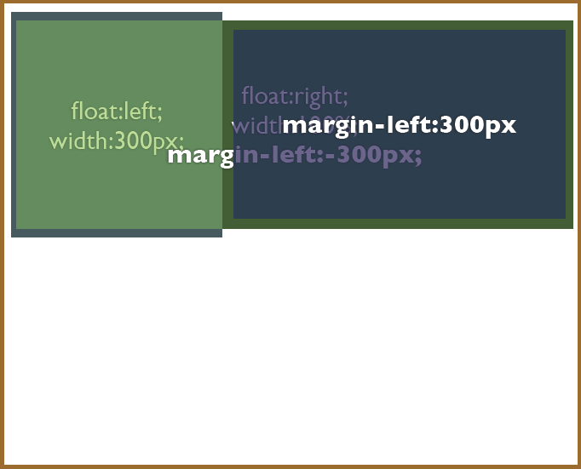
Fixed + Fluid

Slide 21

Feature

Slide 22
Questions
?

Slide 23
Contacts
Europe Headquarters
52 V. Velykoho Str.
Lviv 79053, Ukraine
Tel: +380-32-240-9090
Fax: +380-32-240-9080
E-mail: info@softserveinc.com
Website: www.softserveinc.com
US Headquarters
12800 University Drive, Suite 250
Fort Myers, FL 33907, USA
Tel: 239-690-3111
Fax: 239-690-3116
Thank You!
Copyright © 2010 SoftServe, Inc.

