Slide 1
JavaScript. BOM. DOM.
Petro Drogomyretskyi
19/03/2012

Slide 2
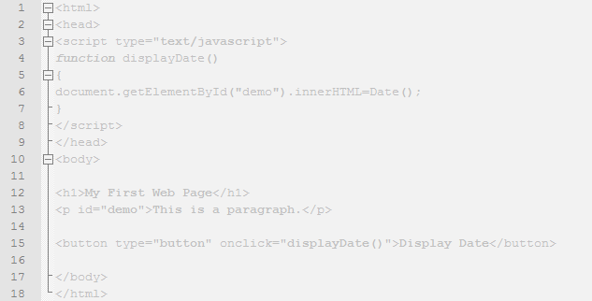
Agenda
1) Browser Object Model (BOM)
2) Document Object Model (DOM)
3) Summary

Slide 3
What is JavaScript BOM
* The Browser Object Model (BOM) is a browser-specific convention referring to all the objects exposed by the web browser.
* Browser Object Model (BOM): the collection of objects that define the browser window and its contents for the browser software

Slide 4
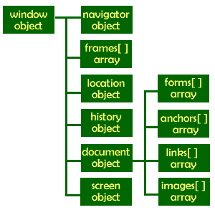
What is JavaScript BOM

Slide 5
BOM elements
window - When you run JavaScript in a web browser all the variables and functions you create will be properties and methods of the window object.
history - This object is not as useful as you would expect as you can't actually access what pages are stored there, just how many.
location - This object both allows you to check on what address has been passed to the current page but also to load a new page into the browser.
navigator - This is perhaps the least useful part of the browser object model. About the most useful information that it can provide is the language your visitor's browser uses.
document object is perhaps the most important object in the Browser Object Model. It is also a major sticking point in the writing of JavaScript programs.
screen object contains information about the display properties of the computer being used to view the page. It can be used to determine the abilities of the display so that the page can be modified for different displays if necessary.

Slide 6
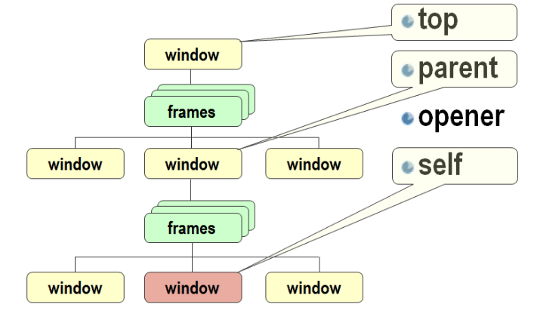
Relationships

Slide 7
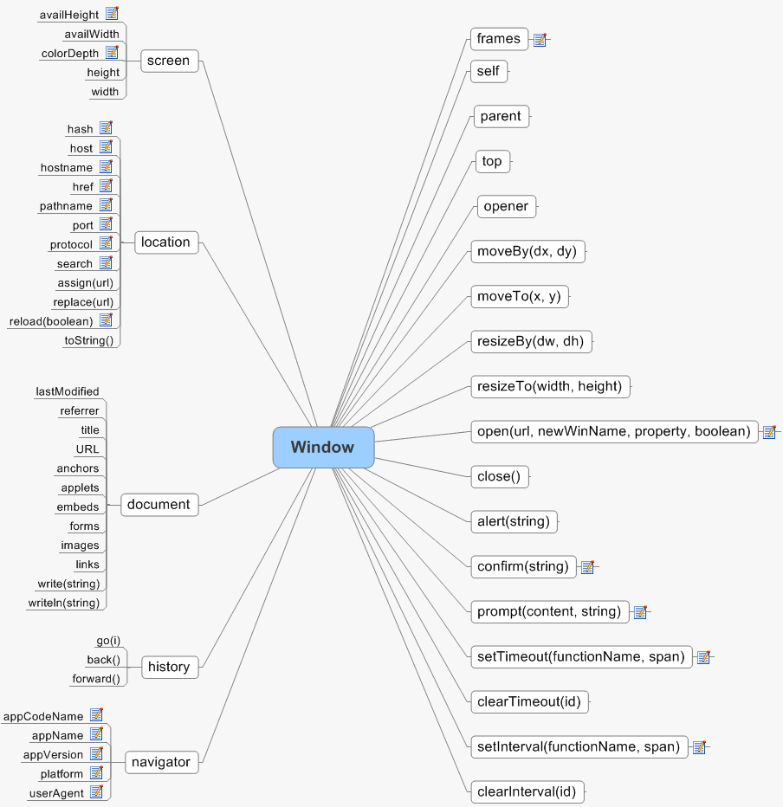
Details

Slide 8
More details
navigator objects (properties, methods, events,…)
  http://www.comptechdoc.org/independent/web/cgi/javamanual/javanavigator.html
window objects (properties, methods, events,…)
  http://www.comptechdoc.org/independent/web/cgi/javamanual/javawindow.html
location objects (properties, methods, events,…)
  http://www.comptechdoc.org/independent/web/cgi/javamanual/javalocation.html
history objects (properties, methods, events,…)
  http://www.comptechdoc.org/independent/web/cgi/javamanual/javahistory.html
frame objects (properties, methods, events,…)
  http://www.comptechdoc.org/independent/web/cgi/javamanual/javaframe.html
document objects (properties, methods, events,…)
  http://www.comptechdoc.org/independent/web/cgi/javamanual/javadocument.html
screen objects (properties, methods, events,…)
  http://www.w3schools.com/jsref/obj_screen.asp

Slide 9

Examples
Let us see how it works!

Slide 10

The Document Object Model
This is the part of JavaScript that allows the script to actually interact with the content of the web page itself. It works by mapping the tags and text within the page to nodes and nodelists accessible within the JavaScript.
The DOM maps out an entire page as a document composed of a hierarchy of nodes like a tree structure and using the DOMAPI nodes can be removed, added, and replaced.
DOM level 1
DOM Level 2
DOM Level 3

Slide 11
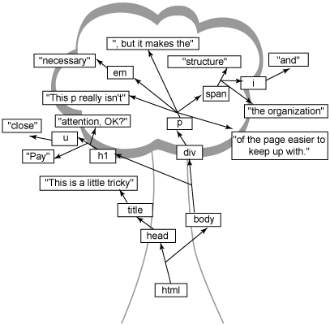
DOM tree

Slide 12
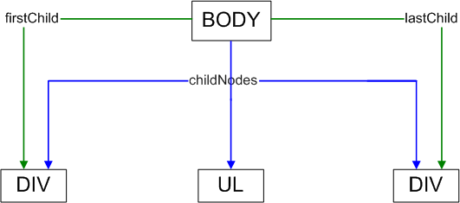
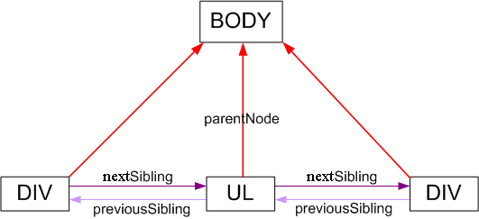
“Nodes” man

Slide 13
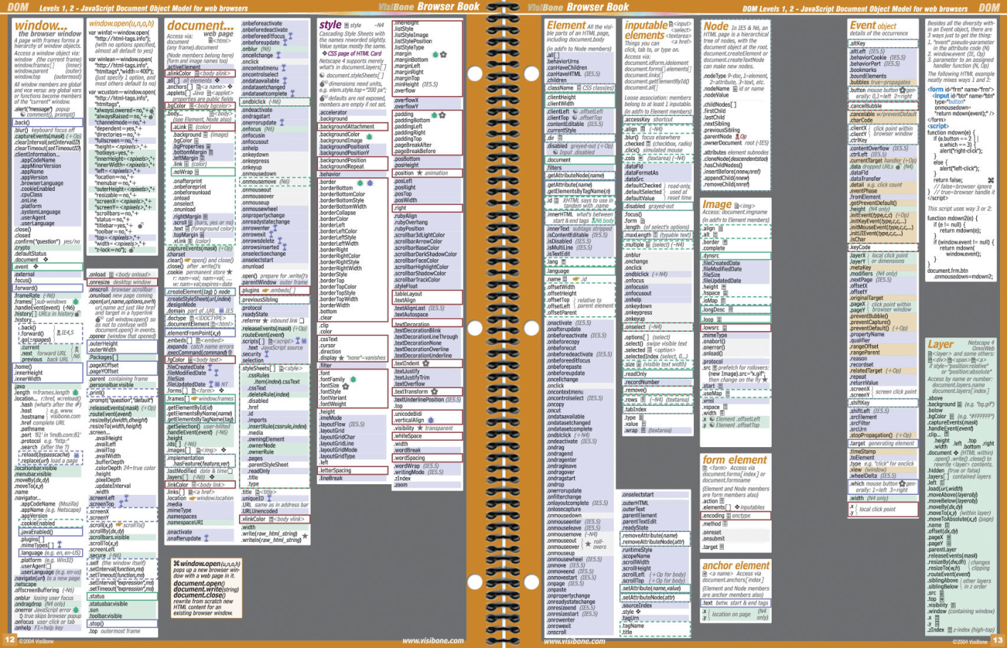

Fun details
http://www.visibone.com/products/bbk12-13_850.jpg

Slide 14


Summary

Slide 15

Questions

Slide 16
Links
http://www.comptechdoc.org/independent/web/cgi/javamanual/
http://www.daaq.net/old/javascript/index.php?page=the+js+bom
http://www.w3schools.com/jsref/dom_obj_document.asp
http://www.visibone.com/products/bbk12-13_850.jpg
http://www.w3schools.com/jsref/default.asp

Slide 17
Contacts
Europe Headquarters
52 V. Velykoho Str.
Lviv 79053, Ukraine
Tel: +380-32-240-9090
Fax: +380-32-240-9080
E-mail: info@softserveinc.com
Website: www.softserveinc.com
US Headquarters
12800 University Drive, Suite 250
Fort Myers, FL 33907, USA
Tel: 239-690-3111
Fax: 239-690-3116
Thank You!
Copyright © 2010 SoftServe, Inc.

