Slide 1
JavaScript ::: TDD
Ivan Chyr
17/07/2013

Slide 2
Agenda
Unit testing and TDD
Jasmine and BDD
Matchers
Before/after
Spies
Asynchronous
Code coverage

Slide 3
Unit testing
is a method by which individual units of source code, sets of one or more computer program modules together with associated control data, usage procedures, and operating procedures, are tested to determine if they are fit for use.

Slide 4
Properties of unit test
Ideally, each test case is independent from the others: substitutes like method stubs, mock objects, fakes and test harnesses (automated test frameworks) can be used to assist testing a module in isolation.

Slide 5
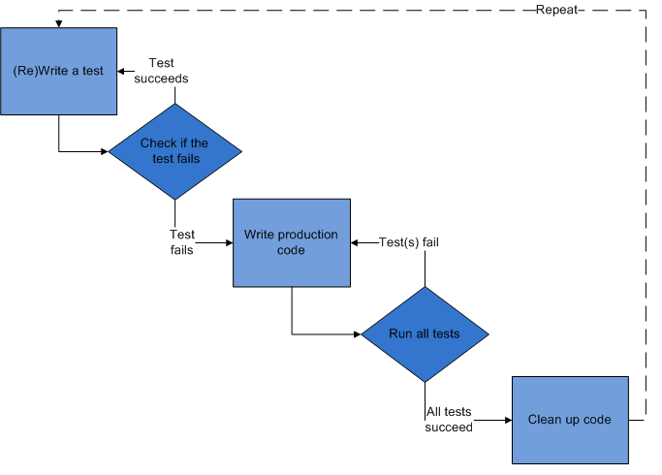
Test driven development

Slide 6
Our new team member Jasmine

Slide 7
Get Jasmine
https://github.com/pivotal/jasmine/downloads

Slide 8
BDD

Slide 9
HelloWorld!
function helloWorld()
{ return "Hello world!"; }
…
describe("Hello world", function() {
it("says hello", function() { expect(helloWorld()).toEqual("Hello world!");
});
});

Slide 10
Basic structure
Suite describe(..,..)
Spec [ification] it(..,..)
Matcher toEquals(..,..)
Save this file as HelloWorldSpec.js in the /spec directory.

Slide 11
Matchers
describe("Hello world", function() {
it("says world", function() { expect(helloWorld()).toContain("world");
});
});
toBeNull()
toBeTruthy()
expect(x).not.toEqual(y)
toBe() – exactly the same
toEqual() – check equivalence

Slide 12
Making matchers
describe('Hello world', function() {
beforeEach(function() {
this.addMatchers({
toBeDivisibleByTwo: function() {
return (this.actual % 2) === 0; }
});
});
it('is divisible by 2', function() {
expect(gimmeANumber()).toBeDivisibleByTwo();
});
});
Notes:
Keep in mind that you often have to say this.actual instead of just this -- you're usually referring to the content of the object, not the instance of the object.

Slide 13
Before and after
describe("A spec (with setup and tear-down)", function() {
var foo;
beforeEach(function() {
foo = 0; foo += 1;
});
afterEach(function() {
foo = 0;
}); …
Notes:
To help a test suite DRY up any duplicated setup and teardown code, Jasmine provides the global beforeEach and afterEachfunctions. As the name implies the beforeEach function is called once before each spec in the describe is run and the afterEachfunction is called once after each spec.
Here is the same set of specs written a little differently. The variable under test is defined at the top-level scope — thedescribe block — and initialization code is moved into abeforeEach function. The afterEach function resets the variable before continuing.

Slide 14
Nesting describe Blocks
Calls to describe can be nested, with specs defined at any level. This allows a suite to be composed as a tree of functions. Before a spec is executed, Jasmine walks down the tree executing each beforeEach function in order. After the spec is executed, Jasmine walks through the afterEach functions similarly.

Slide 15
Disabling Specs and Suites
xdescribe("A spec",
function() {
var foo;
beforeEach(function() {
foo = 0; foo += 1;
});
xit("is just a function, so it can contain any code", function() {
expect(foo).toEqual(1);
});
});

Slide 16
Spies
var Person = function() {};
Person.prototype.helloSomeone = function(toGreet) {
return this.sayHello() + " " + toGreet;
};
Person.prototype.sayHello = function() {
return "Hello";
};
Notes:
Jasmine’s test doubles are called spies. A spy can stub any function and tracks calls to it and all arguments. There are special matchers for interacting with spies.

Slide 17
describe("Person", function() {
it("calls the sayHello() function", function() {
var fakePerson = new Person();
spyOn(fakePerson, "sayHello");
fakePerson.helloSomeone("world");
expect(fakePerson.sayHello).toHaveBeenCalled();
});
});
Notes:
The toHaveBeenCalled matcher will return true if the spy was called. The toHaveBeenCalledWith matcher will return true if the argument list matches any of the recorded calls to the spy.

Slide 18
Asynchronous world
describe("Calculator", function() {
it("should factor two huge numbers asynchronously",
function() {
var calc = new Calculator();
var answer = calc.factor(18973547201226, 28460320801839);
waitsFor(function() {
return calc.answerHasBeenCalculated();
}, "It took too long to find those factors.", 10000);
runs(function() {
expect(answer).toEqual(9486773600613);
});
});
});
Notes:
run() blocks execute procedurally, so you don't have to worry about asynchronous code screwing everything up. This is some code that runs one after the other.
waitsFor() waits for some condition to be true, and then it continues on. You can also specify an optional timeout; if it waits for longer than that, it'll fail with an optional message.

Slide 19
Code coverage
Main…
Function coverage - Has each function (or subroutine) in the program been called?
Statement coverage - Has each node in the program been executed?
Decision coverage (not the same as branch coverage.) - Has every edge in the program been executed? For instance, have the requirements of each branch of each control structure (such as in IF and CASE statements) been met as well as not met?
Condition coverage (or predicate coverage) - Has each boolean sub-expression evaluated both to true and false? This does not necessarily imply decision coverage.
Condition/decision coverage - Both decision and condition coverage should be satisfied.
State coverage - Has each state in a finite-state machine been reached and explored?
Parameter Value Coverage - In a method taking parameters, have all the common values for such parameters been considered?
Other…
Linear Code Sequence and Jump (LCSAJ) coverage - has every LCSAJ been executed?
JJ-Path coverage - have all jump to jump paths (aka LCSAJs) been executed?
Path coverage - Has every possible route through a given part of the code been executed?
Entry/exit coverage - Has every possible call and return of the function been executed?
Loop coverage - Has every possible loop been executed zero times, once, and more than once?
Istanbul – it’s not the city, it’s a tool!

Slide 20
Task #1
Create tests for cover basic functionality of site in notes:
Picking answer
Checking answers
Generation questions
Generation answers
Calculating “true” percentage

Slide 21
Home work
Determine code coverage of Task #1

Slide 22
References
Official tutorial
Beginners tutorial
Some presentation
Code coverage
Testing Backbone.js with Jasmine and Sinon

