Slide 1
DB Design Training
Mahersky Volodymyr

Slide 2
Agenda
Before start
Relations
Normalization
Integrity
ACID Principle
Transaction Locking
Transaction Isolations
Optimization and Security
UML Tools

Slide 3


Before start, make a decision
Functionality
Data warehousing
Object-oriented DB
Multimedia DB
Active DB
Temporal DB
Deductive DB
Secure DB
Fuzzy DB
Parallel DB
Main-memory DB
Real-time DB
Distributed DB, Federated DB,
MultiDB, Mobile DB
Distribution
Performance

Slide 4

Why Design?

Slide 5
Design
Defining the System Parameters
Defining the Work Processes
Building the Conceptual Data Model
Preparing the Database Schema
Designing the User Interface

Slide 6
Design
The objective of conceptual design is to obtain a good representation of the enterprise data resources, independent of the implementation level as well as the specific needs of each user or application.
The objective of logical design is to transform the conceptual schema by adapting it to the data model that implements the DBMS to be used (usually relational).

Slide 7


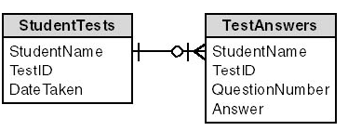
Relations
One to One

Slide 8
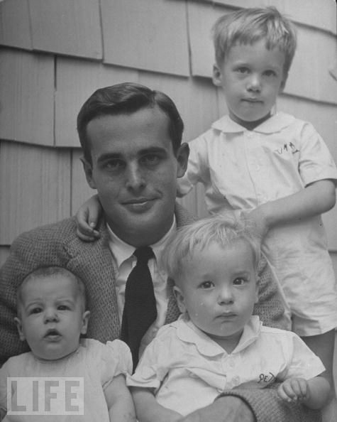
Relations
One to Many
Father
Children

Slide 9
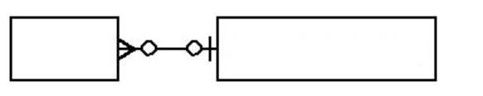

Relations
One to Many
Father
Children

Slide 10

Relations
Many to Many
Many to many relations are everywhere. One newspaper has many readers, for example, and one reader reads many newspapers.
Reader
Newspaper

Slide 11
Relations
Many to Many
Most of the time the relation can be made a lot clearer, by adding a link table, at the 'top' or the 'bottom'.
A many-to-many relation is unclear. Many-to-many relations often are a sign that further analysis is required.

Slide 12
Relations
Many to Many implementation
Reader
Newspaper
Subscription
M. Thatcher
Guardian
S. Holmes
Times
Financial Times

Slide 13
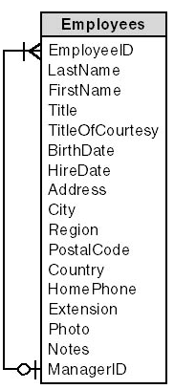
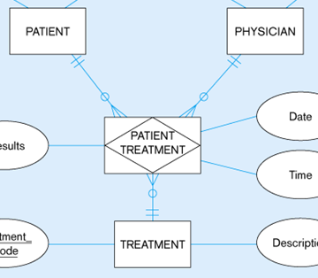
Other Relations
Unary Relations
Ternary Relations

Slide 14
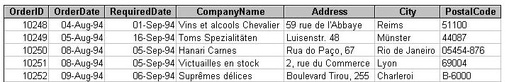
Basic Principles
What is odd?

Slide 15
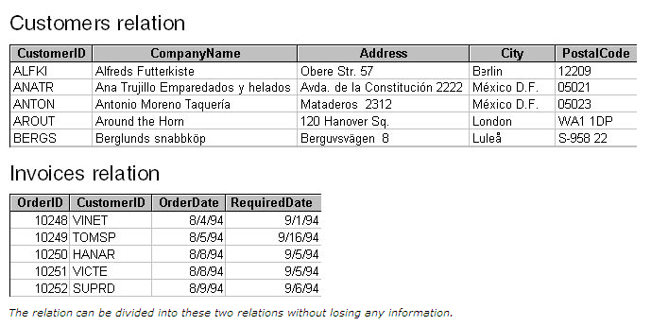
Basic Principles: Lossless Decomposition
The relation can be divided into these two relations
without losing any information

Slide 16
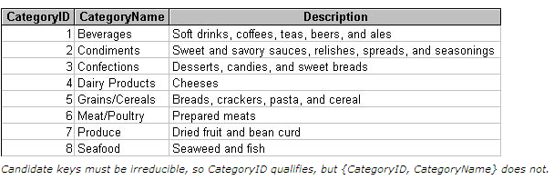

Basic Principles:
What is forgot?

Slide 17
Basic Principles: Primary Key
Primary key or artificial keys (identity, sequence)

Slide 18

Basic Principles: Functional Dependency
Functional dependencies can be expressed as X -> Y,
which reads "X functionally determines Y

Slide 19

Basic Principles: Functional Dependency
VIN WMWMN51030TR88899
So, VIN functionally determines Car
Other functionally determines:
VIN -> Car -> Engine -> Diesel -> Valves
VIN -> Car -> Color -> Metallic
VIN -> Car -> Type (Hatchback/Sedan/Cabrio)

Slide 20



Principles of Normalization: 1NF
What is odd?
What are the deficiencies?
What can we do?

Slide 21
Principles of Normalization: 1NF
A row of data cannot contain repeating groups of similar data (atomicity)
Each row of data must have a unique identifier (or Primary Key)

Slide 22
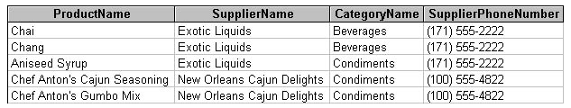
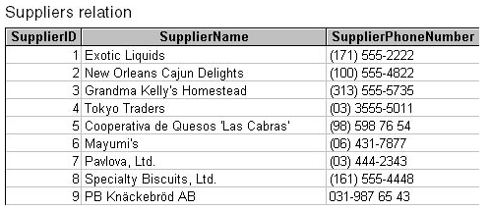
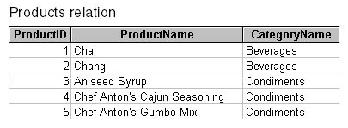
Principles of Normalization: 2NF

Slide 23
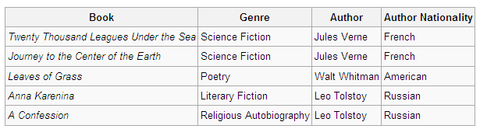
Principles of Normalization: 3NF
The functional dependency {Book} → {Author Nationality} applies; that is, if we know the book, we know the author's nationality.
Furthermore:
{Book} → {Author}
{Author} → {Author Nationality}
{Author} does not → {Book}
Therefore {Book} → {Author Nationality} is a transitive dependency.

Slide 24
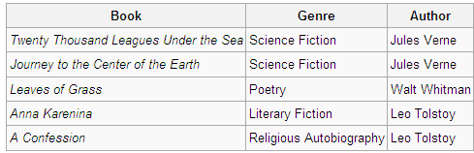
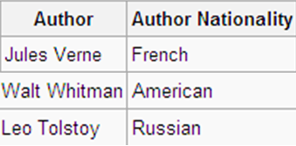
Principles of Normalization: 3NF
Third Normal Form: No Dependencies on Non-Key Attributes

Slide 25
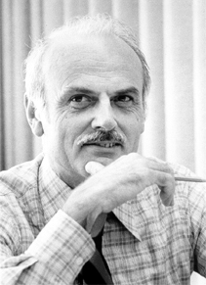
How To Remember
The key, the whole key, and nothing but the key,
so help me Codd."
Codd invented:
First Normal Form 1NF in 1970 year,
Second Normal Form (2NF)
and Third Normal Form (3NF) in 1971
August 23, 1923 – April 18, 2003

Slide 26
How To Remember
Guru normalizations
Nothing but the key
BCNF, 4NF, 5NF, 6NF
3NF
The whole key
2NF
1NF
The key
1NF
2NF
3NF
BCNF, 4NF, 5NF, 6NF

Slide 27

Practice and Remember
Person | Favorite Color | Foods Not Eaten 1 | Foods Not Eaten 2 | Foods Not Eaten 3
Carolina | Red | Orange | Pineapples
Alice | Yellow | Mango
This schema is not in the 1NF, and does not accurately represent the relationship as it exists in the real world
Even if the database designer believes that users will not need to store more than three foods not eaten, this system makes it difficult to add a fourth or fifth food in the future, thus limiting expandability

Slide 28
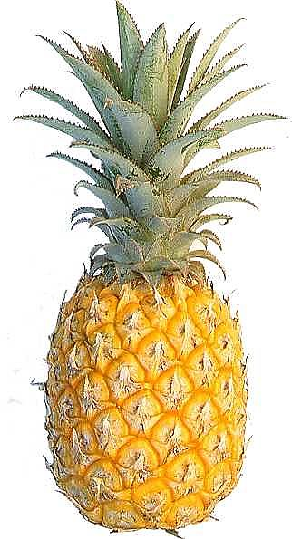

Practice and Remember
Person | Favorite Color
Carolina | Red
Alice | Yellow
Person | Foods Not Eaten
Alice | Mango
Carolina | Orange
Carolina | Pineapples

Slide 29

Practice
PART_NUMBER (PRIMARY KEY) MANUFACTURER_NAME MANUFACTURER_ADDRESS
What it is form?
2 NF
MANUFACTURER_NAME (PRIMARY KEY)
MANUFACTURER_ADDRESS
PART_NUMBER (PRIMARY KEY) MANUFACTURER_NAME

Slide 30

Integrity
Column Type, Primary Key, Constraint, Unique Key, Trigger, Foreign Key, FK (On Delete Cascade)
Entity
Integrity
Domain
Integrity
Referential Integrity
Integrity

Slide 31
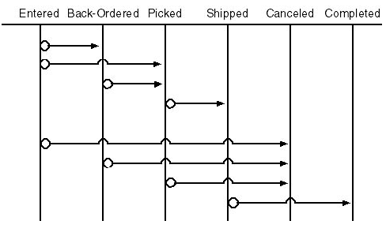
Integrity: Transition Integrity
Order Process

Slide 32
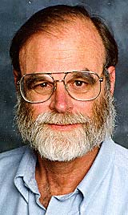
ACID Principle
Partly
Non is lost
A
Jim Gray, 1970s
C
No ghosts
I
D
Data are saved
Atomicity
Consistency
Isolation
Durability

Slide 33
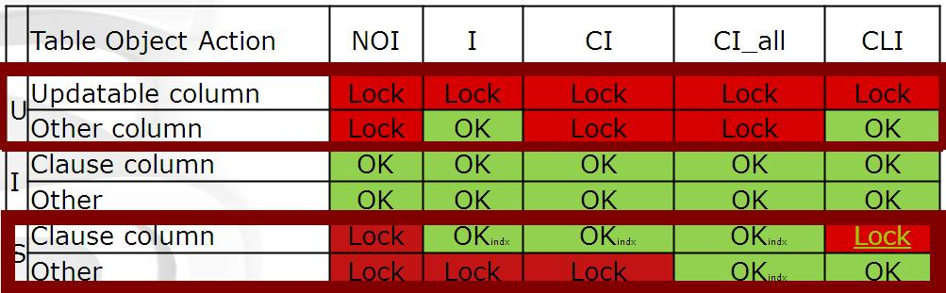
Transaction Locking
Updates influences selects
Selects
Occur user wait’s
Data can be not accessible
75%
70%
8%
10%
7%
Deletes
Inserts
Updates

Slide 34
Quick overview Isolation Levels
Isolation level | Dirty read | Nonrepeatable read | Phantom
Read uncommitted | Yes | Yes | Yes
Read committed | No | Yes | Yes
Repeatable read | No | No | Yes
Snapshot (vers) | No | No | No
Serializable | No | No | No
A lower isolation level increases the ability of many users to access data at the same time, but increases the number of concurrency effects (such as dirty reads or lost updates) users might encounter.
Conversely, a higher isolation level reduces the types of concurrency effects that users may encounter, but requires more system resources and increases the chances that one transaction will block another.

Slide 35

Database Snapshots
ALTER DATABASE <database name> SET READ_COMMITTED_SNAPSHOT ON
 | Table Object Action | NOI | I | CI | CI_all | CLI
U | Updatable column | Lock | Lock | Lock | Lock | Lock
 | Other column | Lock | OK | Lock | Lock | OK
I | Clause column | OK | OK | OK | OK | OK
 | Other | OK | OK | OK | OK | OK
S | Clause column | OK | OK | OK | OK | OK
 | Other | OK | OK | OK | OK | OK
Updates don’t influence selects:
No user waits
Data is always accessible
Real 1000+ users system

Slide 36
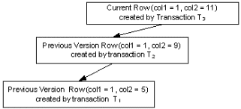
Row Versioning
Understanding Row Versioning
Versioning effectively starts with a copy-on-write mechanism that is invoked when a row is modified or deleted.
This requires that while the transaction is running the old version of the row must be available for transactions that require an earlier transactionally consistent state.

Slide 37
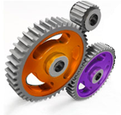
Optimization
Indexes
Partitions
Build indexes on predicate columns, use correct indexes,
watch out for index statistic
Moreover for create partitions
for huge tables
Hints (PLAN TABLE)
Clusters
Explore PLAN
Find highest Cost
Rebuild query
When hardware doesn’t help
think about software cluster

Slide 38
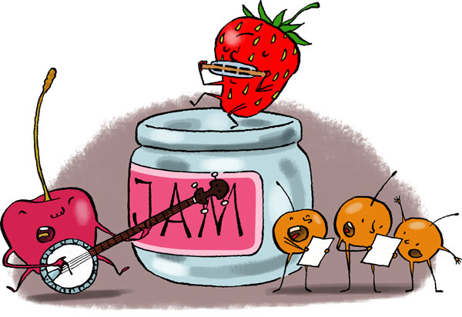
Security
Be careful,
your data can run out.

Slide 39


Security
Encrypt connection/data/business logic,
User audit with triggers.
Users
Roles
Manage user expiring passwords
Manage user profiles (for CPU,
RAM limit, idle time, etc.)
Create roles for viewing data
Create roles for changing data
Create roles for managing DB
Security
Manage views, to implement
row and column level security

Slide 40
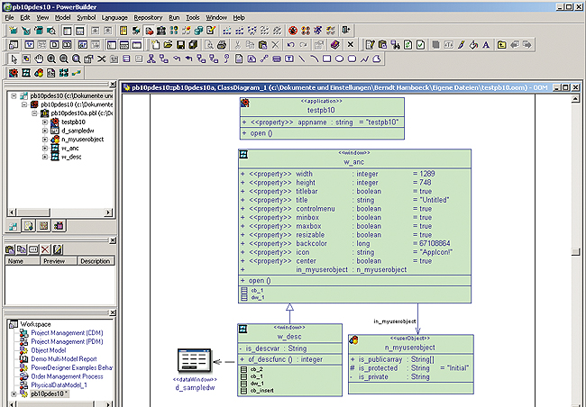
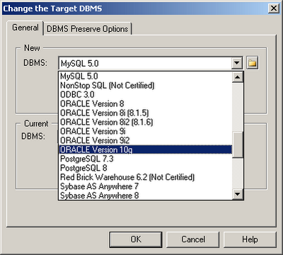
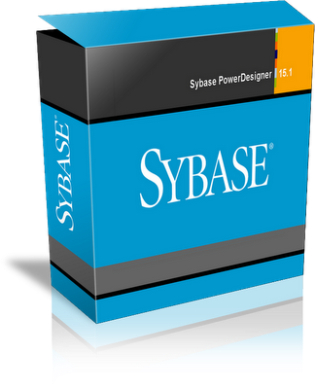
UML Tools

Slide 41
Questions
Questions

Slide 42
Thank you
Thank you

