Slide 1

Unit Testing and Error Handling in Python
Presentation by Taras Todosiychuk
SoftServe, Inc.

Slide 2
Agenda
Intro on Testing Levels
What is a Mock Object?
Unit Testing: “old school” approach
Unit Testing: unittest library
Unit Testing: doctest library
Unit Testing: nose library
Unit Testing metrics: coverage.py
Exceptions vs. Error code
Exception inheritance tree
Catching exceptions
Raising Exceptions
Static code check: Pylint and Pychecker
Questions?

Slide 3
Intro on Testing Levels
End-to-end: validate the flow through the entire system, from the ultimate source to the ultimate sink.
Integration: validate the integration between multiple components.
Functional/Component: A functional test is supposed to validate the behavior of a single process or daemon. In practice, the difference between integration and functional/component testing isn't very significant.
Unit: Test the isolated logic of a small piece of code (e.g., a single method of a python class). These tests are automated: a single invocation runs all unit tests for a product, complete with counts of passed/failed tests and information (what broke, traceback) on failed tests. Unit tests should have no external dependencies other than the specific code being tested. No databases, no network connectivity, no outside processes. External resources should be mocked up when necessary.

Slide 4
What is a Mock Object?
In object-oriented programming, mock objects are simulated objects that mimic the behavior of real objects in controlled ways. A computer programmer typically creates a mock object to test the behavior of some other object, in much the same way that a car designer uses a crash test dummy to simulate the dynamic behavior of a human in vehicle impacts (quote from Wikipedia: http://en.wikipedia.org/wiki/Mock_object. )
Use cases:
Supply non-deterministic results (e.g. the current time or the hardware temperature)
States that are difficult to create or reproduce (e.g. network errors)
General slowness (e.g. database, which is hard to create and initialize)
Artifact that does not exist or may change behavior

Slide 5
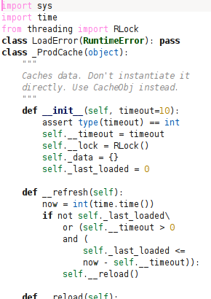
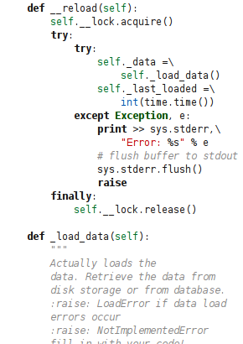
What is a Mock Object? - Code Example

Slide 6
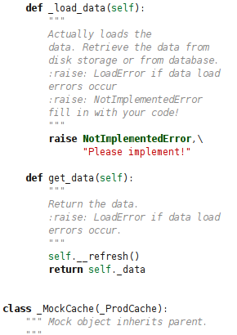
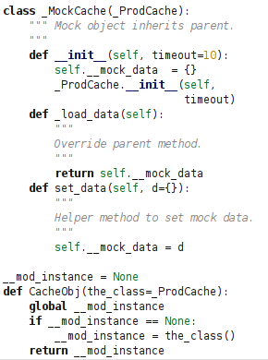
What is a Mock Object? - Code Example

Slide 7
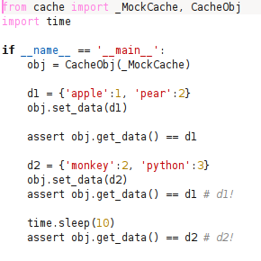
Unit Testing: “old school” approach
This approach was used before times when JUnit became popular, and JUnit was the first framework which became widely known (since 1997-1998). Now used mainly for dirty debugging.

Slide 8
Unit Testing: unittest library
The Python unit testing framework, sometimes referred to as “PyUnit,” is a Python language version of JUnit, by Kent Beck and Erich Gamma.
“unittest” supports test automation, sharing of setup and shutdown code for tests, aggregation of tests into collections, and independence of the tests from the reporting framework. The unittest module provides classes that make it easy to support these qualities for a set of tests.
The main concept from “unittest” is Test Case: a test case is the smallest unit of testing. It checks for a specific response to a particular set of inputs. “unittest” provides a base class, TestCase, which may be used to create new test cases.
“unittest” is a part of Python Standard Library
Explore more here: http://docs.python.org/library/unittest.html

Slide 9
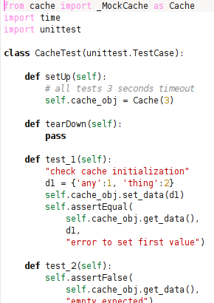
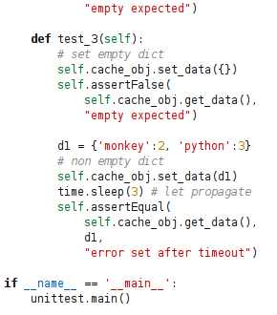
Unit Testing: unittest library – Code Example

Slide 10
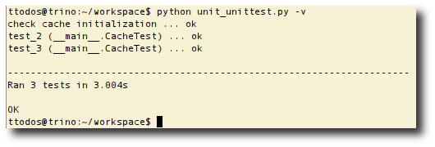
Unit Testing: unittest library – Execution
unittest.main() provides command-line interface to the script, but there is no requirement to be run from the command line. Python IDEs integrate PyUnit using alternative facilities for running tests.

Slide 11
Unit Testing: doctest library
The “doctest” module searches for pieces of text that look like interactive Python sessions, and then executes those sessions to verify that they work exactly as shown.
The most often the doctests are integrated into the comment sections of the code, but may be placed into a separate file.
“doctest” is a part of Python Standard Library
Explore more here: http://docs.python.org/library/doctest.html

Slide 12
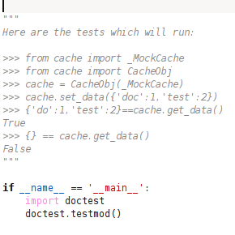
Unit Testing: doctest library – Code Example

Slide 13
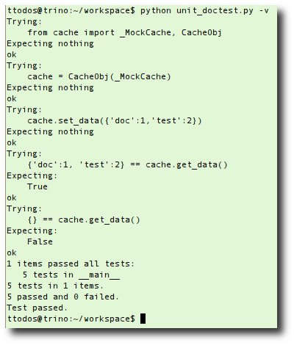
Unit Testing: doctest library - Execution
The “doctest” library parses source code in order to find tests and run them. -v switch forces verbose mode for the runner.

Slide 14
Unit Testing: nose library
“nose” extends “unittest” to make testing easier.
“nose” collects tests automatically from python source files, directories and packages found in its working directory (which defaults to the current working directory).
Any python source file, directory or package that matches the testMatch regular expression (by default: (?:^|[b_.-])[Tt]est) will be collected as a test (or source for collection of tests).
Nose library is a third party unittest framework.
Explore more here: http://somethingaboutorange.com/mrl/projects/nose

Slide 15
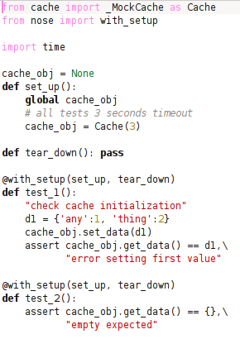
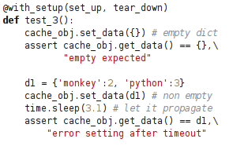
Unit Testing: nose library – Code Example

Slide 16
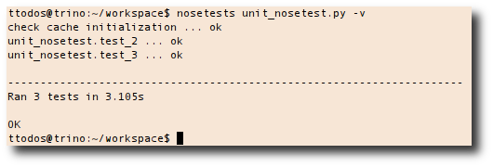
Unit Testing: nose library - Execution
If it looks like a test, it’s a test. Names of directories, modules, classes and functions are compared against the testMatch regular expression, and those that match are considered tests. Any class that is a unittest.TestCase subclass is also collected, so long as it is inside of a module that looks like a test.
Directories that don’t look like tests and aren’t packages are not inspected.
More info here: http://somethingaboutorange.com/mrl/projects/nose/0.11.3/finding_tests.html

Slide 17
Unit Testing metrics: coverage.py
Coverage.py is a tool for measuring code coverage of Python programs. It monitors your program, noting which parts of the code have been executed, then analyzes the source to identify code that could have been executed but was not.
Coverage measurement is typically used to gauge the effectiveness of tests. It can show which parts of your product code are being exercised by tests, and which are not.
Explore more here: http://nedbatchelder.com/code/coverage/

Slide 18
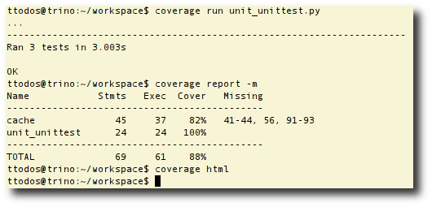
Unit Testing metrics: coverage.py - Execution

Slide 19
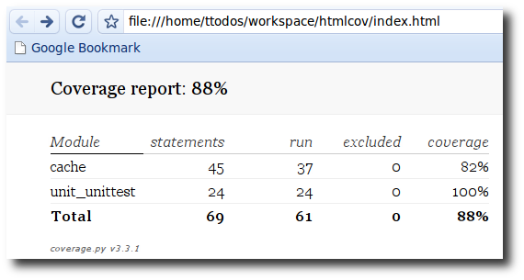
Unit Testing metrics: coverage.py – Report 1

Slide 20
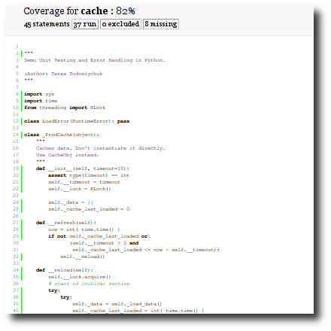
Unit Testing metrics: coverage.py – Report 2

Slide 21
Exceptions vs. Error code
There are two strategies for signaling errors as they appear from layer to layer in software: raising exceptions and returning status code.
Languages like C don't have real exception handling mechanism. Newer languages like Python do support exceptions. Python is a high level language and it also has no “goto” operator.
Handling status code makes code less readable.
Exceptions allow to separate concerns in a way that the code can't (unpredictable situations from the lower layers of a program).
>>> def some_func(a, b):
... status = other_func1(a)
... if not status:
... return status
... status = other_func2(b)
... if not status:
... return status
... return 1
...
>>> def some_func(a, b):
... other_func1(a)
... other_func2(b)
...

Slide 22
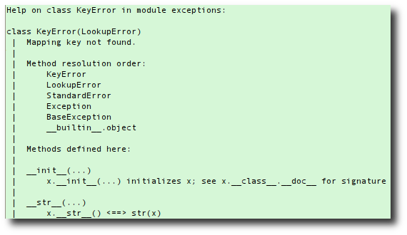
Exception inheritance tree
Exceptions should be class objects. The exceptions are defined in the module “exceptions”. This module never needs to be imported explicitly: the exceptions are provided in the built-in namespace as well as the exceptions module.
The built-in exception classes can be sub-classed to define new exceptions; programmers are encouraged to at least derive new exceptions from the Exception class and not BaseException.

Slide 23
Catching exceptions
One can catch exception with the help of "try...except", which have the following syntax:
try:
try_case
except exception_group1 as variable1:
except_case1
...
except exception_groupN as variableN:
except_caseN
else:
else_case # all's ok
finally:
finally_case # always executed

Slide 24
Catching exceptions - Example
In case of several "except" blocks always place from the top to bottom and from more specialized (KeyError) to less specialized (LookupError). Read about Liskov principle http://en.wikipedia.org/wiki/Liskov_substitution_principle
>>> d = {}
>>> try:
... d[1] # key error!
... except LookupError, e:
... print "LookupError: %s" % e
... except KeyError, e:
... print "KeyError: %s" % e
...
LookupError: 1
>>>
>>> try:
... d[1] # key error!
... except KeyError, e:
... print "KeyError: %s" % e
... except LookupError, e:
... print "LookupError: %s" % e
...
KeyError: 1

Slide 25
Raising Exceptions
The raise statement allows the programmer to force a specified exception to occur. The exception has to be either builtin or custom subclassed from Exception class. In case of empty exception class, raise will re-raise current active exception, and in case of missing an active exception, there will be thrown TypeError.
raise exception(args)
raise

Slide 26
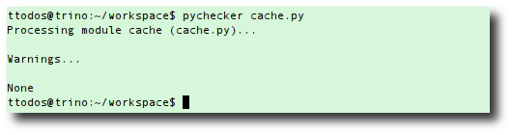
Static code check: Pychecker
PyChecker is a tool for finding bugs in python source code. It finds problems that are typically caught by a compiler for less dynamic languages, like C and C++. It is similar to lint. Because of the dynamic nature of python, some warnings may be incorrect; however, spurious warnings should be fairly infrequent.
PyChecker works in a combination of ways. First, it imports each module. If there is an import error, the module cannot be processed. The import provides some basic information about the module. The code for each function, class, and method is checked for possible problems.
Explore more here: http://pychecker.sourceforge.net/

Slide 27
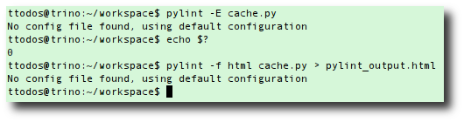
Static code check: pylint
Pylint is a python tool that checks if a module satisfies a coding standard. Pylint is similar to PyChecker but offers more features, like checking line-code's length, checking if variable names are well-formed according to your coding standard, or checking if declared interfaces are truly implemented, and much more.
The big advantage with Pylint is that it is highly configurable, customizable, and you can easily write a small plugin to add a personal feature.
Explore more here: http://www.logilab.org/857

Slide 28
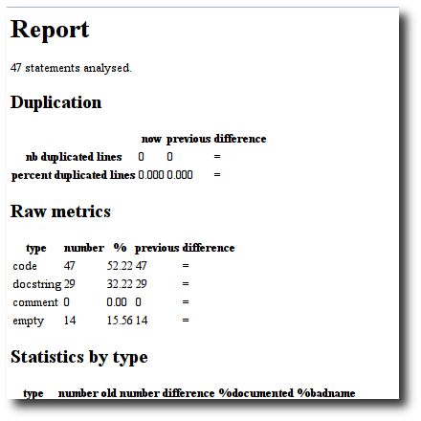
Static code check: pylink - Report

Slide 29
Questions?

