Slide 1
jQuery
Dmytro Petin
01/2016

Slide 2
Agenda
Introduction
Selectors
Events
Methods
.each
Ajax

Slide 3
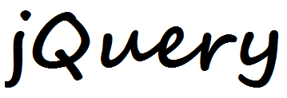

Slide 4
What is jQuery?
jQuery is a fast and concise JavaScript Library that simplifies HTML document traversing, event handling, animating and Ajax interactions for rapid web development.
jQuery - set of typical JavaScript helpers encapsulated in one object.

Slide 5
Short info
jQuery library developed by John Resig.
v 1.0 of library released on November 26th, 2006.
Now jQuery maintained as an Open Source software.

Slide 6
Features of jQuery
Cross-browser engine
DOM element selections
DOM traversal and modification.
Events handling.
CSS manipulation.
Effects and animations
AJAX technology

Slide 7

How to use jQuery?
Find elements
Do something with it
Be happy :)

Slide 8
How to use jQuery?
In general base syntax looks like:
Find elements.Do something
Or more concretely:
$(selector).method();
Shortcut $ usually used for calling jQuery object

Slide 9
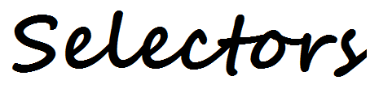

Slide 10
Selectors
jQuery supported selectors in CSS style:
$(el) – selects existing element
$(“*”) – selects all elements (rarely used)
$(“div”) – selects by tag name
$(“#test”) – selects by id
$(“.test”) – selects by class-name
$(“div#test”) – complex selects by tag and id
$(“div.test”) – complex selects by tag and class

Slide 11
Selectors
jQuery supported selectors in CSS style:
$(“div *”) – selects all descendants
$(“div span”) – selects descendants by tag name
$(“div>span”) – selects children by tag name
$(“div+img”) – selects next siblings
$(“[checked]”) – selects by attribute name
$(“[type=‘button’]”) – selects by attribute value

Slide 12
Selectors
jQuery also supported filters and methods:
$(“selector:filter”) – applying of filter
:first, :last, :even, :odd – filter by position
:empty, :contins(), :has() – filter by content
:eq(i), :lt(i), :gt(i) – filter by index
:hidden, :visible – filter by displaying

Slide 13
Selectors
jQuery also supported filters and methods:
$(“selector”).method(“selector”) – applying of filter
.find() – selects descendants
.prev(), .next() – selects siblings
.children() – selects all descendants
.parent() – selects direct parent

Slide 14
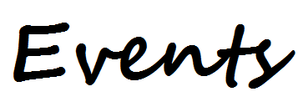

Slide 15
Events
Base syntax of event’s assigning in jQuery
$(selector).method(event, handler);
Methods:
on() – add event handler
off() – remove event handler
one() – add event handler and remove it after first using
Old Methods [deprecated!]:
bind() – add event handler if element exist
live() – add event handler if element not exist

Slide 16
Events
Base syntax of event’s assigning in jQuery
$(selector).method(event, handler);
Events:
“click”, “”dbclick”, “contextmenu”, “chamge”,
“blur”, “submit”, “mouseup” and etc.
Handler:
Any function that should be called if event occurred

Slide 17
Events
Base syntax of event’s assigning in jQuery
$(selector).method(event, handler);
For example:
$(“#btn”).on(“click”, function() {
console.log(“button click detected”);
});
//message in console will be provided
//after clicking on button with id “btn”

Slide 18
Bubbling and default action
For stopping bubbling and prevention of default actions can be use return false; instead of native e.preventDefault() and e.stopPropagation() from JavaScript.
But object e still a first parameter of event- handler and can be processed if it needed.

Slide 19
Document ready
jQuery can processed synthetic event "ready". This event will execute handler when the DOM is fully loaded:
$(document).ready(function() { … });
Or more shortly:
$(function() { … }); // recommended

Slide 20
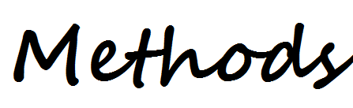

Slide 21
Basic jQuery methods
Some of big collection jQuery methods
For work with content:
.text() – Sets or returns the text-content of element
.html() – Sets or returns the html-content of elements
.var() – Sets or returns the value of form fields
.attr() – Sets or gets attribute values
For work with CSS:
.css() – Sets or returns the style attributes [not recommended]
.addClass() – Add one of more style classes
.removeClass() – Remove or more selected classes
.toggleClass() – Toggles between adding/removing classes

Slide 22
Basic jQuery methods
Some of big collection jQuery methods
For DOM manipulation:
.append() – Inserts content at the end of the elements
.prepend() – Inserts content at the beginning of the elements
.after() – Inserts content after the elements
.before() – Inserts content before the elements
.remove() – Removes the element (and all its children)
.empty() – Removes all children elements
And many-many other:
.trigger(), .show(), .hide(), .animate(), .fadeIn(), etc.

Slide 23
Optimization
If you need to use some DOM-element in different times will be better to find it once and cashed. For example:
$(“#input”).text(“some text”);
. . .
$(“#input”).text(“any text”);

Slide 24
Optimization
If you need to use some DOM-element in different times will be better to find it once and cashed. For example:
$(“#input”).text(“some text”);
. . .
$(“#input”).text(“any text”);
var $el = $(“#input”);
. . .
$el. text(“some text”);
. . .
$el. text(“any text”);

Slide 25
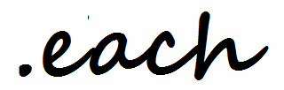

Slide 26
.each()
.each() - iterates over any collection, executing function-handler for every matched element.
Base syntax:
$(selector).each(handler);
or
$.each(collection, handler);
Format of handler:
function(index, element) { . . . };

Slide 27
.each()
For example:
// Take this code . .
$(“li”).each(function(i, el) {
console.log($(el).text());
});

Slide 28
.each()
For example:
<ul>
<li>item 1</li>
<li>item 2</li>
<li>item 3</li>
</ul>
// . . . and apply it for this html
$(“li”).each(function(i, el) {
console.log($(el).text());
});

Slide 29
.each()
For example:
<ul>
<li>item 1</li>
<li>item 2</li>
<li>item 3</li>
</ul>
// each in action! :)
$(“li”).each(function(i, el) {
console.log($(el).text());
});
item 1
item 2
item 3

Slide 30
.each()
For example:
<ul>
<li>item 1</li>
<li>item 2</li>
<li>item 3</li>
</ul>
$(“li”).each(function(i, el) {
console.log($(el).text());
});
// Note: second parameter
// of handler is not jQuery
// Wrapper $(el) is required
// for using jQuery methods
item 1
item 2
item 3

Slide 31
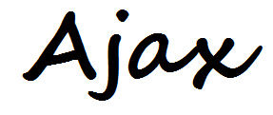

Slide 32
Ajax in jQuery
.ajax() – universal method for providing ajax-technology:
Base syntax:
$.ajax(options);
Options:
hash with parameters for setting ajax-dialog:
data, dataType, type, url, success and error callbacks, etc.

Slide 33
Ajax in jQuery
For example:
$.ajax({
url: '/server/give-me-list-of-cats',
dataType : ‘json’,
success: function (list_of_cats) {
$.each(list_of_cats, function(I, cat) {
console.log(cat.name);
});
}
});

Slide 34
Wrappers
Also jQuery can propose some usable wrappers:
get() – sends GET request
post() – sends POST request
Parameters:
url – string with URL to which the request is sent.
data – optional object or string that is sent to the server
successCallback – executed if the request succeeds.
dataType – the type of data expected from the server

Slide 35
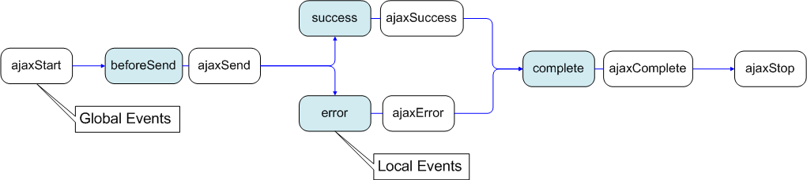
Ajax events
jQuery supported next event model for ajax-dialog:
Global events:
ajaxStart, ajaxSend, ajaxSuccess,
ajaxError, ajaxComplete, ajaxStop
Internal events:
beforeSend, succes, error, complete

Slide 36
Ajax events
Global event can be used in method on():
$(el).on(“ajaxSuccess”, function() { … });
Internal events used by method ajax:
$.ajax({
. . .
error: function() { … }),
. . .
});

Slide 37


Slide 38
