Slide 1
Sorting
Data Structures and Algorithms
Nanjing University, Fall 2020
郑朝栋

Slide 2
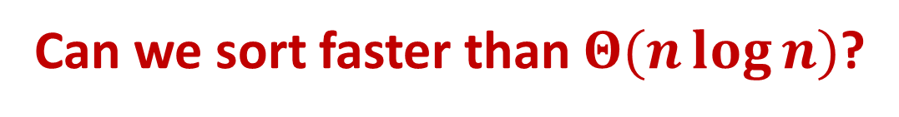
Can we sort faster than $Θ(n\log{n})$?

Slide 3
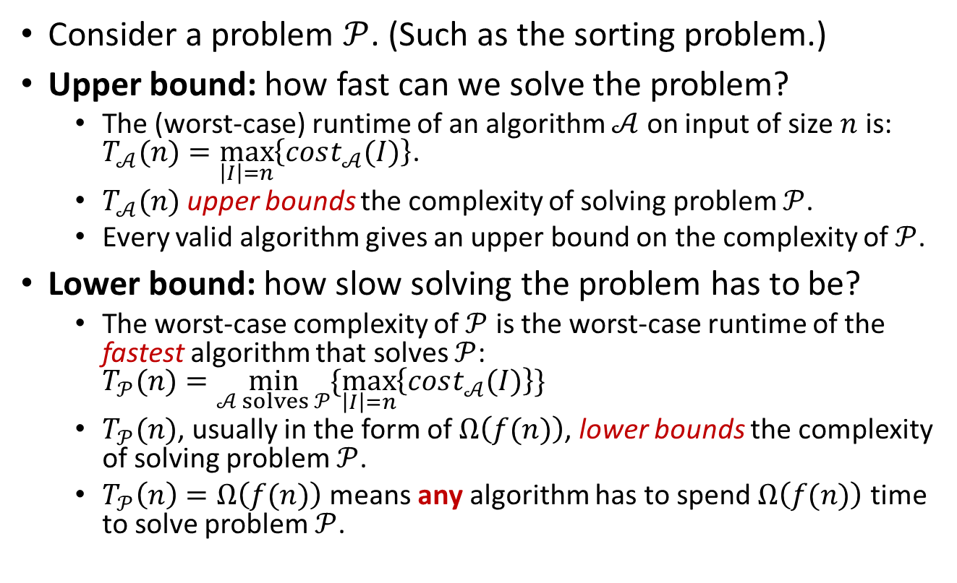
Complexity of a problem: Upper bound and Lower bound
Consider a problem $𝒫$. (Such as the sorting problem.)
Upper bound: how fast can we solve the problem?
The (worst-case) runtime of an algorithm $𝒜$ on input of size $n$ is: $T_{𝒜}(n)=\max_{\left|I\right|=n}\left\{cost_{𝒜}(I)\right\}$.
$T_{𝒜}(n)$ upper bounds the complexity of solving problem $𝒫$.
Every valid algorithm gives an upper bound on the complexity of $𝒫$.
Lower bound: how slow solving the problem has to be?
The worst-case complexity of $𝒫$ is the worst-case runtime of the fastest algorithm that solves $𝒫$: $T_{𝒫}(n)=\min_{𝒜 solves 𝒫}{\{\max_{\left|I\right|=n}\left\{cost_{𝒜}(I)\right\}\}}$
$T_{𝒫}(n)$, usually in the form of $Ω\left(f(n)\right)$, lower bounds the complexity of solving problem $𝒫$.
$T_{𝒫}\left(n\right)=Ω\left(f(n)\right)$ means any algorithm has to spend $Ω\left(f(n)\right)$ time to solve problem $𝒫$.

Slide 4
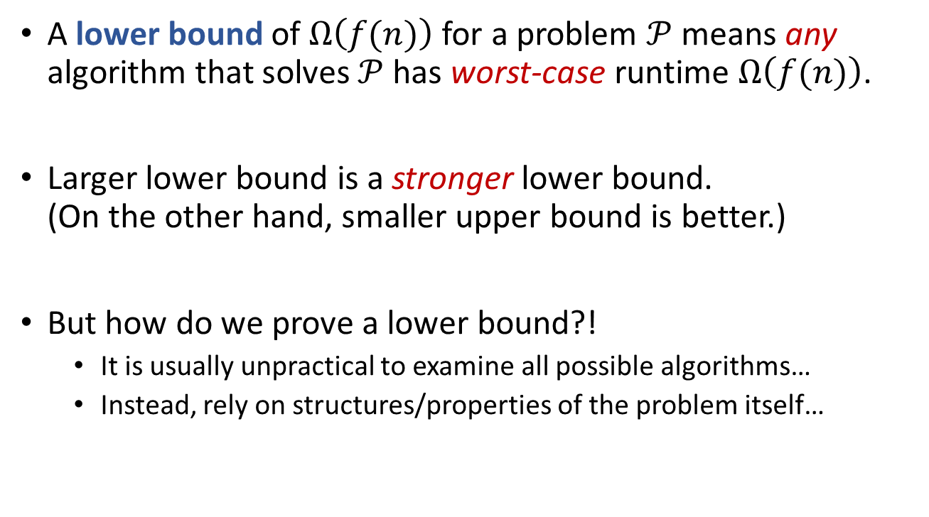
Lower bound of a problem
A lower bound of $Ω\left(f(n)\right)$ for a problem $𝒫$means any algorithm that solves $𝒫$ has worst-case runtime $Ω\left(f(n)\right)$.
Larger lower bound is a stronger lower bound. (On the other hand, smaller upper bound is better.)
But how do we prove a lower bound?!
It is usually unpractical to examine all possible algorithms…
Instead, rely on structures/properties of the problem itself…

Slide 5

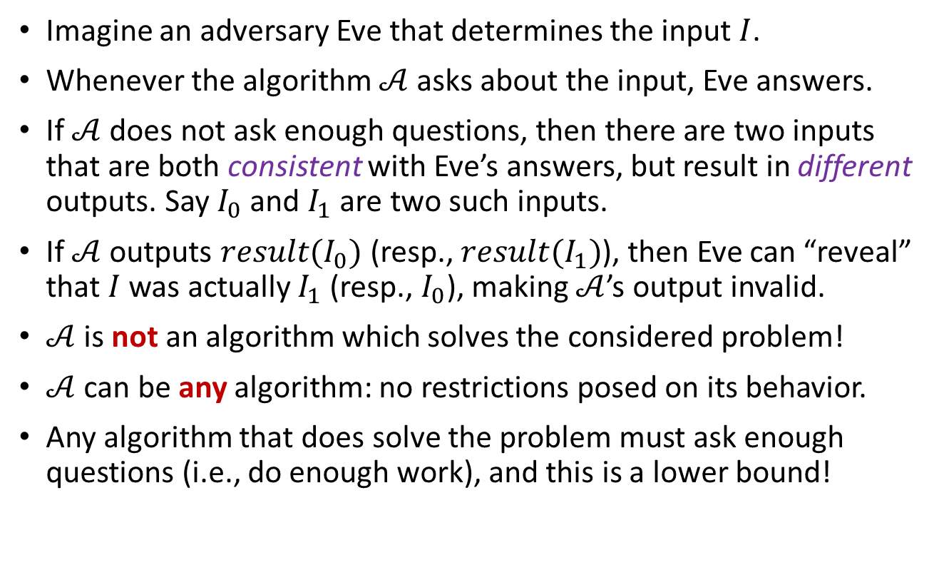
Techniques for proving lower bounds: The Adversary Argument
Imagine an adversary Eve that determines the input $I$.
Whenever the algorithm $𝒜$ asks about the input, Eve answers.
If $𝒜$ does not ask enough questions, then there are two inputs that are both consistent with Eve’s answers, but result in different outputs. Say $I_{0}$ and $I_{1}$ are two such inputs.
If $𝒜$ outputs $result(I_{0})$ (resp., $result(I_{1})$), then Eve can “reveal” that $I$ was actually $I_{1}$ (resp., $I_{0}$), making $𝒜$’s output invalid.
$𝒜$ is not an algorithm which solves the considered problem!
$𝒜$ can be any algorithm: no restrictions posed on its behavior.
Any algorithm that does solve the problem must ask enough questions (i.e., do enough work), and this is a lower bound!

Slide 6





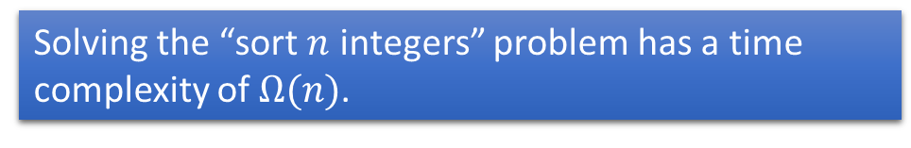
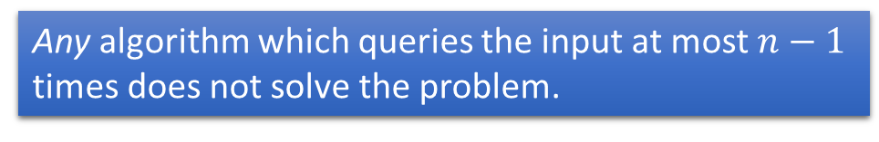
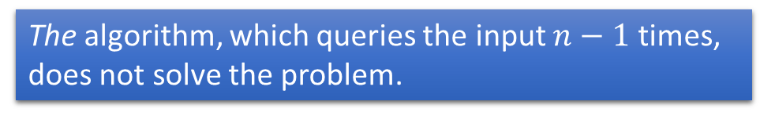










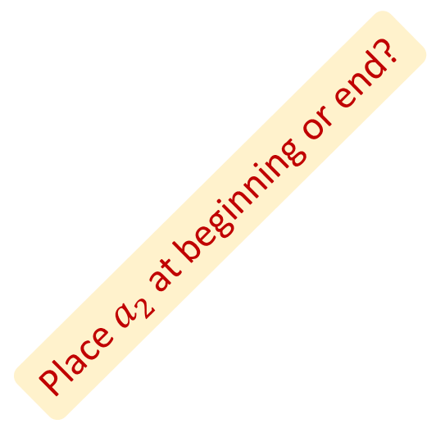


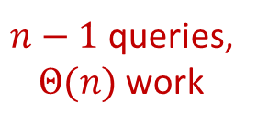












The adversary argument in action: Lower bound for sorting
Assume we want to sort $n$ integers.
The algorithm, which queries the input $n−1$ times, does not solve the problem.
$$a_{1}$$
$$a_{2}$$
…
$$a_{n−1}$$
$$a_{n}$$
Any algorithm which queries the input at most $n−1$ times does not solve the problem.
“What is $a_{n−1}$?”
$$a_{1}$$
$$a_{2}$$
…
$$a_{n−1}$$
=1
$$a_{n}$$
“$a_{n−1}=1$”
Place $a_{2}$ at beginning or end?
Busy…busy…busy…
$$a_{1}$$
=1
$$a_{2}$$
…
$$a_{n−1}$$
=1
$$a_{n}$$
Solving the “sort $n$ integers” problem has a time complexity of $Ω(n)$.
“What is $a_{1}$?”
“$a_{1}=1$”
…
$$a_{1}$$
=1
$$a_{2}$$
=?
…
$$a_{n−1}$$
=1
$$a_{n}$$
=1
… (always say 1)
$n−1$ queries, $Θ(n)$ work
sorry but $a_{2}>1$
$$a_{2}$$
<1
$$a_{1}$$
=1
…
$$a_{n−1}$$
=1
$$a_{n}$$
=1
$$a_{1}$$
=1
$$a_{3}$$
=1
…
$$a_{n}$$
=1
$$a_{2}$$
>1

Slide 7

Sorting needs $Ω(n)$ time.
Can we sort faster than $Θ(n\log{n})$?
No, at least not for a large class of algorithms…

Slide 8


Comparison-based sorting lower bound
A comparison-based sorting algorithm determines sorted order only based on comparisons between the input items.
In a comparison sort, only comparisons between elements are used to gain order information about the input sequence.
Given $a_{i}$ and $a_{j}$, only use “$<$”, “$≤$”, “$=$”, “$≥$”, or “$>$” to gain order info.
Particularly, the algorithm cannot inspect the values of input items.
Any comparison-based sorting algorithm has time complexity $Ω(n\log{n})$, in the worst case.

Slide 9
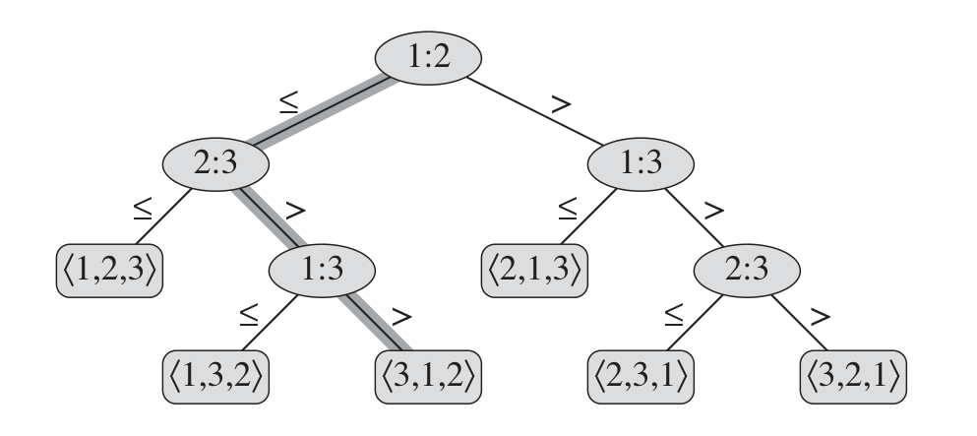


Decision Tree
Decisions trees can be used to describe algorithms.
A decision tree is a tree.
Each internal node denotes a query the algorithm makes on input.
Outgoing edges denote the possible answers to that query.
Each leaf denotes an output.
One execution of the algorithm is a path from root to a leaf.
At each internal node, answer to query tells us where to go next.
The worst-case time complexity is at least the length of the longest path from root to some leaf. I.e., height of the tree!
Sort $\left\langle a_{1},a_{2},a_{3}\right\rangle$.
$$\left\langle a_{1}=6,a_{2}=8,a_{3}=5\right\rangle$$

Slide 10


Decision tree in action: Comparison-based sorting lower bound
Assume input items are distinct.
Assume the algorithm only uses “$≤$” to do comparison.
We can use a binary comparison tree to describe the alg.
Each internal node has two outgoing edges.
Each internal node denotes a query of the form “$a_{i}≤a_{j}$”.
The tree must have $≥n!$ leaves.
The height of the tree must be $≥\lg\left(n!\right)$, which is $Ω(n\log{n})$.
Any comparison-based sorting algorithm has time complexity $Ω(n\log{n})$, in the worst case.

Slide 11

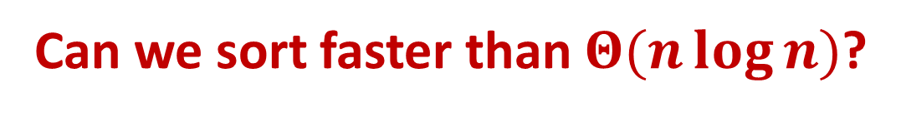
Sorting needs $Ω(n)$ time.
Can we sort faster than $Θ(n\log{n})$?
No, at least not for comparison-based sorting…
Humm, maybe “non-comparison-based” sorting?

Slide 12
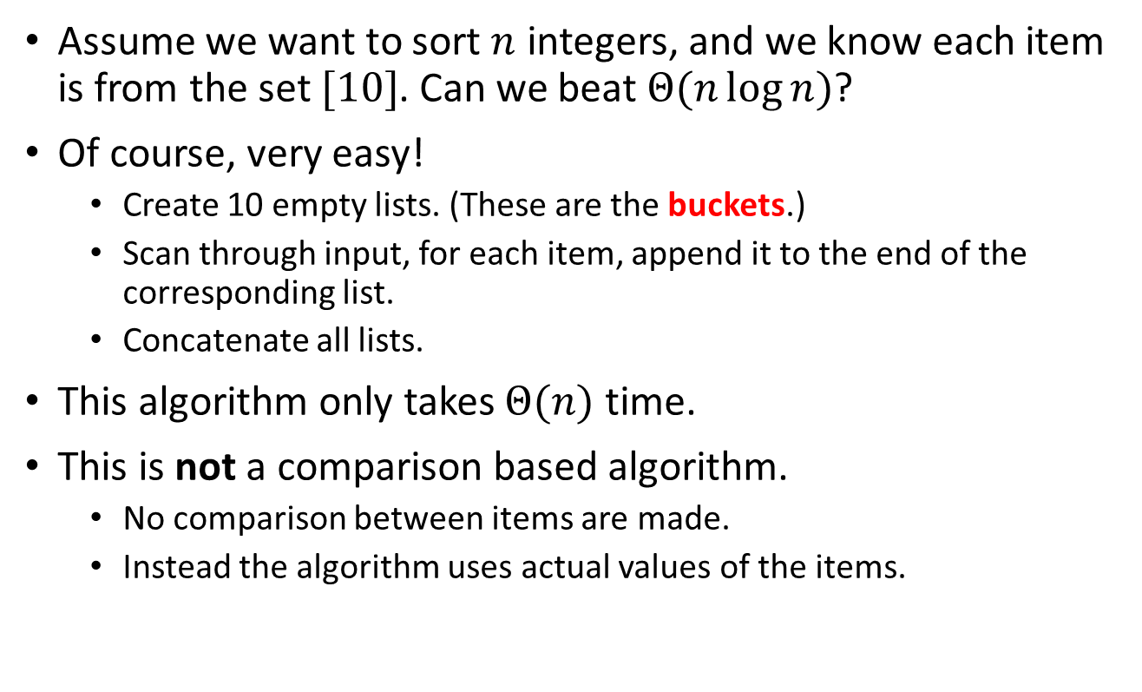
Bucket sort
Assume we want to sort $n$ integers, and we know each item is from the set $[10]$. Can we beat $Θ(n\log{n})$?
Of course, very easy!
Create 10 empty lists. (These are the buckets.)
Scan through input, for each item, append it to the end of the corresponding list.
Concatenate all lists.
This algorithm only takes $Θ(n)$ time.
This is not a comparison based algorithm.
No comparison between items are made.
Instead the algorithm uses actual values of the items.

Slide 13

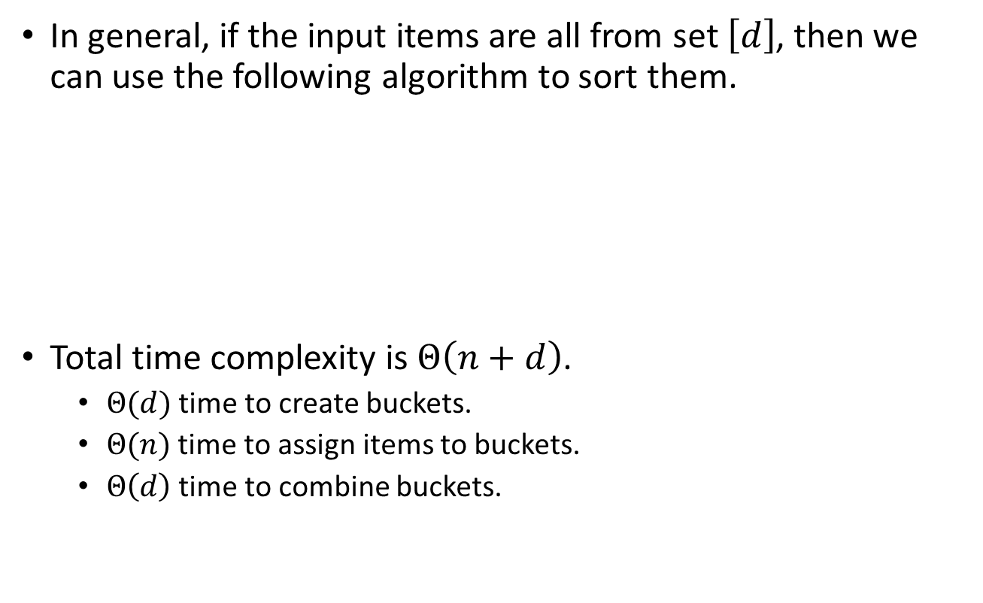
Bucket sort
In general, if the input items are all from set $\left[d\right]$, then we can use the following algorithm to sort them.
Total time complexity is $Θ\left(n+d\right)$.
$Θ(d)$ time to create buckets.
$Θ(n)$ time to assign items to buckets.
$Θ\left(d\right)$ time to combine buckets.
BucketSort(A, d):
<L₁,L₂,…,L_{d}> = CreateBuckets(d)
for (i=1 to A.length)
AssignToBucket(A[i])
CombineBuckets(L₁,L₂,…,L_{d})
What if $n≪d$? Say sort 1000 64-bit integers.

Slide 14
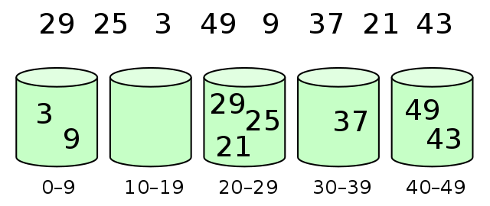
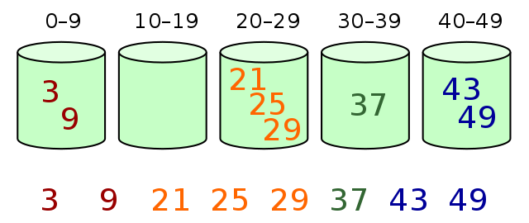


Bucket sort
If the range of items’ values is too large, allow each bucket to hold multiple values.
Allocate $k$ buckets each responsible for an interval of size $d/k$.
But now we need to sort each bucket before combining them.
$$n=8,d=50,k=5$$
BucketSort(A, k):
<L₁,L₂,…,L_{k}> = CreateBuckets(k)
for (i=1 to A.length)
AssignToBucket(A[i])
for (j=1 to k)
SortWithinBucket(L_{j})
CombineBuckets(L₁,L₂,…,L_{k})

Slide 15
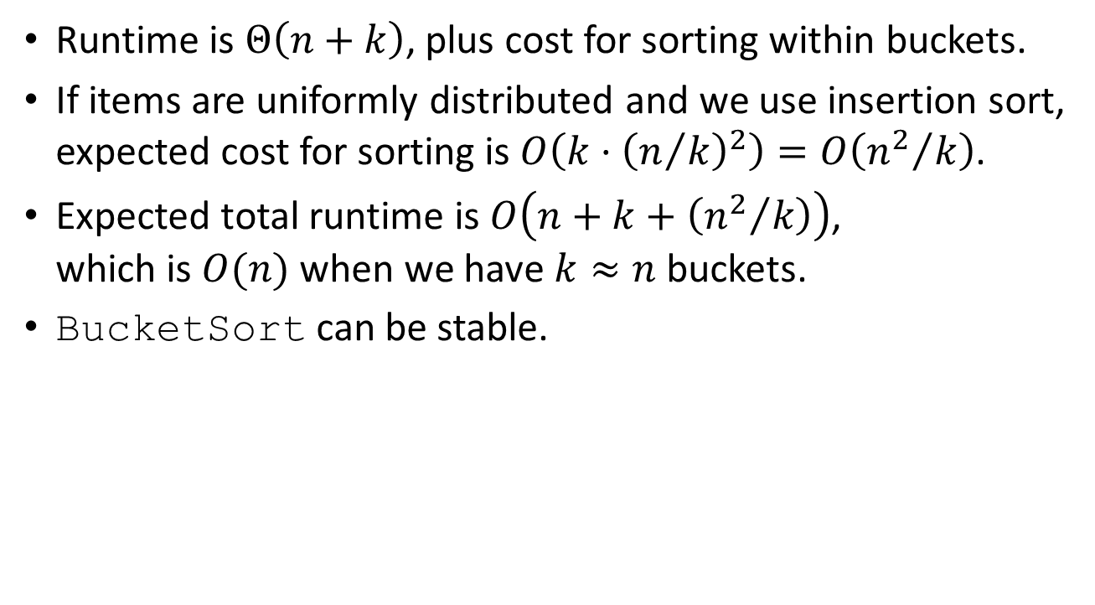
Bucket sort
Runtime is $Θ\left(n+k\right)$, plus cost for sorting within buckets.
If items are uniformly distributed and we use insertion sort, expected cost for sorting is $O\left(k⋅{\left(n/k\right)}^{2}\right)=O\left({n^{2}}/k\right)$.
Expected total runtime is $O\left(n+k+\left({n^{2}}/k\right)\right)$, which is $O(n)$ when we have $k≈n$ buckets.
BucketSort can be stable.
BucketSort(A, k):
<L₁,L₂,…,L_{k}> = CreateBuckets(k)
for (i=1 to A.length)
AssignToBucket(A[i])
for (j=1 to k)
SortWithinBucket(L_{j})
CombineBuckets(L₁,L₂,…,L_{k})

Slide 16
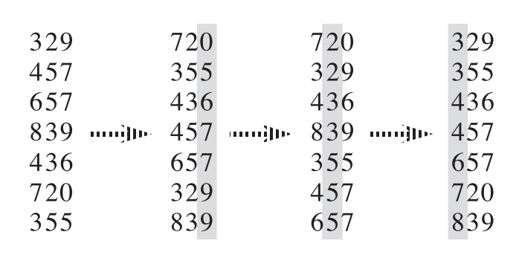

Radix sort
Assume we want to sort $n$ decimal integers each of $d$-digits.
How about recursive bucket sort?
Based on most significant bit, assign items to 10 buckets.
Sort recursively in each bucket (i.e., use 2nd most significant bit).
RadixSort: iterative, starting from least significant bit.
Valid but not for now…
RadixSort(A, d):
for (i=1 to d)
use-a-stable-sort-to-sort-A-on-digit-i

Slide 17
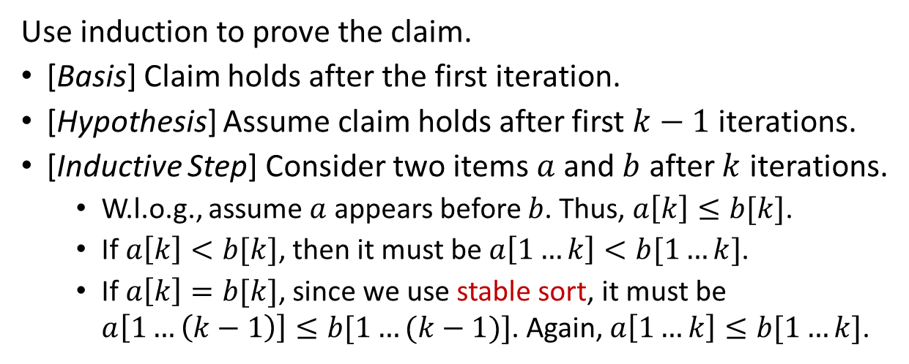
Radix sort
RadixSort(A, d):
for (i=1 to d)
use-a-stable-sort-to-sort-A-on-digit-i
Why it works?!
Claim: after $i$^{th} iteration, items are sorted by their rightmost $i$ bits.
Use induction to prove the claim.
[Basis] Claim holds after the first iteration.
[Hypothesis] Assume claim holds after first $k−1$ iterations.
[Inductive Step] Consider two items $a$ and $b$ after $k$ iterations.
W.l.o.g., assume $a$ appears before $b$. Thus, $a\left[k\right]≤b[k]$.
If $a\left[k\right]<b[k]$, then it must be $a\left[1…k\right]<b[1…k]$.
If $a\left[k\right]=b[k]$, since we use stable sort, it must be $a\left[1…\left(k−1\right)\right]≤b[1…(k−1)]$. Again, $a\left[1…k\right]≤b[1…k]$.

Slide 18
Radix sort
RadixSort(A, d):
for (i=1 to d)
use-a-stable-sort-to-sort-A-on-digit-i
How much time?
RadixSort(A, d):
for (i=1 to d)
use-bucket-sort-to-sort-A-on-digit-i
Since only considering decimal numbers, we only need $10=Θ\left(1\right)$ buckets.
RadixSort can sort $n$ decimal $d$-digits numbers in $O(dn)$ time.

Slide 19
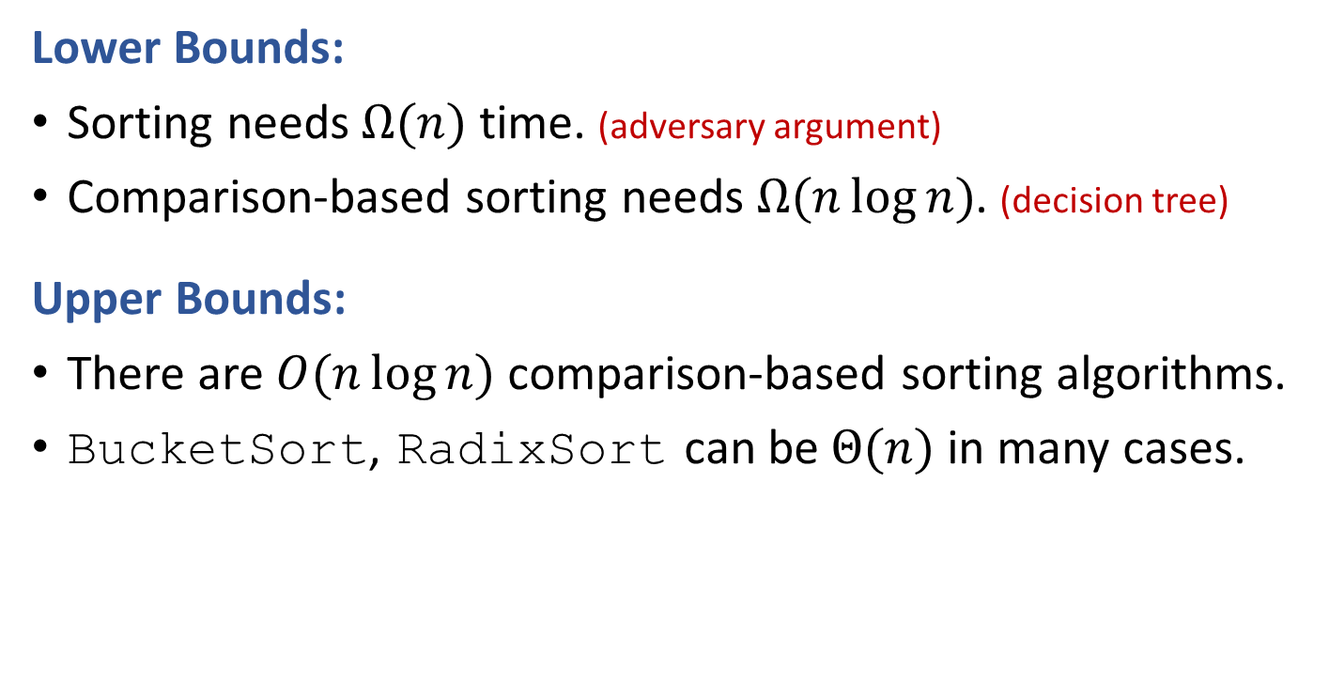
Summary
Lower Bounds:
Sorting needs $Ω(n)$ time. (adversary argument)
Comparison-based sorting needs $Ω(n\log{n})$. (decision tree)
Upper Bounds:
There are $O(n\log{n})$ comparison-based sorting algorithms.
BucketSort, RadixSort can be $Θ(n)$ in many cases.

Slide 20
Reading
[CLRS] Ch.8

