Slide 1
Greedy Algorithms
Data Structures and Algorithms
Nanjing University, Fall 2020
郑朝栋

Slide 2
The Greedy Strategy
For many games, you should think ahead, a strategy which focuses on immediate advantage could easily lead to defeat.
Such as playing chess.
But for many other games, you can do quite well by simply making whichever move seems best at the moment, without worrying too much about future consequences.
Such as building an MST.
The Greedy Algorithmic Strategy: given a problem, build up a solution piece by piece, always choosing the next piece that offers the most obvious and immediate benefit.
Sometimes it gives optimal solution.
Sometimes it gives near-optimal solution.
Or, it simply fails…

Slide 3
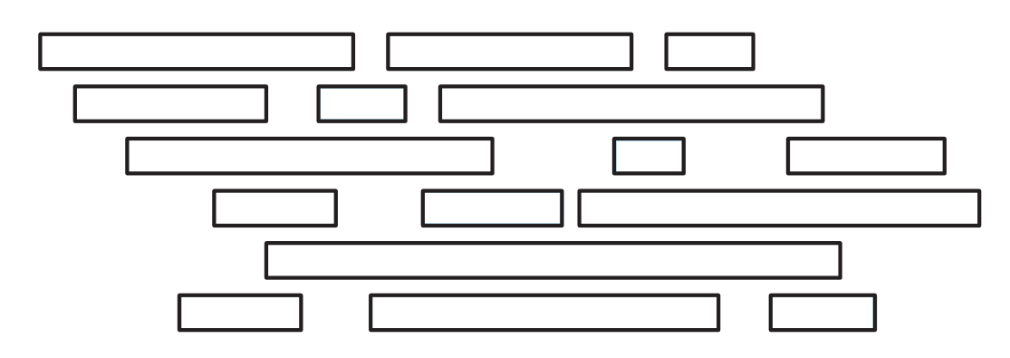
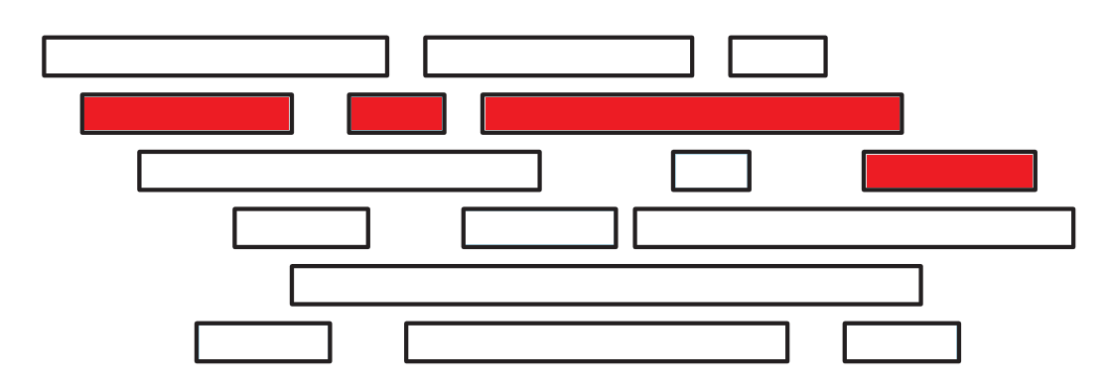
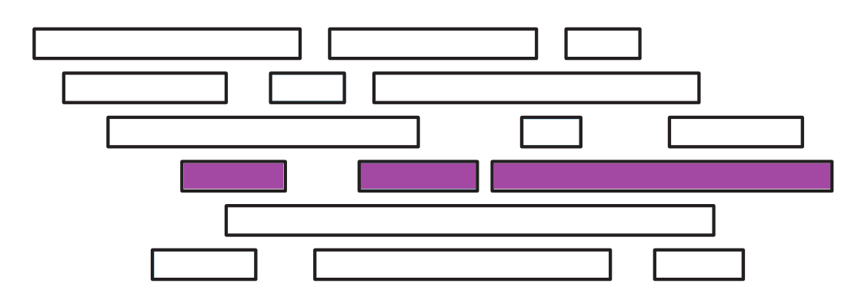
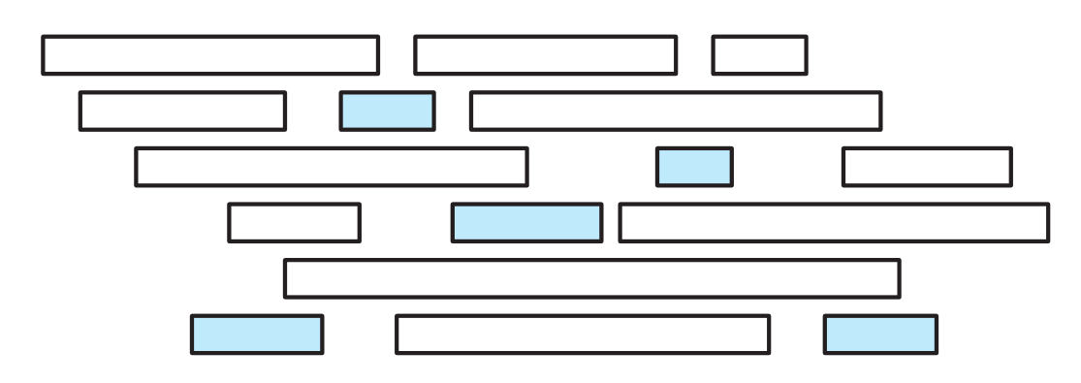

An Activity-Selection Problem
Assume we have one hall and $n$ activities $S=\left\{a_{1},⋯,a_{n}\right\}$.
Each activity has a start time $s_{i}$ and a finish time $f_{i}$.
Two activities cannot happen simultaneously in the hall.
Maximum number of activities we can schedule?

Slide 4
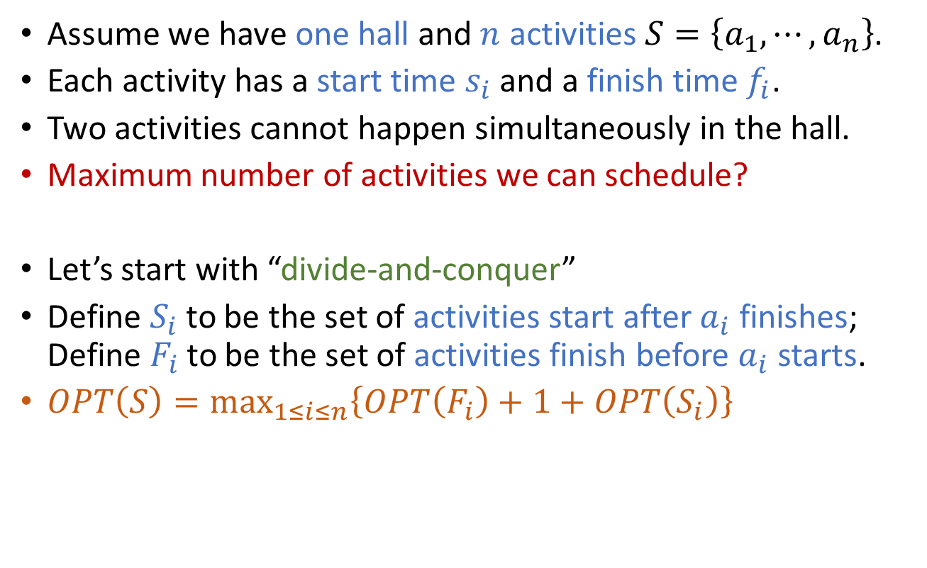
An Activity-Selection Problem
Assume we have one hall and $n$ activities $S=\left\{a_{1},⋯,a_{n}\right\}$.
Each activity has a start time $s_{i}$ and a finish time $f_{i}$.
Two activities cannot happen simultaneously in the hall.
Maximum number of activities we can schedule?
Let’s start with “divide-and-conquer”
Define $S_{i}$ to be the set of activities start after $a_{i}$ finishes; Define $F_{i}$ to be the set of activities finish before $a_{i}$ starts.
$OPT\left(S\right)=\max_{1≤i≤n}\left\{OPT\left(F_{i}\right)+1+OPT\left(S_{i}\right)\right\}$

Slide 5
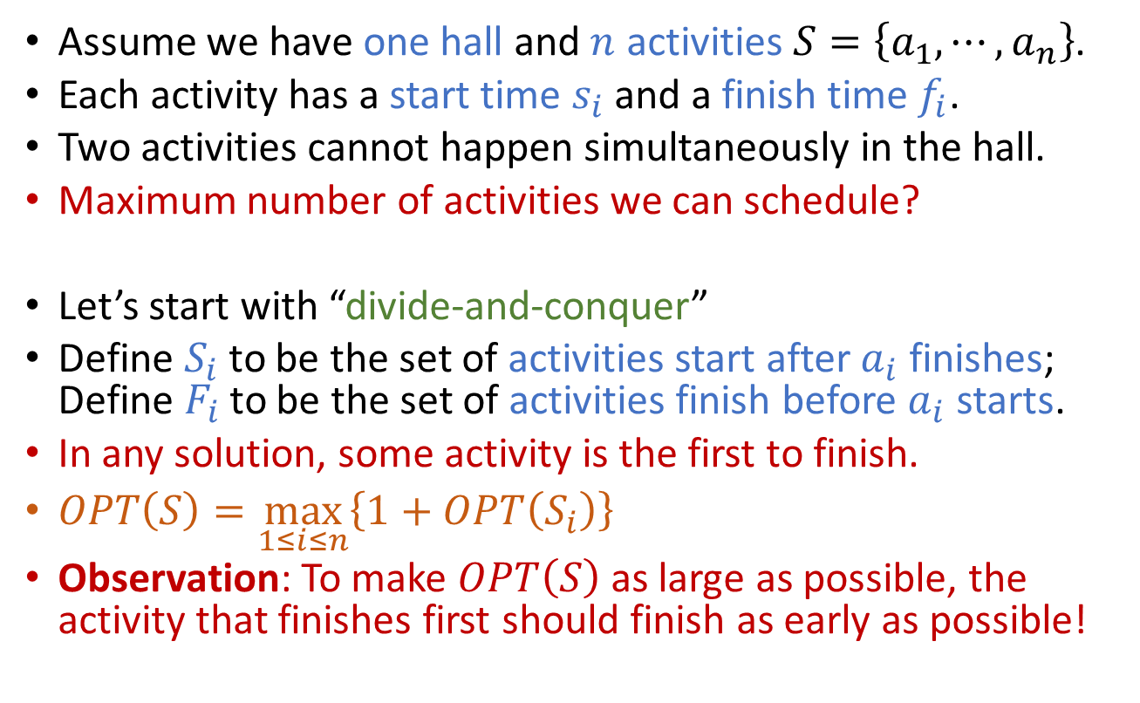
An Activity-Selection Problem
Assume we have one hall and $n$ activities $S=\left\{a_{1},⋯,a_{n}\right\}$.
Each activity has a start time $s_{i}$ and a finish time $f_{i}$.
Two activities cannot happen simultaneously in the hall.
Maximum number of activities we can schedule?
Let’s start with “divide-and-conquer”
Define $S_{i}$ to be the set of activities start after $a_{i}$ finishes; Define $F_{i}$ to be the set of activities finish before $a_{i}$ starts.
In any solution, some activity is the first to finish.
$OPT\left(S\right)=\max_{1≤i≤n}\left\{1+OPT\left(S_{i}\right)\right\}$
Observation: To make $OPT\left(S\right)$ as large as possible, the activity that finishes first should finish as early as possible!

Slide 6
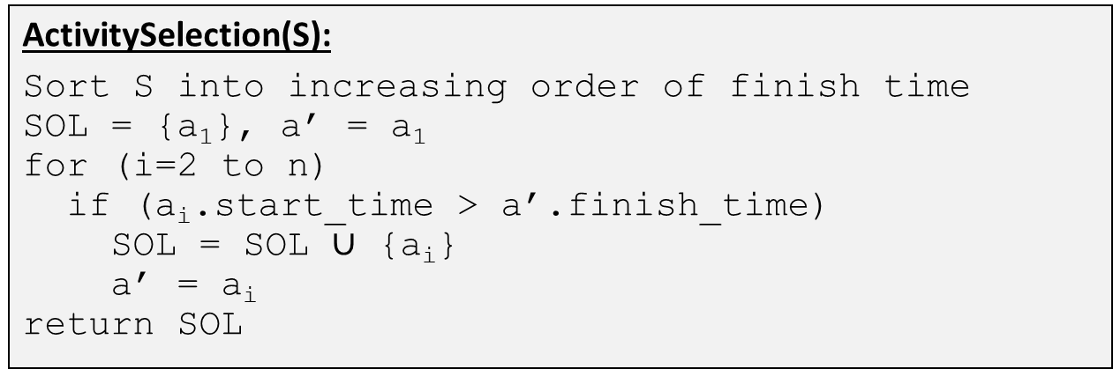

An Activity-Selection Problem
Assume we have one hall and $n$ activities $S=\left\{a_{1},⋯,a_{n}\right\}$.
Each activity has a start time $s_{i}$ and a finish time $f_{i}$.
Two activities cannot happen simultaneously in the hall.
Maximum number of activities we can schedule?
The “greedy” strategy:
Let $S^{′}=S$
Find the activity that finishes first in $S^{′}$, call it $a^{′}$. (Greedy Step!)
Add $a^{′}$ to the solution, remove from $S^{′}$ the activities that overlap with $a^{′}$.
Repeat above two steps until $S^{′}$ is empty.
Complexity: $T\left(n\right)≤T\left(n−1\right)+O\left(n\right)$, implying $T\left(n\right)=O\left(n^{2}\right)$
But we can have a better implementation!
ActivitySelection(S):
Sort S into increasing order of finish time
SOL = {a₁}, a’ = a₁
for (i=2 to n)
if (a_{i}.start_time > a’.finish_time)
SOL = SOL $∪$ {a_{i}}
a’ = a_{i}
return SOL

Slide 7
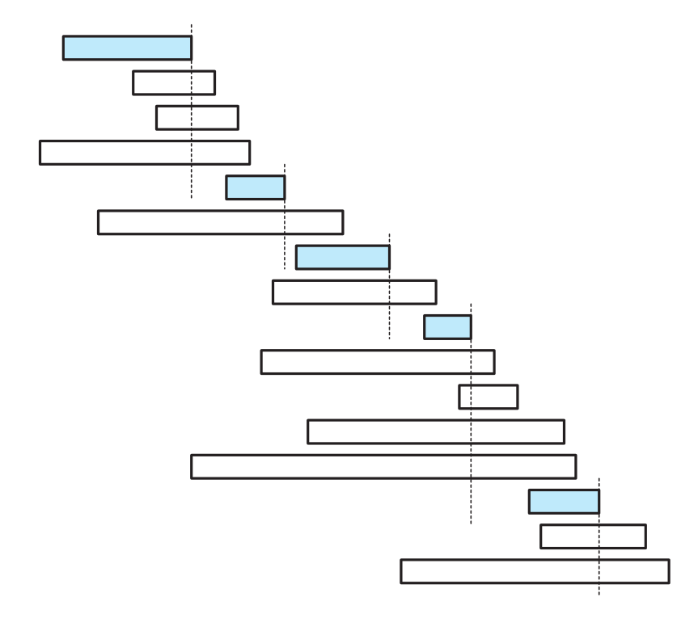
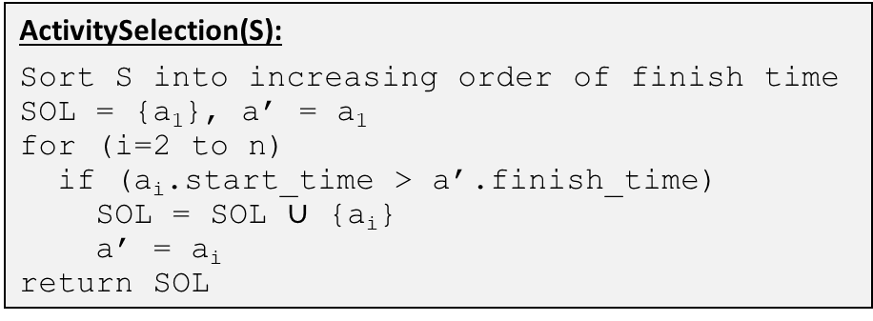
ActivitySelection(S):
Sort S into increasing order of finish time
SOL = {a₁}, a’ = a₁
for (i=2 to n)
if (a_{i}.start_time > a’.finish_time)
SOL = SOL $∪$ {a_{i}}
a’ = a_{i}
return SOL

Slide 8
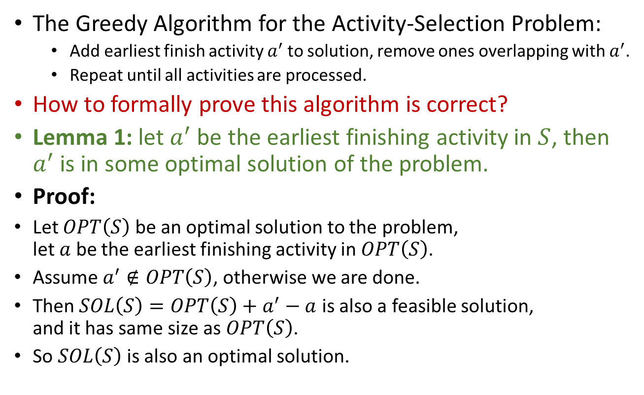
Greedy strategy for the activity-selection problem Correctness
The Greedy Algorithm for the Activity-Selection Problem:
Add earliest finish activity $a^{′}$to solution, remove ones overlapping with $a^{′}$.
Repeat until all activities are processed.
How to formally prove this algorithm is correct?
Lemma 1: let $a^{′}$ be the earliest finishing activity in $S$, then $a^{′}$ is in some optimal solution of the problem.
Proof:
Let $OPT\left(S\right)$ be an optimal solution to the problem, let $a$ be the earliest finishing activity in $OPT\left(S\right)$.
Assume $a^{′}∉OPT\left(S\right)$, otherwise we are done.
Then $SOL\left(S\right)=OPT\left(S\right)+a^{′}−a$ is also a feasible solution, and it has same size as $OPT\left(S\right)$.
So $SOL\left(S\right)$ is also an optimal solution.

Slide 9
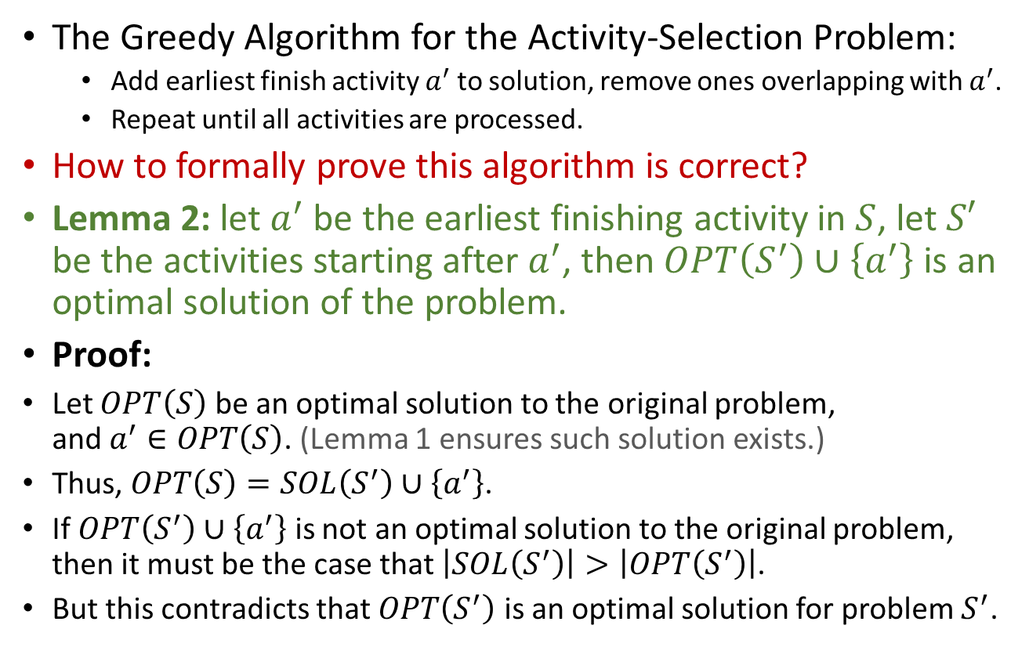
Greedy strategy for the activity-selection problem Correctness
The Greedy Algorithm for the Activity-Selection Problem:
Add earliest finish activity $a^{′}$to solution, remove ones overlapping with $a^{′}$.
Repeat until all activities are processed.
How to formally prove this algorithm is correct?
Lemma 2: let $a^{′}$ be the earliest finishing activity in $S$, let $S′$ be the activities starting after $a^{′}$, then $OPT\left(S^{′}\right)∪\left\{a^{′}\right\}$ is an optimal solution of the problem.
Proof:
Let $OPT\left(S\right)$ be an optimal solution to the original problem, and $a^{′}∈OPT\left(S\right)$. (Lemma 1 ensures such solution exists.)
Thus, $OPT\left(S\right)=SOL\left(S^{′}\right)∪\left\{a^{′}\right\}$.
If $OPT\left(S^{′}\right)∪\left\{a^{′}\right\}$ is not an optimal solution to the original problem, then it must be the case that $\left|SOL\left(S^{′}\right)\right|>\left|OPT\left(S^{′}\right)\right|$.
But this contradicts that $OPT\left(S^{′}\right)$ is an optimal solution for problem $S^{′}$.

Slide 10
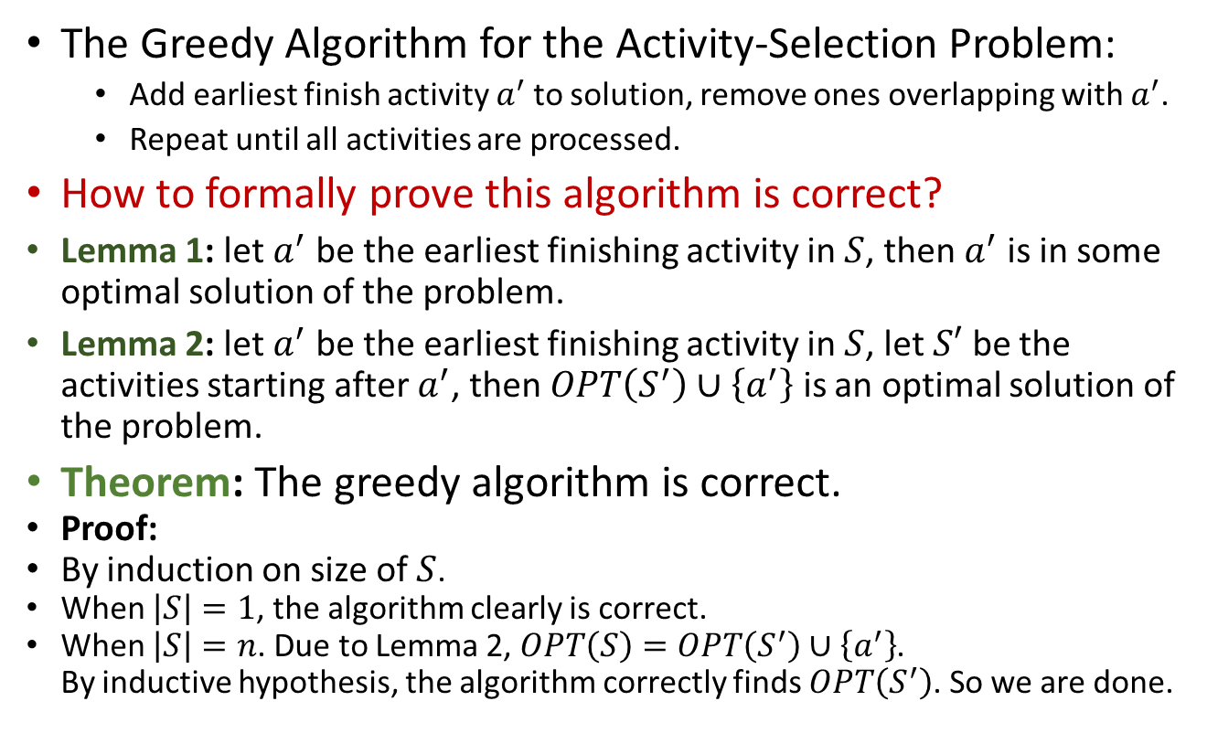
Greedy strategy for the activity-selection problem Correctness
The Greedy Algorithm for the Activity-Selection Problem:
Add earliest finish activity $a^{′}$to solution, remove ones overlapping with $a^{′}$.
Repeat until all activities are processed.
How to formally prove this algorithm is correct?
Lemma 1: let $a^{′}$ be the earliest finishing activity in $S$, then $a^{′}$ is in some optimal solution of the problem.
Lemma 2: let $a^{′}$ be the earliest finishing activity in $S$, let $S′$ be the activities starting after $a^{′}$, then $OPT\left(S^{′}\right)∪\left\{a^{′}\right\}$ is an optimal solution of the problem.
Theorem: The greedy algorithm is correct.
Proof:
By induction on size of $S$.
When $\left|S\right|=1$, the algorithm clearly is correct.
When $\left|S\right|=n$. Due to Lemma 2, $OPT\left(S\right)=OPT\left(S^{′}\right)∪\left\{a^{′}\right\}$. By inductive hypothesis, the algorithm correctly finds $OPT\left(S^{′}\right)$. So we are done.

Slide 11
Elements of the Greedy Strategy
If an (optimization) problem has following two properties, then the greedy strategy usually works for it:
Optimal substructure;
Greedy property.

Slide 12
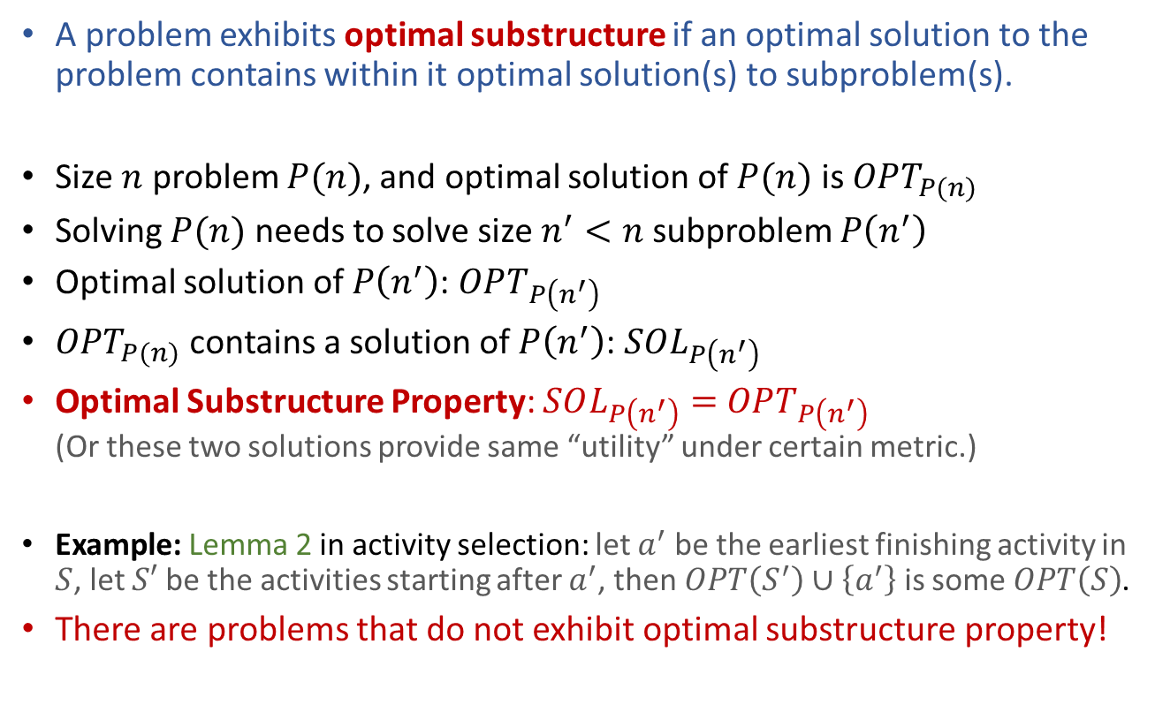
Elements of the Greedy Strategy Optimal Substructure
A problem exhibits optimal substructure if an optimal solution to the problem contains within it optimal solution(s) to subproblem(s).
Size $n$ problem $P(n)$, and optimal solution of $P(n)$ is $OPT_{P(n)}$
Solving $P(n)$ needs to solve size $n^{′}<n$ subproblem $P\left(n^{′}\right)$
Optimal solution of $P\left(n^{′}\right)$: $OPT_{P\left(n^{′}\right)}$
$OPT_{P(n)}$ contains a solution of $P\left(n^{′}\right)$: $SOL_{P\left(n^{′}\right)}$
Optimal Substructure Property: $SOL_{P\left(n^{′}\right)}=$ $OPT_{P\left(n^{′}\right)}$ (Or these two solutions provide same “utility” under certain metric.)
Example: Lemma 2 in activity selection: let $a^{′}$ be the earliest finishing activity in $S$, let $S′$ be the activities starting after $a^{′}$, then $OPT\left(S^{′}\right)∪\left\{a^{′}\right\}$ is some $OPT\left(S\right)$.
There are problems that do not exhibit optimal substructure property!

Slide 13
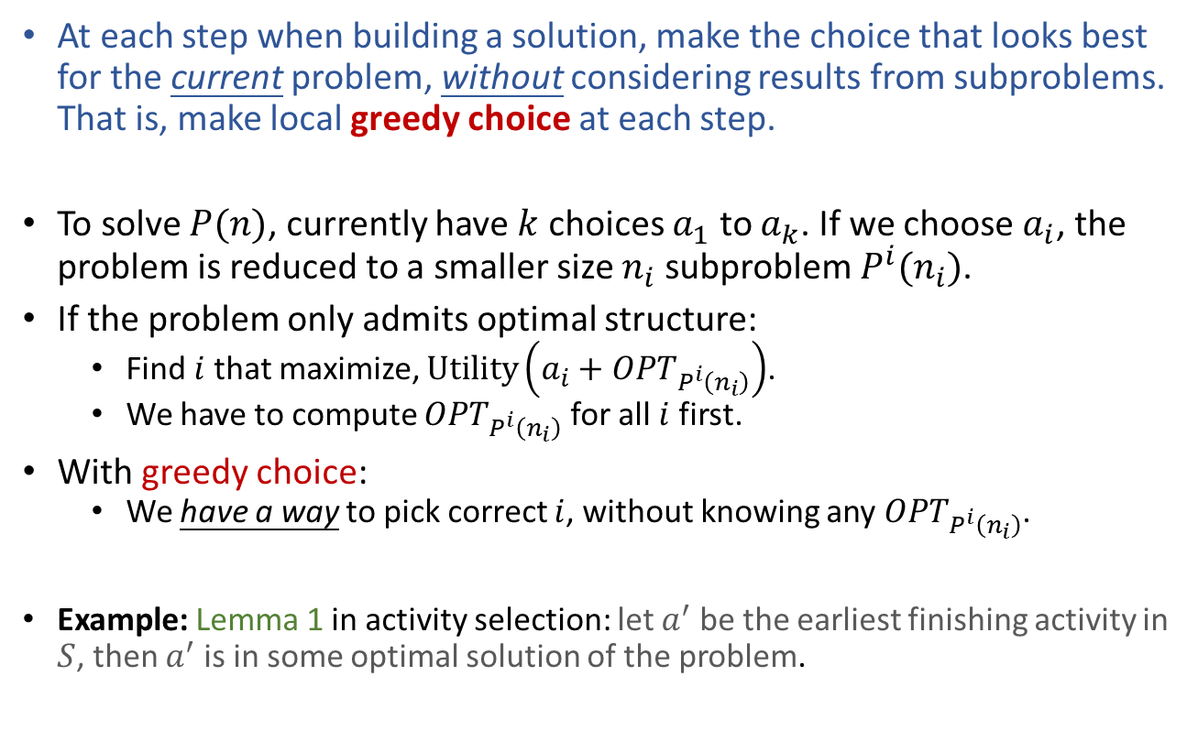
Elements of the Greedy Strategy Greedy-Choice Property
At each step when building a solution, make the choice that looks best for the current problem, without considering results from subproblems. That is, make local greedy choice at each step.
To solve $P(n)$, currently have $k$ choices $a_{1}$ to $a_{k}$. If we choose $a_{i}$, the problem is reduced to a smaller size $n_{i}$ subproblem $P^{i}(n_{i})$.
If the problem only admits optimal structure:
Find $i$ that maximize, $\text{Utility}\left(a_{i}+OPT_{P^{i}\left(n_{i}\right)}\right)$.
We have to compute $OPT_{P^{i}\left(n_{i}\right)}$ for all $i$ first.
With greedy choice:
We have a way to pick correct $i$, without knowing any $OPT_{P^{i}\left(n_{i}\right)}$.
Example: Lemma 1 in activity selection: let $a^{′}$ be the earliest finishing activity in $S$, then $a^{′}$ is in some optimal solution of the problem.
Identifying a greedy-choice property is the challenging part!

Slide 14
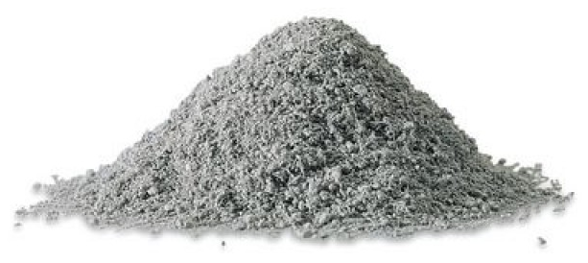

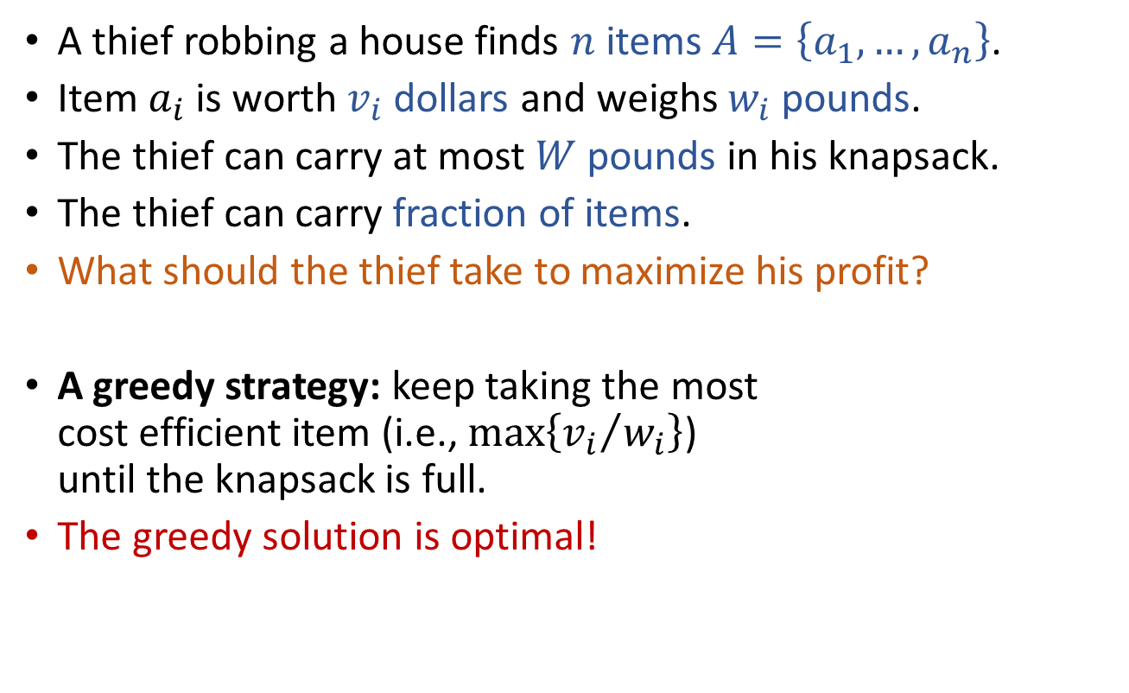
Fractional Knapsack Problem
A thief robbing a house finds $n$ items $A=\left\{a_{1},…,a_{n}\right\}$.
Item $a_{i}$ is worth $v_{i}$ dollars and weighs $w_{i}$ pounds.
The thief can carry at most $W$ pounds in his knapsack.
The thief can carry fraction of items.
What should the thief take to maximize his profit?
A greedy strategy: keep taking the most cost efficient item (i.e., $\max\left\{{v_{i}}/{w_{i}}\right\}$) until the knapsack is full.
The greedy solution is optimal!

Slide 15
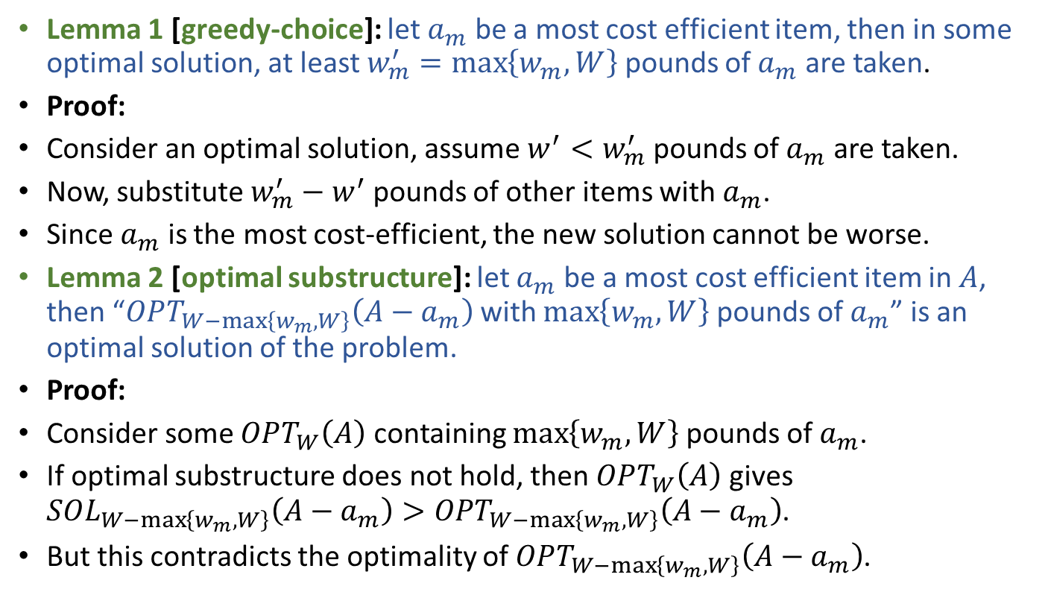
Fractional Knapsack Problem Correctness of the greedy algorithm
Lemma 1 [greedy-choice]: let $a_{m}$ be a most cost efficient item, then in some optimal solution, at least $w_{m}^{′}=\max\left\{w_{m},W\right\}$ pounds of $a_{m}$ are taken.
Proof:
Consider an optimal solution, assume $w^{′}<w_{m}^{′}$ pounds of $a_{m}$ are taken.
Now, substitute $w_{m}^{′}−w^{′}$ pounds of other items with $a_{m}$.
Since $a_{m}$ is the most cost-efficient, the new solution cannot be worse.
Lemma 2 [optimal substructure]: let $a_{m}$ be a most cost efficient item in $A$, then “$OPT_{W−\max\left\{w_{m},W\right\}}\left(A−a_{m}\right)$ with $\max\left\{w_{m},W\right\}$ pounds of $a_{m}$” is an optimal solution of the problem.
Proof:
Consider some $OPT_{W}\left(A\right)$ containing $\max\left\{w_{m},W\right\}$ pounds of $a_{m}$.
If optimal substructure does not hold, then $OPT_{W}\left(A\right)$ gives $SOL_{W−\max\left\{w_{m},W\right\}}\left(A−a_{m}\right)>OPT_{W−\max\left\{w_{m},W\right\}}\left(A−a_{m}\right)$.
But this contradicts the optimality of $OPT_{W−\max\left\{w_{m},W\right\}}\left(A−a_{m}\right)$.

Slide 16

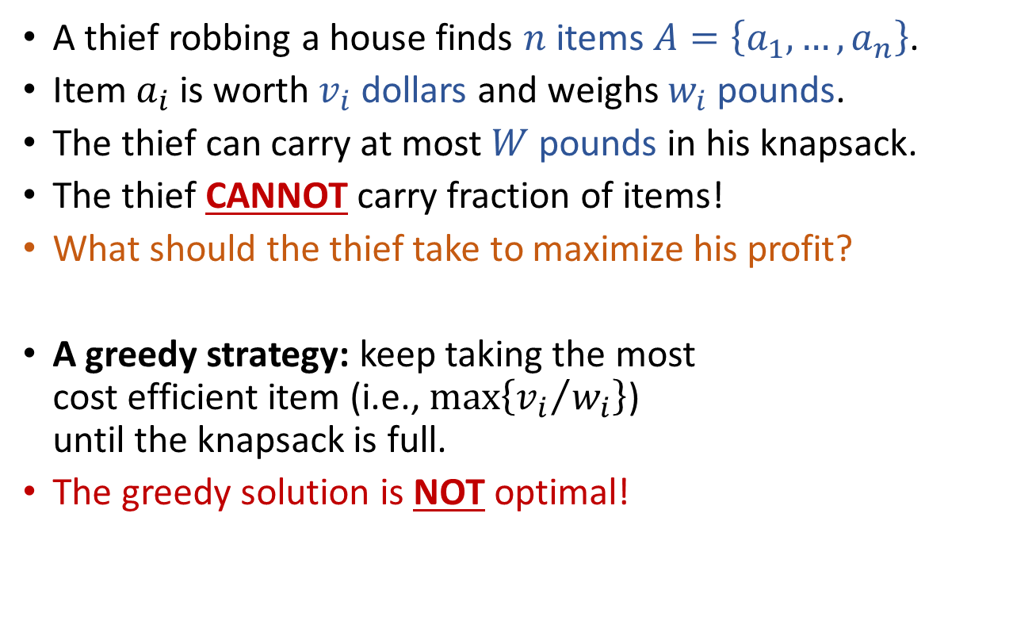
0-1 Knapsack Problem
A thief robbing a house finds $n$ items $A=\left\{a_{1},…,a_{n}\right\}$.
Item $a_{i}$ is worth $v_{i}$ dollars and weighs $w_{i}$ pounds.
The thief can carry at most $W$ pounds in his knapsack.
The thief CANNOT carry fraction of items!
What should the thief take to maximize his profit?
A greedy strategy: keep taking the most cost efficient item (i.e., $\max\left\{{v_{i}}/{w_{i}}\right\}$) until the knapsack is full.
The greedy solution is NOT optimal!

Slide 17
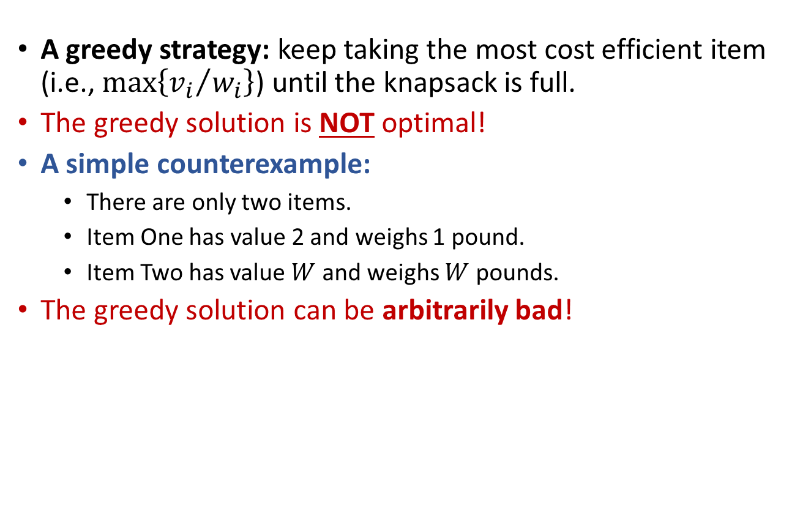
0-1 Knapsack Problem
A greedy strategy: keep taking the most cost efficient item (i.e., $\max\left\{{v_{i}}/{w_{i}}\right\}$) until the knapsack is full.
The greedy solution is NOT optimal!
A simple counterexample:
There are only two items.
Item One has value 2 and weighs 1 pound.
Item Two has value $W$ and weighs $W$ pounds.
The greedy solution can be arbitrarily bad!

Slide 18
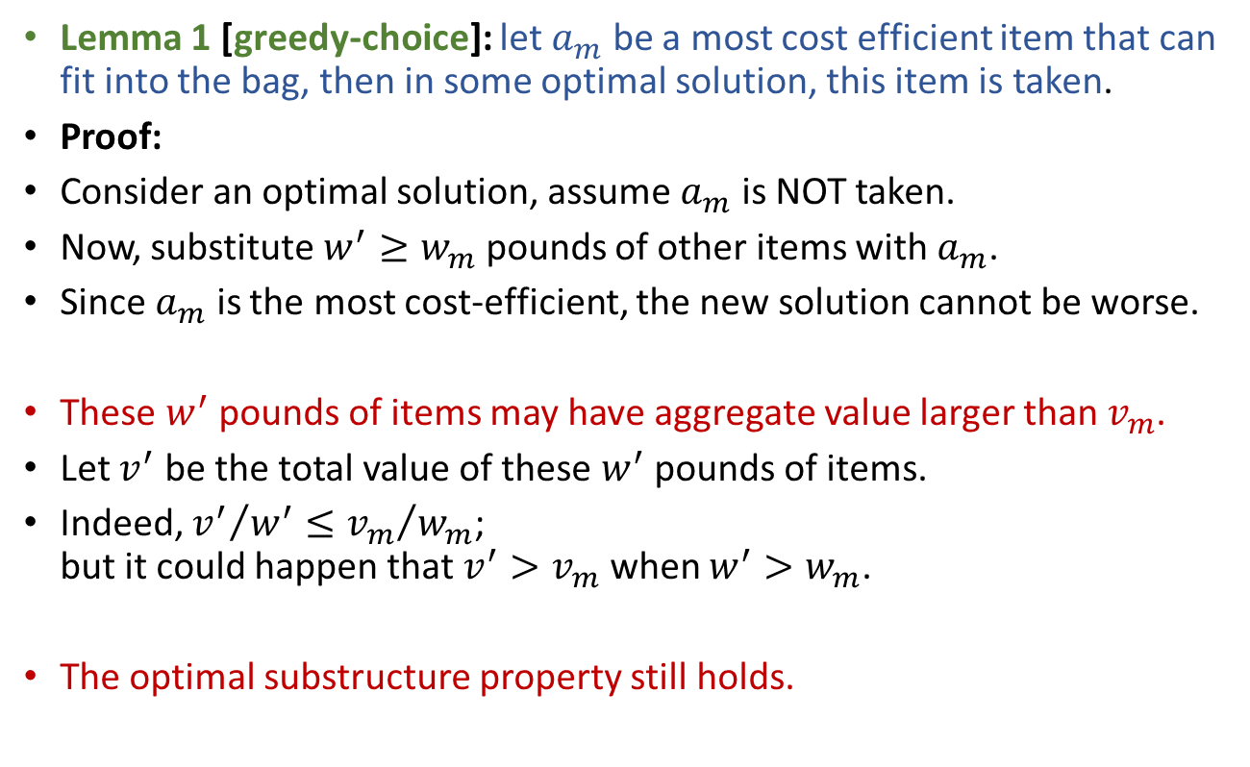
0-1 Knapsack Problem Why greedy strategy fail?
Lemma 1 [greedy-choice]: let $a_{m}$ be a most cost efficient item that can fit into the bag, then in some optimal solution, this item is taken.
Proof:
Consider an optimal solution, assume $a_{m}$ is NOT taken.
Now, substitute $w^{′}≥w_{m}$ pounds of other items with $a_{m}$.
Since $a_{m}$ is the most cost-efficient, the new solution cannot be worse.
These $w^{′}$ pounds of items may have aggregate value larger than $v_{m}$.
Let $v^{′}$ be the total value of these $w^{′}$ pounds of items.
Indeed, ${v^{′}}/{w^{′}}≤{v_{m}}/{w_{m}}$; but it could happen that $v^{′}>v_{m}$ when $w^{′}>w_{m}$.
The optimal substructure property still holds.

Slide 19

A data compression problem
Assume we have a data file containing 100k characters.
Further assume the file only uses 6 characters. (Huh?!)
How to store this file to save space?
Simplest way: use 3 bits to encode each char.
a=000,b=001,…,f=101
This costs 300k bits in total.
Can we do better?

Slide 20
A data compression problem
Assume we have a data file containing 100k characters.
Further assume the file only uses 6 characters. (Huh?!)
How to store this file to save space?
Instead of using fixed-length codeword for each char, we should let frequent chars use shorter codewords. That is, use a variable-length code.
 | a | b | c | d | e | f
Frequency | 45k | 13k | 12k | 16k | 9k | 5k
Fixed-length Code | 000 | 001 | 010 | 011 | 100 | 101
Var-length Code | 0 | 00 | 01 | 1 | 10 | 11
How to decode bit string 000?

Slide 21
A data compression problem
Assume we have a data file containing 100k characters.
Further assume the file only uses 6 characters. (Huh?!)
How to store this file to save space?
Instead of using fixed-length codeword for each char, we should let frequent chars use shorter codewords. That is, use a variable-length code.
To avoid ambiguity in decoding, variable-length code should be prefix-free: no codeword is also a prefix of some other codeword.

Slide 22
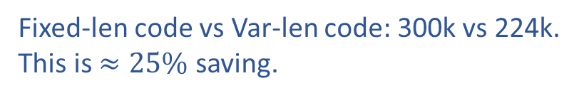
A data compression problem
Assume we have a data file containing 100k characters.
Further assume the file only uses 6 characters. (Huh?!)
How to store this file to save space?
Use (prefix-free) variable-length code.
 | a | b | c | d | e | f
Frequency | 45k | 13k | 12k | 16k | 9k | 5k
Fixed-length Code | 000 | 001 | 010 | 011 | 100 | 101
Var-length Code | 0 | 101 | 100 | 111 | 1101 | 1100
Fixed-len code vs Var-len code: 300k vs 224k.
This is $≈25\%$ saving.
Given data file, how to generate optimal code?

Slide 23
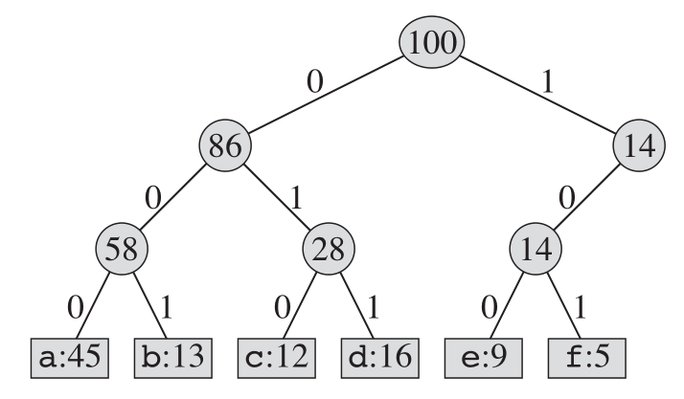
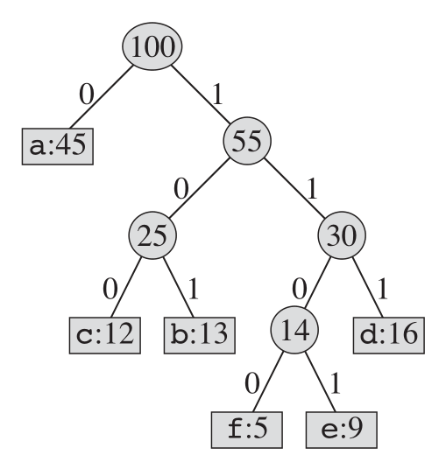
Properties of prefix-free code
Use a binary tree to visualize a prefix-free code.
Each leaf denotes a char.
Each internal node: left branch is 0, right branch is 1.
Path from root to leaf is the codeword of that char.
Optimal code must be represented by a full binary tree: a tree each node having zero or two children. (WHY?)
 | a | b | c | d | e | f
Frequency | 45k | 13k | 12k | 16k | 9k | 5k
Fixed-length Code | 000 | 001 | 010 | 011 | 100 | 101
Var-length Code | 0 | 101 | 100 | 111 | 1101 | 1100

Slide 24
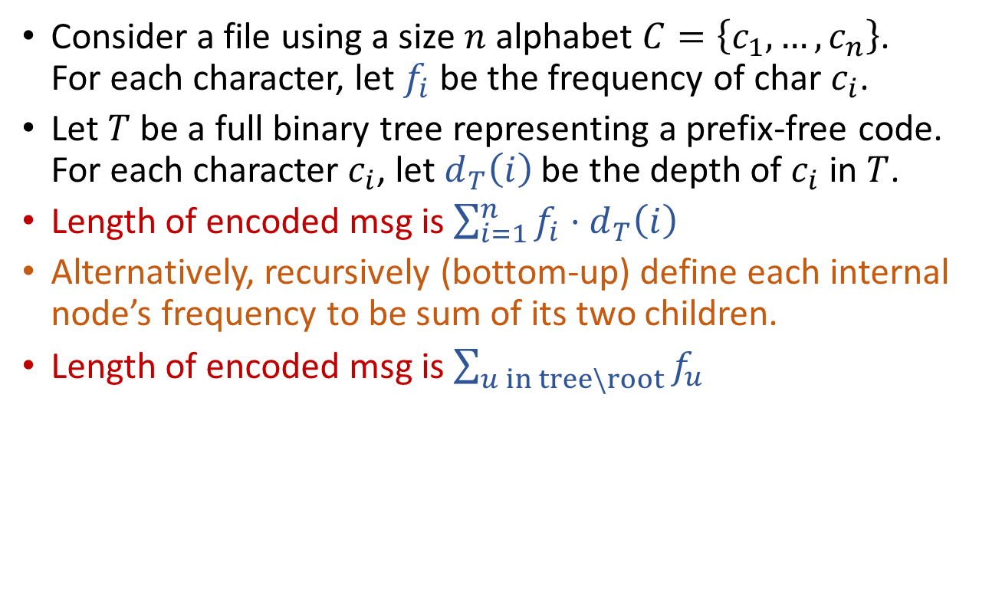
Length of encoded message
Consider a file using a size $n$ alphabet $C=\left\{c_{1},…,c_{n}\right\}$. For each character, let $f_{i}$ be the frequency of char $c_{i}$.
Let $T$ be a full binary tree representing a prefix-free code. For each character $c_{i}$, let $d_{T}\left(i\right)$ be the depth of $c_{i}$ in $T$.
Length of encoded msg is $\sum_{i=1}^{n}{f_{i}⋅d_{T}\left(i\right)}$
Alternatively, recursively (bottom-up) define each internal node’s frequency to be sum of its two children.
Length of encoded msg is $\sum_{u in tree\backslash root}{f_{u}}$
 | a | b | c | d | e | f
Frequency | 45k | 13k | 12k | 16k | 9k | 5k
Fixed-length Code | 000 | 001 | 010 | 011 | 100 | 101
Var-length Code | 0 | 101 | 100 | 111 | 1101 | 1100

Slide 25
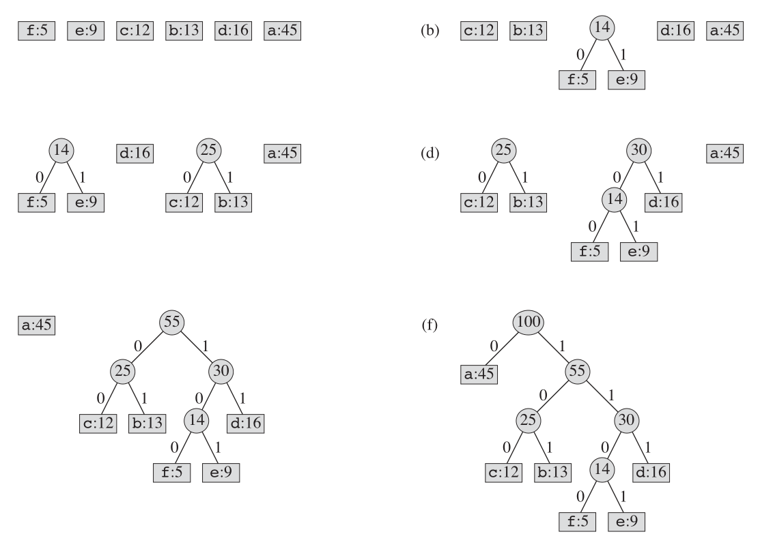

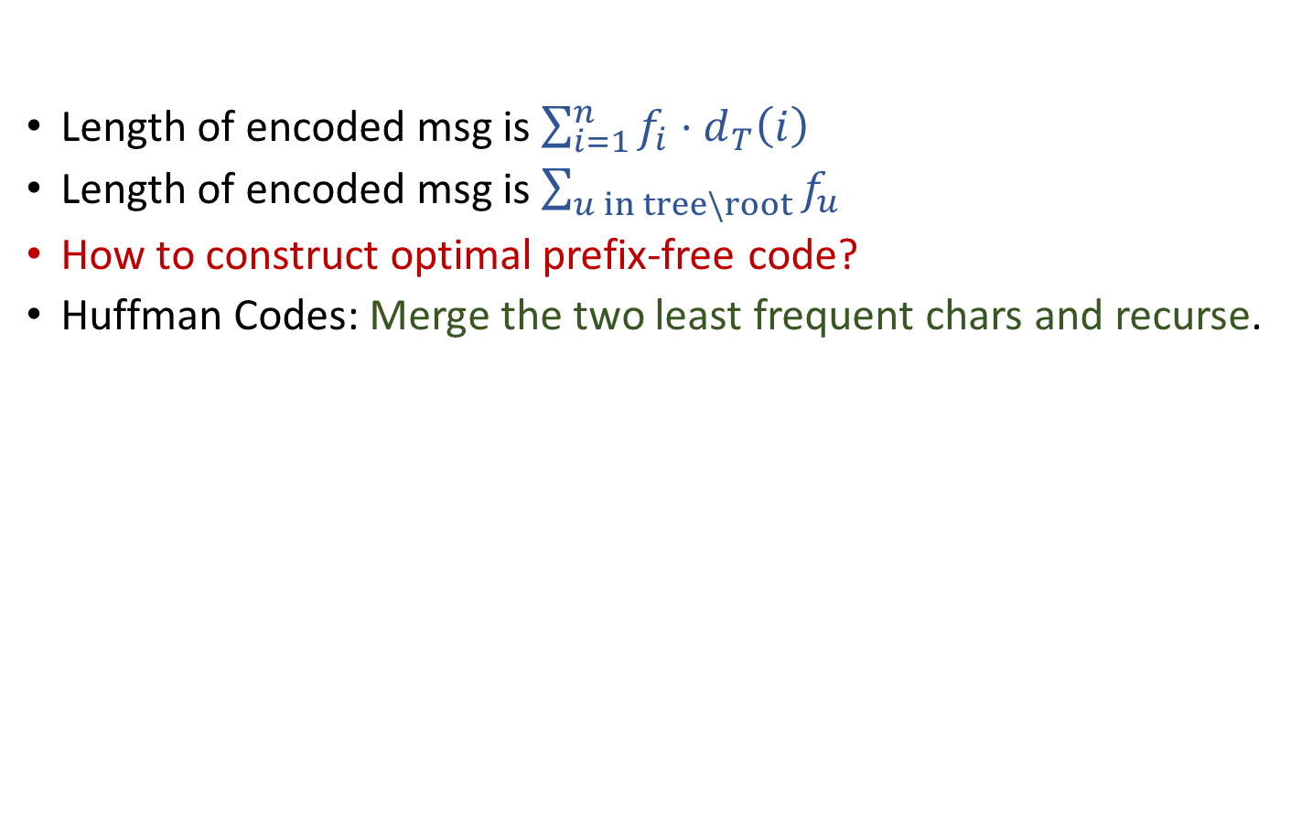
Huffman Codes
Length of encoded msg is $\sum_{i=1}^{n}{f_{i}⋅d_{T}\left(i\right)}$
Length of encoded msg is $\sum_{u in tree\backslash root}{f_{u}}$
How to construct optimal prefix-free code?
Huffman Codes: Merge the two least frequent chars and recurse.
Time complexity is $O\left(n\log{n}\right)$
Huffman(C):
Build a priority queue Q based on frequency
for (i=1 to n-1)
Allocate new node z
x = z.left = Q.ExtractMin()
y = z.right = Q.ExtractMin()
z.frequency = x.frequency + y.frequency
Q.Insert(z)
return Q.ExtractMin()

Slide 26
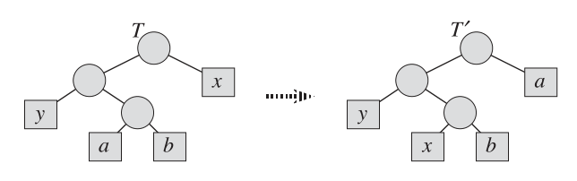
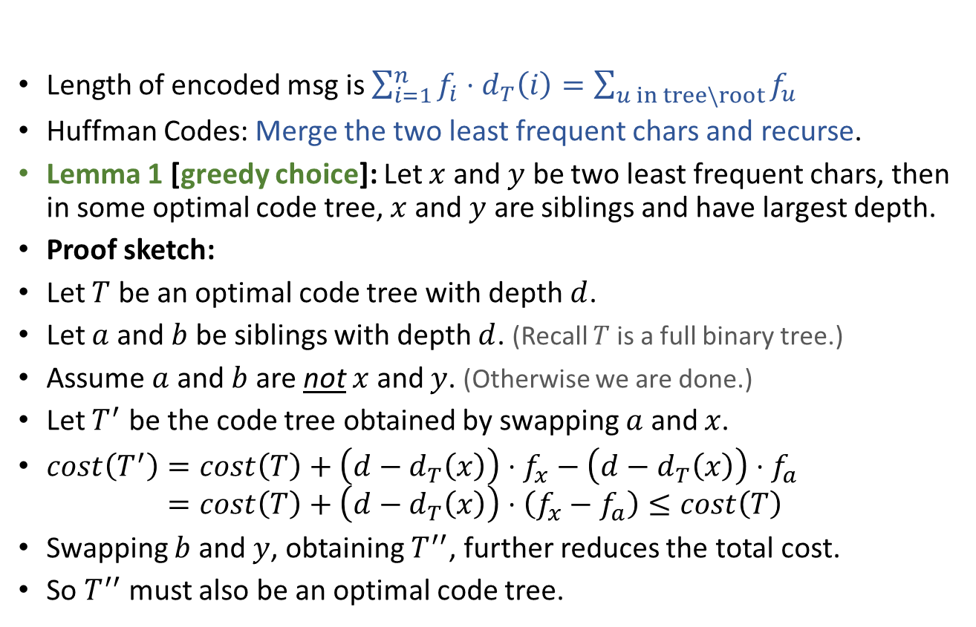
Huffman Codes Correctness
Length of encoded msg is $\sum_{i=1}^{n}{f_{i}⋅d_{T}\left(i\right)=\sum_{u in tree\backslash root}{f_{u}}}$
Huffman Codes: Merge the two least frequent chars and recurse.
Lemma 1 [greedy choice]: Let $x$ and $y$ be two least frequent chars, then in some optimal code tree, $x$ and $y$ are siblings and have largest depth.
Proof sketch:
Let $T$ be an optimal code tree with depth $d$.
Let $a$ and $b$ be siblings with depth $d$. (Recall $T$ is a full binary tree.)
Assume $a$ and $b$ are not $x$ and $y$. (Otherwise we are done.)
Let $T^{′}$ be the code tree obtained by swapping $a$ and $x$.
$cost\left(T^{′}\right)=cost\left(T\right)+\left(d−d_{T}\left(x\right)\right)⋅f_{x}−\left(d−d_{T}\left(x\right)\right)⋅f_{a}$ $cost\left(T^{′}\right)=cost\left(T\right)+\left(d−d_{T}\left(x\right)\right)⋅\left(f_{x}−f_{a}\right)≤cost\left(T\right)$
Swapping $b$ and $y$, obtaining $T^{′′}$, further reduces the total cost.
So $T^{′′}$ must also be an optimal code tree.

Slide 27
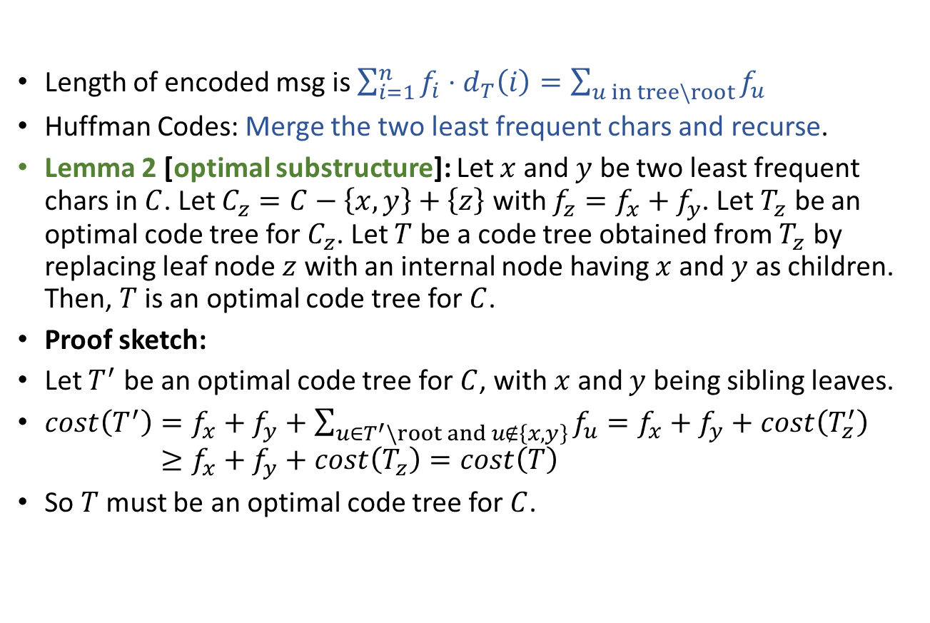
Huffman Codes Correctness
Length of encoded msg is $\sum_{i=1}^{n}{f_{i}⋅d_{T}\left(i\right)}=\sum_{u in tree\backslash root}{f_{u}}$
Huffman Codes: Merge the two least frequent chars and recurse.
Lemma 2 [optimal substructure]: Let $x$ and $y$ be two least frequent chars in $C$. Let $C_{z}=C−\left\{x,y\right\}+\left\{z\right\}$ with $f_{z}=f_{x}+f_{y}$. Let $T_{z}$ be an optimal code tree for $C_{z}$. Let $T$ be a code tree obtained from $T_{z}$ by replacing leaf node $z$ with an internal node having $x$ and $y$ as children. Then, $T$ is an optimal code tree for $C$.
Proof sketch:
Let $T^{′}$ be an optimal code tree for $C$, with $x$ and $y$ being sibling leaves.
$cost\left(T^{′}\right)=f_{x}+f_{y}+\sum_{u∈T^{′}\backslash root and u∉\left\{x,y\right\}}{f_{u}}=f_{x}+f_{y}+cost\left(T_{z}^{′}\right)$ $cost\left(T^{′}\right)≥f_{x}+f_{y}+cost\left(T_{z}\right)=cost\left(T\right)$
So $T$ must be an optimal code tree for $C$.

Slide 28
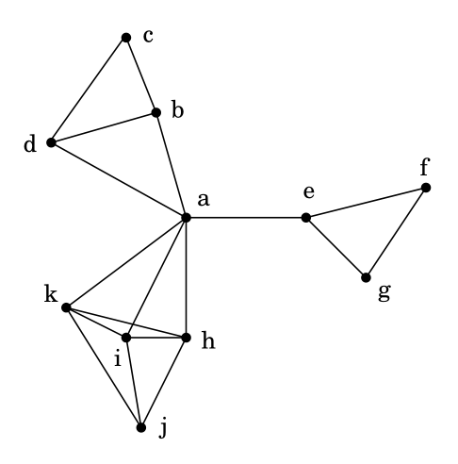
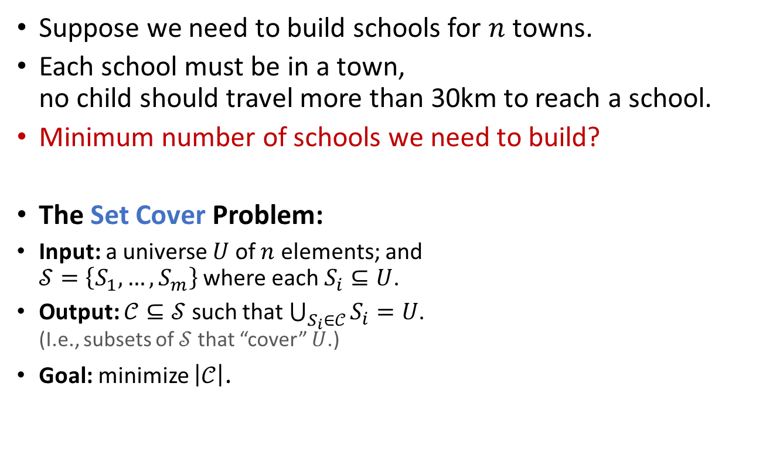
Set Cover
Suppose we need to build schools for $n$ towns.
Each school must be in a town, no child should travel more than 30km to reach a school.
Minimum number of schools we need to build?
The Set Cover Problem:
Input: a universe $U$ of $n$ elements; and $𝒮=\left\{S_{1},…,S_{m}\right\}$ where each $S_{i}⊆U$.
Output: $𝒞⊆𝒮$ such that $\bigcup_{S_{i}∈𝒞}{S_{i}}=U$. (I.e., subsets of $𝒮$ that “cover” $U$.)
Goal: minimize $\left|𝒞\right|$.

Slide 29
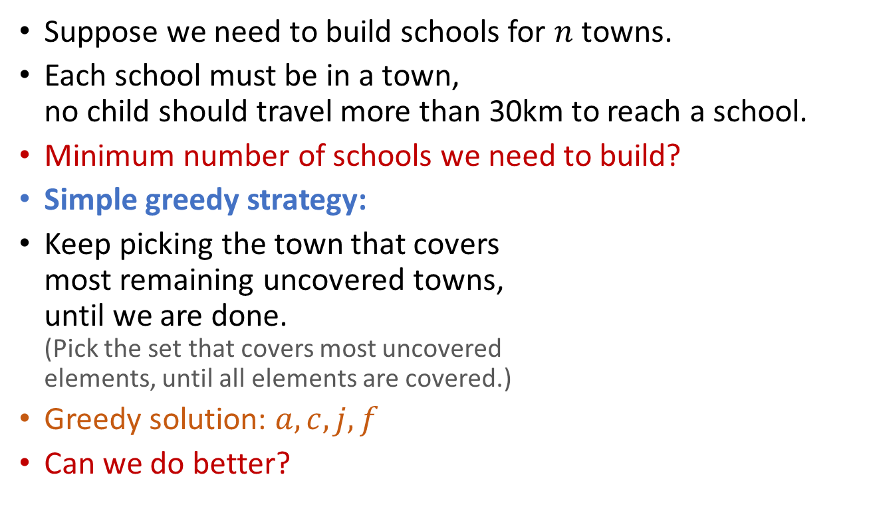
Set Cover
Suppose we need to build schools for $n$ towns.
Each school must be in a town, no child should travel more than 30km to reach a school.
Minimum number of schools we need to build?
Simple greedy strategy:
Keep picking the town that covers most remaining uncovered towns, until we are done. (Pick the set that covers most uncovered elements, until all elements are covered.)
Greedy solution: $a,c,j,f$
Can we do better?

Slide 30

Set Cover
Suppose we need to build schools for $n$ towns.
Each school must be in a town, no child should travel more than 30km to reach a school.
Minimum number of schools we need to build?
Simple greedy strategy:
Keep picking the town that covers most remaining uncovered towns, until we are done. (Pick the set that covers most uncovered elements, until all elements are covered.)
Greedy solution: $a,c,j,f$
Optimal solution: $b,e,i$

Slide 31

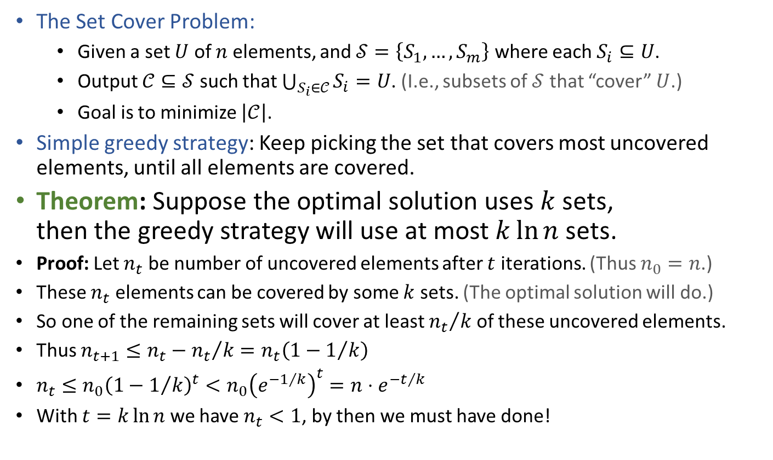
Set Cover Greedy solution is close to optimal
The Set Cover Problem:
Given a set $U$ of $n$ elements, and $𝒮=\left\{S_{1},…,S_{m}\right\}$ where each $S_{i}⊆U$.
Output $𝒞⊆𝒮$ such that $\bigcup_{S_{i}∈𝒞}{S_{i}}=U$. (I.e., subsets of $𝒮$ that “cover” $U$.)
Goal is to minimize $\left|𝒞\right|$.
Simple greedy strategy: Keep picking the set that covers most uncovered elements, until all elements are covered.
Theorem: Suppose the optimal solution uses $k$ sets, then the greedy strategy will use at most $k\ln{n}$ sets.
Proof: Let $n_{t}$ be number of uncovered elements after $t$ iterations. (Thus $n_{0}=n$.)
These $n_{t}$ elements can be covered by some $k$ sets. (The optimal solution will do.)
So one of the remaining sets will cover at least ${n_{t}}/k$ of these uncovered elements.
Thus $n_{t+1}≤n_{t}−{n_{t}}/k=n_{t}\left(1−1/k\right)$
$n_{t}≤n_{0}{\left(1−1/k\right)}^{t}<n_{0}{\left(e^{−1/k}\right)}^{t}=n⋅e^{−t/k}$
With $t=k\ln{n}$ we have $n_{t}<1$, by then we must have done!
$1−x<e^{−x}$ when $x≠0$

Slide 32
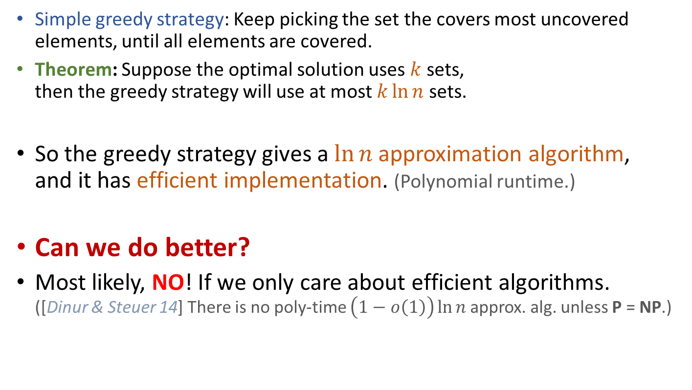
Set Cover Greedy solution is close to optimal
Simple greedy strategy: Keep picking the set the covers most uncovered elements, until all elements are covered.
Theorem: Suppose the optimal solution uses $k$ sets, then the greedy strategy will use at most $k\ln{n}$ sets.
So the greedy strategy gives a $\ln{n}$ approximation algorithm, and it has efficient implementation. (Polynomial runtime.)
Can we do better?
Most likely, NO! If we only care about efficient algorithms. ([Dinur & Steuer 14] There is no poly-time $\left(1−o\left(1\right)\right)\ln{n}$approx. alg. unless P = NP.)

Slide 33
Summary
Basic idea of greedy strategy: At each step when building a solution, make the choice that looks best at that moment, based on some metric.
Properties that make greedy strategy work:
Optimal substructure [usually easy to prove]: optimal solution to the problem contains within it optimal solution(s) to subproblem(s).
Greedy choice [could be hard to identify and prove]: the greedy choice is contained within some optimal solution.
Greed gives optimal solutions: MST, Huffman codes, …
Greed gives near-optimal solutions: Set cover, …
Greed gives arbitrarily bad solutions: 0-1 knapsack, …

Slide 34

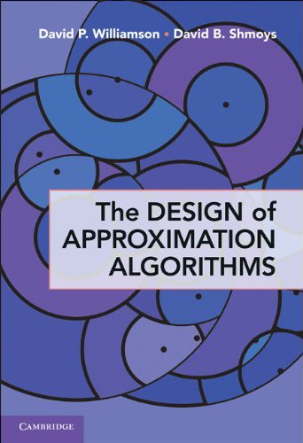
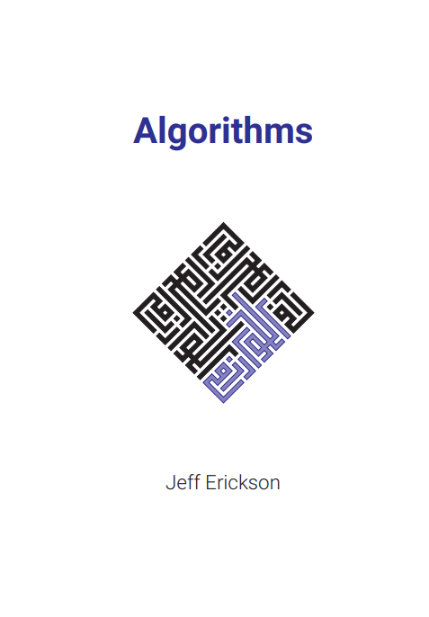
Reading
[CLRS] Ch.16 (16.1-16.3)
Optional reading:
Ch.35 (35.3) of [CLRS] discusses the set cover problem.
[Vazirani] and [Williamson & Shmoys] are two standard textbooks on approximation algorithms. Both of them introduce several hard problems that have efficient approximation algorithms using the greedy strategy.
Greedy strategy can also be used to solve non-optimization problems, such as the “stable matching” problem. See [Erickson v1] Ch.4 (4.5).

