Slide 1
NP Completeness
Data Structures and Algorithms
Nanjing University, Fall 2020
郑朝栋

Slide 2

Quick review of P and NP
P contains decision problems that are efficiently solvable.
NP contains decision problems that are efficiently verifiable.
$P⊆NP$, but we don’t know whether $P=NP$ or $P≠NP$.
Most people believe $P≠NP$.
decidable
NP
P

Slide 3
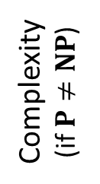

The hardest among the hard ones
NP-Complete (NPC) problems are the hardest ones in NP.
A decision problem $𝒫$ is NPC if:
The problem $𝒫$ is in NP.
If we have an algorithm for $𝒫$, then all problems in NP can be solved with limited extra work.
NP
NPC
Complexity
(if $P≠NP$)
P

Slide 4









Reduction
If we have an algorithm for $𝒫$, and can convert an instance of $𝒬$ to an instance of $𝒫$, then we effectively have an algorithm for $𝒬$ already!
Example: shortest distances in unit-length graphs via BFS
Algorithm for $𝒬$
$$T$$
$$y=T(x)$$
Algorithm for $𝒫$
$$T′$$
$$x$$
(input for $𝒬$)
answer for $𝒬(x)$
(input for $𝒫$)

Slide 5









Polynomial Reduction
Define function $T$: input of decision problem $𝒬$ $→$ input of decision problem $𝒫$.
$T$ is a polynomial reduction from $𝒬$ to $𝒫$ if:
$T$ can be computed within polynomial time (w.r.t. input length).
Input $x$ is a “yes” input for $𝒬$ iff $T(x)$ is a “yes” input for $𝒫$.
$𝒬$ is polynomially reducible to $𝒫$: $𝒬≤_{P}𝒫$.
$𝒫$ is at least as hard as $𝒬$.
Algorithm for $𝒬$
$$T$$
$$y=T(x)$$
Algorithm for $𝒫$
$$x$$
(input for $𝒬$)
answer for $𝒬(x)$
(input for $𝒫$)
no
no
yes
yes
$$T$$
$$𝒬$$
$$𝒫$$

Slide 6
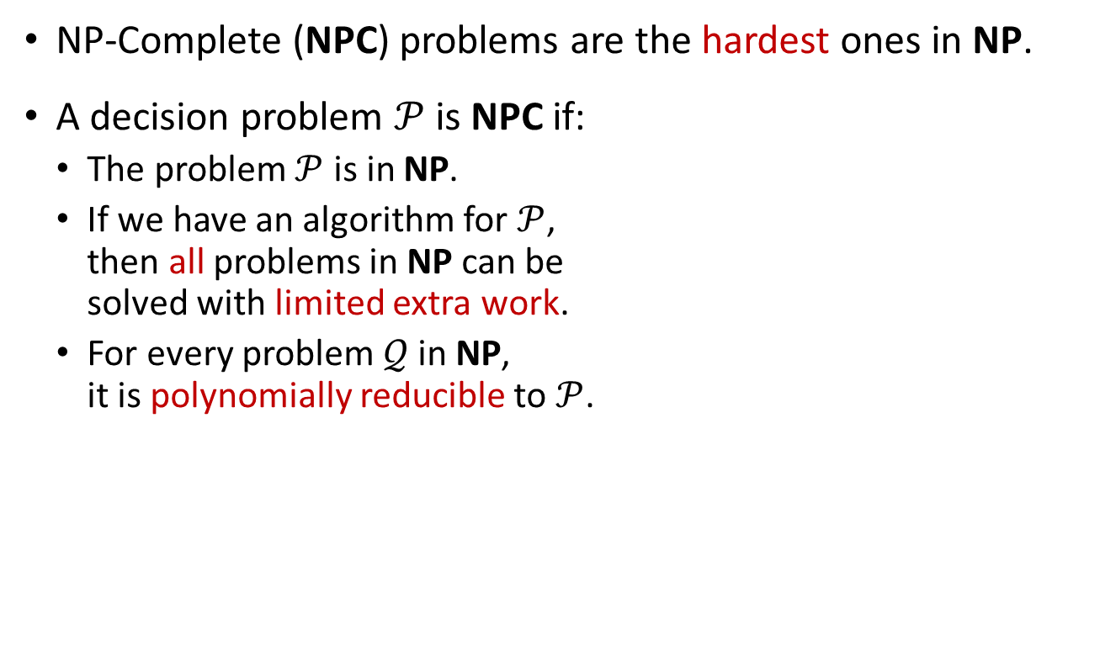
The hardest among the hard ones
NP-Complete (NPC) problems are the hardest ones in NP.
A decision problem $𝒫$ is NPC if:
The problem $𝒫$ is in NP.
If we have an algorithm for $𝒫$, then all problems in NP can be solved with limited extra work.
For every problem $𝒬$ in NP, it is polynomially reducible to $𝒫$.
NP
NPC
Complexity
(if $P≠NP$)
P

Slide 7
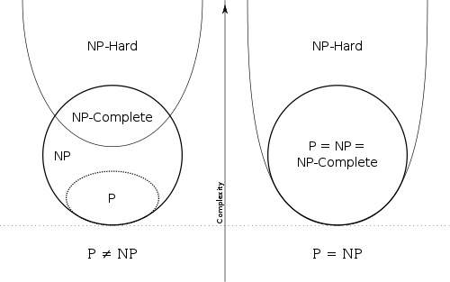

NPC and NP-hard
A decision problem $𝒫$ is NP-hard if:
For every problem $𝒬$ in NP, it is polynomially reducible to $𝒫$.
NP-hard problems are the ones that are “at least as hard as the hardest problems in NP”.
A decision problem $𝒫$ is NPC if it is both NP and NP-hard.

Slide 8
How to prove a decision problem is NPC?
?!
Show the problem is in NP.
Show every $𝒬∈NP$ is polynomially reducible to the problem.

Slide 9
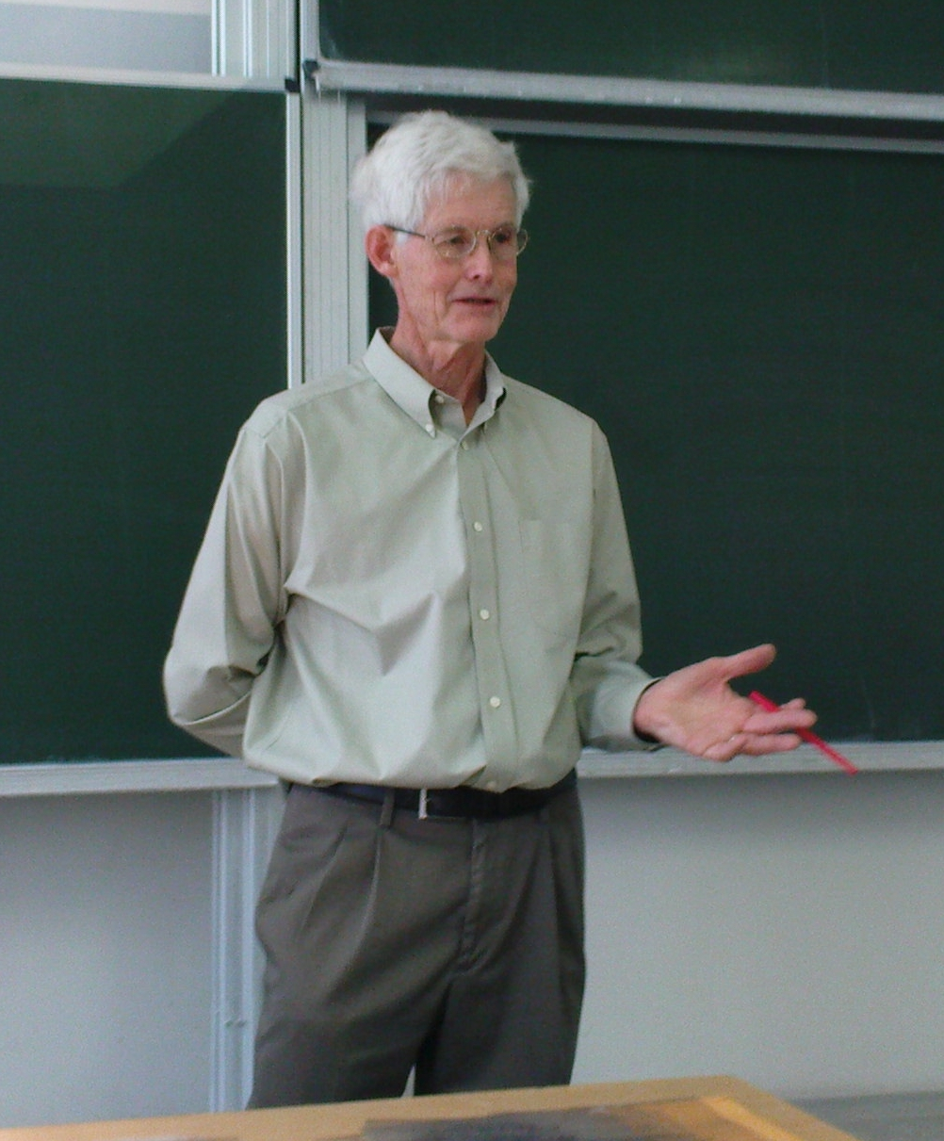
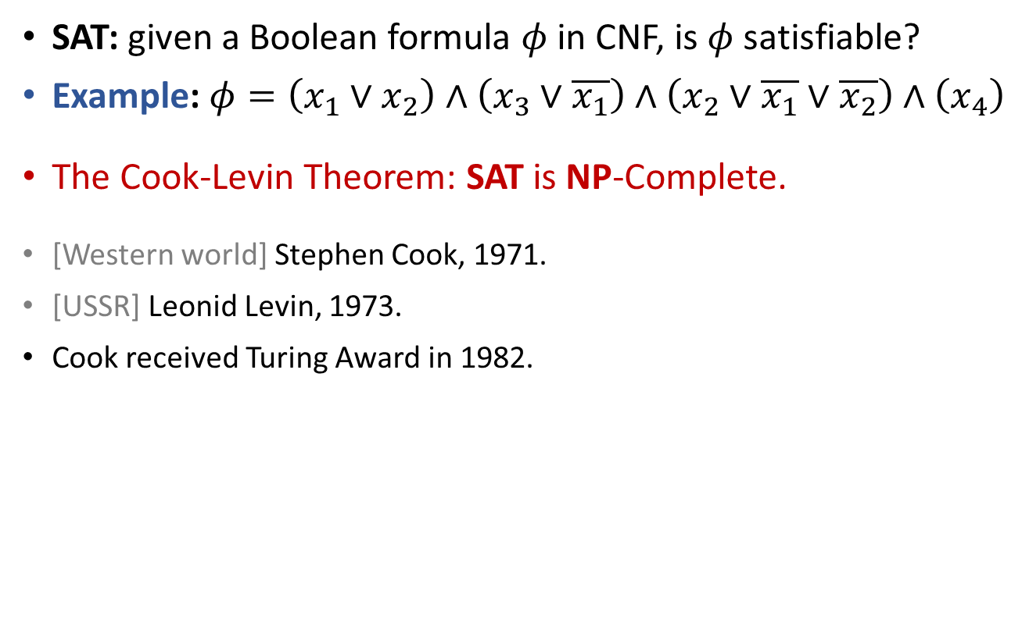
SAT: the First NPC Problem
SAT: given a Boolean formula $φ$ in CNF, is $φ$ satisfiable?
Example: $φ=\left(x_{1}∨x_{2}\right)∧\left(x_{3}∨\overline{x_{1}}\right)∧\left(x_{2}∨\overline{x_{1}}∨\overline{x_{2}}\right)∧\left(x_{4}\right)$
The Cook-Levin Theorem: SAT is NP-Complete.
[Western world] Stephen Cook, 1971.
[USSR] Leonid Levin, 1973.
Cook received Turing Award in 1982.
“Dr. Cook has advanced our understanding of the complexity of computation in a significant and profound way.”

Slide 10
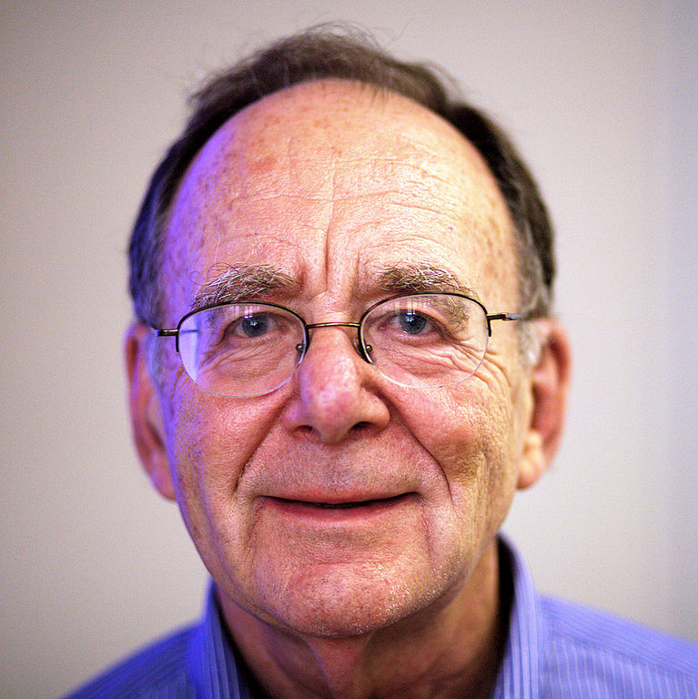
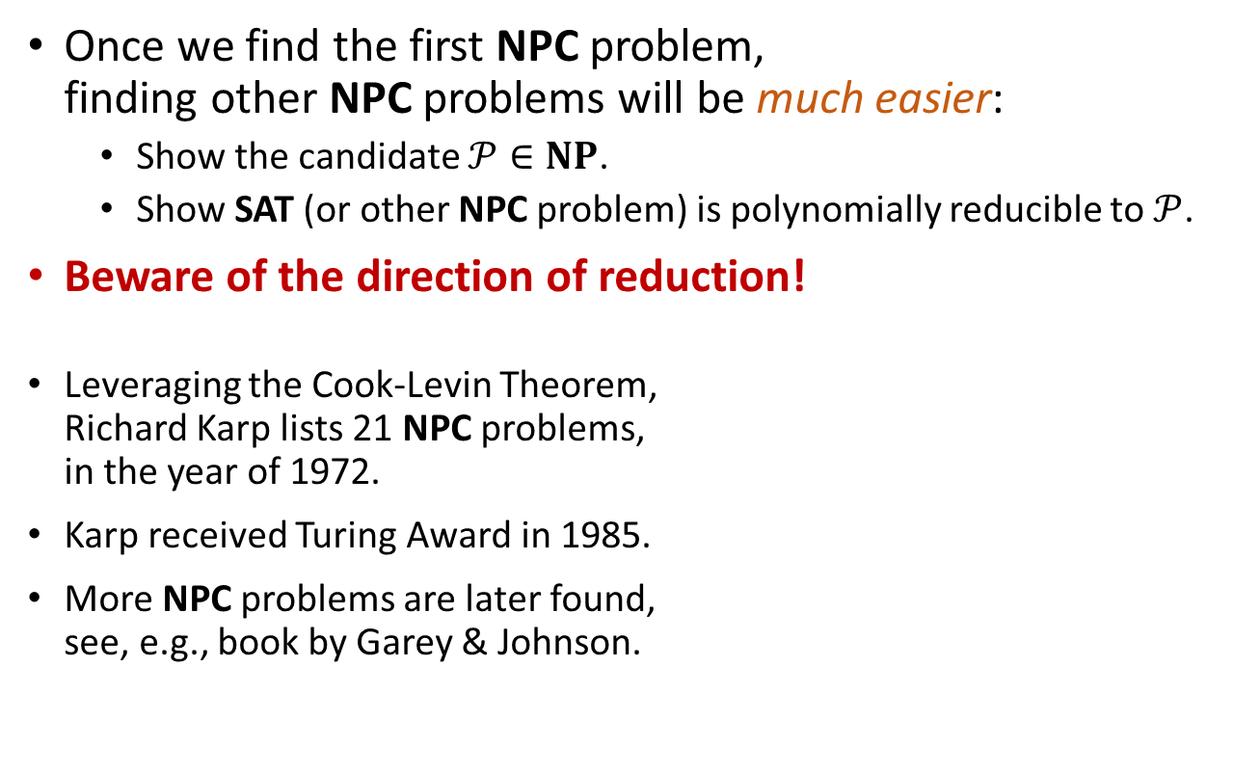
And it all starts here…
Once we find the first NPC problem, finding other NPC problems will be much easier:
Show the candidate $𝒫∈NP$.
Show SAT (or other NPC problem) is polynomially reducible to $𝒫$.
Beware of the direction of reduction!
Leveraging the Cook-Levin Theorem, Richard Karp lists 21 NPC problems, in the year of 1972.
Karp received Turing Award in 1985.
More NPC problems are later found, see, e.g., book by Garey & Johnson.

Slide 11

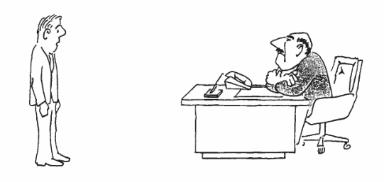
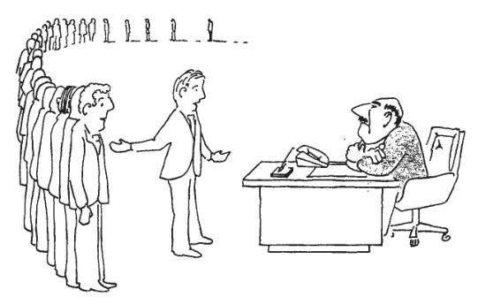
I can’t find an efficient algorithm, I guess I’m just too dumb.
(when you don’t know complexity theory)
I can’t find an efficient algorithm, because no such algorithm is possible!
(when you have a lower bound)
I can’t find an efficient algorithm, but neither can these famous people.
(when you find a problem is NP-Complete)

Slide 12
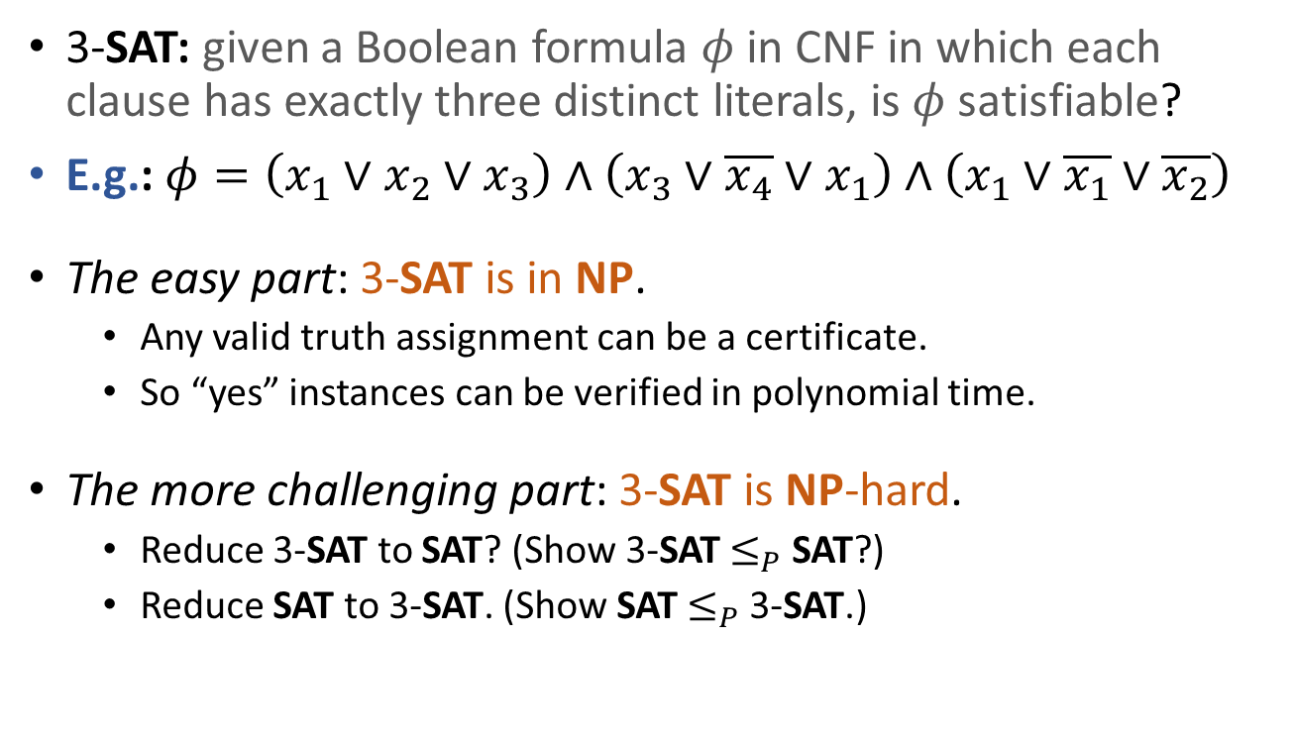
3-SAT is NPC
3-SAT: given a Boolean formula $φ$ in CNF in which each clause has exactly three distinct literals, is $φ$ satisfiable?
E.g.: $φ=\left(x_{1}∨x_{2}∨x_{3}\right)∧\left(x_{3}∨\overline{x_{4}}∨x_{1}\right)∧\left(x_{1}∨\overline{x_{1}}∨\overline{x_{2}}\right)$
The easy part: 3-SAT is in NP.
Any valid truth assignment can be a certificate.
So “yes” instances can be verified in polynomial time.
The more challenging part: 3-SAT is NP-hard.
Reduce 3-SAT to SAT? (Show 3-SAT $≤_{P}$ SAT?)
Reduce SAT to 3-SAT. (Show SAT $≤_{P}$ 3-SAT.)

Slide 13
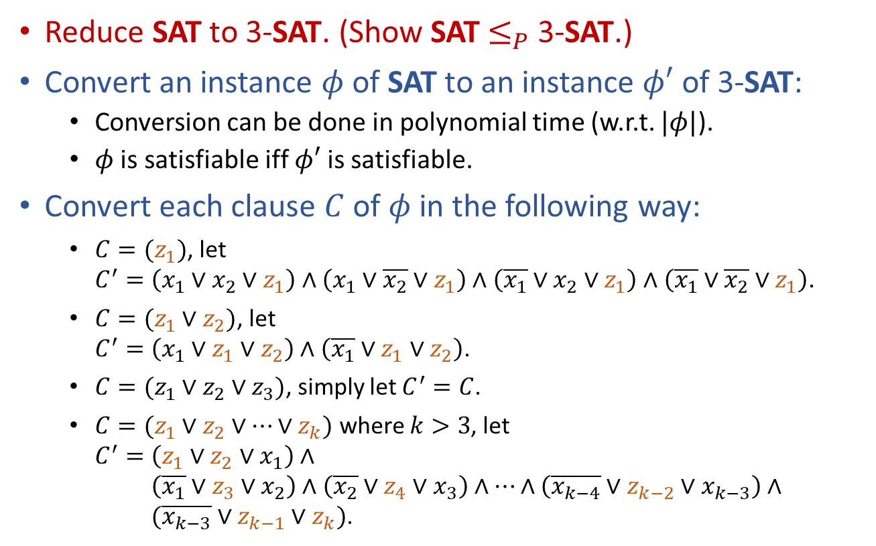
3-SAT is NP-hard
Reduce SAT to 3-SAT. (Show SAT $≤_{P}$ 3-SAT.)
Convert an instance $φ$ of SAT to an instance $φ′$ of 3-SAT:
Conversion can be done in polynomial time (w.r.t. $|φ|$).
$φ$ is satisfiable iff $φ′$ is satisfiable.
Convert each clause $C$ of $φ$ in the following way:
$C=(z_{1})$, let $C^{′}=\left(x_{1}∨x_{2}∨z_{1}\right)∧\left(x_{1}∨\overline{x_{2}}∨z_{1}\right)∧\left(\overline{x_{1}}∨x_{2}∨z_{1}\right)∧\left(\overline{x_{1}}∨\overline{x_{2}}∨z_{1}\right)$.
$C=(z_{1}∨z_{2})$, let $C^{′}=\left(x_{1}∨z_{1}∨z_{2}\right)∧\left(\overline{x_{1}}∨z_{1}∨z_{2}\right)$.
$C=(z_{1}∨z_{2}∨z_{3})$, simply let $C^{′}=C$.
$C=(z_{1}∨z_{2}∨⋯∨z_{k})$ where $k>3$, let $C^{′}=\left(z_{1}∨z_{2}∨x_{1}\right)∧$ $C^{′}=\left(\overline{x_{1}}∨z_{3}∨x_{2}\right)∧\left(\overline{x_{2}}∨z_{4}∨x_{3}\right)∧⋯∧\left(\overline{x_{k−4}}∨z_{k−2}∨x_{k−3}\right)∧$ $C^{′}=(\overline{x_{k−3}}∨z_{k−1}∨z_{k})$.

Slide 14
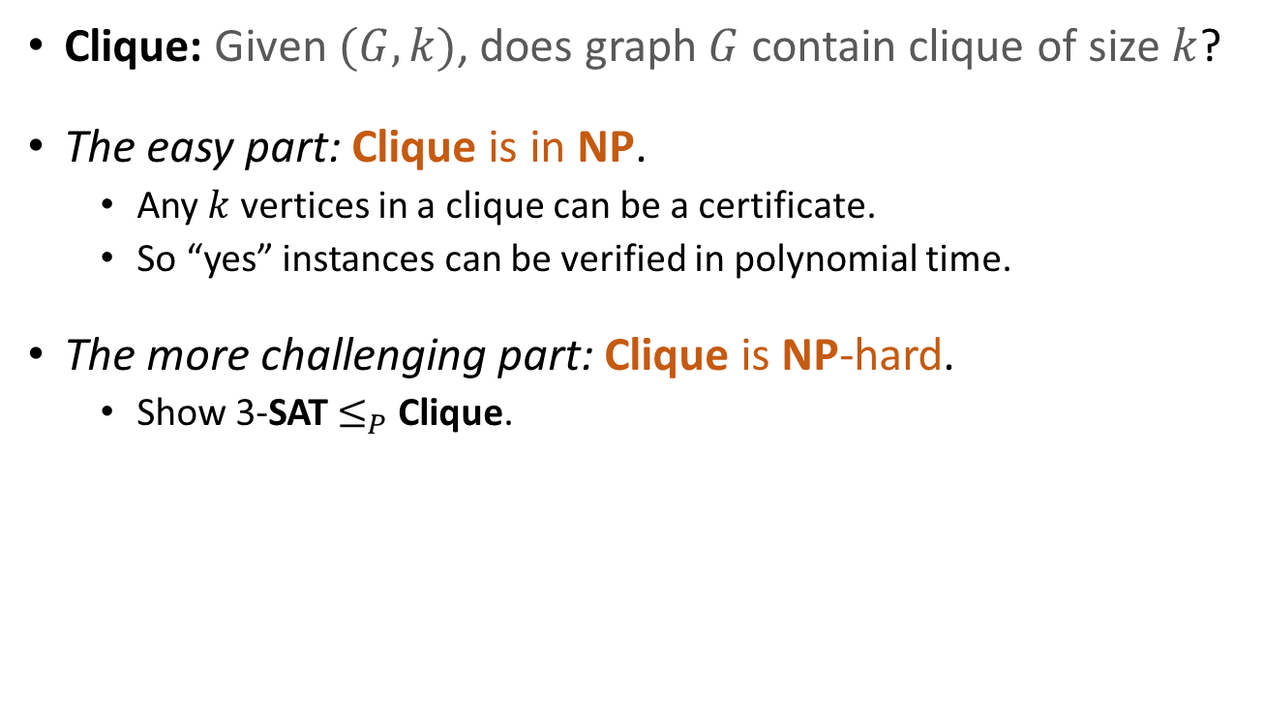
Clique is NPC
Clique: Given $(G,k)$, does graph $G$ contain clique of size $k$?
The easy part: Clique is in NP.
Any $k$ vertices in a clique can be a certificate.
So “yes” instances can be verified in polynomial time.
The more challenging part: Clique is NP-hard.
Show 3-SAT $≤_{P}$ Clique.

Slide 15
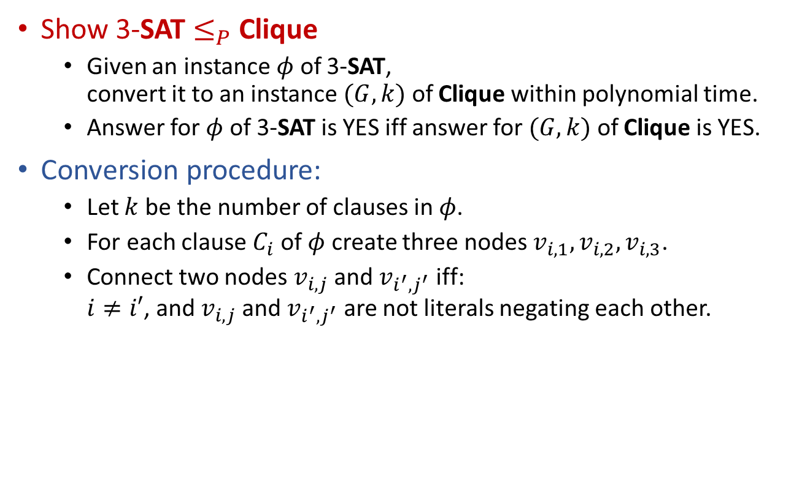
Clique is NP-hard
Show 3-SAT $≤_{P}$ Clique
Given an instance $φ$ of 3-SAT, convert it to an instance $(G,k)$ of Clique within polynomial time.
Answer for $φ$ of 3-SAT is YES iff answer for $(G,k)$ of Clique is YES.
Conversion procedure:
Let $k$ be the number of clauses in $φ$.
For each clause $C_{i}$ of $φ$ create three nodes $v_{i,1},v_{i,2},v_{i,3}$.
Connect two nodes $v_{i,j}$ and $v_{i^{′},j^{′}}$ iff: $i≠i′$, and $v_{i,j}$ and $v_{i^{′},j^{′}}$ are not literals negating each other.

Slide 16








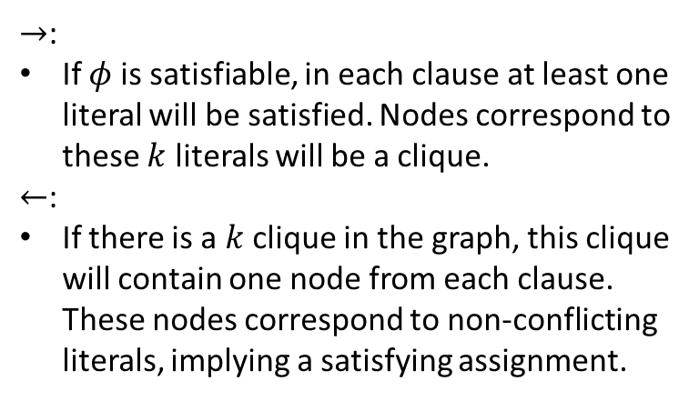
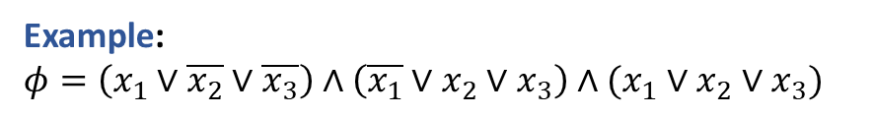
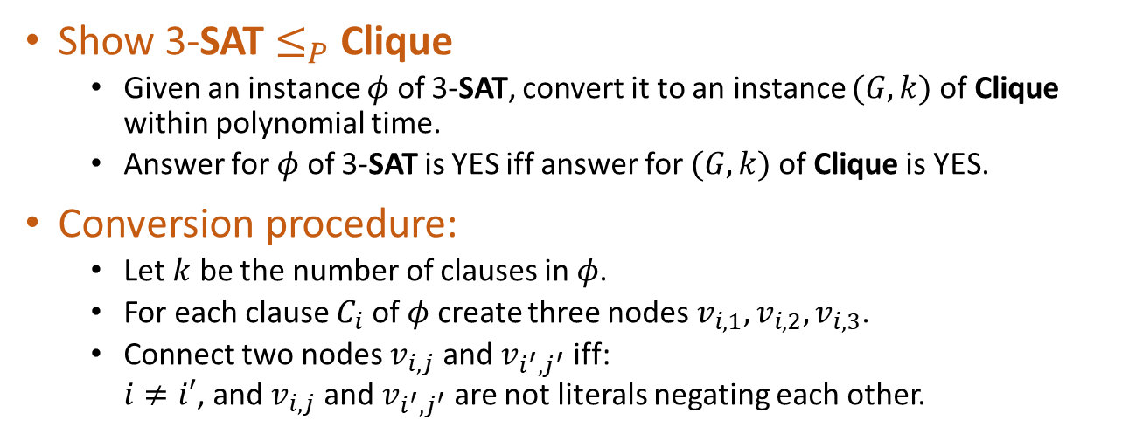




Show 3-SAT $≤_{P}$ Clique
Given an instance $φ$ of 3-SAT, convert it to an instance $(G,k)$ of Clique within polynomial time.
Answer for $φ$ of 3-SAT is YES iff answer for $(G,k)$ of Clique is YES.
Conversion procedure:
Let $k$ be the number of clauses in $φ$.
For each clause $C_{i}$ of $φ$ create three nodes $v_{i,1},v_{i,2},v_{i,3}$.
Connect two nodes $v_{i,j}$ and $v_{i^{′},j^{′}}$ iff: $i≠i′$, and $v_{i,j}$ and $v_{i^{′},j^{′}}$ are not literals negating each other.
Example:
$φ=\left(x_{1}∨\overline{x_{2}}∨\overline{x_{3}}\right)∧\left(\overline{x_{1}}∨x_{2}∨x_{3}\right)∧(x_{1}∨x_{2}∨x_{3})$
$$C_{1}$$
$$x_{1}$$
$$\overline{x_{2}}$$
$$\overline{x_{3}}$$
$→$:
If $φ$ is satisfiable, in each clause at least one literal will be satisfied. Nodes correspond to these $k$ literals will be a clique.
$←$:
If there is a $k$ clique in the graph, this clique will contain one node from each clause. These nodes correspond to non-conflicting literals, implying a satisfying assignment.
$$C_{2}$$
$$C_{3}$$
$$\overline{x_{1}}$$
$$x_{1}$$
$$x_{2}$$
$$x_{2}$$
$$x_{3}$$
$$x_{3}$$

Slide 17

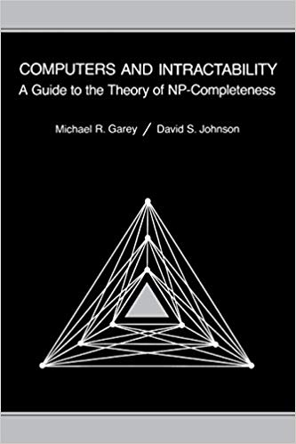
Reading
[CLRS] Ch.34 (34.3-34.5)
Other great books:
Michael Sipser, Introduction to the Theory of Computation (3ed)
Garey and Johnson, Computers and Intractability: A Guide to the Theory of NP-Completeness

