Slide 1
VOICERA USING Interactive Voice Response System
Working under the guidance of
CH. SRUJANA
Assistant Professor,ITD
BY
S.HRUTURAJ - 2451-19-737-040
G.OM PRAKASH - 2451-19-737-027
H.KUSHAL - 2451-19-737-030

Slide 2
CONTENTS
ABSTRACT
INTRODUCTION
PROBLEM STATEMENT
LITERATURE SURVEY
EXISTING SYSTEM
PROPOSED SYSTEM
SYSTEM REQUIREMENTS
MODULE SPLIT-UP
DESIGN PHASE
DESIGN METHODOLOGY
ALGORITHM
CONCLUSION
REFERENCES

Slide 3
ABSTRACT
An Interactive Voice Response System (IVRS) is an automation tool that generates automated voice to address the queries raised by a human through interactive voice response (speech recognition) and (DTMF) tones input provided via keypad.In this project, we are implementing a robust automation process for ordering delivery of academic certificates through an interactive voice response system and making payment against the charge.This system provides dynamic information related to academics and routes them to the appropriate section based on the text input options. This technology reduces human effort and gives the caller a better experience by routing him to the exact option.DTMF decoding and speech recognition are used to interpret the caller's response to voice prompts. DTMF tones are entered via the telephone keypad. Other technologies include using text-to-speech to speak complex and dynamic information.

Slide 4
This IVR system is an efficient and cost-effective solution for establishing a personalized customer experience. The best part about IVR is that it's not dependent on humans to work. Once it’s programmed, it will continue to function unless configured otherwise. It is capable of providing 24hrs service to its customers.

Slide 5
INTRODUCTION
Even though the internet has received significant attention in the last few decades, voice is still considered an efficient way of communication between humans-to-humans and human-to-computer. IVR systems can lean toward reduced service costs, increase customer satisfaction and offer new and improved services.
IVR phone systems have become so widely used that you’ve probably found yourself communicating with a virtual assistant over the phone more times than you can count.
Academic records are information and documents about a student's academic career. Using IVRS technology we will deliver different academic certificates to students at their doorsteps in collaboration with respective institutions, boards or universities.

Slide 6
Final year/semester marks Cards, degree/diploma certificates etc., are printed and sent to colleges a few months after students leave the institution. They have to visit the institution again to collect such documents. The application helps students avoid such exercise.
The documents could be delivered across India and the delivery address could be different from the one given at the time of admission. The document would be delivered within a maximum of five days based on priority mode.

Slide 7

PROBLEM STATEMENT
To Build an Interactive Voice Response System (IVRS) based application for ordering delivery of academic certificates and making payment against the charge.

Slide 8
LITERATURE SURVEY

Slide 9
S.NO | AUTHOR NAME | YEAR OF PUBLICATION | OBJECTIVE | DRAWBACKS
1 | Olawande Daramo..et al | 2018 | Comparative analysis and review of interactive voice response systems | Not able to capture user requirements and present rigid interface to users.
2 | Polyna Khudyakov..et al | 2018 | Designing a Call Center with IVR | Less number of Trunk Lines Performance drops under heavy traffic
3 | Priscilla Manatsa | 2019 | Impact of IVR in Canadian Banking Industry | Less awareness about the voice-technology, therefore not well received by clients
4 | Ruth Choy..et al | 2022 | Personalized Digital Customer Services for Consumer Banking Call-Centre using Neural Networks | Poor Call Containment More improvement in Pattern recognization
5 | Esra Ben Ismail..et al | 2022 | IVR System use by patients with Heart failure | Self Reporting nature of IVR registered a lot of spam records.

Slide 10
EXISTING SYSTEM
Final year/semester marks Cards, degree/diploma certificates etc., are printed and sent to colleges a few months after students leave the institution. They have to visit the institution again to collect such documents.
In most of the Universities the certificates are applied or information related to academics is collected through their official websites.
The IVR system services are used in diverse domain including telecommunication, insurance, utilities, entertainment, manufacturing, financing, utilities, agriculture, etc. Speech Recognition and other machine learning models are intergrated with new IVR systems.

Slide 11

PROPOSED SYSTEM
Proposed System receives calls automatically from user and it will provide welcome tone. The user will be asked to verify his institutional details. After confirming their identity the user will be directed to an ivr menu. Based on the user input interpreted either thorough speech recognition or dual tone multi frequency (DTMF) tones input provided via keypad, routes them to the appropriate section. This system provides dynamic information related to academics and allows them to order delivery of academic certificates and making payment against the charge.

Slide 12
SYSTEM REQUIREMENTS
Hardware Requirements:
CPU : i5 9th or 10th Gen.
RAM : 8 GB
Hard Disk : 500GB
Software Requirements:
OS : Windows 7 or higher with the latest updates installed.
PYHTON : 3.6
Anaconda : Latest Version imported with required libraries.
VS Code Editor
Twilio Account

Slide 13
MODULE SPLIT-UP
CUSTOMER: Dial the service number to either know the academic details or to place an order for delivery of certificates
TWILIO: This module would include the functions and data structures needed to interact with theTwilio API, which would be used to manage incoming and outgoing phone calls and text messages.
FLASK: This could include functions for defining routes,rendering templates, and handling user input. Flask would be used to provide a user interface formanaging customer data and initiating phone calls and text messages using the Twilio API.

Slide 14
DESIGN IMPLEMENTATION

Slide 15
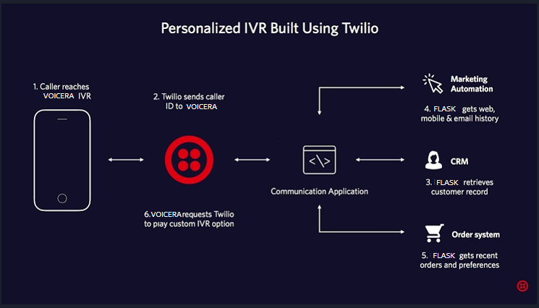
ARCHITECTURE

Slide 16
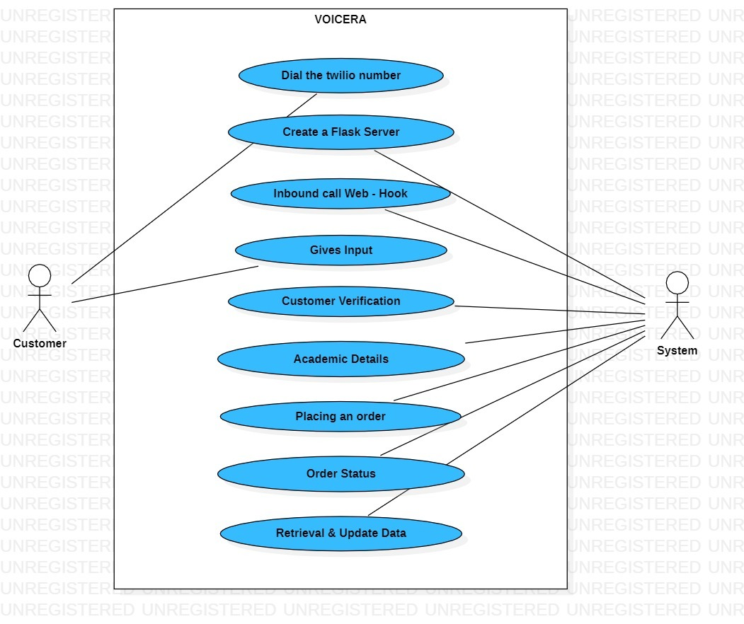
USECASE DIAGRAM

Slide 17
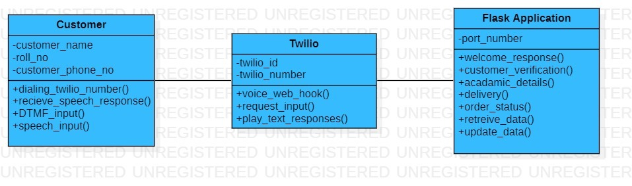
CLASS DIAGRAM

Slide 18
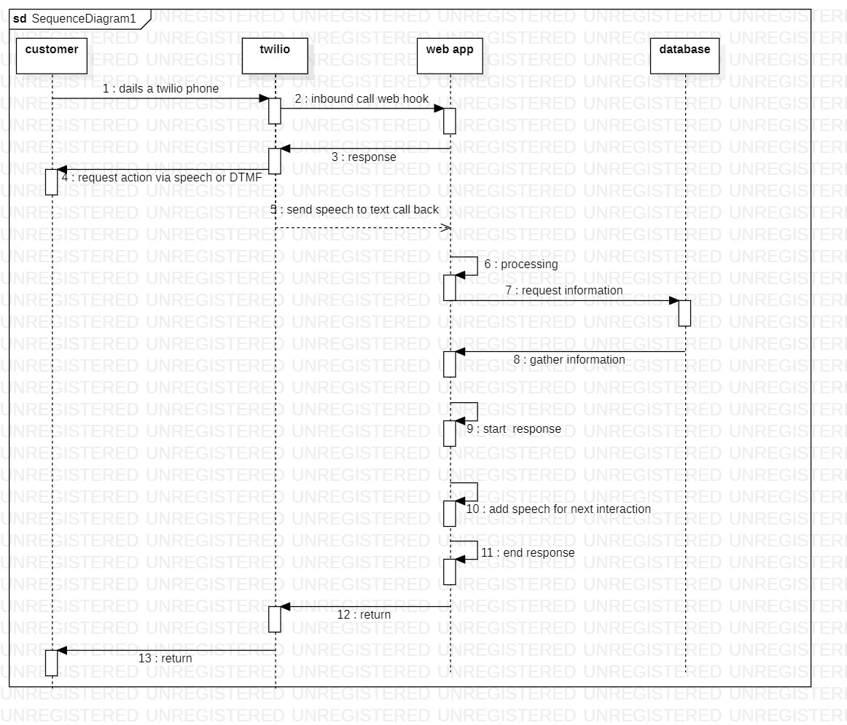
SEQUENCE DIAGRAM

Slide 19
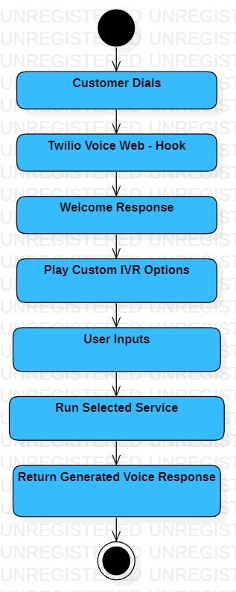
ACTIVITY DIAGRAM

Slide 20
DESIGN METHODOLOGY
CUSTOMER:
Here user first calls a number
User selects the suitable option he/she requires by pressing specific key on keypad
User can request for certificates, academic details .. etc and can place an order of report.
TWILIO:
Twilio acts as an intermediate between customer and application
It forwards the call to the web server where it can connect to an application
Using DTMF sounds of keypad users are routed to appropriate sections which they want to access
Gathering of information and generation of responses are done in this section

Slide 21
Web Application:
customer verifies his/her identity
welcome response to customer is given
contains academic details of students
updating content
retrieving of data
status of order

Slide 22
ALGORITHM

Slide 23
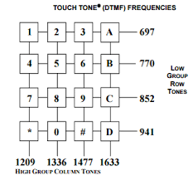
Dual-Tone Multi-Frequency
Dual-Tone Multi-Frequency (DTMF) is a method of encoding and decoding the digit signals transmitted by a touch-tone telephone keypad. When a key on the telephone keypad is pressed, it generates two simultaneous sinusoidal tones of specific frequencies, one from a high-frequency group and one from a low-frequency group. These frequencies are then decoded by the receiving system to determine which key was pressed. DTMF is widely used in interactive voice response (IVR) systems and telephone networks for automated communication with customers or clients.

Slide 24
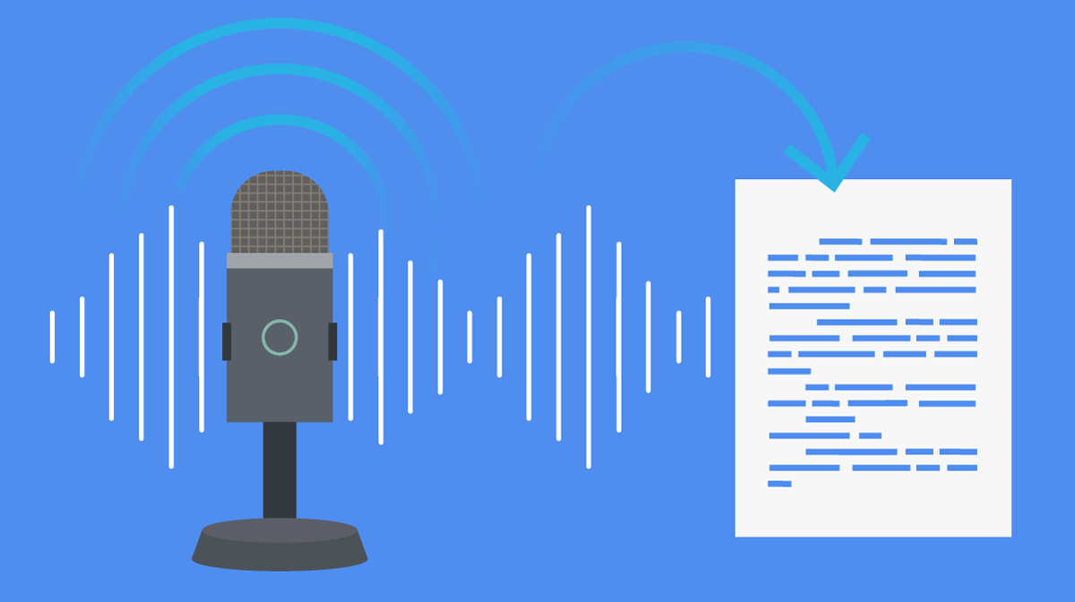
Text-to-speech (TTS) and speech-to-text (STT)
Text-to-speech (TTS) technology converts written text into spoken words. This technology is useful in situations where the user needs to hear a piece of text, such as for people who are visually impaired or for use in automated customer service systems. TTS technology works by processing text input and synthesizing it into audible speech output. TTS systems use various techniques such as concatenative synthesis, formant synthesis, and neural TTS to generate speech.

Slide 25
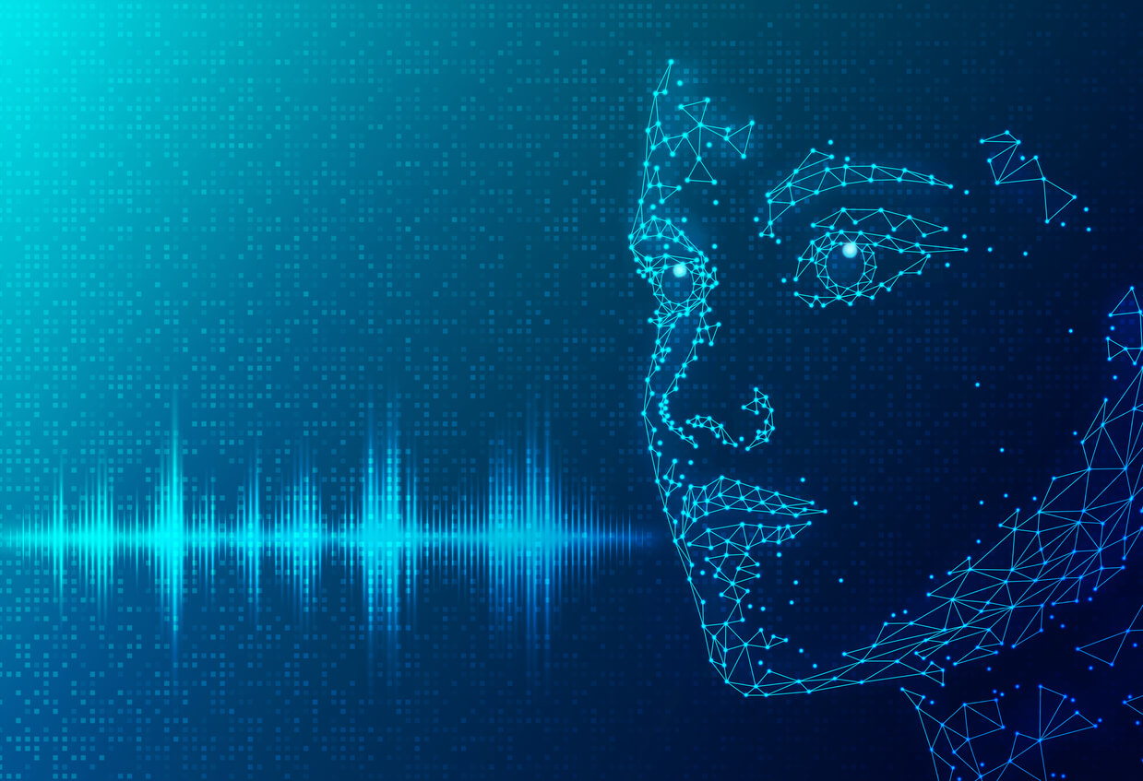
Natural Language Processing (NLP)
Natural Language Processing (NLP) is a subfield of artificial intelligence and computer science that focuses on the interaction between computers and human language. It involves developing algorithms and computational models that enable computers to understand, interpret, and generate natural language. NLP encompasses a wide range of tasks, including language understanding, language generation, machine translation, sentiment analysis, named entity recognition, speech recognition, and text summarization.

Slide 26
CONCLUSION
Voice-based delivery of academic records using Interactive Voice Response (IVR) is a promising solution that provides a convenient and accessible way for students to access their academic records through a simple phonecall, without the need for an internet connection or specialized hardware.
Voice-based delivery of academic records using IVR has the potential to revolutionize the way students access and manage their academic records, and educational institutions should consider implementing this technology to improve the efficiency and accessibility of their record management systems.
IVR systems can also provide an additional layer of security for academic records, as students wouldneed to provide some form of identification to access their records.
Overall, an IVR system can be an effective way to provide students with easy and secure access totheir academic records. By automating the delivery of academic certificates and academic details, academic institutions can save time and resources while providing a convenient service to their students.

Slide 27
REFERENCES
S.Uma Maheshwari et al., Interactive Voice Response System Development, International Journal of Engineering and Advanced Technology (IJEAT) ISSN: 2249 – 8958, Volume-8, Issue-2S, December 2018
Itorobong A. Inam et al.,Comparative Analysis and Review of Interactive Voice Response Systems,Conference on Information Communications Technology and Society,2018
Samarth Agarwal et al., Personalized Digital Customer Services for Consumer Banking Call Centre using Neural Networks, University of Western Ontario,2020
Polyna Khudyakov et al., Designing a call center with an IVR (Interactive Voice Response),2018
Esra Ben Ismail et al., IVR System Use by Patients with Heart Failure: Compliance and Services Utilization Patterns, Journal of Medical Systems (2022)

Slide 28
Priscilla Manatsa, An Analysis of the impact of implementing a new Interactive Voice Response System (IVR) on Client experience in the canadian Banking Industry, International Economics and Finance, Ryerson University, 2019
Next Generation IVR Using Twilio Speech Recognition and Chatbots https://www.linkedin.com/pulse/next-generation-ivr-using-twilio-speech-recognition-chatbots-badri/?trk=v-feed
Interactive voice response https://en.wikipedia.org/wiki/Interactive_voice_response

Slide 29
THANK YOU!

