Slide 1

SMART INDIA HACKATHON 2026
Problem Statement ID : SIH26177
Problem Statement Title : A Deployable AI-Powered Autonomous Drone that Aids Search-and-Rescue Operations by Detecting People and Hazards
Theme : Robotics and Drones
PS Category : Hardware
Team ID : R15-270
Team Name (Registered on portal) : JATAYU

Slide 2
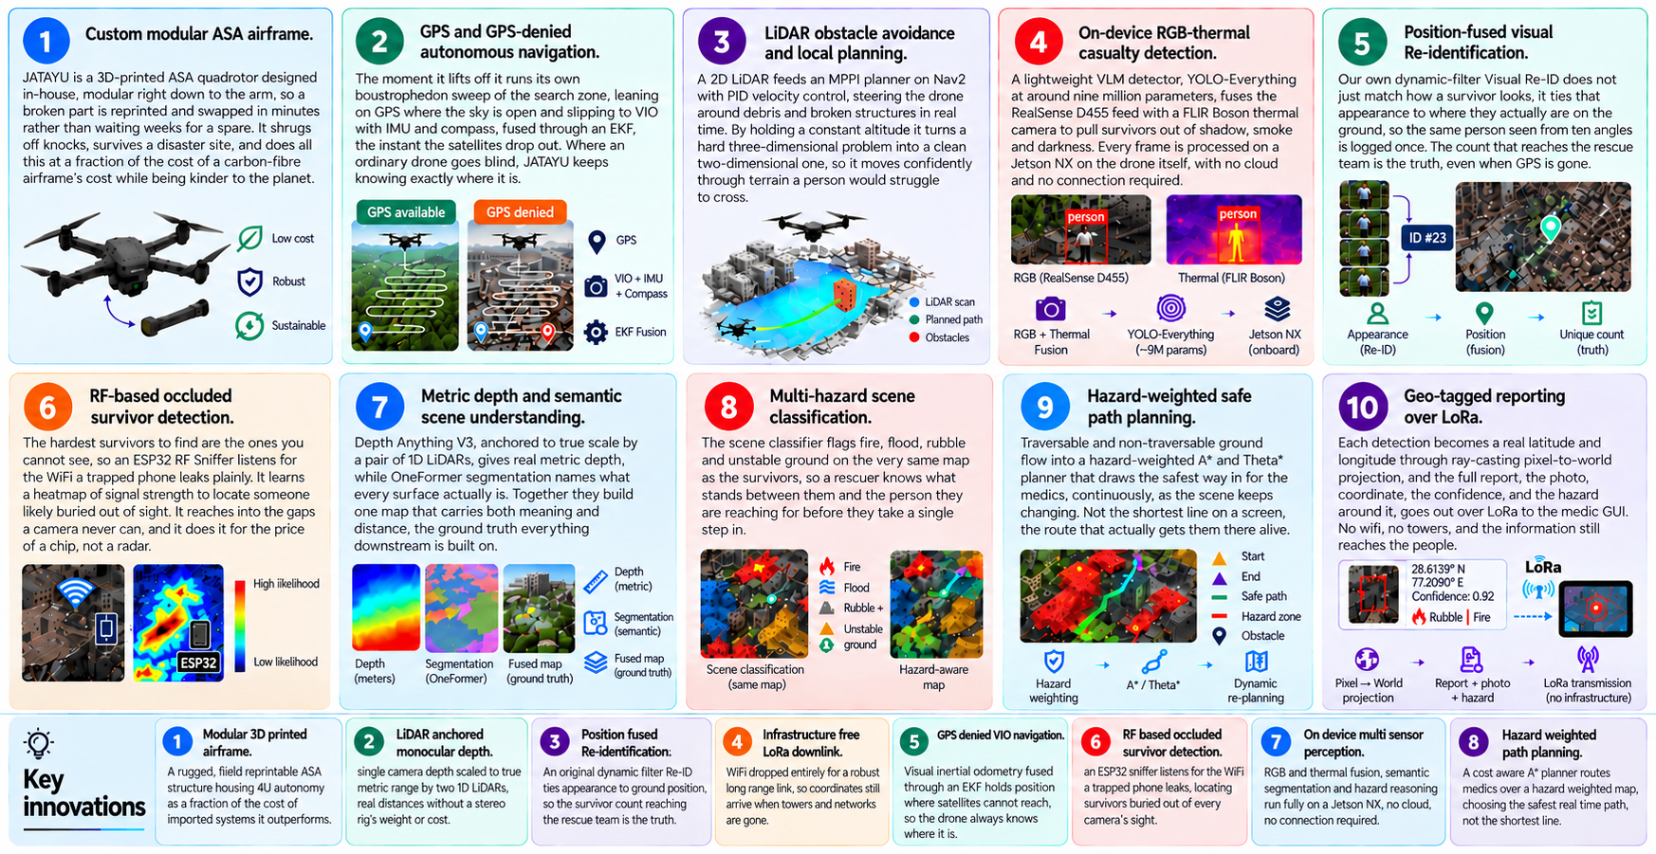
THE JATAYU DRONE SYSTEM
JATAYU

Slide 3
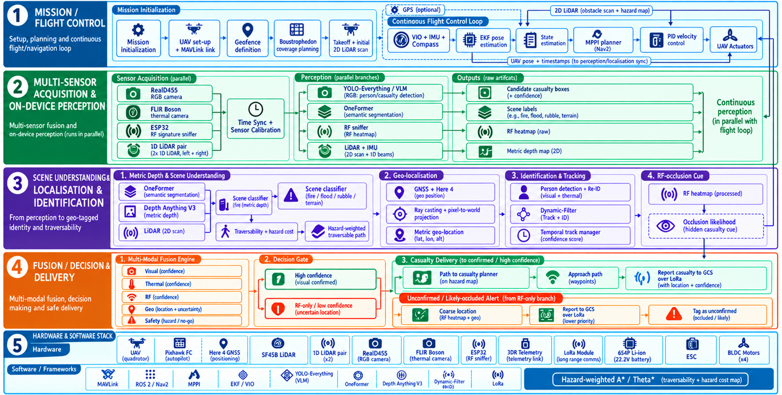
TECHNICAL APPROACH
JATAYU

Slide 4
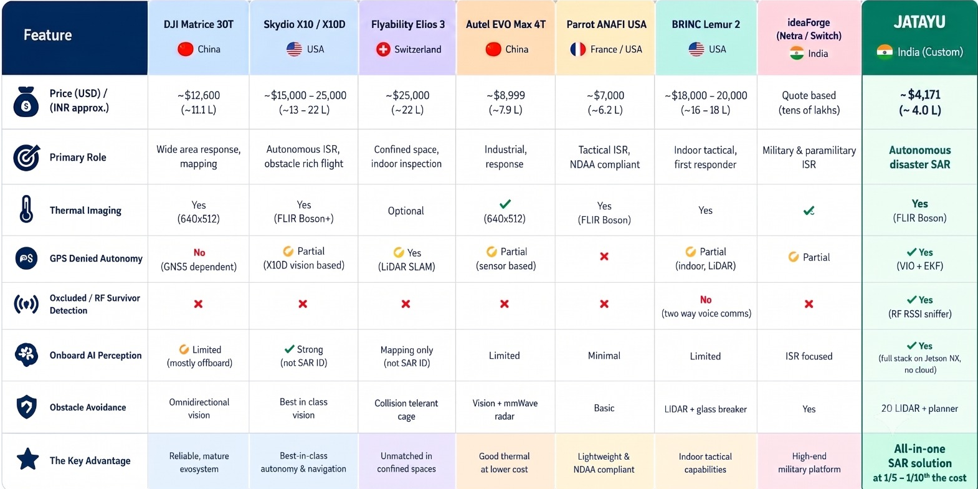
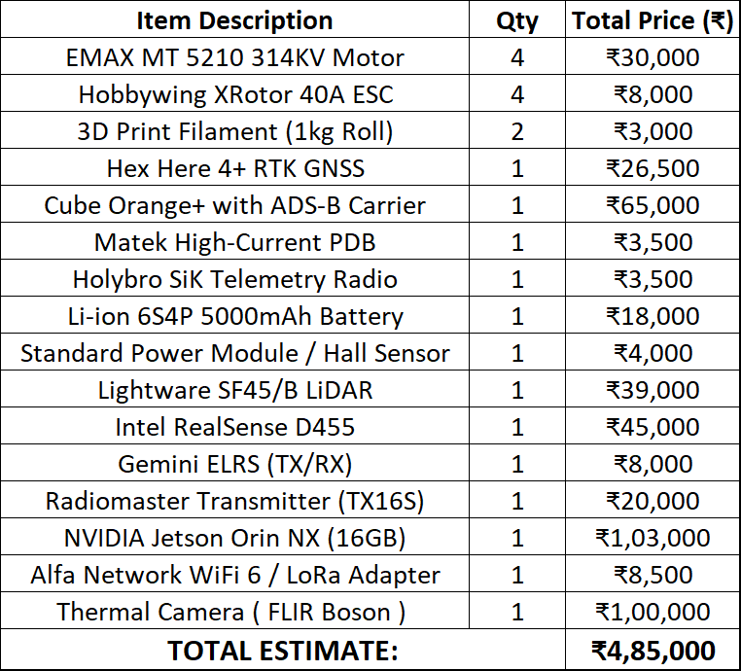
FEASIBILITY AND VIABILITY
JATAYU
Jatayu Single Unit Making Cost
CHALLENGES
Indoor navigation: flying deep inside a collapsed structure, where GPS is gone, walls close in tight, and even VIO struggles for reliable reference.
Fully buried survivors with no signal: a person trapped under dense rubble whose phone is dead or shielded emits nothing for either a camera or the RF sniffer to catch.
Casualty prioritisation and traversability: ranking who is most critical and mapping a clear, safe route so medics can actually reach them fast.
STRATEGIES
Indoor navigation: develop a smaller companion system with the same core capabilities, sized to enter and manoeuvre through confined interior voids.
Fully buried survivors: integrate a stronger radar payload with see through sensing potential, giving a signal path where visual and RF cues cannot reach.
Prioritisation and analysis: deepen the software stack with VLM based models for richer casualty triage, scene understanding, and traversability analysis.

Slide 5
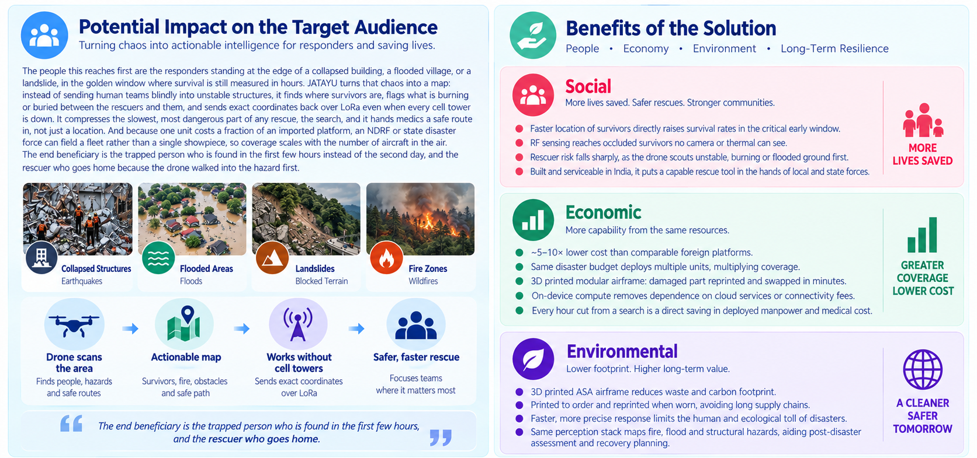
IMPACT AND BENEFITS
JATAYU

Slide 6
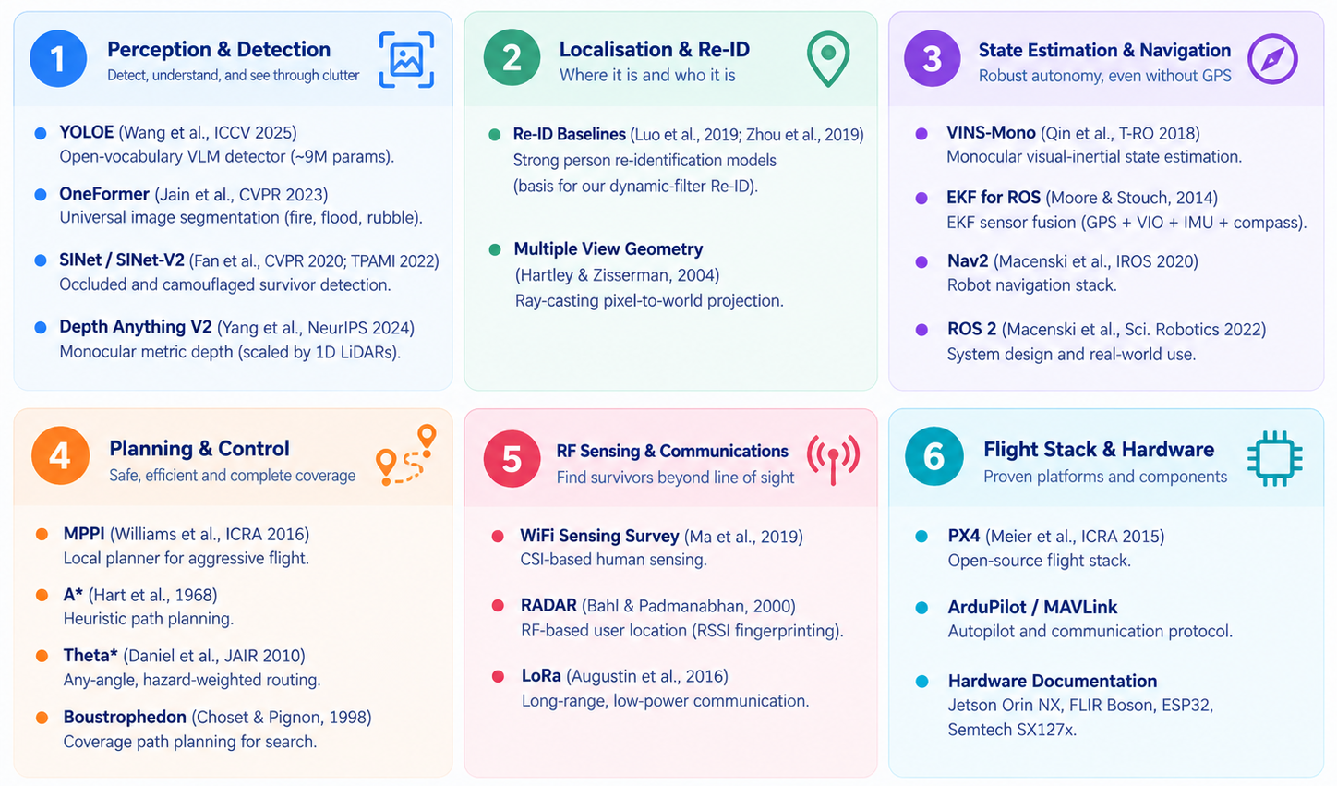
RESEARCH AND REFERENCES
JATAYU

