Slide 1
Android Application Project Calculator

Slide 2
Outline
Introduction
Flow Chart
Implementation
Shunting-Yard-Parser
Expression Solutions
Source
Credit

Slide 3
Introduction
Calculator is an expression based calculator application.
Calculate directly with the expression that user inputs.
A log area that keeps track of previous calculations.

Slide 4
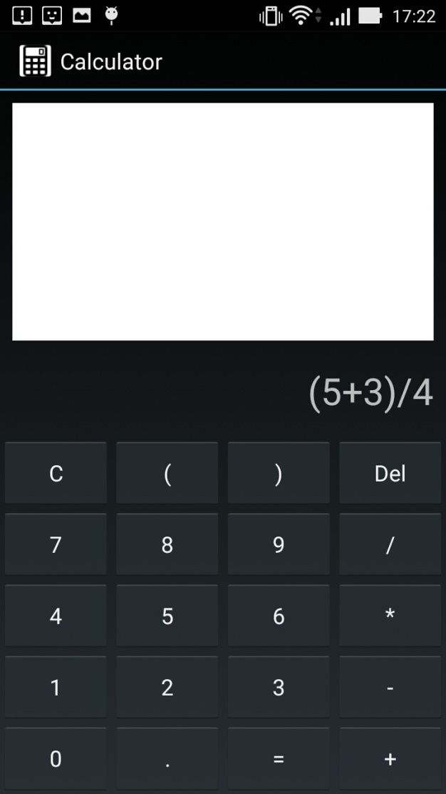
Introduction
Calculator allows you to input arithmetic expression!

Slide 5
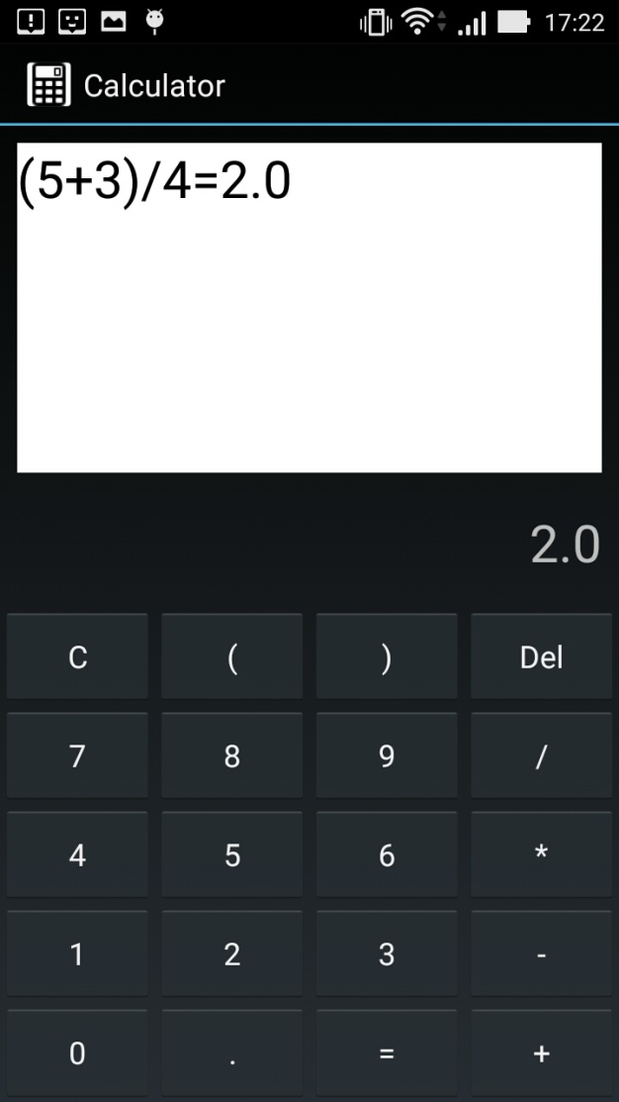
Introduction
Calculation is recorded.

Slide 6
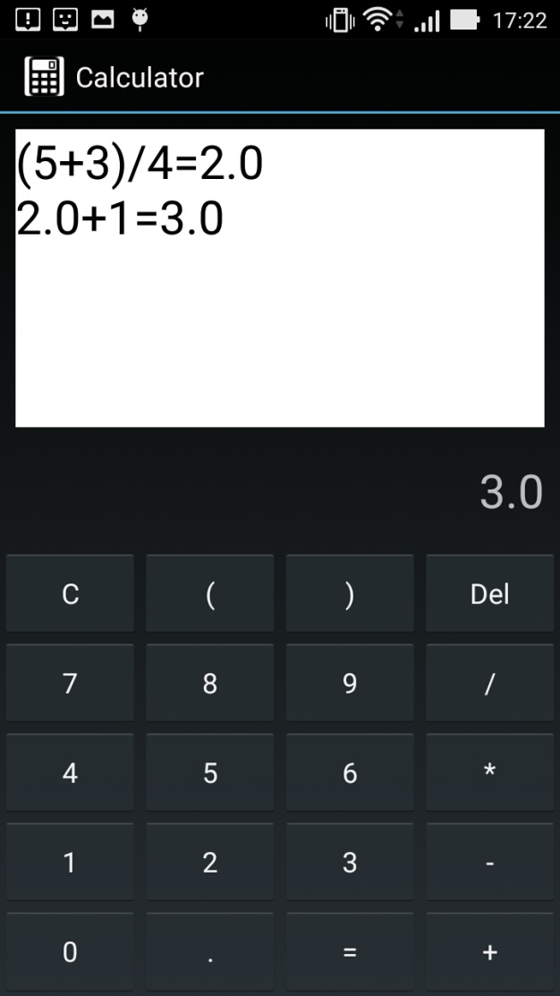
Introduction
Another expression calculated.

Slide 7
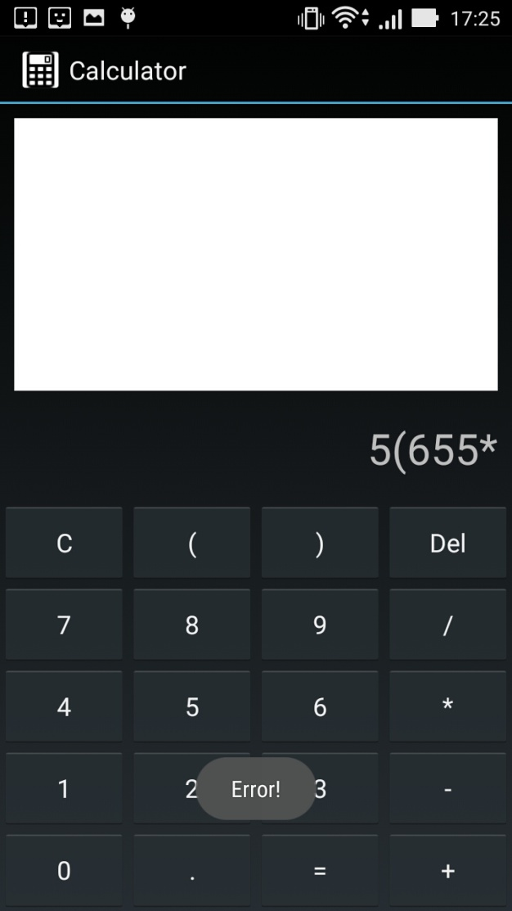
Introduction
Oops!
Wrong expression!

Slide 8
Flow Chart
Activity
Delete
Build Token
By Entered Digits
Delete Last
Built Token
Enter
Operator
Build Token
By Entered Digits
Build Token
By Operator
Clear
Calculate
Build Token
By Entered Digits
Calculate Result By Tokens
Update Log And Display
Result
Clear All Tokens And Digits
Enter Digit
Store Digit

Slide 9
Implementation
Tokens
Activity
Shunting Yard
Parser
Result

Slide 10
Implementation-Shunting-Yard Parser
Transform a list of tokens into Reversed Polish Notation.
Calculate through Reversed Polish Notation to get numeric result.
https://en.wikipedia.org/wiki/Shunting-yard_algorithm

Slide 11
Implementation-Expression Solutions
Treat every value or operator as a token.
Once an operator is entered, build a value with entered digits.
Pass all tokens to parser to calculate the desired result.

Slide 12
Source
Icon : http://www.icon2s.com/32916/android-icons/black-white-android-calculator/

Slide 13
Credit
Author : YANG, TUN-HUNG
Email : B9915034@gmail.com
Download : https://drive.google.com/open?id=0BwChadRsgnubNW9BM0xNR2pBUWs

