Slide 1
Android Application Project Greedy Mouse

Slide 2
Outline
Introduction
Flow Chart
User Interface
Implementation
Game System
Animation System
View System
Source
Credit

Slide 3
Introduction
Greedy Mouse is a greedy snake like mini game.
There are three different types of food, and each provides different points and effect.
Top 5 high score records.

Slide 4
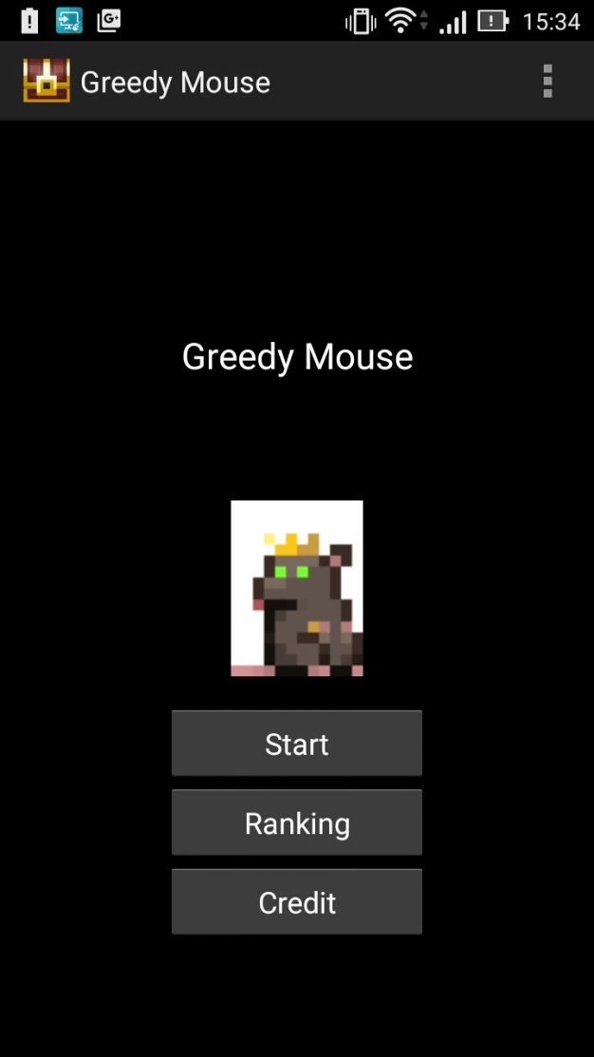
Introduction
The start screen of Greedy Mouse.

Slide 5
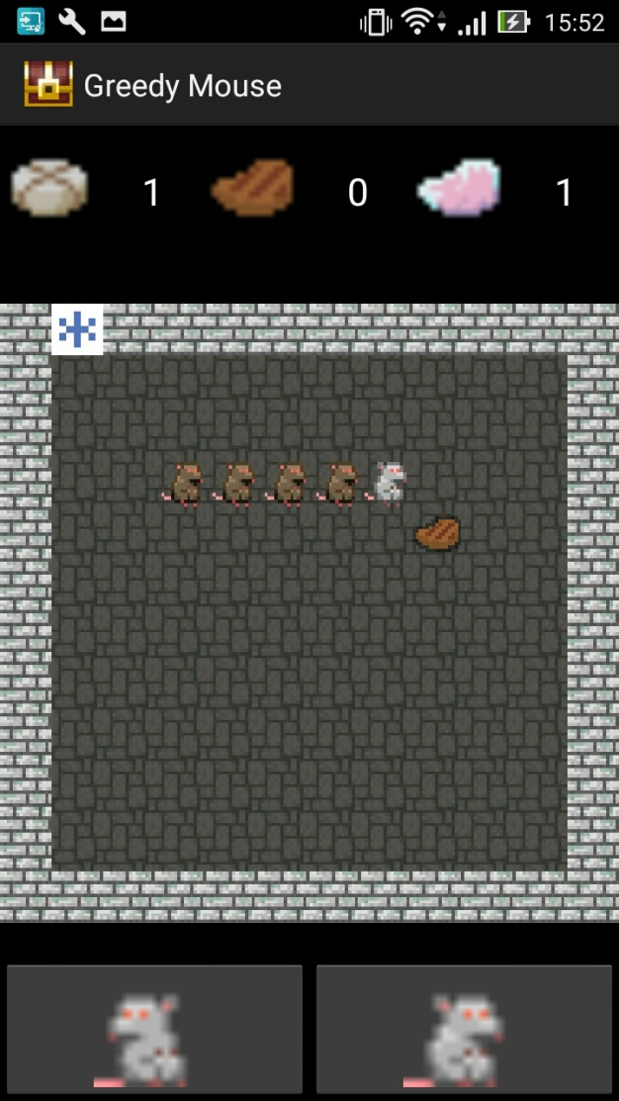
Introduction
Game scene.

Slide 6
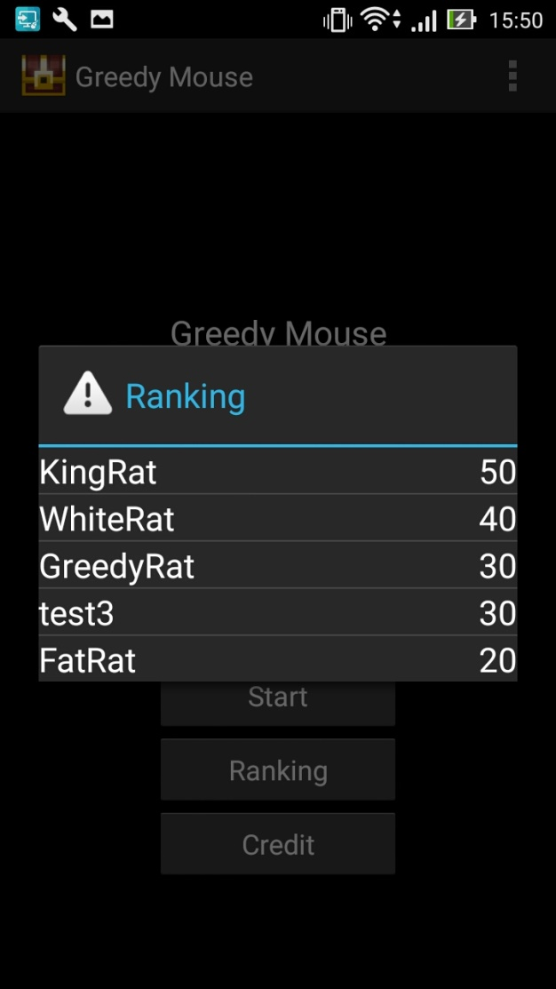
Introduction
What’s the high score?

Slide 7
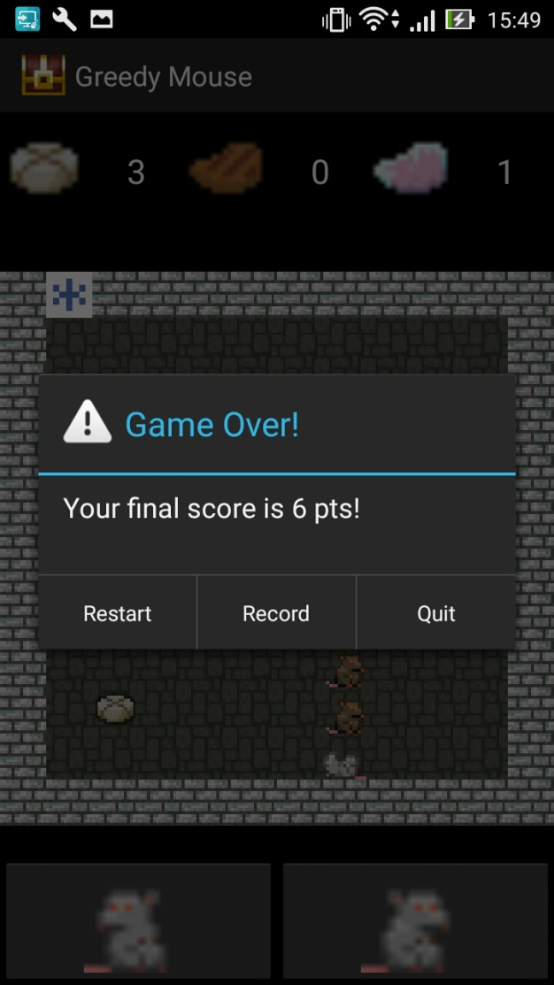
Introduction
Game over!

Slide 8
Flow Chart
Start
Activity
Launch
Game
Game
Reset
Restart
Start/End
Show Ranking
Game Activity
Game
Over
Record
Score
Y
N
Show
Credit
User
Interaction
Quit

Slide 9
Implementation
View
System
User Interaction
Screen Display
Greedy Snake
Animation System
Game
System
Bitmap Process
Sprite
Surface Renderer

Slide 10
Implementation—Game System
View
System
Animation
System
Stop
Direction
Positions
Yes
Initialization
Start
Snake
Move
Eat
Update
Is Dead?
No

Slide 11
Implementation—Animation System
Positions
View
System
Renderer
Draw
Image
Resource
Sprite
Decode
Build
Sprite
Bitmap

Slide 12
Implementation—View System
Start
Activity
Activate
Animation
System
Activate
Game
System
Listen
Motion
Event
Direction
Game
System
Animation
System
Update
View
Position

Slide 13
Source
Graphics : Watabou
Music : Cube_Code
Website : pixeldungeon.watabou.ru

Slide 14
Credit
Author : YANG, TUN-HUNG
Test : 顏廷安、簡超
Email : B9915034@gmail.com

