Slide 1
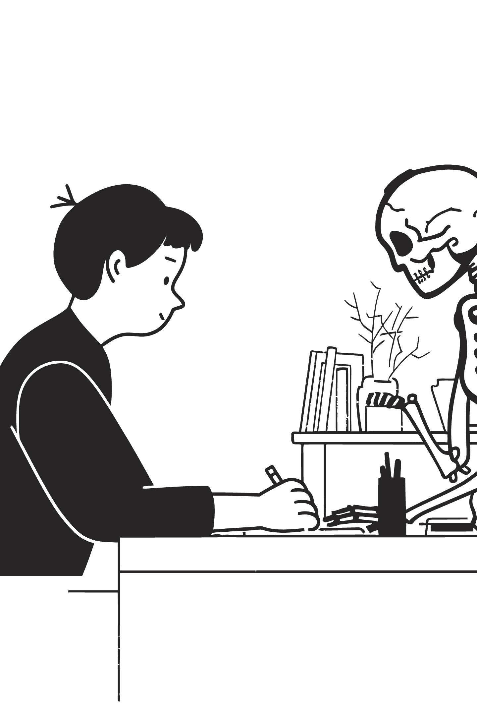
The Silent Crisis: A Global Mental Health Challenge
The world faces an escalating mental health crisis, impacting millions and straining healthcare systems. We see a pervasive need for accessible, timely, and stigma-free support.
Staggering Statistics
Over 280 million people worldwide suffer from depression.
1 in 5 adults experience mental health issues annually.
60% lack access to essential mental health services.
Critical Barriers
Average waiting time for therapy: 4-12 weeks.
Mental health stigma prevents 50% from seeking help.
Limited access to qualified therapists and high costs are major deterrents.

Slide 2





Empath.ai: Your AI-Powered Mental Wellness Companion
We introduce Empath.ai, an innovative web-based chatbot designed to revolutionise mental health support. Our solution provides immediate, empathetic, and personalised assistance, bridging the critical gaps in current care.
Real-time Emotional Support
Engage in conversations that feel genuinely supportive, akin to speaking with a counsellor, any time you need it.
Daily Mood Tracking
Monitor your emotional landscape with intuitive tracking tools, revealing trends and offering actionable insights into your well-being.
Personalised Coping Strategies
Receive tailored recommendations for breathing exercises, meditation, and other techniques proven to aid emotional regulation.
One-Click Crisis Support
Access vital crisis resources instantly, ensuring help is always within reach when it's needed most.

Slide 3




Our Innovation: Unrivalled Nuance in Emotional Intelligence
Empath.ai sets a new standard in AI-driven mental health support through its unparalleled ability to understand human emotion and deliver highly personalised care. Our proprietary approach offers a significant competitive advantage.
Empath.ai vs. Typical Apps
Feature
Empath.ai
Typical Apps
28-Emotion Detection
Emotion Detection
28 emotions
4-6 emotions
We detect 28 distinct emotions, a 7x increase in nuance compared to typical apps, which only recognise 4-6 basic emotions.
Data Source
Real therapist conversations
Generic AI
Personalisation
Feedback-driven learning
Static responses
Real Therapist Data
Risk Assessment
Yes (depression patterns)
No
Trained on over 510,000 actual therapist-patient conversations, ensuring responses are genuinely therapeutic and informed.
Access
Instant (web)
App download required
Depression Risk Assessment
Our AI proactively identifies concerning patterns, offering an early warning system for potential depression, unlike generic solutions.
Continuous Learning
The bot evolves with each interaction, learning from user preferences and dynamically improving its support over time.

Slide 4






Seamless Support: The Empath.ai User Journey
Experiencing Empath.ai is intuitive and supportive. Our system is designed to provide help precisely when and how it's needed, adapting to each individual's unique emotional landscape.
Express Yourself
A user types: "I'm feeling really anxious today, everything just feels overwhelming."
AI Understands
Empath.ai's AI detects nuanced emotions: anxiety, nervousness, and underlying fear.
Empathetic Response
The bot responds empathetically: "I understand anxiety can feel incredibly overwhelming. It's brave of you to share this."
Personalised Suggestion
User receives a tailored suggestion: "Would you like to try a calming 4-7-8 breathing exercise for about 5 minutes?"
Track & Learn
User completes the exercise, rates their mood (e.g., 5/10 → 7/10), and the system logs the positive impact.
Smarter Support
Next time the user reports anxiety, Empath.ai intelligently recommends the now-proven effective strategy, continuously optimising personal care.

Slide 5
Core Features: Empowering Your Mental Wellness Journey
Empath.ai integrates a suite of powerful features, each meticulously designed to provide comprehensive, intelligent, and accessible mental health support.
1
2
3
Intelligent Chat
Mood Tracking
Personalised Strategies
Our AI precisely detects your emotional state from text, responding with empathy and offering relevant, effective support.
Effortlessly log your daily mood and visualise trends over time (7, 30, 90 days) to identify patterns, such as "anxiety peaks at 9 PM".
Access a library of coping techniques, custom-matched to your emotions and ranked by their proven effectiveness for you, across various difficulty levels.
4
5
Analytics & Insights
Crisis Support
Gain valuable insights like "Your meditation improved mood by 2.3 points," alongside early depression risk assessments and activity effectiveness tracking.
Immediate, one-click access to local and international crisis hotlines and resources, available 24/7 for urgent situations.

Slide 6
The Profound Impact: Transforming Mental Health Access
Empath.ai addresses the critical shortcomings of traditional mental health services, offering a transformative solution that provides immediate, effective, and judgment-free support to those who need it most.
Current Reality
Empath.ai's Solution
60% of individuals struggle to access therapy.
✅ Instant, 24/7 web-based access to support.
Weeks or months are spent on waiting lists to see a counsellor.
✅ Judgment-free conversations, eliminating shame and waiting.
No immediate support is available during critical moments, like at 3 AM.
✅ Continuous learning to personalise what helps YOU.
✅ Early depression risk assessment for timely intervention.
Mental health stigma remains a significant barrier.
✅ Free and accessible to everyone, everywhere.
Quantifiable Impact
+2.3
4.2/5
95%
Mood Improvement
User Satisfaction
Risk Detection Accuracy
Average mood improvement points after using Empath.ai strategies.
Average rating for helpfulness of strategies provided by the platform.
Precision in identifying concerning patterns associated with depression.

Slide 7
The Engineering Behind Empathy: Our Technical Foundation
Empath.ai is built on a robust, privacy-first technical architecture, leveraging advanced AI and secure data management to deliver its empathetic and intelligent support.
01
02
AI Training Data
Core Technology Stack
We utilise Google's GoEmotions (58k+ real examples for 28 emotions), a vast Mental Health Chat Dataset (510k+ therapist conversations), and Kaggle Depression Data for early warning patterns.
Developed as a web application for universal accessibility, powered by advanced AI models for emotional detection and response generation, and secured with a PostgreSQL database.
03
04
User Experience Design
Data Security & Privacy
A responsive design, meticulously crafted from Figma mockups, ensures a seamless and intuitive user experience across any device.
All user data is encrypted and guaranteed to be never shared, upholding the highest standards of privacy and trust.

Slide 8
Measuring Success: Impact & Performance
Our commitment to excellence is reflected in our rigorous measurement of both technical performance and user impact, ensuring Empath.ai consistently delivers on its promise of effective mental health support.
Technical Performance
User Impact
Emotion detection accuracy: 89%+
Average mood improvement: +2.3 points
Response time: < 500ms (instantaneous feel)
Strategy completion rate: > 40%
Uptime: 99.5%+ (always available)
Retention: > 70% of users active for 1-4 weeks
User satisfaction: 4.2/5 stars rating
Health Outcomes
95%+
<2 clicks
Depression Risk Detection
Crisis Resource Access
Accuracy in identifying early signs of depression.
Immediate access to critical support in urgent situations.

Slide 9

Our Vision: Roadmap to a Full-Scale Mental Wellness Platform
From our Hackathon MVP, Empath.ai is poised for strategic expansion, evolving into a comprehensive platform that continuously innovates to meet the growing global demand for mental health support.
Hackathon MVP (Now)
1
Chat with emotion detection
Mood logging (1-10 scale)
Coping strategies & risk assessment
2
Phase 2 (Next 3 Months)
Advanced analytics dashboard
Crisis resources
Voice input/output & community features
Phase 3 (Growth)
3
Therapist referral system
Mobile apps (iOS/Android)
Multi-language support
Wearable integration
Clinic & employer integrations
Research partnerships

Slide 10



Our Ask & Vision: Partnering for a Healthier Future
We invite you to join us in shaping the future of mental health support. Your insights and collaboration are invaluable as we strive to make compassionate, intelligent care universally accessible.
Our Call to Action
Our Enduring Vision
Provide feedback: Does this solution genuinely address a critical problem?
Mental health support should be as accessible as texting a friend, as judgment-free as talking to someone you trust, and as intelligent as professional therapy.
Share your priorities: Which features do you believe are most crucial for future development?
Explore partnerships: Let's discuss opportunities to scale Empath.ai beyond this hackathon and amplify its impact.

