Slide 1
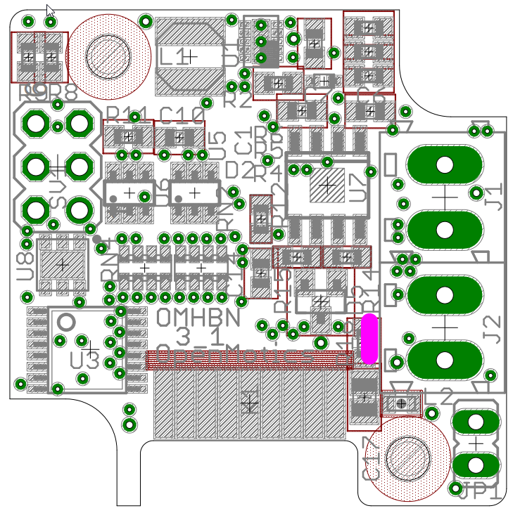
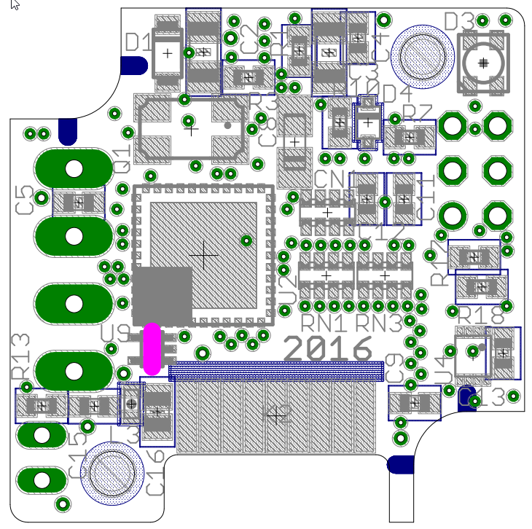
Top view
Bottom view
OUTPUT common
OUTPUT 6
OUTPUT 5
OUTPUT 4
OUTPUT 3
5V OUT
INPUT 6
INPUT 5
INPUT 4
INPUT 3
INPUT 2
INPUT 1
OUT2 / SCL
OUT1 / SDA
OUTPUT 2
OUTPUT 1
GND
GND

Slide 2
Top view
Bottom view
1
2
3
4
5
6
7
8
9
10
18
11
12
13
14
15
16
17
OUTPUT common
GND
OUTPUT 6
OUTPUT 5
OUTPUT 4
OUTPUT 3
OUTPUT 2
OUTPUT 1
GND
5V OUT
OUT2 / SCL
INPUT 6
INPUT 5
INPUT 4
INPUT 3
INPUT 2
INPUT 1
OUT1 / SDA

Slide 3
Top view
Bottom view
1
2
3
4
5
6
7
8
9
10
18
11
12
13
14
15
16
17
OUTPUT common
GND
OUTPUT 6
OUTPUT 5
OUTPUT 4
OUTPUT 3
OUTPUT 2
OUTPUT 1
GND
5V OUT
OUT2 / SCL
INPUT 6
INPUT 5
INPUT 4
INPUT 3
INPUT 2
INPUT 1
OUT1 / SDA

Slide 4
OUTPUT common
1
OUTPUT 6
2
3
4
5
6
7
8
9
10
11
12
13
14
15
16
18
17
OUTPUT 5
OUTPUT 4
OUTPUT 3
5V OUT
INPUT 6
INPUT 5
INPUT 4
INPUT 3
INPUT 2
INPUT 1
OUT2 / SCL
OUT1 / SDA
OUTPUT 2
OUTPUT 1
GND
GND

Slide 6
Top view
Bottom view
1
2
3
4
5
6
7
8
9
10
18
11
12
13
14
15
16
17
OUTPUT common
GND
OUTPUT 6
OUTPUT 5
OUTPUT 4
OUTPUT 3
OUTPUT 2
OUTPUT 1
GND
5V OUT
OUT2 / SCL
INPUT 6
INPUT 5
INPUT 4
INPUT 3
INPUT 2
INPUT 1
OUT1 / SDA

