Slide 1
01. Introduction to Generative AI
Szigeti Mark Bence

Slide 2
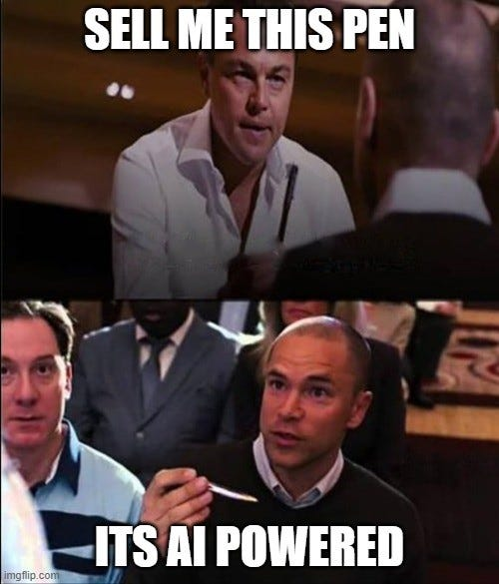
What is AI?

Slide 3
What is Generative AI?
Nowdays, it depends who you ask
Definition: “artificial intelligence designed to produce output, especially text or images, normally requiring human intelligence, typically by applying machine learning techniques to large collections of data.”

Slide 4
What is Generative AI?
Nowdays, it depends who you ask
Definition: “artificial intelligence designed to produce output, especially text or images, normally requiring human intelligence, typically by applying machine learning techniques to large collections of data.”
Researcher: Transformer modell mostly
Coorporate developer: OpenAI/Claude/etc API endpoints
Marketing, sales: everything
IT Security: huge money in the future
Nontechnical people: Terminator, Chatgpt

Slide 5
Timeline of Generative AI

Slide 6
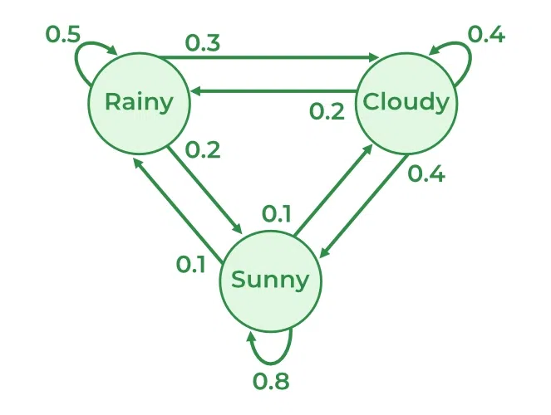
Foundations (1900s–1950s)
Markov Chains (1906) – Statistical sequence modeling
Alan Turing (1950) – Foundations of machine intelligence
Early computational theories of learning and logic

Slide 7
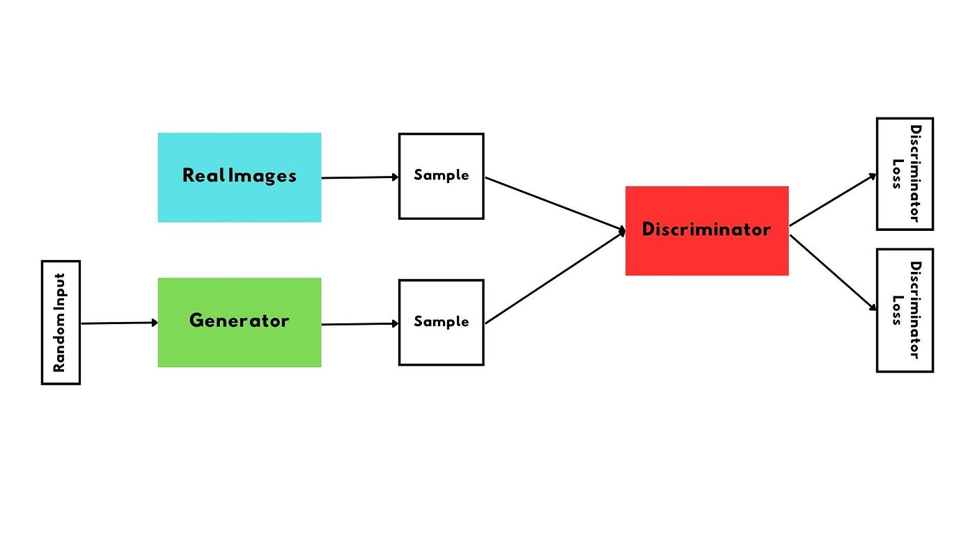
Deep Learning (2012–2014)
Convolutional Neural Networks
GANs (2014) – Generative Adversarial Networks for image generation

Slide 8
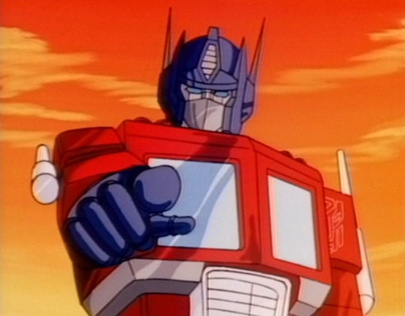
Transformer Era (2017)
'Attention Is All You Need' paper
Introduction of Transformer architecture
Foundation for modern large language models

Slide 9

Transformer Era (2017)
'Attention Is All You Need' paper
Introduction of Transformer architecture
Foundation for modern large language models

Slide 10
Large Language Models (2018–????)
GPT-1 (2018) – Pretrained transformer model
GPT-2 (2019) – Scaled coherent text generation
GPT-3 (2020) – 175B parameters, major leap in fluency
GPT-4, GPT-5, Claude, Gemini, Deepseek, ...........

Slide 11
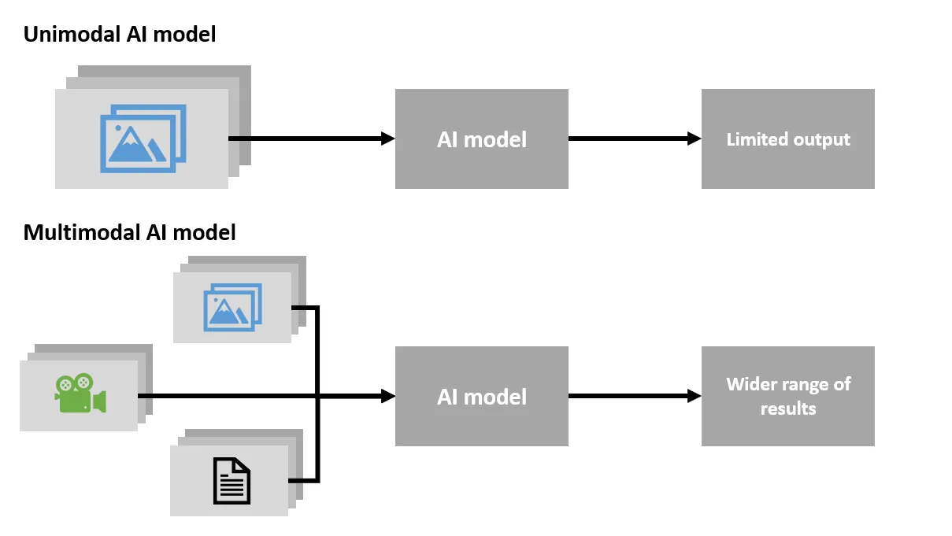
Multimodal & Enterprise Expansion (2023–2024)
Multimodal models (text, image, audio, video)

Slide 12

Current Trends & Future Directions (2025+)
AI agents and autonomous systems
Video and 3D world generation
Regulation, ethics, and responsible AI development

