Slide 1

Computer Networking: A Top Down Approach
Seventh Edition
Chapter 4
The Network Layer: Data Plane
Slides in this presentation contain hyperlinks. JAWS users should be able to get a list of links by using INSERT+F7
Copyright © 2017, 2013, 2010 Pearson Education, Inc. All Rights Reserved
Notes:
If this PowerPoint presentation contains mathematical equations, you may need to check that your computer has the following installed:
1) MathType Plugin
2) Math Player (free versions available)
3) NVDA Reader (free versions available)

Slide 2
Learning Objectives (1 of 7)
4.1 Overview of Network layer
data plane
control plane
4.2 What’s inside a router
4.3 I P: Internet Protocol
datagram format
fragmentation
I Pv4 addressing
network address translation
I Pv6
4.4 Generalized Forward and S D N
match
action
OpenFlow
examples of match-plus-action in action

Slide 3
Chapter 4: Network Layer
chapter goals:
understand principles behind network layer services, focusing on data plane:
network layer service models
forwarding versus routing
how a router works
generalized forwarding
instantiation, implementation in the Internet

Slide 4
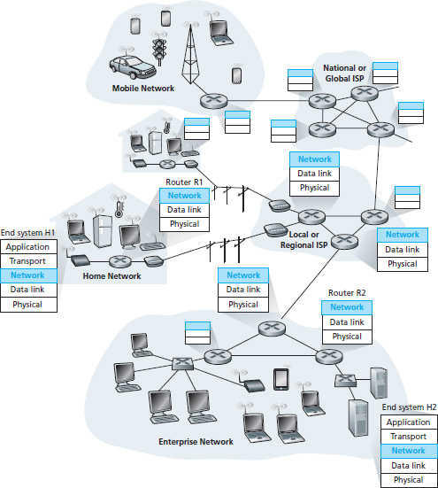
Network Layer
transport segment from sending to receiving host
on sending side encapsulates segments into datagrams
on receiving side, delivers segments to transport layer
network layer protocols in every host, router
router examines header fields in all I P datagrams passing through it

Slide 5
Two Key Network-Layer Functions
network-layer functions:
forwarding: move packets from router’s input to appropriate router output
routing: determine route taken by packets from source to destination
routing algorithms
analogy: taking a trip
forwarding: process of getting through single interchange
routing: process of planning trip from source to destination

Slide 6
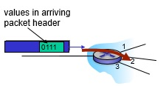
Network Layer: Data Plane, Control Plane
Data plane
local, per-router function
determines how datagram arriving on router input port is forwarded to router output port
forwarding function
Control plane
network-wide logic
determines how datagram is routed among routers along end-end path from source host to destination host
two control-plane approaches:
traditional routing algorithms: implemented in routers
software-defined networking (S D N): implemented in (remote) servers

Slide 7
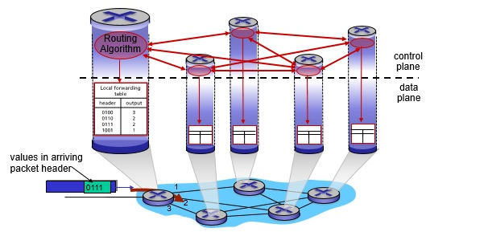
Per-Router Control Plane
Individual routing algorithm components in each and every router interact in the control plane

Slide 8
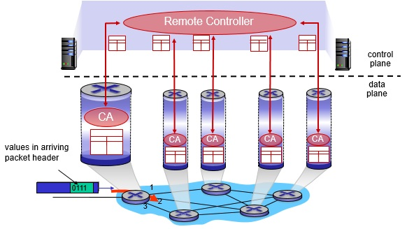
Logically Centralized Control Plane
A distinct (typically remote) controller interacts with local control agents (C A s)

Slide 9
Network Service Model
Q: What service model for “channel” transporting datagrams from sender to receiver?
example services for individual datagrams:
guaranteed delivery
guaranteed delivery with less than 40 msec delay
example services for a flow of datagrams:
in-order datagram delivery
guaranteed minimum bandwidth to flow
restrictions on changes in inter-packet spacing

Slide 10
Network Layer Service Models:
Network Architecture | Service Model | Guarantees ? Bandwidth | Guarantees ? Loss | Guarantees ? Order | Guarantees ? Timing | Congestion feedback
Internet | best effort | none | no | no | no | no (inferred via loss)
A T M | C B R | constant rate | yes | yes | yes | no congestion
A T M | V B R | guaranteed rate | yes | yes | yes | no congestion
A T M | A B R | guaranteed minimum | no | yes | no | yes
A T M | U B R | none | no | yes | no | no

Slide 11
Learning Objectives (2 of 7)
4.1 Overview of Network layer
data plane
control plane
4.2 What’s inside a router
4.3 I P: Internet Protocol
datagram format
fragmentation
I Pv4 addressing
network address translation
I Pv6
4.4 Generalized Forward and S D N
match
action
OpenFlow examples of match-plus-action in action

Slide 12
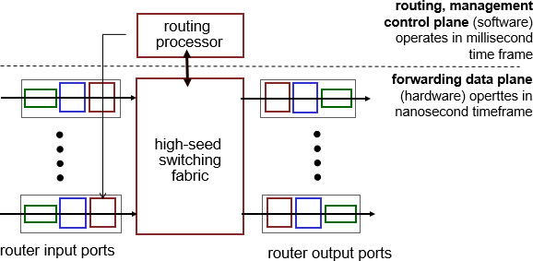
Router Architecture Overview
high-level view of generic router architecture:

Slide 13
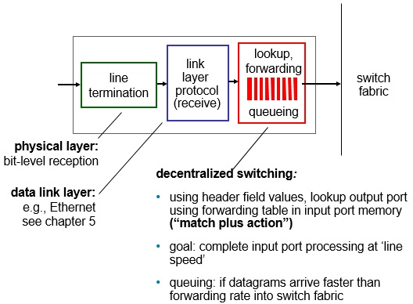
Input Port Functions (1 of 2)

Slide 14
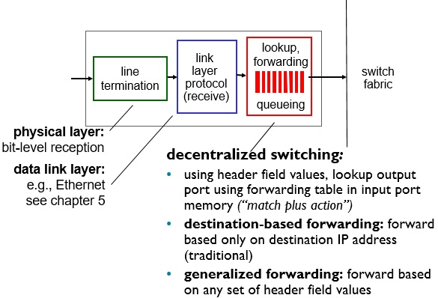
Input Port Functions (2 of 2)

Slide 15
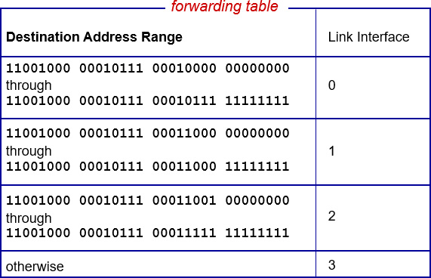
Destination-Based Forwarding
Q: but what happens if ranges don’t divide up so nicely?

Slide 16
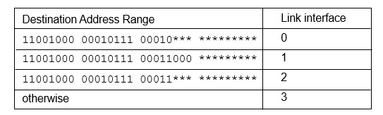
Longest Prefix Matching (1 of 2)
longest prefix matching
when looking for forwarding table entry for given destination address, use longest address prefix that matches destination address.
examples:

Slide 17
Longest Prefix Matching (2 of 2)
we’ll see why longest prefix matching is used shortly, when we study addressing
longest prefix matching: often performed using ternary content addressable memories (T C A M s)
content addressable: present address to T C A M : retrieve address in one clock cycle, regardless of table size
Cisco Catalyst: can up ~1M routing table entries in T C A M

Slide 18
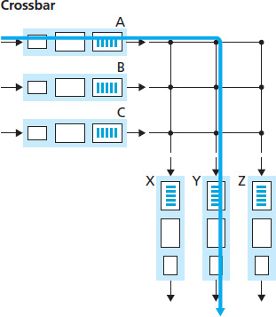
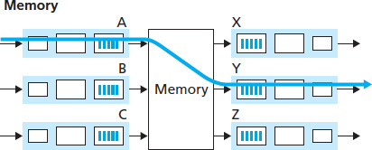
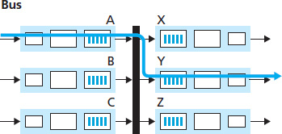
Switching Fabrics
transfer packet from input buffer to appropriate output buffer
switching rate: rate at which packets can be transfer from inputs to outputs
often measured as multiple of input/output line rate
N inputs: switching rate N times line rate desirable
three types of switching fabrics

Slide 19
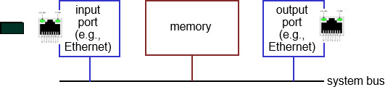
Switching via Memory
first generation routers:
traditional computers with switching under direct control of C P U
packet copied to system’s memory
speed limited by memory bandwidth (2 bus crossings per datagram)

Slide 20
Switching via a Bus
datagram from input port memory to output port memory via a shared bus
bus contention: switching speed limited by bus bandwidth
32 G b p s bus, Cisco 5600: sufficient speed for access and enterprise routers

Slide 21
Switching via Interconnection Network
overcome bus bandwidth limitations
banyan networks, crossbar, other interconnection nets initially developed to connect processors in multiprocessor
advanced design: fragmenting datagram into fixed length cells, switch cells through the fabric.
Cisco 12000: switches 60 Gbps through the interconnection network
Notes:
Crossbar 网络是互连网络中最一般的形式，是最严格意义下的无阻塞开关网络。Crossbar 网络由 N 个输入和 N 个输出构成，有 N²个交叉点，通过控制每个节点开关的状态，可以实现任意输入与输出之间的无阻塞连接，且每个输出通道都可以独立输出任意一个输入通道的数据。缺点是当通道数N增加，Crossbar 网络节点开关数迅速增加，网络复杂度迅速增大。
Crossbar 网络中每个节点称为一个switch，每个switch有两种状态,“BAR”代表直通状态，“CROSS”表示交换状态。后续介绍的网络节点也都采用switch构成。
banyan：榕树
Banyan 网络是一种内部阻塞结构型的互联网络。采用了一种蝶形的互联结构，节点开关数目远小于Crossbar网络。以16×16 的 Banyan 网络为例，每一级有 N∕2 个开关，共有 log2N 级，开关总数为8*4=32。而N=16的Crossbar网络需要16²=256个开关。 但是Banyan网络中会存在路径冲突,使得有些输出排序得不到实现。目前有许多方式可以消除Banyan 网络的路径冲突与阻塞，例如通过banyan网络与逆banyan网络的串联构成的双banyan互连网络能有效地解决路径的冲突与阻塞，这种串联的双banyan互连网络就是benes网络。

Slide 22
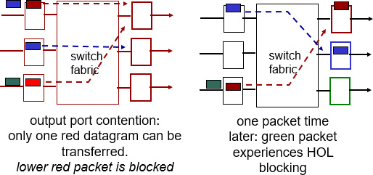
Input Port Queuing
fabric slower than input ports combined -> queueing may occur at input queues
queueing delay and loss due to input buffer overflow!
Head-of-the-Line (H O L) blocking: queued datagram at front of queue prevents others in queue from moving forward

Slide 23
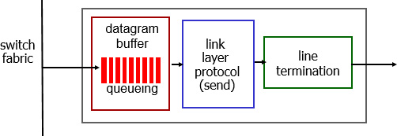
Output Ports
buffering required when datagrams arrive from fabric faster than the transmission rate
Datagram (packets) can be lost due to congestion, lack of buffers
scheduling discipline chooses among queued datagrams for transmission
Priority scheduling – who gets best performance, network neutrality

Slide 24
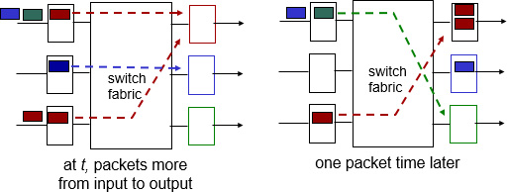
Output Port Queueing
buffering when arrival rate via switch exceeds output line speed
queueing (delay) and loss due to output port buffer overflow!

Slide 25
How Much Buffering?
R F C 3439 rule of thumb: average buffering equal to “typical” R T T (say 250 msec) times link capacity C
e.g., C = 10 G p b s link: 2.5 Gbit buffer
recent recommendation: with N flows, buffering equal to

Slide 26
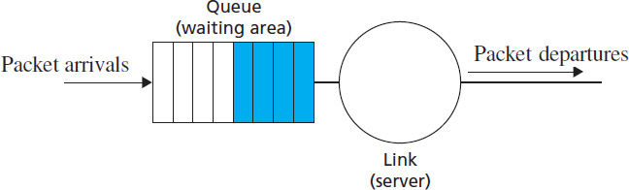
Scheduling Mechanisms
scheduling: choose next packet to send on link
F I F O (first in first out) scheduling: send in order of arrival to queue
real-world example?
discard policy: if packet arrives to full queue: who to discard?
tail drop: drop arriving packet
priority: drop/remove on priority basis
random: drop/remove randomly

Slide 27
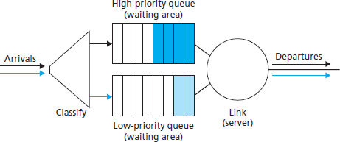
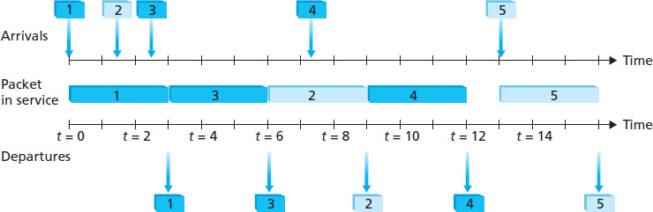
Scheduling Policies: Priority
priority scheduling: send highest priority queued packet
multiple classes, with different priorities
class may depend on marking or other header info, e.g. I P source/dest, port numbers, etc.
real world example?

Slide 28
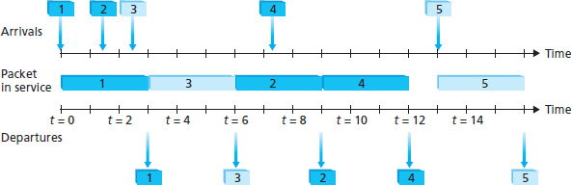
Scheduling Policies: Round Robin
Round Robin (R R) scheduling:
multiple classes
cyclically scan class queues, sending one complete packet from each class (if available)
real world example?

Slide 29
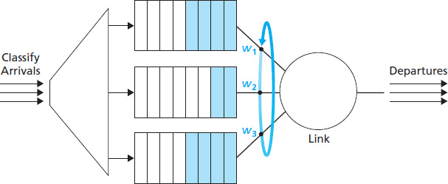
Scheduling Policies: Weighted Fair Queuing
Weighted Fair Queuing (W F Q):
generalized Round Robin
each class gets weighted amount of service in each cycle
real-world example?

Slide 30
Learning Objectives (3 of 7)
4.1 Overview of Network layer
data plane
control plane
4.2 What’s inside a router
4.3 I P: Internet Protocol
datagram format
fragmentation
I Pv4 addressing
network address translation
I Pv6
4.4 Generalized Forward and S D N
match
action
OpenFlow examples of match-plus-action in action

Slide 31
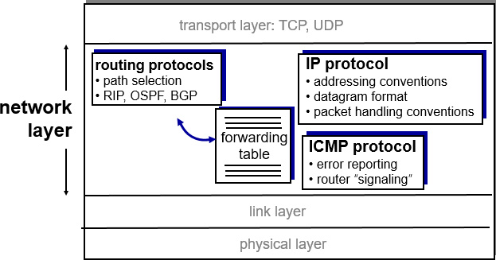
The Internet Network Layer
host, router network layer functions:

Slide 32
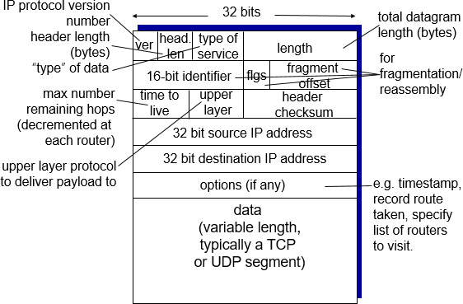
I P Datagram Format
how much overhead?
20 bytes of T C P
20 bytes of I P
= 40 bytes + app layer overhead

Slide 33
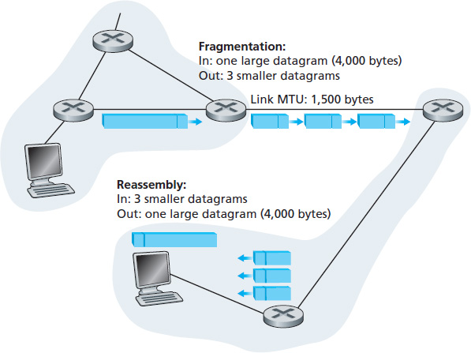
I P Fragmentation, Reassembly (1 of 2)
network links have M T U (max.transfer size) - largest possible link-level frame
different link types, different M T U s
large I P datagram divided (“fragmented”) within net
one datagram becomes several datagrams
“reassembled” only at final destination
I P header bits used to identify, order related fragments

Slide 34
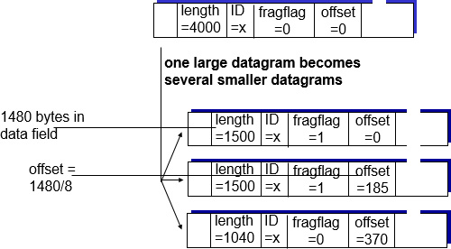
I P Fragmentation, Reassembly (2 of 2)
example:
4000 byte datagram
M T U = 1500 bytes

Slide 35
Learning Objectives (4 of 7)
4.1 Overview of Network layer
data plane
control plane
4.2 What’s inside a router
4.3 I P: Internet Protocol
datagram format
fragmentation
I Pv4 addressing
network address translation
I Pv6
4.4 Generalized Forward and S D N
match
action
OpenFlow examples of match-plus-action in action

Slide 36
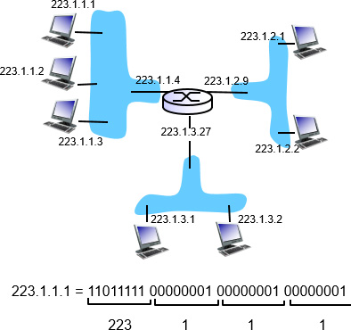
I P Addressing: Introduction (1 of 2)
I P address: 32-bit identifier for host, router interface
interface: connection between host/router and physical link
Router’s typically have multiple interfaces
host typically has one or two interfaces (e.g., wired Ethernet, wireless 802.11)
I P addresses associated with each interface

Slide 37
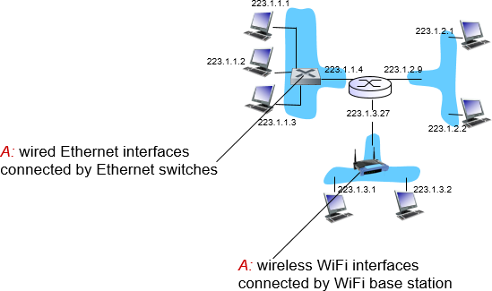
I P Addressing: Introduction (2 of 2)
Q: how are interfaces actually connected?
A: we’ll learn about that in chapter 5, 6.
For now: don’t need to worry about how one interface is connected to another (with no intervening router)

Slide 38
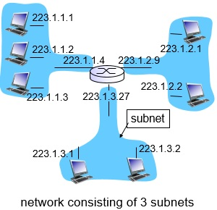
Subnets (1 of 3)
I P address:
subnet part - high order bits
host part - low order bits
What’s subnet ?
device interfaces with same subnet part of I P address
can physically reach each other without intervening router

Slide 39
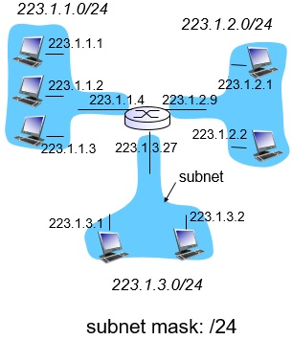
Subnets (2 of 3)
recipe
to determine the subnets, detach each interface from its host or router, creating islands of isolated networks
each isolated network is called a subnet

Slide 40
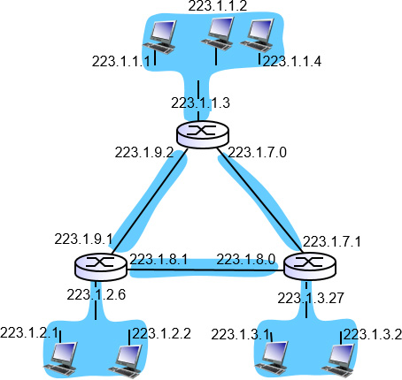
Subnets (3 of 3)
how many?

Slide 41
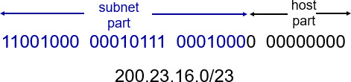
I P Addressing: C I D R
C I D R: Classless Inter Domain Routing
subnet portion of address of arbitrary length
address format:
where x is # bits in subnet portion of address

Slide 42
I P Addresses: How to Get One? (1 of 2)
Q: How does a host get I P address?
hard-coded by system admin in a file
Windows: control-panel->network->configuration->t c p/i p->properties
U N I X: /etc/rc.config
D H C P: Dynamic Host Configuration Protocol: dynamically get address from as server
“plug-and-play”

Slide 43
D H C P: Dynamic Host Configuration Protocol
goal: allow host to dynamically obtain its I P address from network server when it joins network
can renew its lease on address in use
allows reuse of addresses (only hold address while connected/”on”)
support for mobile users who want to join network (more shortly)
D H C P overview:
host broadcasts “D H C P discover” msg [optional]
D H C P server responds with “D H C P offer” msg [optional]
host requests I P address: “D H C P request” msg
D H C P server sends address: “D H C P ack” msg

Slide 44
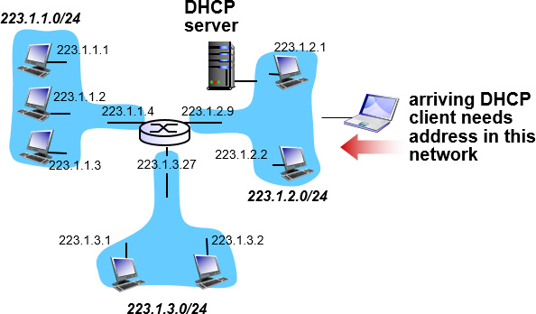
D H C P Client-Server Scenario (1 of 2)

Slide 45
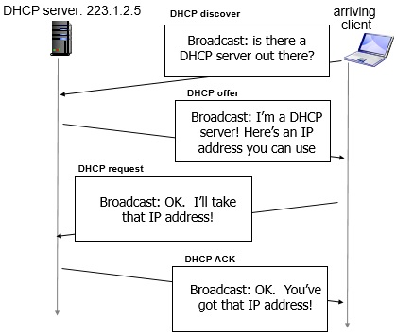
D H C P Client-Server Scenario (2 of 2)

Slide 46
D H C P: More Than I P Addresses
D H C P can return more than just allocated I P address on subnet:
address of first-hop router for client
name and I P address of D N S sever
network mask (indicating network versus host portion of address)

Slide 47
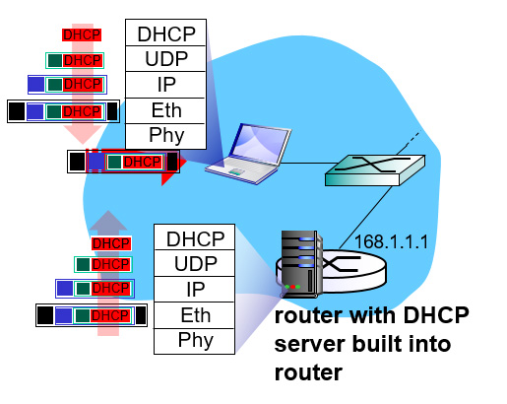
D H C P: Example (1 of 2)
connecting laptop needs its I P address, addr of first-hop router, addr of D N S server: use D H C P
D H C P request encapsulated in U D P, encapsulated in I P, encapsulated in 802.1 Ethernet
Ethernet frame broadcast (dest: FFFFFFFFFFFF) on LAN, received at router running D H C P server
Ethernet demuxed to I P demuxed, U D P demuxed to D H C P

Slide 48
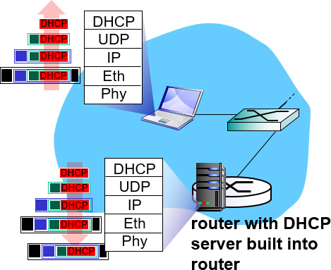
D H C P: Example (2 of 2)
D C P server formulates D H C P A C K containing client’s I P address, I P address of first-hop router for client, name & I P address of D S N server
encapsulation of D H C P server, frame forwarded to client, demuxing up to D H C P at client
client now knows its I P address, name and I P address of D S N server, I P address of its first-hop router

Slide 49
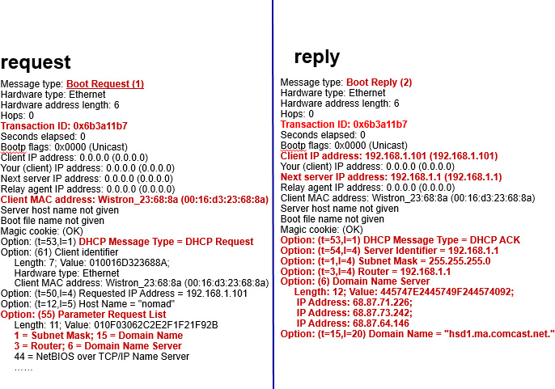
D H C P: Wireshark Output (Home LAN)

Slide 50
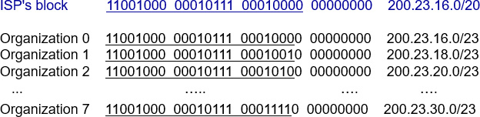
I P Addresses: How to Get One? (2 of 2)
Q: how does network get subnet part of I P addr?
A: gets allocated portion of its provider I S P’s address space

Slide 51
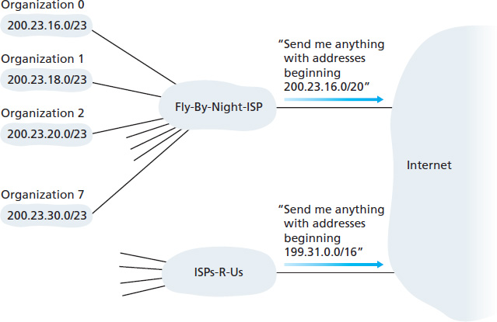
Hierarchical Addressing: Route Aggregation
hierarchical addressing allows efficient advertisement of routing information:

Slide 52
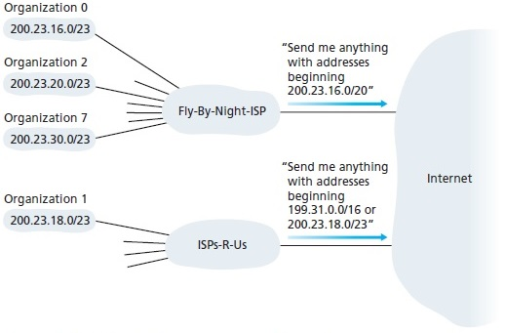
Hierarchical Addressing: More Specific Routes
I S P s-R-U s has a more specific route to Organization 1

Slide 53
I P Addressing: The Last Word
Q: how does an I S P get block of addresses?
A: I C A N N: Internet Corporation for Assigned Names and Numbers http://www.icann.org/
allocates addresses
manages D N S
assigns domain names, resolves disputes

Slide 54
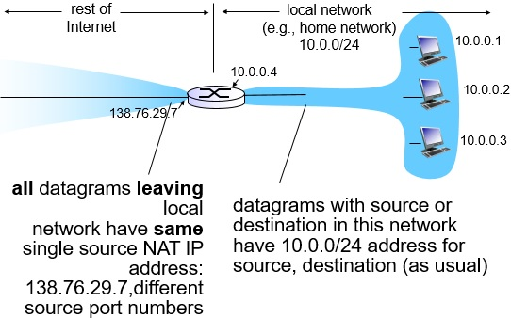
N A T: Network Address Translation (1 of 5)

Slide 55
N A T: Network Address Translation (2 of 5)
motivation: local network uses just one I P address as far as outside world is concerned:
range of addresses not needed from I S P: just one I P address for all devices
can change addresses of devices in local network without notifying outside world
can change I S P without changing addresses of devices in local network
devices inside local net not explicitly addressable, visible by outside world (a security plus)

Slide 56
N A T: Network Address Translation (3 of 5)
implementation: N A T router must:
outgoing datagrams: replace (source I P address, port #) of every outgoing datagram to (N A T I P address, new port #) . . . remote clients/servers will respond using (N A T I P address, new port #) as destination addr
remember (in N A T translation table) every (source I P address, port #) to (N A T I P address, new port #) translation pair
incoming datagrams: replace (N A T I P address, new port #) in dest fields of every incoming datagram with corresponding (source I P address, port #) stored in N A T table

Slide 57
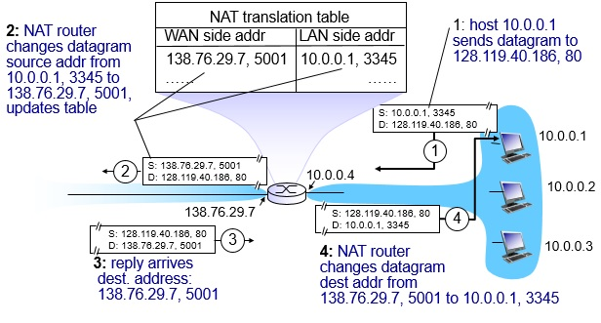
N A T: Network Address Translation (4 of 5)

Slide 58
N A T: Network Address Translation (5 of 5)
16-bit port-number field:
60,000 simultaneous connections with a single L A N-side address!
N A T is controversial:
routers should only process up to layer 3
address shortage should be solved by I P v 6
violates end-to-end argument
N A T possibility must be taken into account by app designers, e.g., P 2 P applications
N A T traversal: what if client wants to connect to server behind N A T?

Slide 59
Learning Objectives (5 of 7)
4.1 Overview of Network layer
data plane
control plane
4.2 What’s inside a router
4.3 I P: Internet Protocol
datagram format
fragmentation
I Pv4 addressing
network address translation
I Pv6
4.4 Generalized Forward and S D N
match
action
OpenFlow examples of match-plus-action in action

Slide 60
I P v 6: Motivation
initial motivation: 32-bit address space soon to be completely allocated.
additional motivation:
header format helps speed processing/forwarding
header changes to facilitate Q o S
I P v 6 datagram format:
fixed-length 40 byte header
no fragmentation allowed

Slide 61
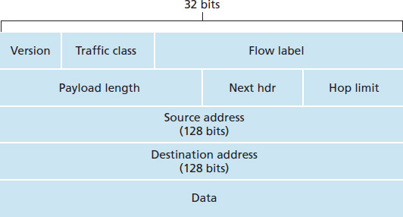
I P v 6 Datagram Format
priority: identify priority among datagrams in flow
flow Label: identify datagrams in same “flow.” (concept of ”flow” not well defined).
next header: identify upper layer protocol for data

Slide 62
Other Changes from I P v 4
checksum: removed entirely to reduce processing time at each hop
options: allowed, but outside of header, indicated by “Next Header” field
I C M P v 6: new version of I C M P
additional message types, e.g. “Packet Too Big”
multicast group management functions

Slide 63
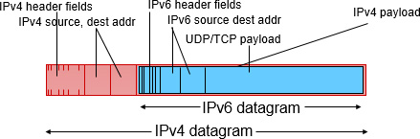
Transition from I P v 4 to I P v 6
not all routers can be upgraded simultaneously
no “flag days”
how will network operate with mixed I P v 4 and I P v 6 routers?
tunneling: I P v 6 datagram carried as payload in I P v 4 datagram among I P v 4 routers

Slide 64
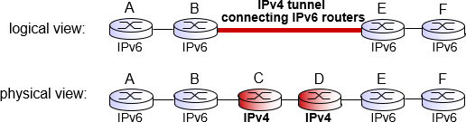
Tunneling (1 of 2)

Slide 65
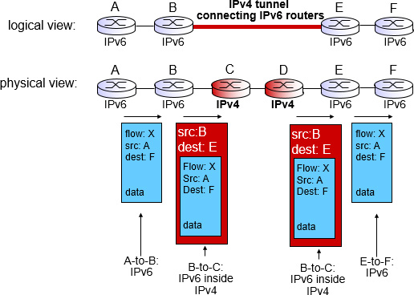
Tunneling (2 of 2)

Slide 66
I P v 6: Adoption
Google: 8% of clients access services via I P v 6
N I S T: 1/3 of all U S government domains are I P v 6 capable
Long (long!) time for deployment, use
20 years and counting!
think of application-level changes in last 20 years: WWW, Facebook, streaming media, Skype, …
Why?

Slide 67
Learning Objectives (6 of 7)
4.1 Overview of Network layer
data plane
control plane
4.2 What’s inside a router
4.3 I P: Internet Protocol
datagram format
fragmentation
I Pv4 addressing
network address translation
I Pv6
4.4 Generalized Forward and S D N
match
action
OpenFlow examples of match-plus-action in action

Slide 68
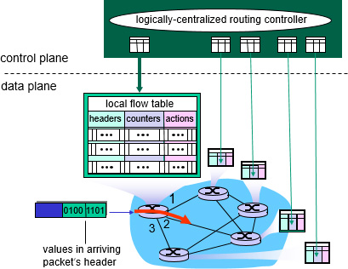
Generalized Forwarding and S D N
Each router contains a flow table that is computed and distributed by a logically centralized routing controller

Slide 69

OpenFlow Data Plane Abstraction (1 of 2)
flow: defined by header fields
generalized forwarding: simple packet-handling rules
Pattern: match values in packet header fields
Actions: for matched packet: drop, forward, modify, matched packet or send matched packet to controller
Priority: disambiguate overlapping patterns
Counters: #bytes and #packets
Flow table in a router (computed and distributed by controller) define router’s match+action rules

Slide 70

OpenFlow Data Plane Abstraction (2 of 2)
* : wildcard

Slide 71
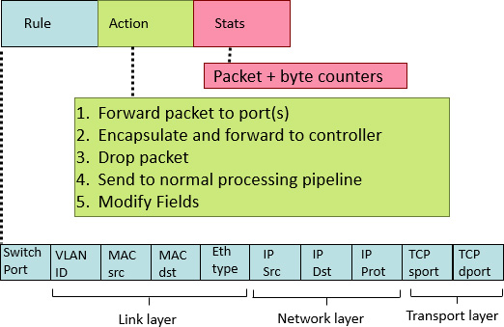
OpenFlow: Flow Table Entries

Slide 72
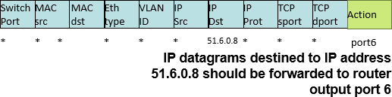
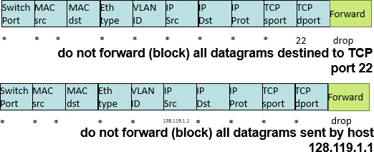
Example (1 of 2)
Destination-based forwarding:
Firewall:

Slide 73
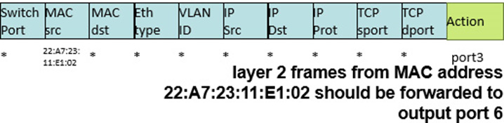
Example (2 of 2)
Destination-based layer 2 (switch) forwarding:

Slide 74
OpenFlow Abstraction (1 of 2)
match+action: unifies different kinds of devices
Router
match: longest destination I P prefix
action: forward out a link
Switch
match: destination MAC address
action: forward or flood

Slide 75
OpenFlow Abstraction (2 of 2)
Firewall
match: I P addresses and T C P/U D P port numbers
action: permit or deny
N A T
match: I P address and port
action: rewrite address and port

Slide 76

OpenFlow Example
Example: datagrams from hosts h5 and h6 should be sent to h3 or h4, via s1 and from there to s2

Slide 77
Learning Objectives (7 of 7)
4.1 Overview of Network layer
data plane
control plane
4.2 What’s inside a router
4.3 I P: Internet Protocol
datagram format
fragmentation
I Pv4 addressing
network address translation
I Pv6
4.4 Generalized Forward and S D N
Match plus action
OpenFlow examples of match-plus-action in action
Question: how do forwarding tables (destination-based forwarding) or flow tables (generalized forwarding) computed?
Answer: by the control plane (next chapter)

Slide 78

Copyright

