Slide 1
Bachelor of Science (Honours) in Data Science and Artificial Intelligence
DA 102 – Sixth Lab

Slide 2
Pivot Tables & Data Validation

Slide 3
Problem 1
Worksheet week06-problem1 contains sales and services data of an organization
This sheet contains 17 columns, 68615 rows.
You task is to obtain one pivot table for each of the following queries
Obtain Total sales amount
Total sales by market
Total sales for each branch
Total sales for each branch and each market
Total sales by City

Slide 4
Problem 1
Total sales for each branch, each market and for every city
Total sales for each state
Total sales for each state and each city
Average sales for each state
Variance of sales in each state
Total sales by product number across Branch
Totals sales by product number filtered by branch

Slide 5
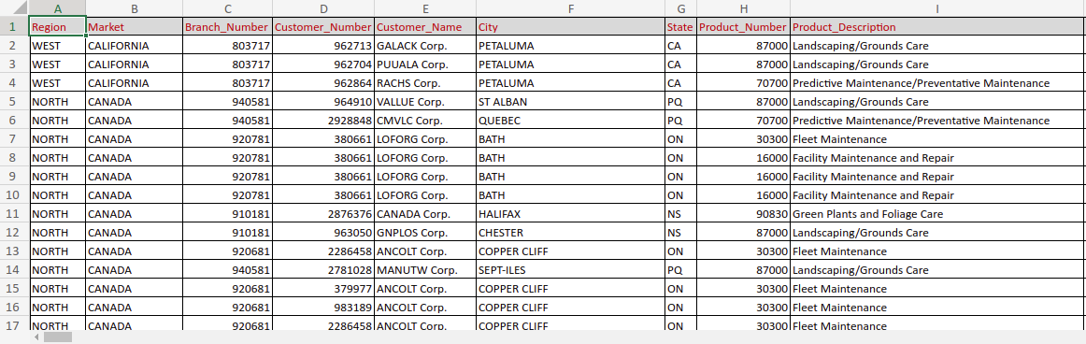
Problem 1

Slide 6
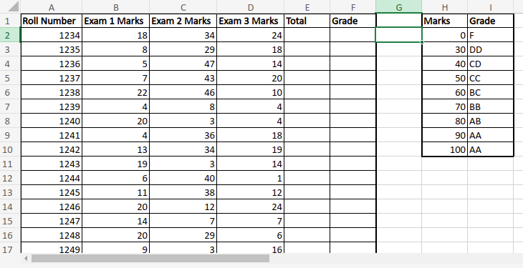
Problem 2
Worksheet week06-problem2 contains marks data of each student
Obtain the data validation rules for each of the below.
Exam 1 marks should be between 0 and 25
Exam 2 marks should be between 0 and 50
Exam 3 marks should be between 0 and 25
Roll numbers should be from 1234 to 1299
Total marks should be between 0 and 100
Grade should be among one of the letter grades

Slide 7
Problem 3
Worksheet week06-problem3 has sales and services data of a certain company
Place the following data validation rules:
Region should be one of {West, North, South, Midwest}
Market should be from {CALIFORNIA, CANADA, FLORIDA, BUFFALO, DENVER, KANSAS CITY, NEWORLEANS, MICHIGAN, PHOENIX, CHARLOTTE, DALLAS, NEW YORK, TULSA, SEATTLE}
State should be from one of the unique states in column G.
Sales representative should be one of the unique in column Q.

Slide 8
Problem 3

Slide 9
Thank You!

