Slide 1
TODO Management System
Sreerekha Deb
17 Jun 2015

Slide 2
Functional Requirements
Create a command line based utility to manage the TODO lists
And support for features like
Create a list
Add items to a list
View the list
Modify /Edit the list
Mark the finished tasks as Done and they need to be moved to a RECENTLY FINISHED list.

Slide 3
Functional Requirements
The items in the RECENTLY FINISHED list need to be auto deleted in 3days.

Slide 4
Softwares
Java .
Hibernate .
SQLLite - Backend .
Junit - creating unit test cases .
Maven – to create build process .
TravisCI – to integrate the Unit tests .

Slide 5
Conceptual Diagram
APPLICATION CLASSES
HIBERNATE
JDBC
DATABASE SERVER

Slide 6
Hibernate
Why do we need to use this ?
Hibernate ORM is concerned with helping the application to achieve persistence.
What is persistence ?
Persistence simply means that we would like our application’s data to outlive the applications process. In Java terms, we would like the state of (some of) our objects to live beyond the scope of the JVM so that the same state is available later.
How can we use it in the present context.

Slide 7
Hibernate contd

Slide 8
SQLlite
Need to test the JDBC based functionality with this database ..

Slide 9
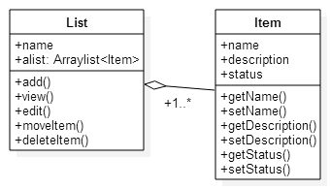
Class Diagram

