Slide 1
PROJECT TITLE Secure data Hiding in images using steganography
CAPSTONE PROJECT
Presented By: Debasish Acharjee
Student Name : Debasish Acharjee
College Name & Department : Narula Institute Of Technology & BCA

Slide 2
OUTLINE
Problem Statement
Technology used
Wow factor
End users
Result
Conclusion
Git-hub Link
Future scope

Slide 3
Problem Statement
Quality Degradation: Altering an image, audio, or video file to embed information can affect its quality.
Detection: Detecting steganography can be a significant concern, especially if the method is not robust enough against statistical analysis or pattern recognition.

Slide 4
Technology used
Hardware Need
RAM 4 GB
PROCSSOR I3/Relatable
Internet
Only Basic things needed
Software Need
Python 3
Vscode
CV2

Slide 5
Wow factors
The "Secure Data Hiding in Images Using Steganography" project enhances traditional steganography with several key features:
Enhanced Security: Combines AES or RSA encryption with steganography for stronger protection.
Robustness: Ensures resilience against attacks like compression and cropping.
High Payload Capacity: Optimizes data embedding to maximize storage without degrading image quality.
Real-time Processing: Enables fast data hiding and extraction for secure messaging. User-friendly Interface: Provides an intuitive GUI for non-technical users.
Multiple Media Support: Extends functionality to audio and video.
Adaptive Techniques: Uses machine learning for optimal data embedding locations.
File Integrity Checks: Ensures data and cover image integrity with checksums or hashes.
Steganalysis Resistance: Reduces detectability by steganalysis tools.
Ethical Framework: Establishes guidelines for responsible usage.
By integrating these features, the project enhances both security and usability, making it a robust steganography solution.

Slide 6
End users
Cybersecurity Professionals:
Cybersecurity Professionals:
Cybersecurity Professionals:
Digital Artists:
Legal Professionals:

Slide 7
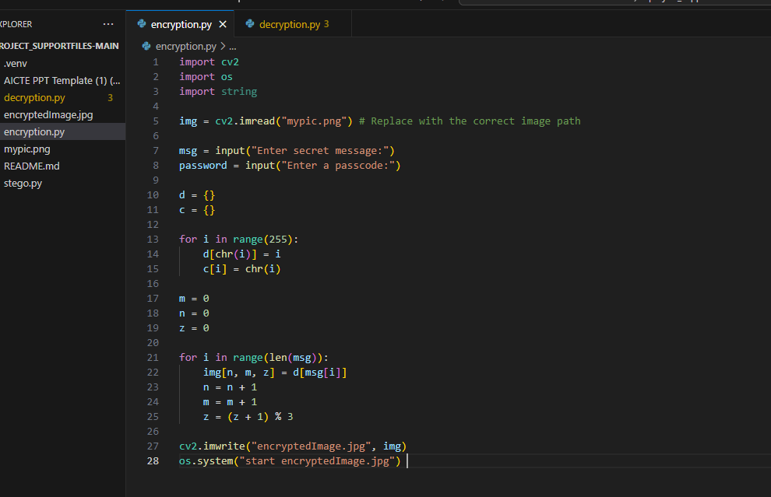
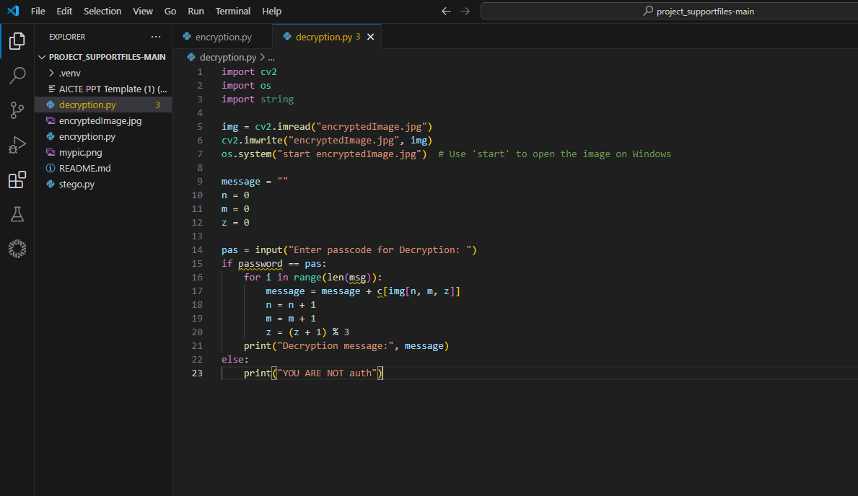


Results
Encryption code
Decryption code
Encryption Image
Decryption Image

Slide 8
Conclusion
In conclusion, the project “Secure Data Hiding in Images Using Steganography” demonstrates a comprehensive approach to embedding information within images while prioritizing security and usability.
The incorporation of advanced encryption algorithms, robust protection against various attacks, and a focus on high payload capacity ensures that sensitive data remains confidential and secure. he development of a user-friendly interface and real-time processing capabilities makes the technology accessible to both technical and non-technical users, thus broadening its potential applications.

Slide 9
GitHub Link
https://github.com/Deba6290/Project-aicte.git

Slide 10
Future scope(optional)
Enhanced Security Protocols: As cybersecurity threats evolve, steganography will likely integrate with advanced encryption techniques to provide more robust security mechanisms.
Forensics and Detection: As steganography practices become more sophisticated, the field of digital forensics will also evolve to include more advanced detection techniques.
Regulatory Compliance: As data privacy laws become stricter worldwide, organizations may leverage steganography as a means to comply with regulations that mandate data protection, ensuring that sensitive information remains secure.

Slide 11
THANK YOU

