Slide 1
Hackfest 2020
Idea Submission

Slide 2
Team name :- Code Junkies
Team Members :-
Debabrata Mukherjee (University of Calcutta)(2020)(CSE) Utkarsh Mishra (Oriental Institute of Science and Technology, Bhopal)(2020)(CSE)
THEME:
Telecom Customer Churn Detection & Retention

Slide 3
PROBLEM STATEMENT
The Goal of our project is to
Identify the reason for the churn of customers
Analyze if a customer has propensity to churn
Suggest possible solutions to reduce this churn

Slide 4
Workflow Of Our Idea
Train the data using Random Forest Classifier. Categorical values are converted using Labeled Encoder
Split the data into Training set(80%) and Test Set(20%)
For given set of inputs, Predict if a customer has propensity to churn
Convert dataset into dataframe using Pandas
Prediction for churning
Solution for Churning
If a Sub-range of that feature is found to have considerable probability of churning, It is highly recommended not to keep that feature_value in that subrange
Divide those important features into sub-ranges and calculate probability of churning in those sub-ranges
Find out important features using feature_importances library of Random Forest Classifier

Slide 5
Components Used
For Classification Purpose, Random Forest Classifier is used because
It is a Robust Method. So, Classification is also pretty accurate
It provides a good indicator of feature importance. So, to detect reasons for such result, this feature becomes pretty handy

Slide 6
Solution 1 :- Predicting propensity of Churning
Steps :-
Read the dataset using Pandas Library
Convert all Categorical Data using Labeled Encoder (as number of classifications are low)
Split the data into training set(80%) and test set (20%)
Train the data using Random Forest Classifier
Predict the output for test set data
Find out accuracy of prediction using Classifier.score( ) method
Result :- Accuracy of Prediction = 80%

Slide 7
Solution 2 :- Reasons of churning and Solutions
Steps :-
Step 1 :-
After Training of data, Find the importance of each feature using Classifier.feature_importances( ) method , i.e , How good each feature splits the result.
The result we got from the dataset was :-

Slide 8
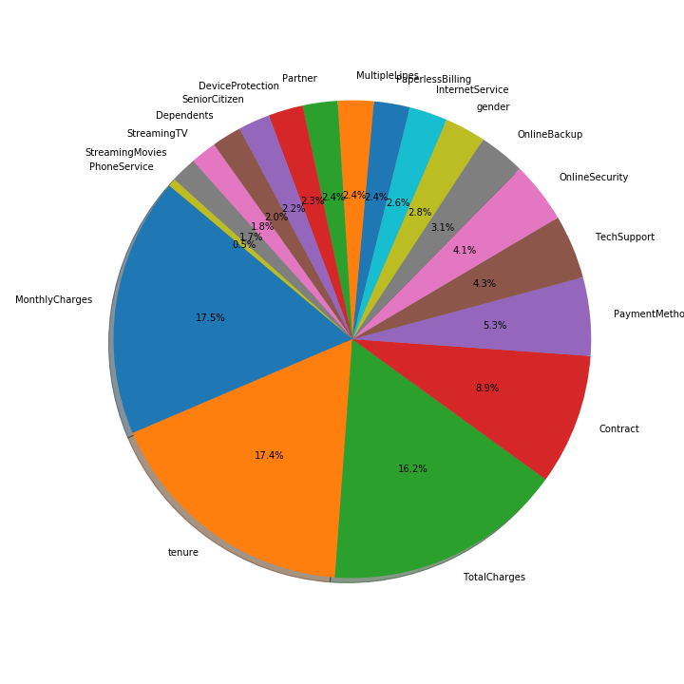
From the Pie Chart, It is evident that Tenure , MonthlyCharges and TotalCharges are most important features

Slide 9
Solution 2 (Continued….)
Step 2 :-
Now, after finding feature importance, we create subdivisions for each of those important features and find out the probability of churning for each range .
The result we got was :-

Slide 10
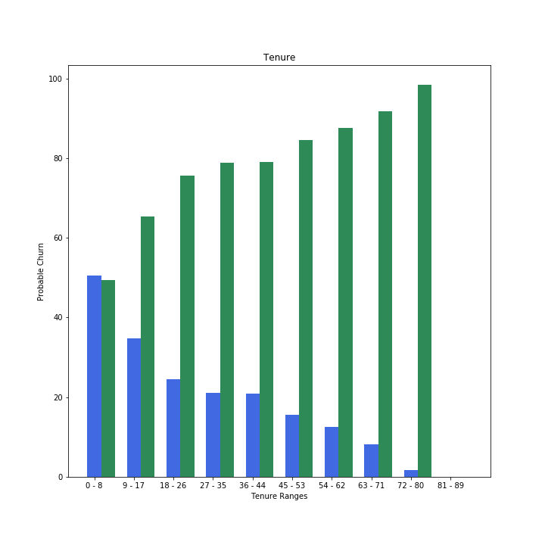
For Tenure
In tenure range 0 - 17, churn rate is quite high. So, Don’t keep tenure value in this range.

Slide 11
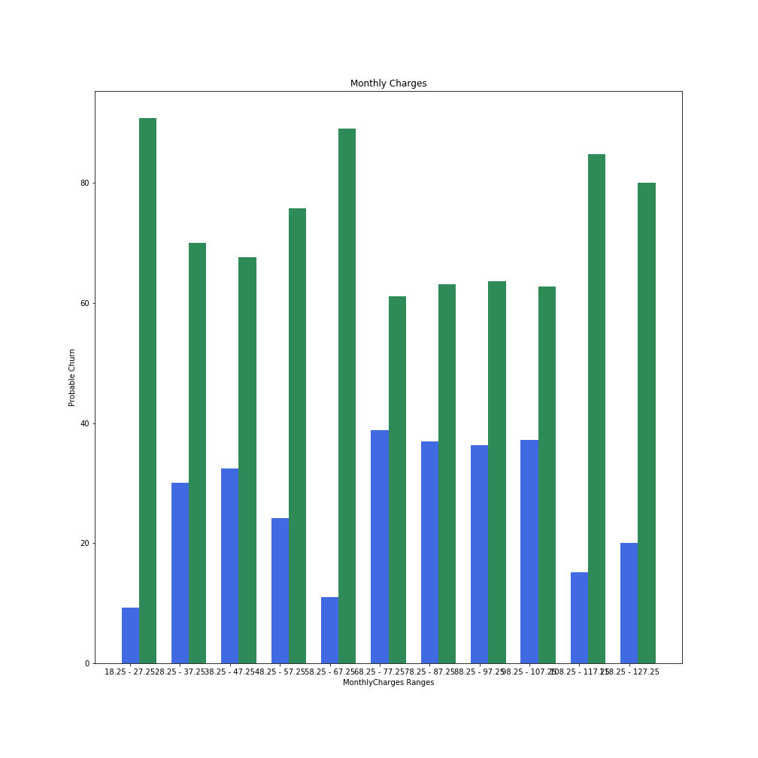
For Monthly Charges
In the range 28.25 - 57.25 & 68.25 - 107.25 , churn rate is high. So, dont keep monthly charges value in this range

Slide 12
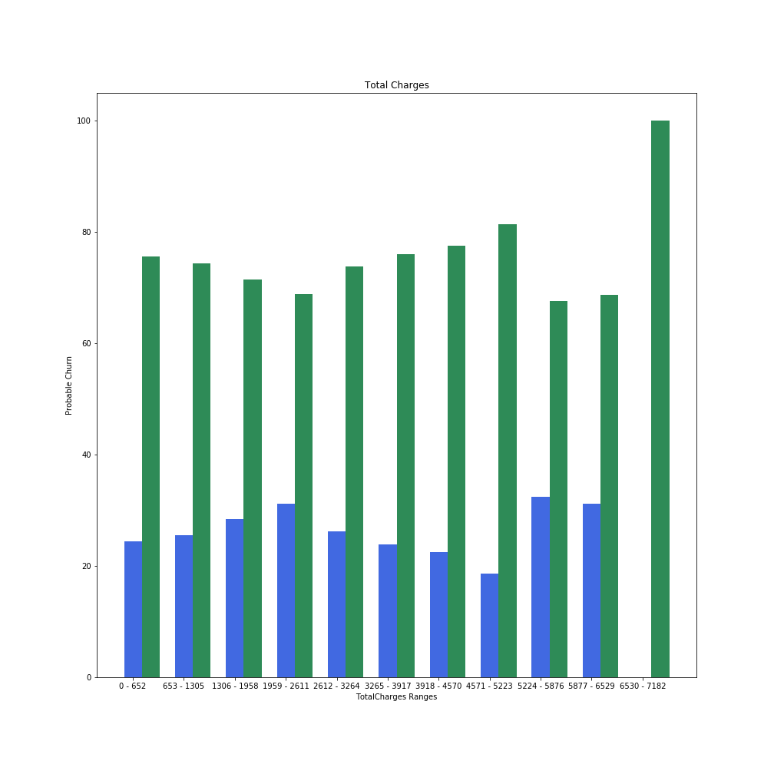
For total Charges
In the range 1959-3264 & 5224 - 5876 , churn rate is high. So, dont keep total charges value in this range

Slide 13
Social Impact
This project will help Telecom industries to determine the range of values for which the churn rate is high and avoid being on those ranges. This will help the company to amplify its growth. This method will also make customer happy, after all, That is all what takes for an industry to succeed.

Slide 14
Further Improvement of this project
In this project, churn rate is calculated for only those features which were deemed important as a single parametre by random classifier model. All the lower importance parametres have been ignored. However, there may be cases in which two parametres may have lower importance value alone, but combined, thay may produce much better significance value. This Factor has been ignored here, reserved for future works.

Slide 15

THANK YOU
Amdocs Hackfest 2020 - College Students | Programming challenges in January, 2020

