Slide 1

Human Detection Sensor And Fall Detection Sensor

Slide 2

Contain:
Sensors And Microcontroller
Circuit Diagram
How to connect
How to Improve for Better Results
Cost

Slide 3
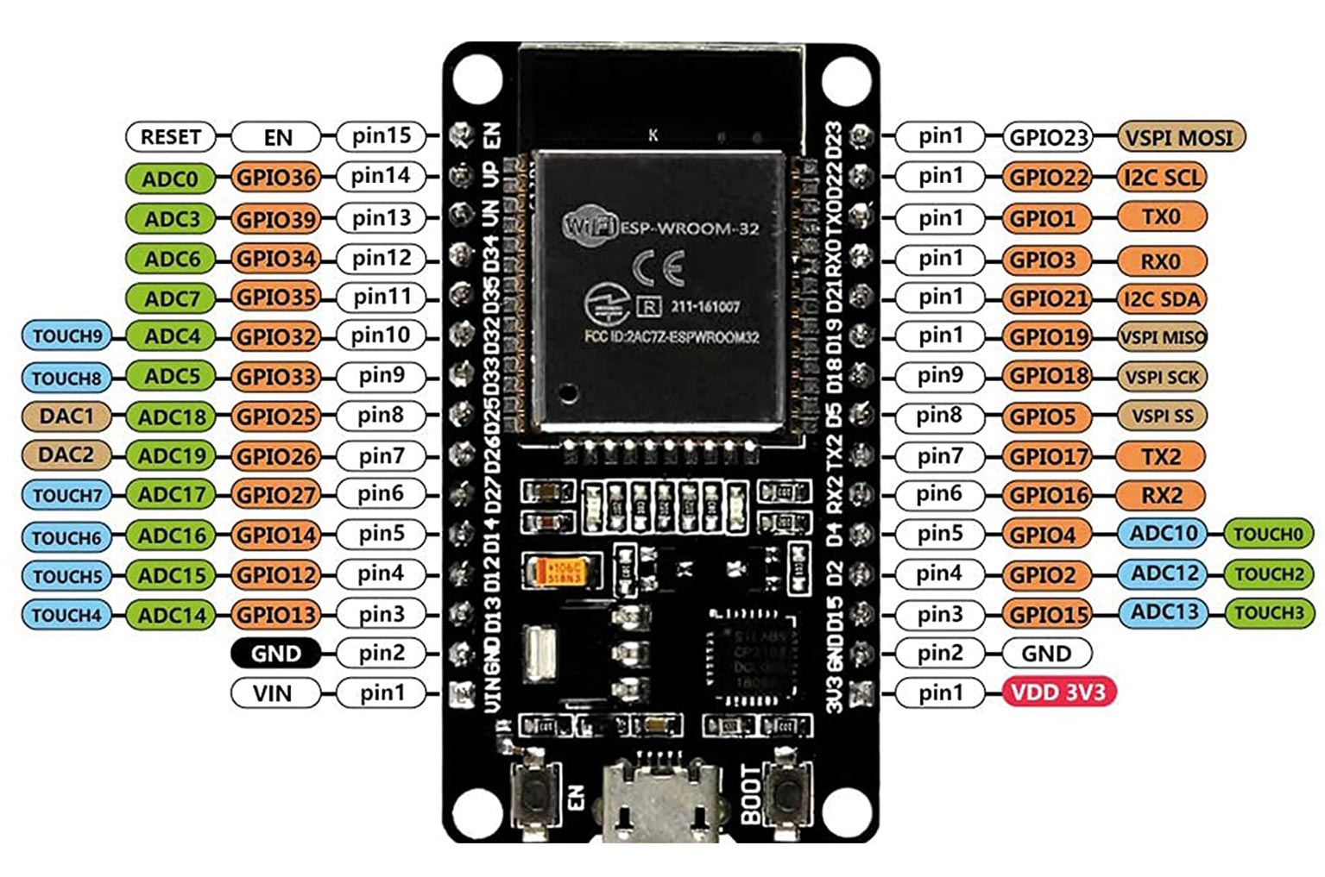
Microcontroller:
we use ESP32 as a microcontroller. ESP32 is the SoC (System on Chip) microcontroller which has gained massive popularity recently.
Integrated Crystal− 40 MHz
Module Interfaces− UART, SPI, I2C, PWM, ADC, DAC, GPIO, pulse counter, capacitive touch sensor
Integrated SPI flash− 4 MB
ROM− 448 KB (for booting and core functions)
SRAM− 520 KB
Integrated Connectivity Protocols− WIFI, Bluetooth, BLE
On−chip sensor− Hall sensor
Operating temperature range− −40 − 85 degrees Celsius
Operating Voltage− 3.3V
Operating Current− 80 mA (average)
For transmitting data, ESP32 has integrated WIFI and Bluetooth stacks, which have proven to be a game-changer. No need to connect a separate module (like a GSM module or an LTE module) for testing cloud communication. Just have the ESP32 board and a running WIFI, and you can get started. ESP32 allows you to use WIFI in Access Point as well as Station Mode. While it supports TCP/IP, HTTP, MQTT, and other traditional communication protocols, it also supports HTTPS.

Slide 4
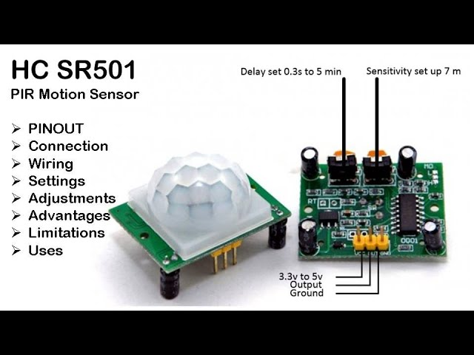
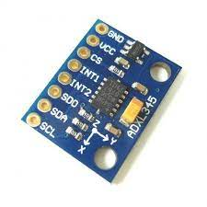
SENSOR
1: PIR Sensor:
A passive infrared (PIR) sensor is an electronic sensor that measures infrared (IR) light radiating from objects in its field of view. They're most frequently utilized in PIR-based motion detectors.
Specification of PIR Sensor:
Detection range: up to 7 meters
Detection angle: 110 degrees
Operating voltage: DC 4.5V - 12V DC
Output signal: 3.3V digital output
Delay time: adjustable from 0.3 seconds to 5 minutes
Operating temperature: -15°C to +70°C
Sensitivity: Adjustable
2: MPU-6050 Sensor:
The MPU6050 is a six-axis motion tracking device that uses a 3-axis accelerometer and a 3-axis gyroscope to calculate movement. It's also an Inertial Measurement Unit (IMU) device.

Slide 5
Specification of MPU6050 Sensor
Gyroscope:
3-axis sensing with a full-scale range of ±250, ±500, ±1000, or ±2000 degrees per second (DPS)
Sensitivity of 131, 65.5, 32.8, or 16.4 LSBs per DPS
Output data rate (ODR) range of 8kHz to 1.25Hz
Accelerometer:
3-axis sensing with a full-scale range of ±2g, ±4g, ±8g, or ±16g
Sensitivity of 16384, 8192, 4096, or 2048 LSBs per g
ODR range of 8kHz to 1.25Hz
Temperature Sensor:
Operating range of -40°C to +85°C
Sensitivity of 340 LSBs per degree Celsius
Accuracy of ±3°C
Supply Voltage:
Operating voltage range of 2.375V to 3.46V for the MPU-6050, and 2.375V to 5.5V for the MPU-6050A
Communication Interface:
I2C serial interface with a maximum clock frequency of 400kHz
8-bit and 16-bit register access modes
Other Features:
Digital Motion Processor (DMP) for complex motion processing
On-chip 16-bit ADCs for accurate analog-to-digital conversion
Programmable digital filters for improved noise performance
Interrupts for triggering events based on specific motion conditions
Low-power consumption (3.9mA for full operation)

Slide 6
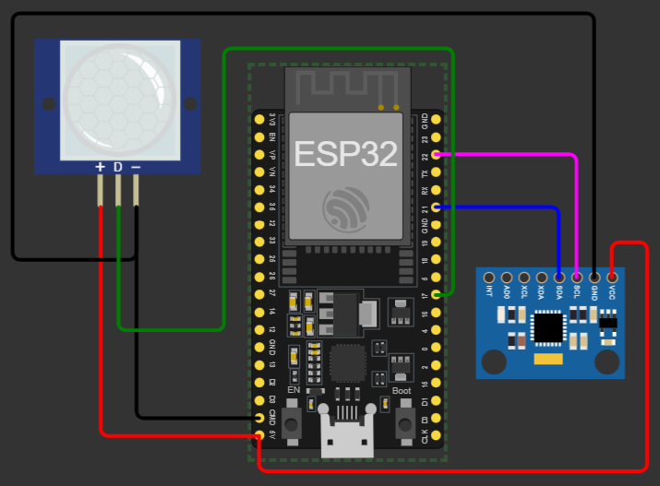
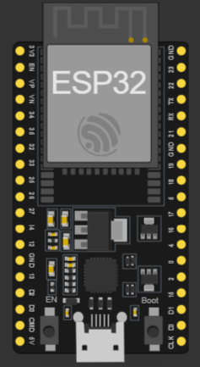
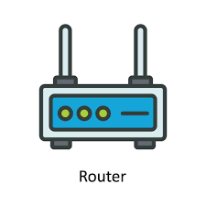
Circuit Diagram
Device1
Device2
ESP NOW PROTOCOL
Wi-Fi
Device3
Device4

Slide 7
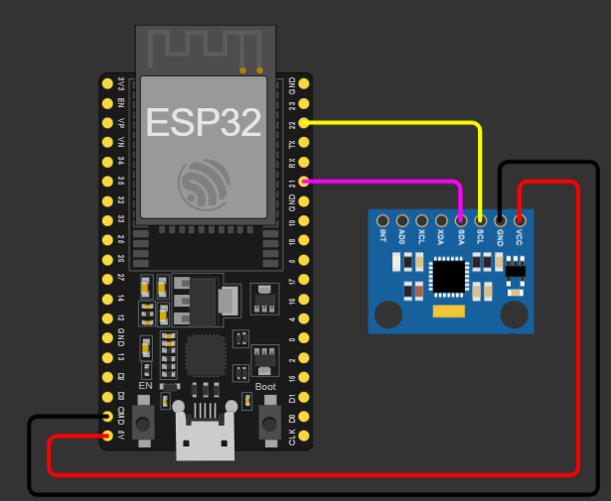
Person 1
Fall Detection Device Circuit Diagram
Wi-Fi
ESP now protocol
Person 2

Slide 8
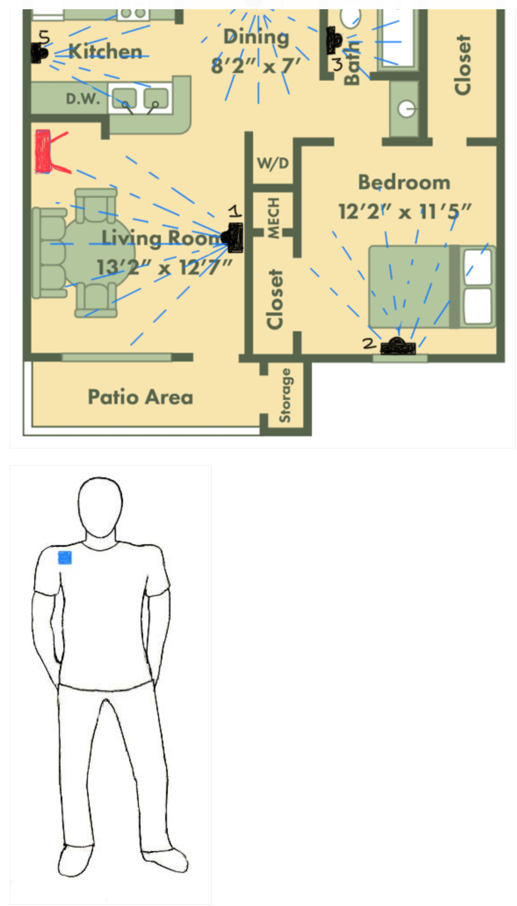
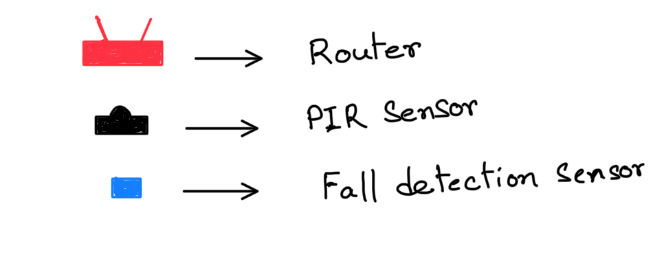
1: MPU-6050 sensor attached to the doors and PIR sensor attached on the door side wall.
2: The Fall detection Device also contains one MPU-6050 sensor and it is attached to the person’s shoulder position on the clothes.

Slide 9
How to Improve for Better Results
If we use 24GHz mm-Wave Sensor - Human Static Presence Module Lite (MR24HPC1) instead of a PIR sensor.
Introduction​:
24GHz mm-Wave Sensor - Human Static Presence Module Lite is an antenna-integrated, health-friendly mm-wave radar sensor that applies FMCW ranging technology, with operation in 24GHz, for implementation of human presence, independently of environmental influences. This is also a personalized radar that users can configure underlying parameters of to determine detected functions.
Application​
Automatically outdoor lighting
Automated door opening
Whole house monitor
Intelligent home appliances (TV, bath bully, security, etc.)
Office energy (air conditioning, lighting)
Sleep monitoring curve
Home Security
IPC trigger
Features​:
Human presence mm-wave radar: Apply FMCW ranging technology, with operation in 24GHz and 5 meters detection range, for detecting human behavior in the sensing area
Personalized radar detection: Provide configurable detection range, motion trigger, state change time, as well as visual debugging software to meet the requirements of various scenarios
Health-friendly working status: Output power as low as harmless to the human body
High immunity against interferences: Output data independently of environmental influences like temperature, humidity, noise, airflow, dust, light.

Slide 10
60GHz mm-Wave Sensor - Human Static Sleep Breathing Monitoring (MR60BHA1)
Introduction​:
The MR60BHA1 60GHz radar module applies FMCW detected theory to implement simultaneous personal breathing rate and heart rate detention in high accuracy, providing a fully total private and secure environment, independently from other noisy influences. It is a standard biotic radar system in consumer electronics, healthcare as well as industrial applications. In this wiki, we will introduce you how to utilize it.
Application​:
Smart home
Health care
Breathing rate detection
Heartbeat rate detection
Smart hotel
Medical assistants
Feature​:
Enabled theory: Implement radar detection based on FMCW FM continuous wave signals
Standard algorithm: Sense and output simultaneously human respiratory rate and heart rhythm in the self-adaption environment
Perfect privacy protection: Apply FMCW monitoring technology to provide surveillance capabilities without identification
Health-friendly working status: Output power as low as harmless to the human body
High stability: Independ from temperature, humidity, noise, airflow, dust, light, and other environmental influences
High measured accuracy: Achieve heartbeat accuracy up to 85% and achieve breathing accuracy up to 90 %
High flexibility hardware design radar: Support secondary development, adapt to various scenarios applications
Independent

Slide 11
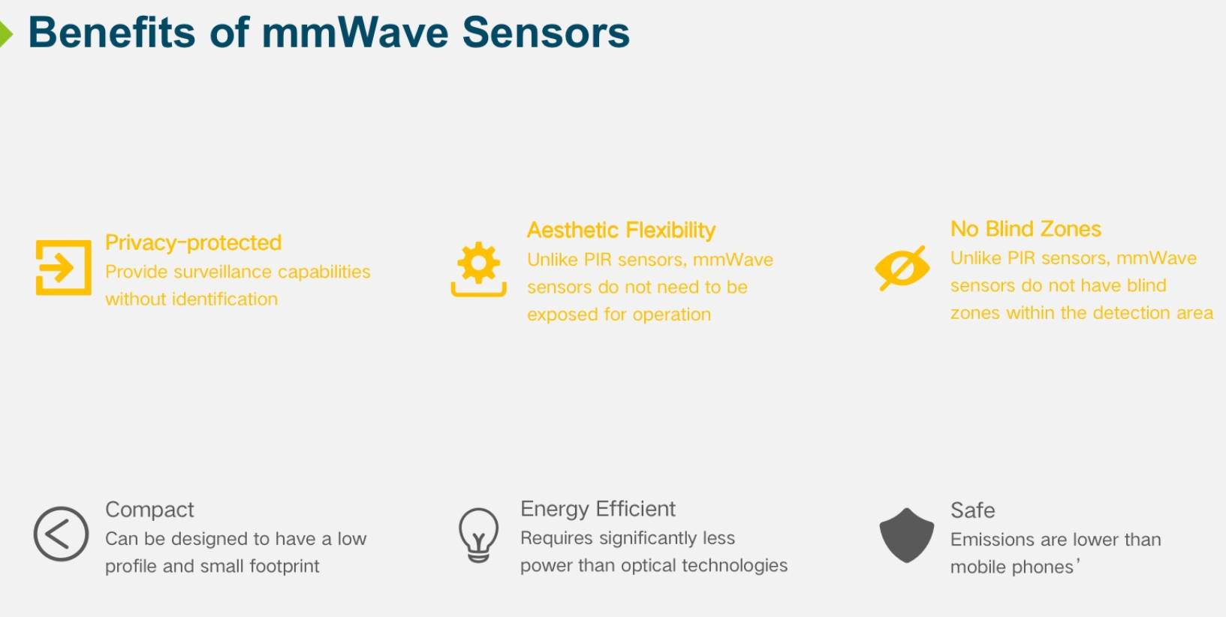
9. High stability: Independent from temperature, humidity, noise, airflow, dust, light, and other environmental influences
10. High measured accuracy: Achieve heartbeat accuracy up to 85% and achieve breathing accuracy up to 90 %
High flexibility hardware design radar: Support secondary development, adapt to various scenarios applications

Slide 12
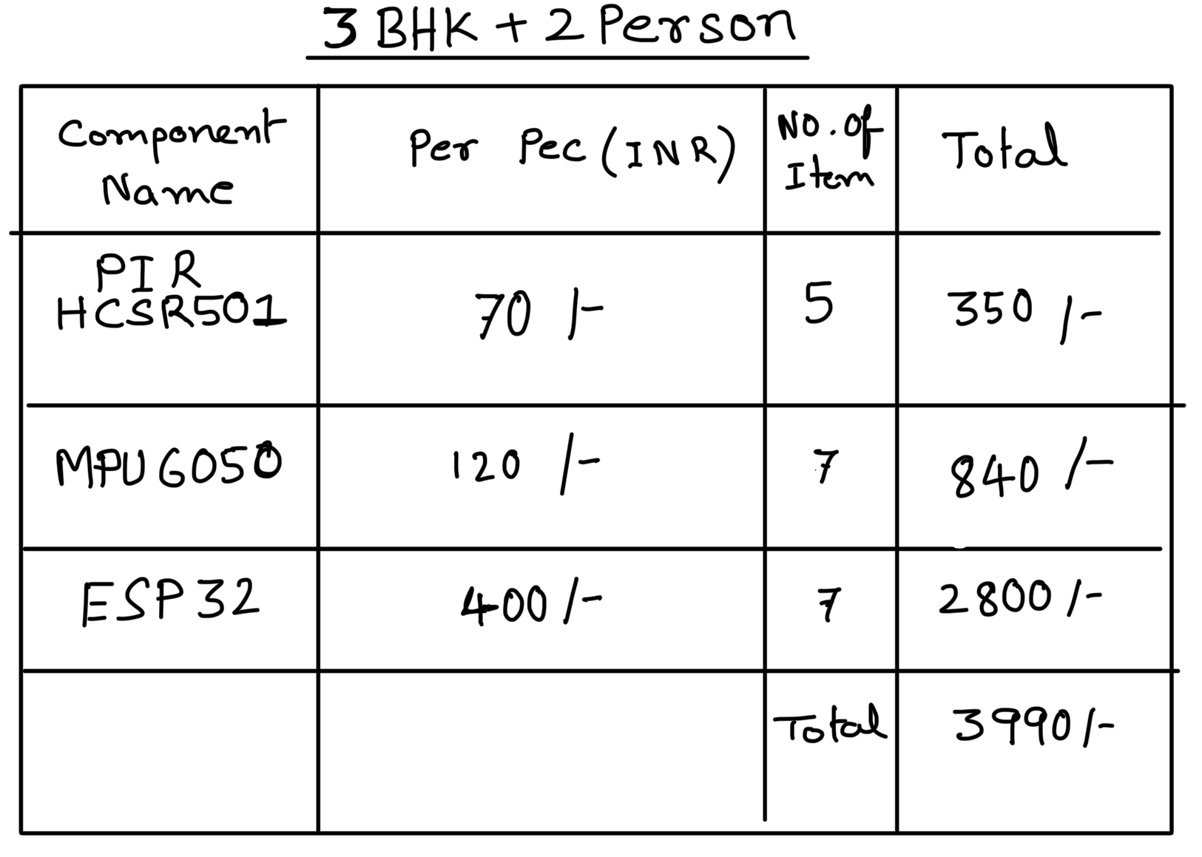
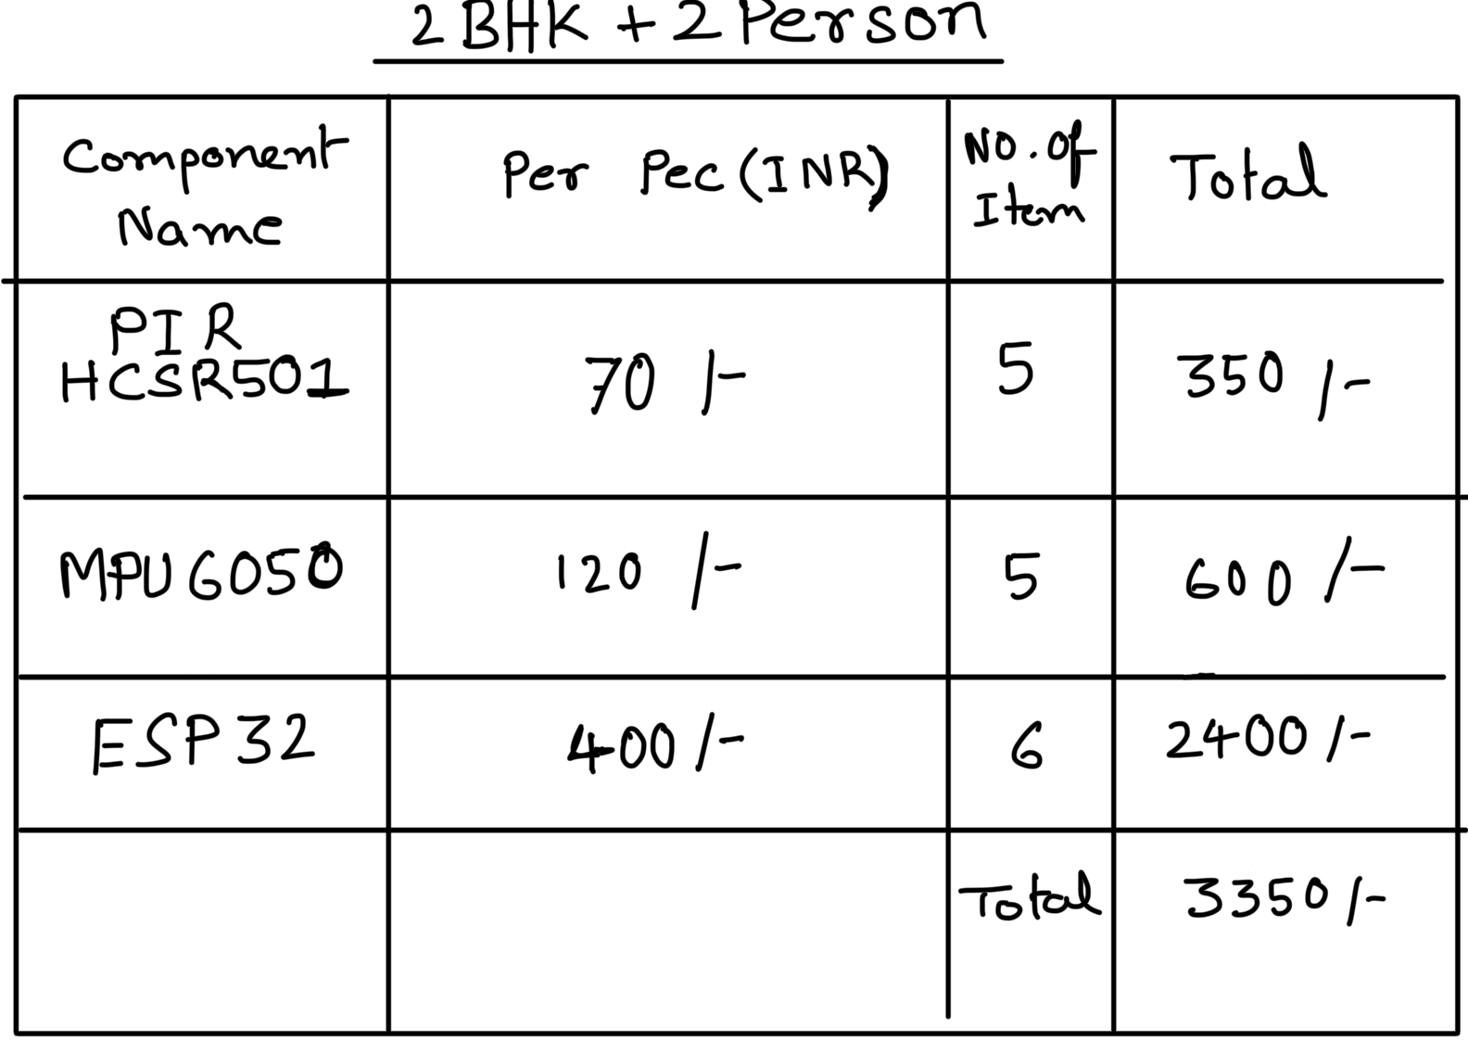

Slide 13
THANK YOU

