Slide 1

Sequential Vessel Speed Optimization under Dynamic Weather Conditions
Debabrota Basu¹, Giulia Pedrielli², Weidong Chen¹,
Szu Hui Ng³, Loo Hay Lee³, Stéphane Bressan¹
¹Department of Computer Science, School of Computing, National University of Singapore
²School of Computing, Informatics and Design Systems Engineering, Arizona State University
³Department of Industrial and Systems Engineering, National University of Singapore

Slide 2
Overview
Automated ships and Reinforcement learning
Fixed track weather routing problem
Solution and experimental analysis

Slide 3

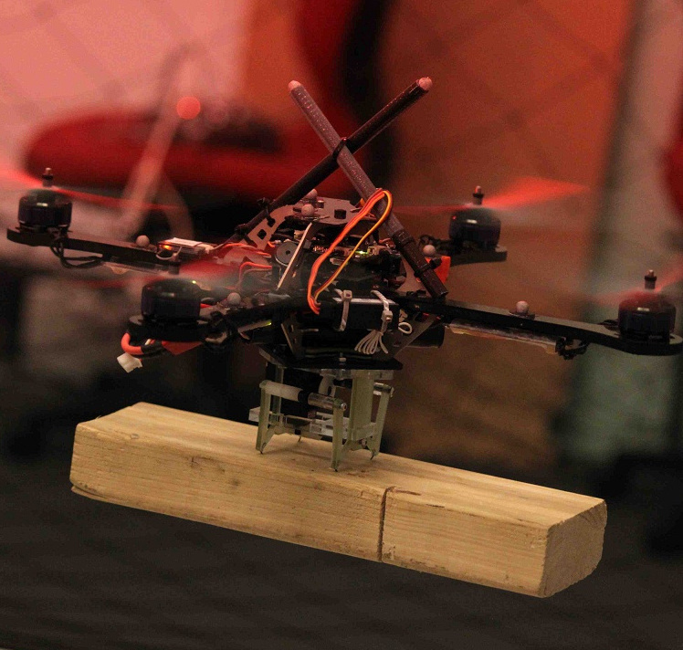

The age of automation

Slide 4


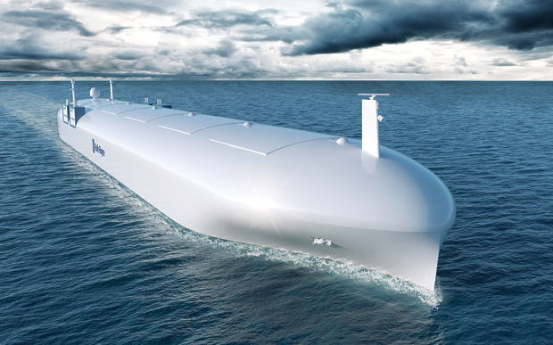
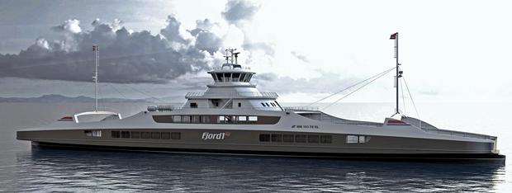
Automating the waters
a) Rolls-Royce
b) Fjord1
Source: http://spectrum.ieee.org/transportation/marine/forget-autonomous-cars-autonomous-ships-are-almost-here

Slide 5
How to automate for varying weather and extreme events?
How to predict the changes?
How to adapt with the changes?
Reinforcement Learning
Debabrota Basu

Slide 6
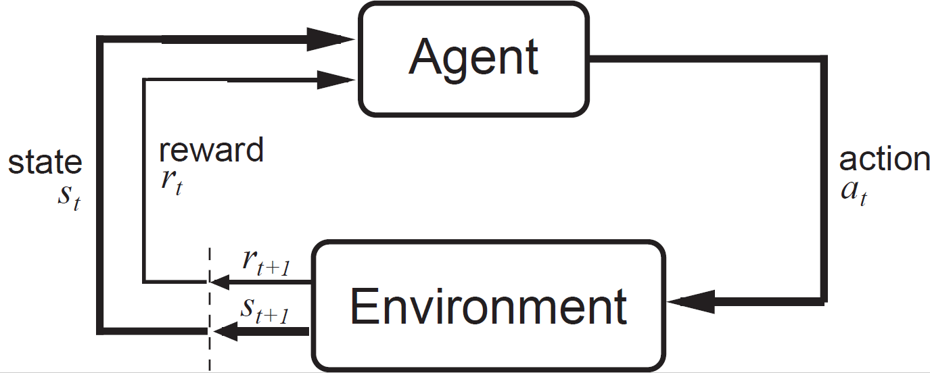
What is Reinforcement Learning?
Reinforcement learning is about an agent learning from its environment through interactions.
Reinforcement learning is like the “new kid in town”!!!

Slide 7
Our Focus
How to automate for varying weather and extreme events?
How to predict the changes?
How to adapt with the changes?
Reinforcement Learning

Slide 8





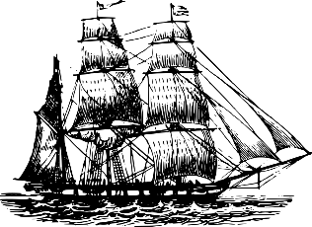

Port 3
Arrival window: [t3, t3’]
Port 2
Arrival window: [t2, t2’]
Weather condition
Bunker consumption rate
$$F(t,v)\text{​​}$$
Port 1
Debabrota Basu

Slide 9

Fixed track weather routing problem
Find the optimal velocity profile that minimizes the final cost of voyage.
Assumption: The time and space variation of weather is known.

Slide 10

Solution
Eureka!!!
Step 1: Discretise time and space.
Step 2: Observe that the optimal velocity profile transforms from one space-time rectangle to the other smoothly. Derive boundary values using Weierstrass-Erdmann condition.
Step 3: Find out the optimal profile in each cell such that each of them satisfies the derived boundary values.
Principles of dynamic programming dictates:
Collection of these piecewise optimal velocity profiles is the answer.

Slide 11
Experimental Set-up
4 ports at distance of 1000 nm and different arrival schedules.
Bunker consumption rate as a resultant of consumption due to power generation by the engine and auxiliary engine load.
Weather condition is modelled by the effective wave height and the wave direction.
The penalty for violating the arrival window = time consumed outside window × penalty for per hour per tons of bunker.

Slide 12
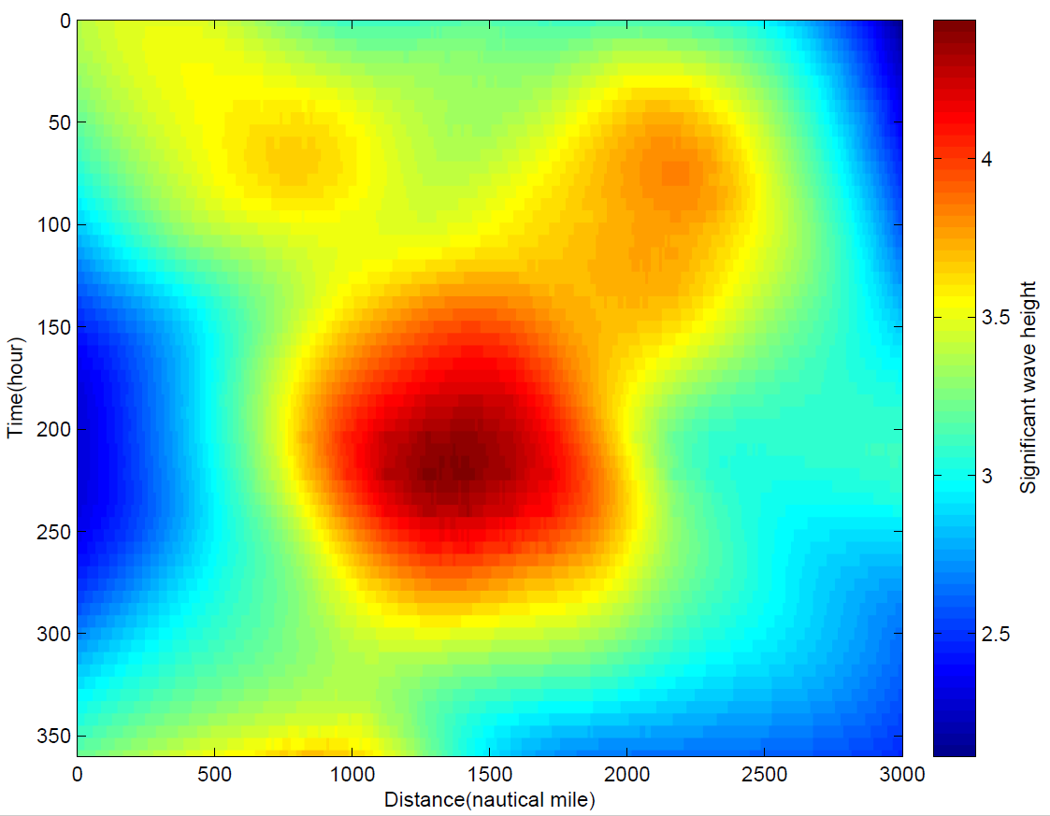
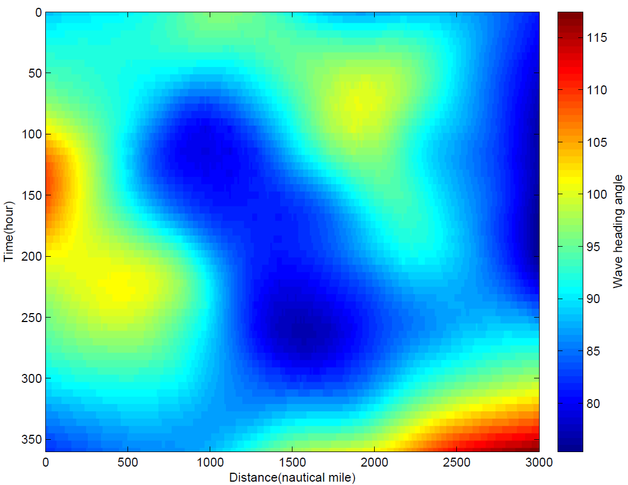
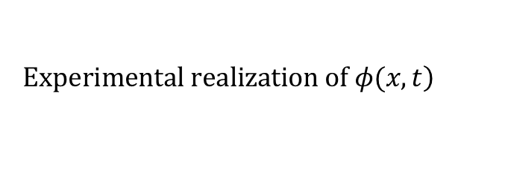
Weather set-up
$$\left.Experimental realization of φ(x,t\right)$$
a) Wave height
b) Wave direction

Slide 13
Results and analysis
Competing method: Solving the initial value problem (IVP) induced by Euler-Lagrange equation of motion of the ship.
Computation time (s) | Proposed method | IVP
Mean | 0.0197 | 0.5298
Standard deviation | 0.0062 | 0.1071
Observations:
The proposed method is faster.
The proposed method is more stable.
Brute force computation of differentials of weather with space and time in IVP is expensive and introduces error in computation. The proposed method does not need such computation and is incremental.

Slide 14
Conclusion
What did we do?
We model the fixed track weather routing problem with known weather conditions as an optimisation problem.
We design and evaluate a dynamic programming algorithm.
The proposed method is faster and stable than the state-of-art method.
What can be done?
Extend the weather model to consider uncertainty in the prediction.
Extend this algorithm using the dynamic tools of reinforcement leaning to solve the general question of automation.

Slide 15
Thank you.

