Slide 1
Dynamic Intention Aware
Motion Planning
Presented by : Jay Nandy & Debabrota Basu
Ph.D student, School of Computing
National University of Singapore

Slide 2
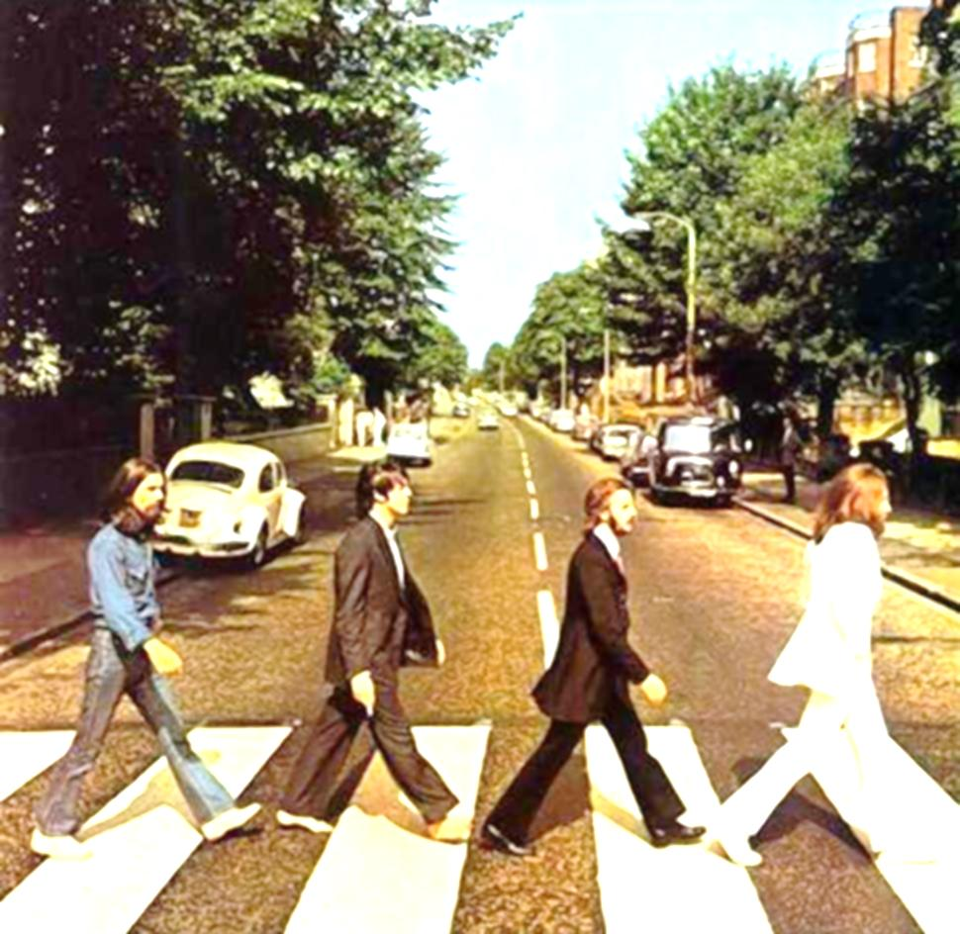
Pedestrian aware motion planning
Partial Information about the Environment
Perfect Sensor Assumption:
Exact information about the pedestrian and robot’s position
No human-intention sensor:
Where the pedestrian wants reach or what is the next move – not known
Imagine, there’s no collision
All cars are MOMDP planned
Driving Autonomous Car through a crowded road

Slide 3

The MOMDP Approach
How to
MODEL the situation…
What should be Optimal Policy…
Few variables are now… others are not known
Mixed Observed Markov Decision Process
State Variables:
Robot’s Location
Pedestrian’s Location
Pedestrian’s Intention
Fully Observed
Not Observed

Slide 4

Reverse Situation
Zombies(robots) are trying to crash on human(s)
Objective:
Model the zombie’s action
Similar assumptions as before
Perfect Sensor Assumption:
No human-intention sensor:

Slide 5

Reverse Situation 2
Crocs(robots) are trying to hunt the human(s)
Objective:
Model the croc’s action
Similar assumptions as before
Perfect Sensor Assumption:
No human-intention sensor:

Slide 6


The MOMDP tuples
State Variables
Observed components:
Robot’s & Human’s position
Hidden Components:
Human’s intention for the goal
Actions
HALT
move LEFT
by α
move RIGHT
by α
move
FORWARD

Slide 7
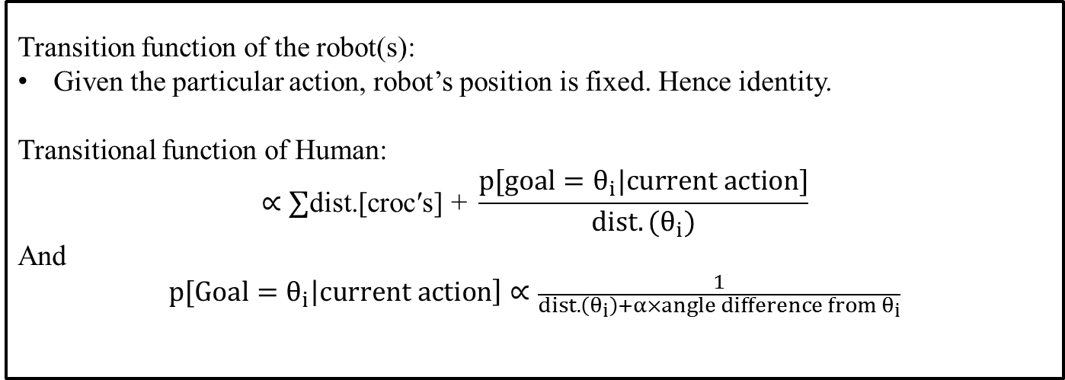
The MOMDP tuples …
Observation Space
Robot’s & Human’s position
Observation Function
Robot’s & Human’s position – Completely Observable
system is fully observed
Transition Function
Transition function of the robot(s):
Given the particular action, robot’s position is fixed. Hence identity.
Transitional function of Human:
$$∝∑\text{dist}\text{.[}\text{croc}\text{′}\text{s}\text{] + }\frac{{p[goal=θ}_{i}|current action]}{dist.(θ_{i})}$$
And
$${p[Goal=θ}_{i}\left|current action\right]∝\frac{1}{dist.\left(θ_{i}\right)+α×angle difference from θ_{i}}$$

Slide 8



The Reward Function …
When the Crocodiles(ROBOTs) captures the human
Big Positive Rewards
When the Human reaches the GOAL
Big Negative Reward
Otherwise
- Reward inversely proportional the distance between them

Slide 9
The Algorithm
Apply MOMDP model for each croc’s action model policy
MOMDP Solver
Real Time Dynamic Programming in BELief space is used to solve MOMDP model
Belief state :
Croc’s position
Agent’s position (fully observed)
Belief over goal intention of Agent
Belief Space :
Union of beliefs over intentions for each of the positions of Agent and Crocs
For reading or writing the value function of belief states in the hash table, belief is replaced by its discretized version
Bonet, B., and Geffner, H.. Solving POMDPs: RTDP-Bel vs. Point-based algorithms. In International joint conference on artificial intelligence (IJCAI), 2009.

Slide 10


The Algorithm
The Agent start from one port. Initialize beliefs for the other goals
Start with an initial positions $x_{0}$, $y_{0}$ and belief $b_{0}$ over goal intentions
For each action $‘a’$ in $belief ′b′$ and positions x, y evaluate:
Initialize the value function to heuristic value if the belief state is not travelled before
Apply action($a)$ that minimizes $Q−value$. [Break the ties randomly]
Update value function of the present belief to minimum $Q−value$
Update belief using
$x$ and $y$ are also updated correspondingly in deterministic fashion for a and a’
Terminate if goal belief state is reached.
Else repeat the “block” for the updated states
Choose the action that minimized certain objective function($Q−value$)
Update parameters
Improve the future decisions
Continue until terminate

Slide 11
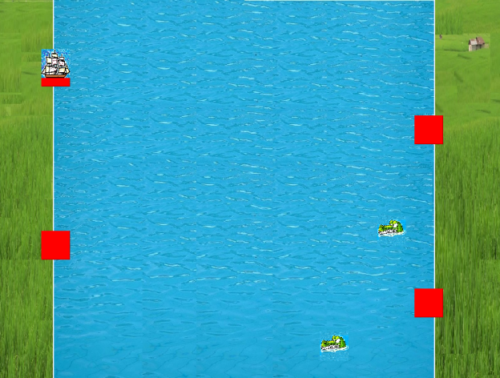
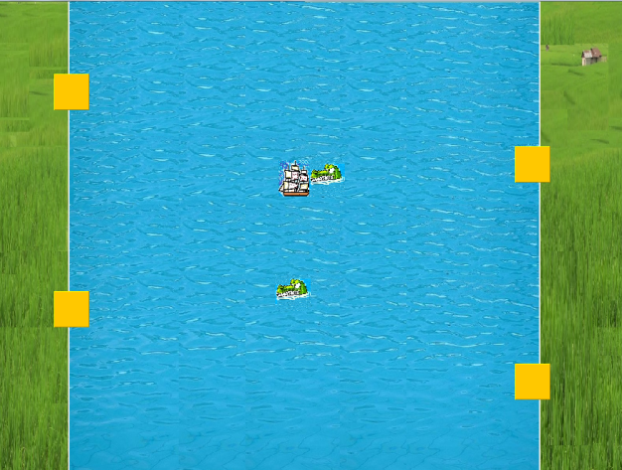
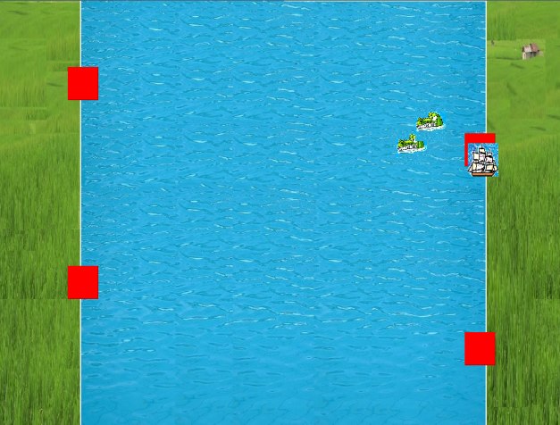
Croc: the man hunter
START GAME
REACHED GOAL!
CAPTURED

Slide 12
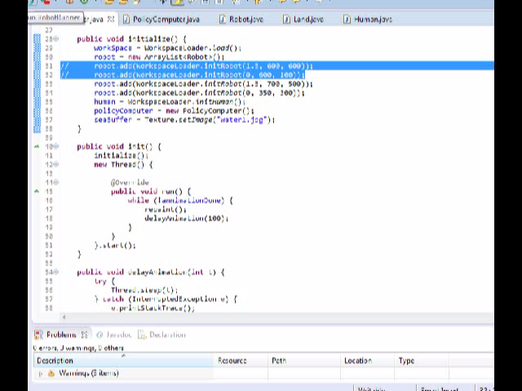

Slide 13


Slide 14
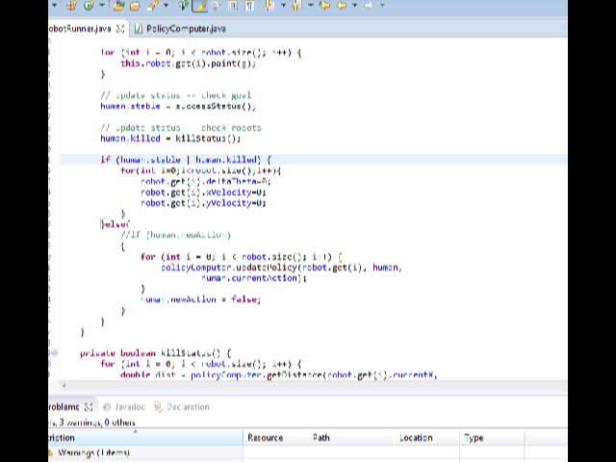

Slide 15
Discussion
MOMDP model decimates the dimension of belief state to one less than number of goal positions for agent which gives it better scalability
RTDP-BEL makes the algorithm faster while keeping the quality of solutions good enough
It can be improved to use as a target tracking model for different applications
Tracking the moving targets for military application

Slide 16
References
Png, S.W., Ong S.C.W., Hsu, D., and Lee, W.S. "POMDPs for Robotic Tasks with Mixed Observability.“ Int. J. Robotics Research, 2010.
Bandyopadhyay, T., Won, K. S., Frazzoli, E., Hsu, D., Lee, W. S., and Rus, D. “Intention-aware motion planning. International Workshop on the Algorithmic Foundations of Robotics, 2012.
Kurniawati, H., Hsu, D., and Lee, W. S. “SARSOP: Efficient Point-Based POMDP Planning by Approximating Optimally Reachable Belief Spaces.” In Robotics: Science and Systems, 2008.
Anderson, R. “A Robot Ping-Pong Player: Experiment in Real-time Intelligent Control.” MIT Press, 1988.
Bonet, B., and Geffner, H.. Solving POMDPs: RTDP-Bel vs. Point-based algorithms. In International joint conference on artificial intelligence (IJCAI), 2009.

Slide 17

Questions?

Slide 18
Thank You!

