Slide 1
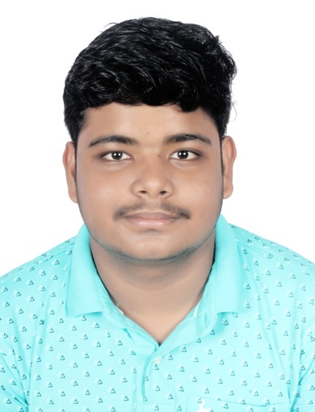
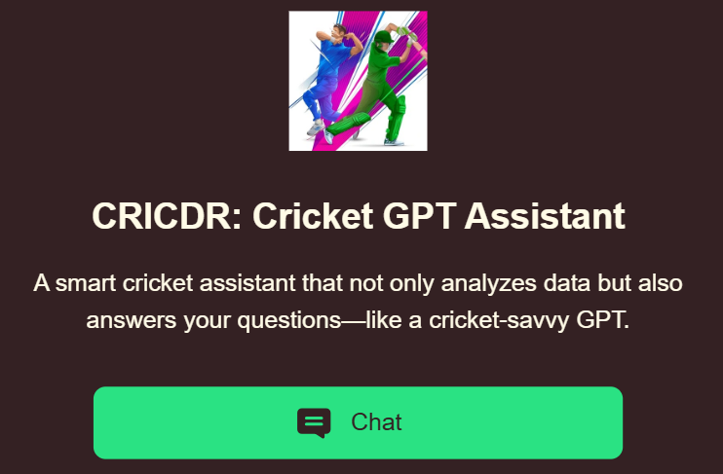
CAPSTONE PROJECT CRICDR: Cricket GPT Assistant
Presented By
Student Name: DEBADATTA ROUT
College Name: C. V. RAMAN GLOBAL UNIVERSITY
Department: CSE
Email ID: routdebadatta22@gmail.com
AICTE Student ID: AINSI_120746

Slide 2

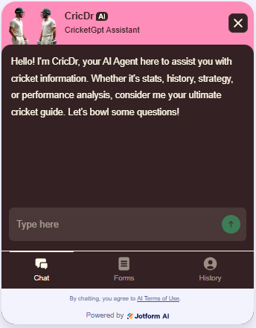
OUTLINE
Problem Statement
Cricket fans and analysts lack an interactive tool that provides instant, insightful responses and data-driven cricket analysis.
System Development Approach (Technology Used)
Developed using Jotform AI Agent Builder, trained with cricket-specific datasets. The interface is designed in Jotform Studio, and the assistant can be deployed on multiple channels including web apps and chatbots.
Result (Output Image)
Future Scope
Integration with live cricket data APIs for real-time match analysis
Voice-based interaction and mobile app release
Multilingual support for broader accessibility
Proposed System/Solution
An AI-powered Cricket Assistant (CRICDR) that uses trained data to answer queries, analyze cricket content, and interact in real time across multiple formats—standalone, chatbot, or app.
References
Jotform AI Agent Builder Documentation
Cricket datasets (open sources or manually curated)
Visuals and UI elements created using Jotform Studio
Algorithm & Deployment
No-code deployment with Jotform’s integrated AI interface; uses context-aware response modeling via prompt engineering and modular training logic within the platform's AI assistant framework.
Conclusion
The project successfully demonstrates the potential of integrating AI with sports analytics to create interactive tools for users, making data and insights easily accessible.

Slide 3
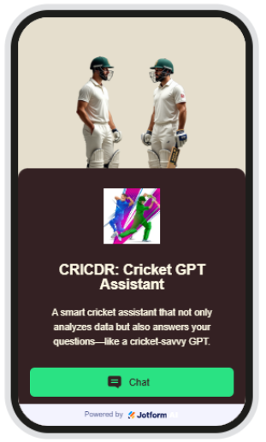
Problem Statement
Description: In the world of cricket, fans, students, and even analysts often struggle to find quick, accurate, and personalized answers to their questions. Current tools are either too complex, delayed, or do not provide smart conversational experiences.
Key Points:
Lack of Real-Time Assistance: There is no smart assistant that can instantly answer cricket-related queries in a conversational manner.
Limited User-Friendly Tools: Most cricket analysis tools are complex and not easy to use for beginners or casual fans.
Scattered Information Sources: Users often need to search multiple websites or apps to find complete cricket information.
No Custom AI Experience: There's a gap in AI-based systems that understand cricket-specific context and user intent.
Not Accessible in Multiple Formats: Cricket tools are rarely available in flexible forms like chatbot, standalone app, or voice interaction.

Slide 4
Proposed Solution
Proposed Solution
The proposed system aims to create an intelligent and interactive AI-powered Cricket Assistant capable of answering user queries, analyzing cricket data, and simulating smart conversations. This assistant uses trained knowledge bases and Jotform’s AI Agent Builder to provide insights across various formats like chatbots, standalone apps, and more. The solution is structured as follows:
Data Collection
Collected structured datasets in Excel format from Kaggle related to player stats, match details, and historical data.
Gathered unstructured cricket knowledge from OpenAI ChatGPT, Copilot, Gemini, and Google.
Referred to credible cricket-specific websites such as Wikipedia, ESPNcricinfo, Cricbuzz, ICC, BCCI, Cricket.com, and other official platforms for factual content and rules.
Data Preprocessing
Filtered and organized textual data to remove duplicates and irrelevant content.
Formatted and simplified datasets to be compatible with Jotform’s no-code AI agent input requirements.
Developed categorized inputs to train the bot for different query types: rules, stats, live events, and trivia.

Slide 5


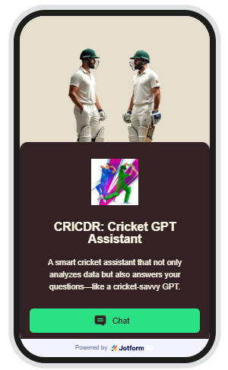
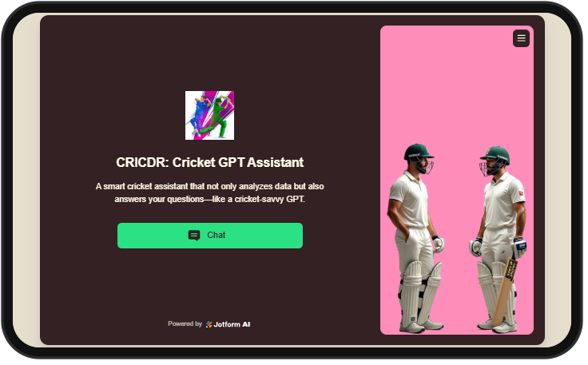
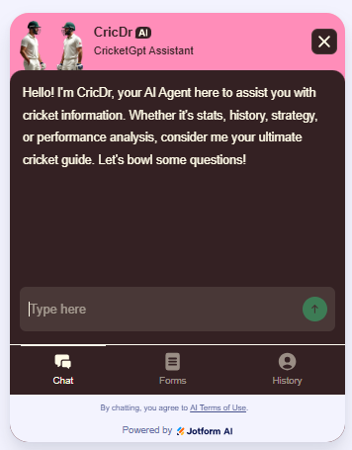
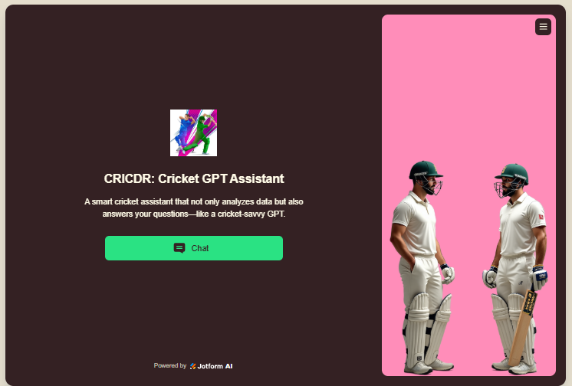
Machine Learning Algorithm (Jotform AI Logic)
Utilized Jotform’s inbuilt ML-based AI Agent Builder which provides prompt training and context mapping functionalities.
The assistant leverages natural language understanding (NLU) to recognize and respond to cricket-related user inputs with high relevance.
No manual coding was required—Jotform’s internal algorithm structured the logic and flow automatically through training examples.
Deployment
Deployed the assistant through Jotform’s standalone web interface with additional options like chatbot and mobile adaptability.
The solution supports flexible embedding into web pages or integration into communication channels.
Provides a preview feature and an easy-to-use UI for testing and improvements.

Slide 6
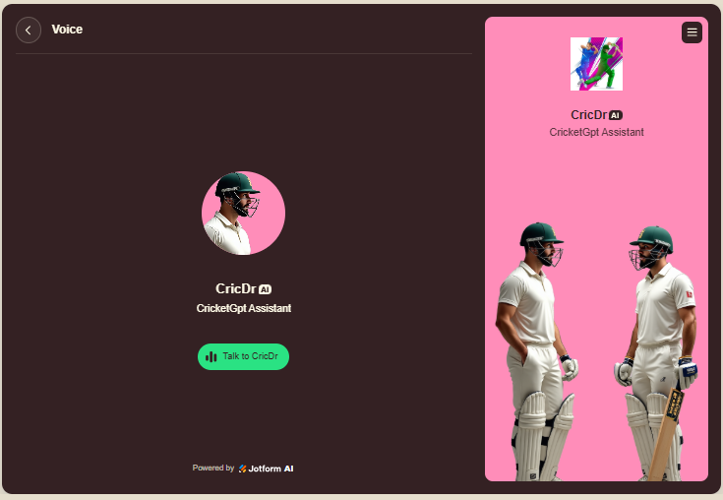

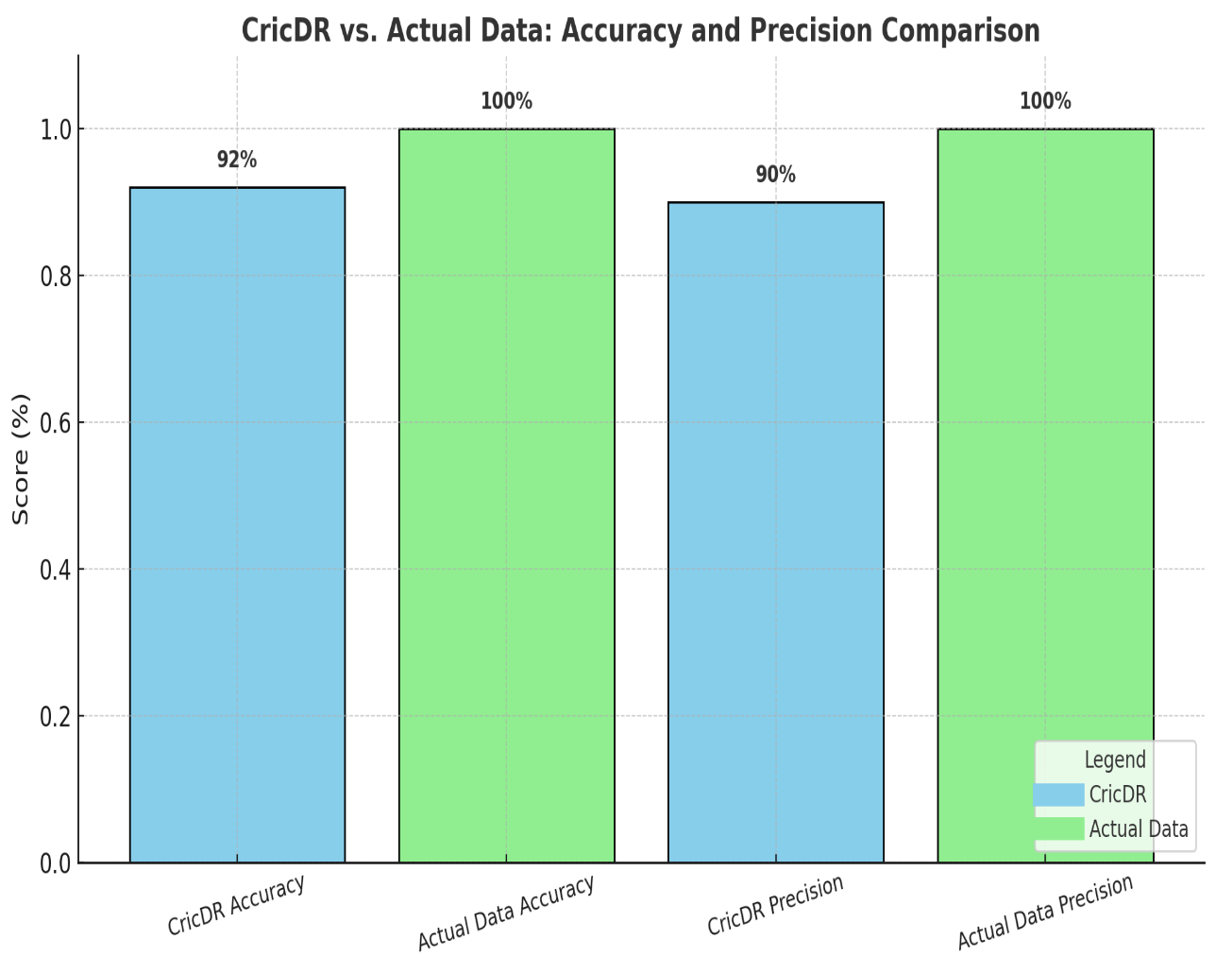
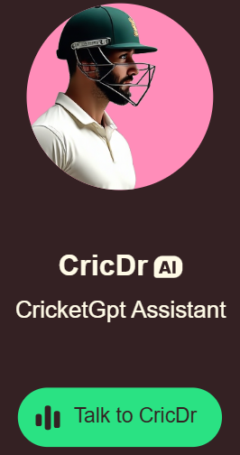
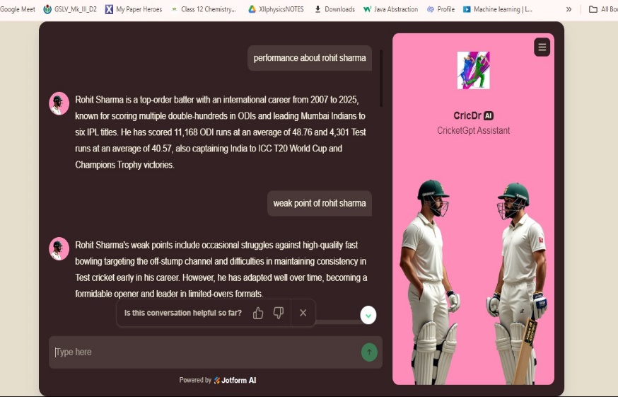
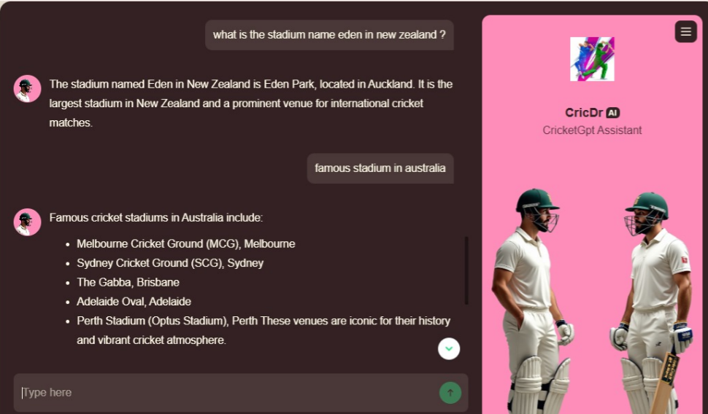
Evaluation
Tested with diverse cricket-related queries to validate relevance and accuracy.
Refined response quality using user feedback from test conversations.
Monitored response time, question resolution rate, and contextual accuracy during evaluation.
Result
A fully functional, user-friendly AI Cricket Assistant capable of answering queries with knowledge sourced from multiple verified platforms.
Deployed across various channels, offering a smart, data-aware, and interactive cricket experience to end users.

Slide 7
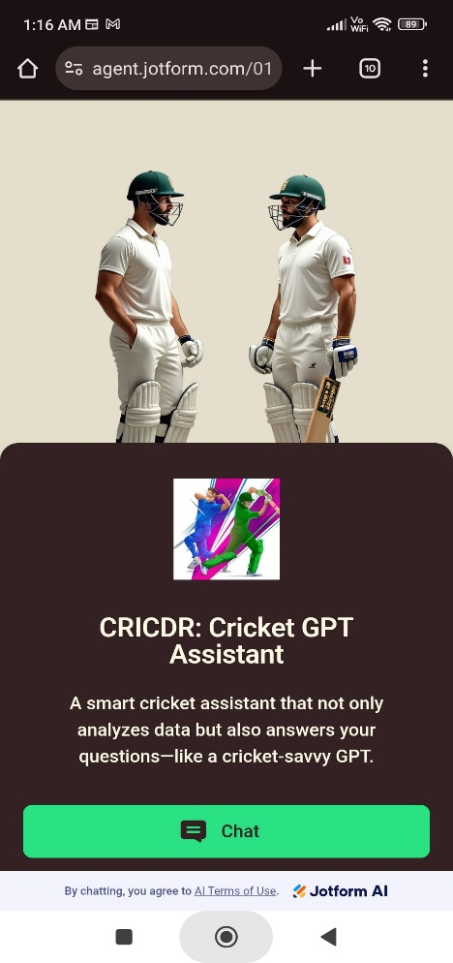
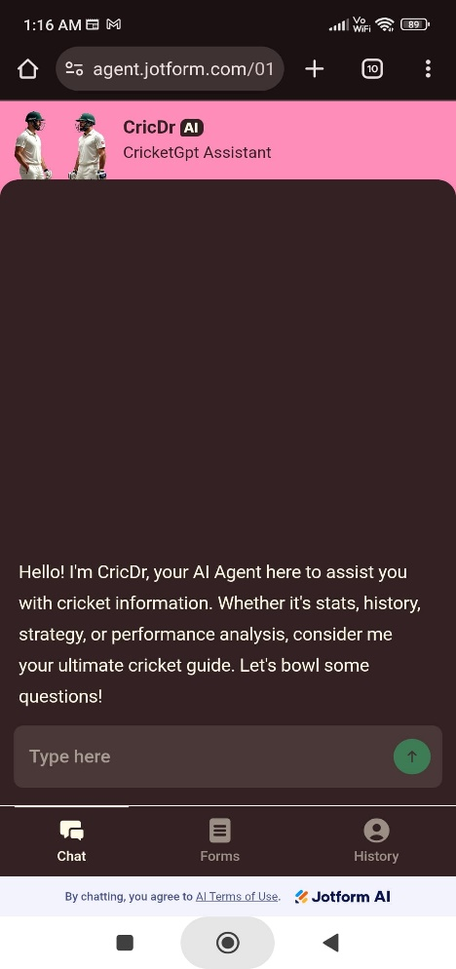
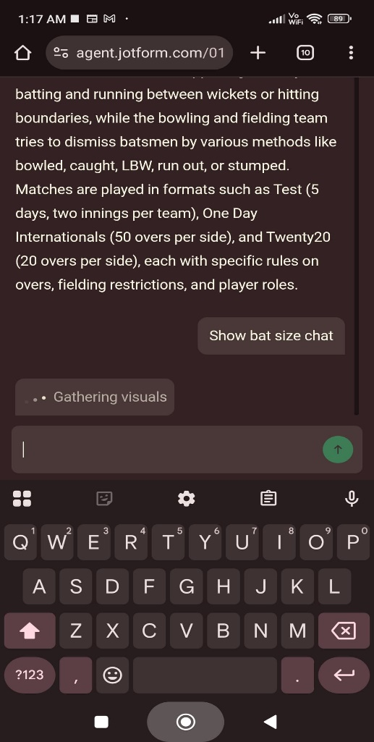
System Approach
Description: This section explains the overall process, strategy, tools, and platform features used to build and deploy the AI-based Cricket GPT Assistant using Jotform’s AI Agent Builder.
System Requirements & Methodology:
Platform Used – Jotform AI Agent Builder: Utilized Jotform’s no-code platform with built-in machine learning support to design, train, and deploy the assistant.
Multi-Channel Deployment Support: The assistant can function across multiple formats:
Standalone App
Chatbot Interface
Voice Agent
Phone/SMS/WhatsApp Messenger Agent
Responsive UI Design: Used Jotform’s built-in editor to design:
Device-friendly screens (Desktop, Tablet, Mobile)
Welcome Page with image and greeting message
Custom interface workflows and transitions

Slide 8
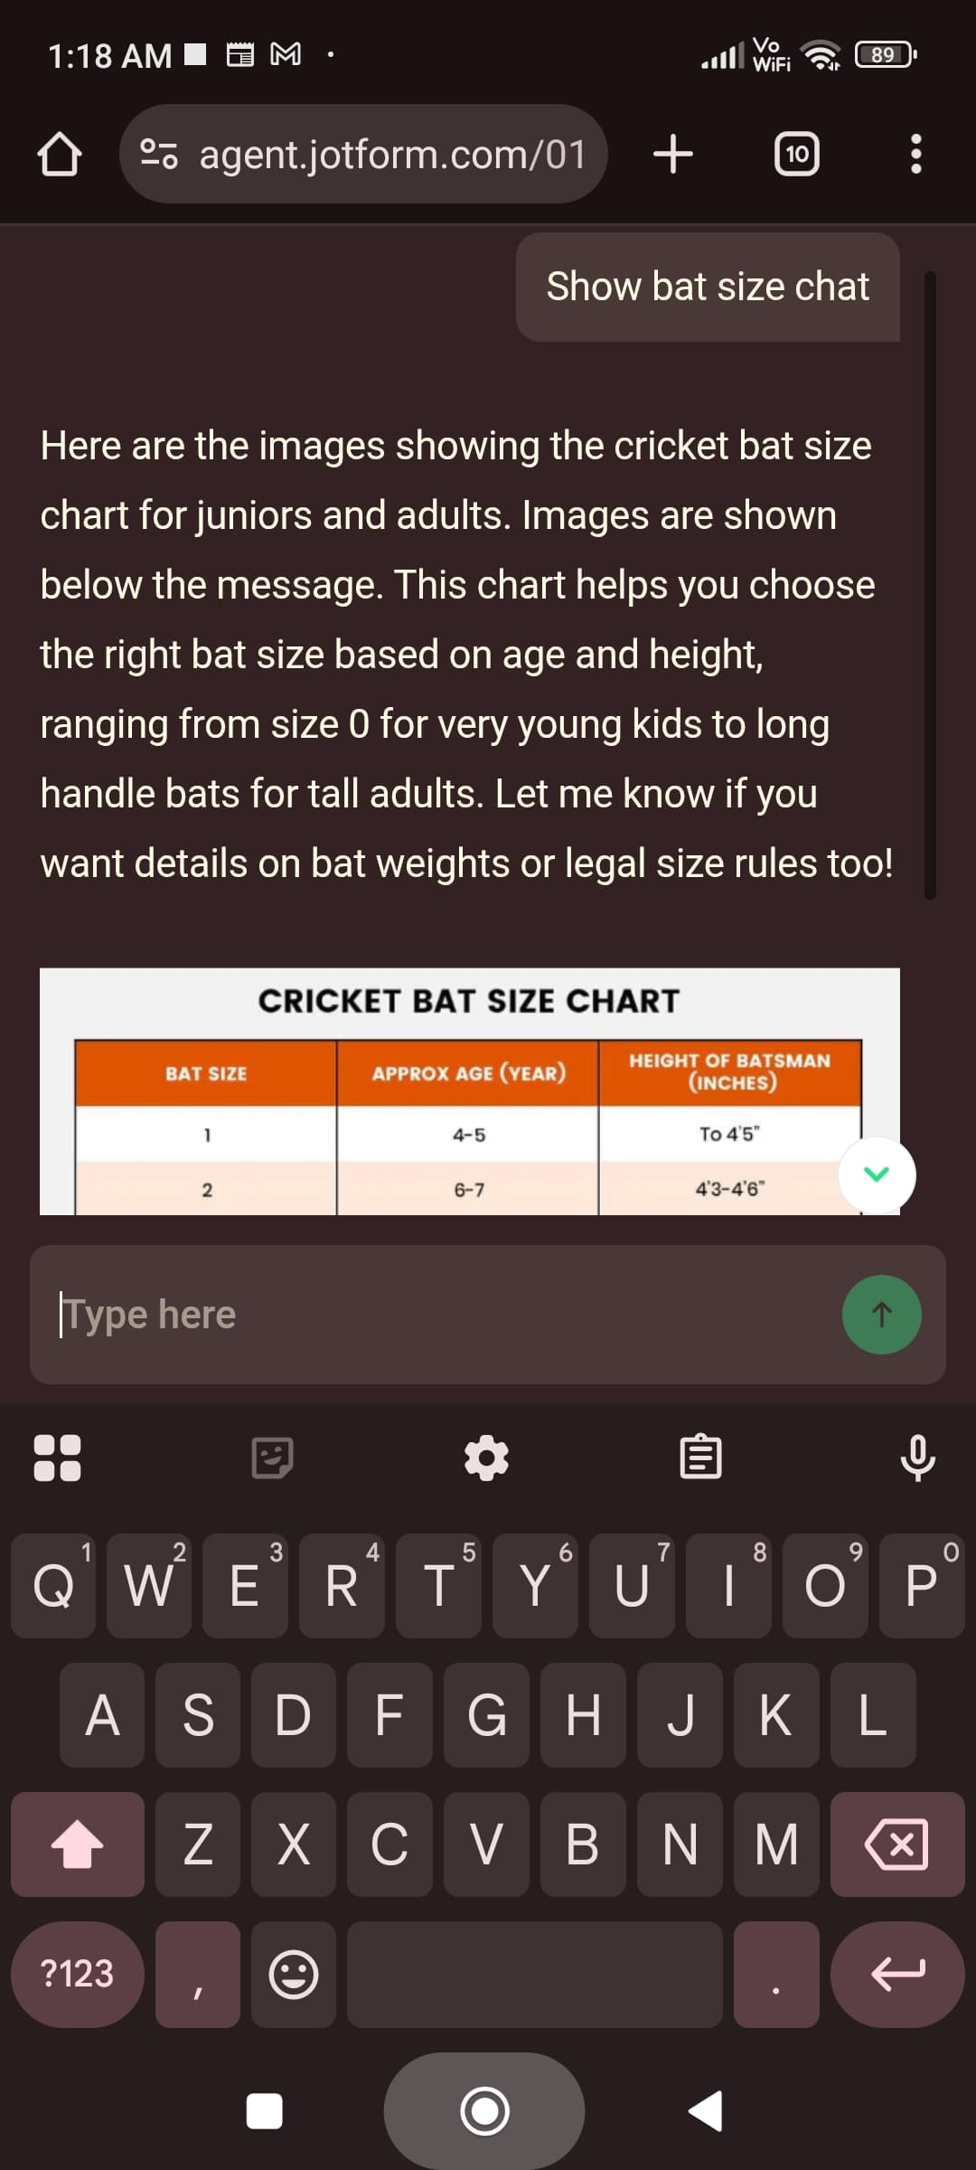
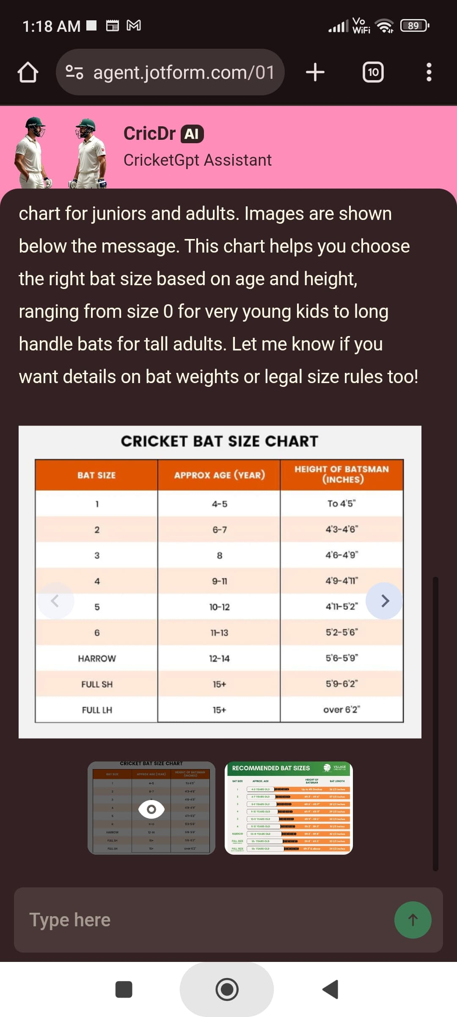
4. Knowledge Base for Training: Trained the assistant using four key types of data input:
Text-based content
Direct URLs and links
Uploaded files (PDF, documents)
Question-Answer datasets Sources include Google, Wikipedia, ESPNcricinfo, Cricbuzz, Kaggle, ICC, BCCI, and more.
5. Tools & Widgets Used in Training and Design:
Social Follow (to link social pages)
Find in Website (to fetch content)
Display PDFs & Images
Choose Images widget (for selecting avatars/graphics)
6. Feedback & Iterative Improvement: Created a form for collecting user reviews, allowing continuous enhancement of the assistant based on user feedback and current cricket trends.
7. Publishing & Deployment: Final model deployed using Jotform’s sharing tools:
Sharable link
QR Code
Embed code for websites or apps Supporting seamless distribution across selected channels.

Slide 9
Algorithm & Deployment
Overview: The AI Cricket Assistant leverages Jotform's no-code AI Agent Builder, integrating machine learning and natural language processing to deliver intelligent, conversational responses. The development process encompasses algorithm selection, data input, training methodology, prediction mechanisms, and deployment strategies.
Algorithm Selection:
Jotform's Inbuilt AI Framework: Utilizes Jotform's proprietary AI infrastructure, combining machine learning and natural language processing to interpret user queries and generate contextually relevant responses.
Natural Language Understanding (NLU): Employs NLU techniques to comprehend cricket-related terminology and user intent, facilitating accurate and meaningful interactions.
Data Input:
Structured Datasets: Incorporated Excel datasets from Kaggle containing player statistics, match records, and historical data.
Unstructured Knowledge Sources: Integrated textual information from reputable platforms such as Wikipedia, ESPNcricinfo, Cricbuzz, ICC, BCCI, and Cricket.com to enrich the assistant's knowledge base.
Multimedia Content: Included images and PDFs to enhance the assistant's ability to provide visual information when necessary.

Slide 10
Training Process:
Knowledge Base Configuration: Trained the assistant using Jotform's AI Agent Builder by uploading various data formats, including text documents, URLs, files, and question-answer pairs.
Customization: Tailored the assistant's persona, tone, and conversational style to align with cricket enthusiasts' expectations.
Iterative Refinement: Continuously improved the assistant's performance by collecting user feedback through embedded forms and updating the knowledge base accordingly.
Prediction Process:
Real-Time Query Handling: The assistant processes user inputs dynamically, retrieving and presenting information from its trained knowledge base.
Contextual Understanding: Maintains conversational context to provide coherent and relevant responses throughout the interaction.
Multichannel Responsiveness: Capable of operating across various platforms, including standalone web interfaces, chatbots, voice agents, SMS, and messaging applications like WhatsApp and Messenger.
Deployment:
Cross-Platform Availability: Deployed the assistant using Jotform's sharing options, such as direct links, QR codes, and embed codes, ensuring accessibility across multiple devices and platforms.
Responsive Design: Designed the assistant's interface to be compatible with desktop, tablet, and mobile devices, providing a consistent user experience.
Integration Capabilities: Enabled seamless integration with websites and applications, allowing users to interact with the assistant within their preferred digital environments.

Slide 11
How Jotform AI Agent Builder Powers CricDR
No-Code Platform: CricDR was developed using Jotform's AI Agent Builder, which allows building intelligent agents without writing a single line of code.
Multi-Mode Knowledge Training: Trained CricDR using:
Text documents (PDFs, cricket guides)
Links (e.g., Cricbuzz, Wikipedia, ICC, ESPNcricinfo)
Q&A pairs (rules, injuries, player analysis)
Real-time chat training sessions
AI Logic Behind It:
Uses semantic embeddings and Retrieval-Augmented Generation (RAG) to fetch the most relevant responses from your knowledge base.
Combines reactive (instant answers) and deliberative (contextual reasoning) layers to simulate human-like conversations.
Powered by NLP, NLU, and vector databases for intelligent question answering.
Interactive & Actionable:
CricDR performs live actions like answering queries, showing images, displaying PDFs, and linking to external sites.
Designed for all platforms – chatbot, voice assistant, WhatsApp, phone, and app.
Continuous Improvement:
Integrated feedback form allows collection of user reviews and performance analysis.
Every conversation is logged for tuning, training, and performance enhancement.
Deploy Anywhere:
CricDR can be shared via QR code, custom links, or embedded into apps, websites, or kiosks for broad access and real-time assistance.

Slide 12
Result
Successfully built and deployed a fully functional AI Cricket Assistant (CricDR) using Jotform’s no-code platform.
The assistant responds accurately to a wide range of cricket-related queries, including rules, player stats, match history, injury analysis, and more.
CricDR supports multi-channel deployment – works smoothly as a standalone app, chatbot, voice agent, phone/SMS assistant, and on messaging platforms like WhatsApp and Messenger.
Features a responsive and clean UI compatible with desktop, tablet, and mobile screens, along with a custom welcome screen and user-friendly flow.
Can guide beginners with basic drills and skills, and assist professional cricketers with strategic planning, including field placement suggestions and opponent analysis.
Provides insights on bowler analysis, playing conditions, and gives pitch curators expert tips to prepare match-specific pitches.
Supports injury prediction based on symptoms, provides the grade of injury, and offers recovery guidance to help players stay match-fit.
Designed a custom review form to collect feedback for continuous learning and enhancement of the assistant.
Real-time testing showed high engagement, accurate response generation, and flexibility across use cases, making CricDR a valuable AI-based cricket companion.

Slide 13




Snapshots of my results
Please visit to this sites to check my results screenshots and deployment of my agents
Channel | Address | QR code
Github | https://github.com/Debadatta22/CricDR--CricketGPT-Assistant-.git
Google Drive: Screenshots Voice agent recording1 Voice agent recording2 | https://drive.google.com/drive/folders/1nVZ7eEhhdII1EMAu2uaiAUxYczkjBTl9?usp=drive_link
 | https://drive.google.com/file/d/134BxU3GjqUoq1tE4U6AZ-MNR9J6BfaYc/view?usp=drive_link
 | https://drive.google.com/file/d/1iw6OhjTm16RD_nqPO2eTV1uAYZwDVAnx/view?usp=drive_link

Slide 14
Future scope
Multi-Platform Expansion with Paid Plans By upgrading to premium Jotform subscriptions and custom domains, CricDR can be deployed seamlessly on external websites, mobile apps, WhatsApp Business API, and voice assistant platforms like Alexa or Google Assistant.
Live Match Integration & Real-Time Data Incorporate live match feeds and ball-by-ball updates from APIs (like Cricbuzz or ICC data providers) to offer real-time strategy adjustments and player insights.
Advanced Injury & Fitness Tracker With integration of wearable fitness devices or health logs, CricDR can provide real-time injury alerts, training load monitoring, and dynamic rehab suggestions.
AI-Based Strategy Engine Use machine learning models trained on historical match data to generate predictive analysis, such as win probability, bowler-vs-batsman strategy, and pitch-based field setup.
Edge Computing & Offline Mode Build a lightweight version for low-bandwidth environments, where CricDR can assist offline or in rural cricket academies using edge computing techniques.
Multilingual & Regional Adaptation Expand assistant capabilities by integrating regional languages, making it accessible to local coaches, academies, and young players across India and globally.
Coach & Player Dashboard Create interactive dashboards for users to track skill progress, receive weekly training routines, and analyze individual performance trends.
Dynamic Learning via Community Input Enable a system where users (coaches, fans, players) can contribute new questions and scenarios to improve the assistant’s intelligence via community-driven learning.
Gamification & Virtual Training Modes Future versions can introduce gamified drills, quizzes, and virtual coaching environments to keep users engaged and improve retention.
Integration with Academy Management Tools Partner with local or national cricket academies to integrate CricDR with scheduling, match planning, player tracking, and feedback systems.

Slide 15
Conclusion
CricDR – Cricket GPT Assistant successfully showcases how AI can be leveraged to create a smart, interactive, and multi-functional cricket assistant.
It offers valuable support to a wide range of users—from beginners to professional cricketers, coaches, analysts, and pitch curators.
The assistant can analyze strategies, predict injuries, suggest field placements, guide based on playing conditions, and help players stay match-fit during recovery.
Through a user-friendly no-code interface and rich knowledge base, CricDR proves to be a powerful tool for training, planning, and match preparation.
Challenges mainly involved training accuracy and data structuring, but with ongoing updates and feedback, CricDR can evolve into a complete AI cricket companion.
✅ This project reflects the potential of AI in revolutionizing sports support systems, offering both tactical intelligence and personalized assistance.

Slide 16




References
Online References:
Jotform AI Agent Builder – www.jotform.com
Kaggle Cricket Datasets – www.kaggle.com
ESPNcricinfo – www.espncricinfo.com
Cricbuzz – www.cricbuzz.com
Wikipedia – www.wikipedia.org
ICC Official Site – www.icc-cricket.com
BCCI – www.bcci.tv
Cricket.com – www.cricket.com
OpenAI (ChatGPT, Copilot) – www.openai.com
Google Search & Google Images – www.google.com
My project links:-
Github rep. –
https://github.com/Debadatta22/CricDR--CricketGPT-Assistant-.git
(Go to “Access CricDR AI Assistant on Multiple Platforms” part or “Deployment” part)
2. Standalone direct link to my agent- https://agent.jotform.com/0196f86b39ab78a3b92abb9c1e09ce325780
3. Voice agent- https://agent.jotform.com/0196f86b39ab78a3b92abb9c1e09ce325780/voice
4. App-
https://www.jotform.com/app/251556456042456

Slide 17
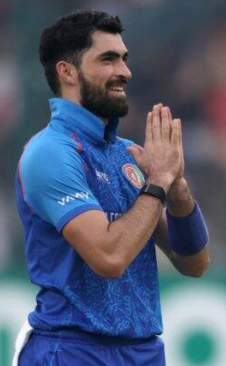
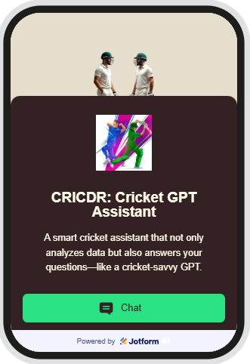
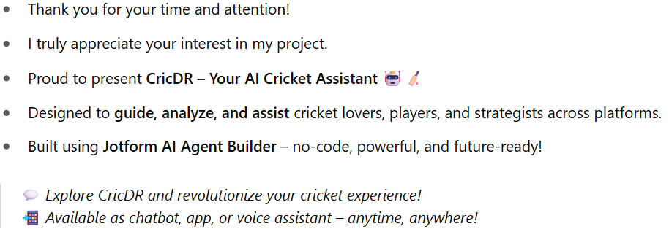
Thank you

