Slide 1
AZURE DATA PIPELINE
For TechRetail
Group 4:
Arnab Saha
Debadrita Acharjee
Kumkum Baswal

Slide 2
Background:
TechRetail, a mid-sized retail company, wants to create a data pipeline to collect retail data from various sources, process it using advanced analytics, and visualize the results in a dashboard. The goal is to gain insights into sales trends and improve decision-making. The company wants to leverage Azure Databricks for data processing and Microsoft Fabric for data integration and visualization.

Slide 3




Objectives:
Data Ingestion
Data Processing
Data Storage
Data Visualization
Azure Data Factory (ADF)
Synapse Data Engineering
ADLS Delta Table
Microsoft PowerBI
ADLS Gen2
Databricks

Slide 4
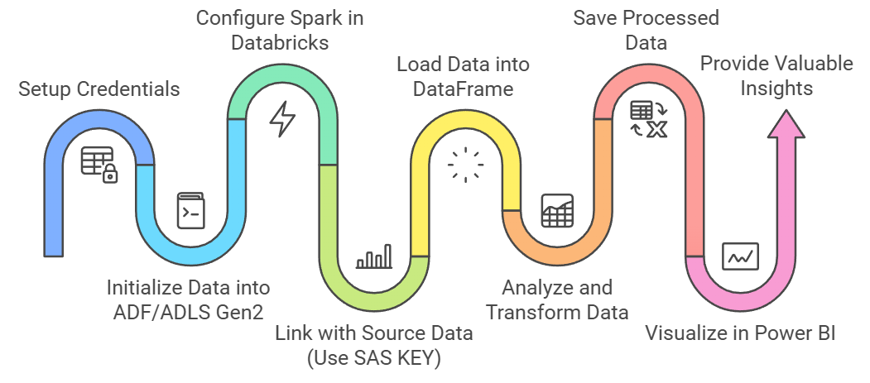
Architectural Process Flow:

Slide 5
KNOW YOUR DATA
Dataset Insights

Slide 6
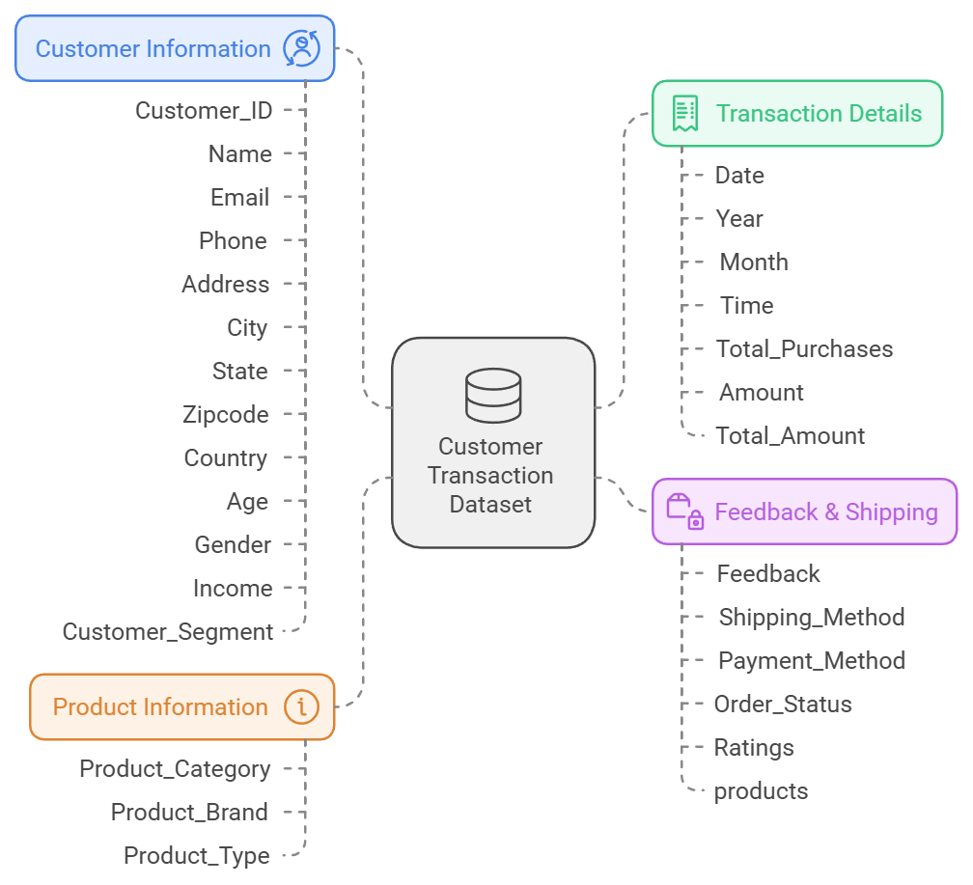


DATASET OVERVIEW

Slide 7
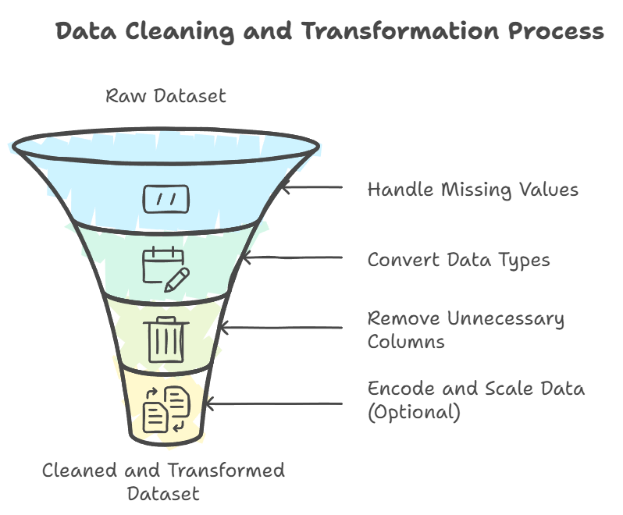

Slide 8
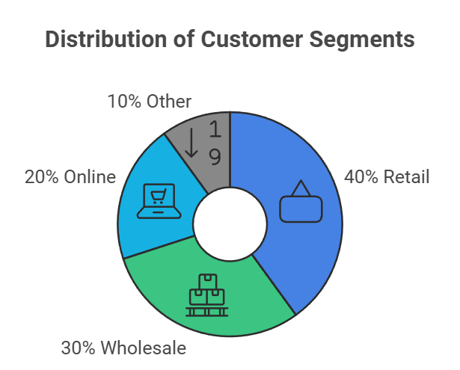
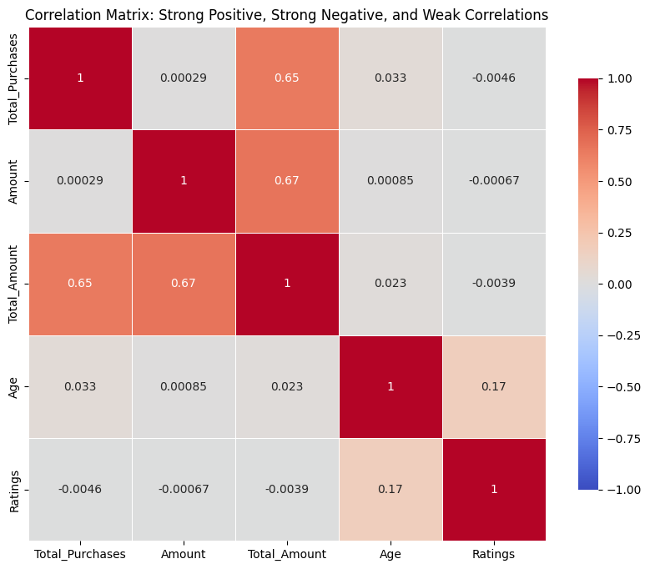
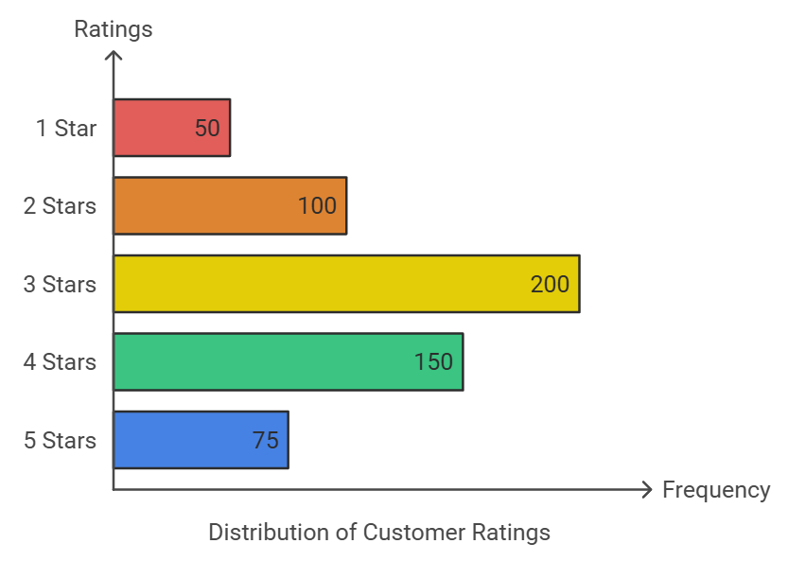
Dataset Insights Visualization

Slide 9
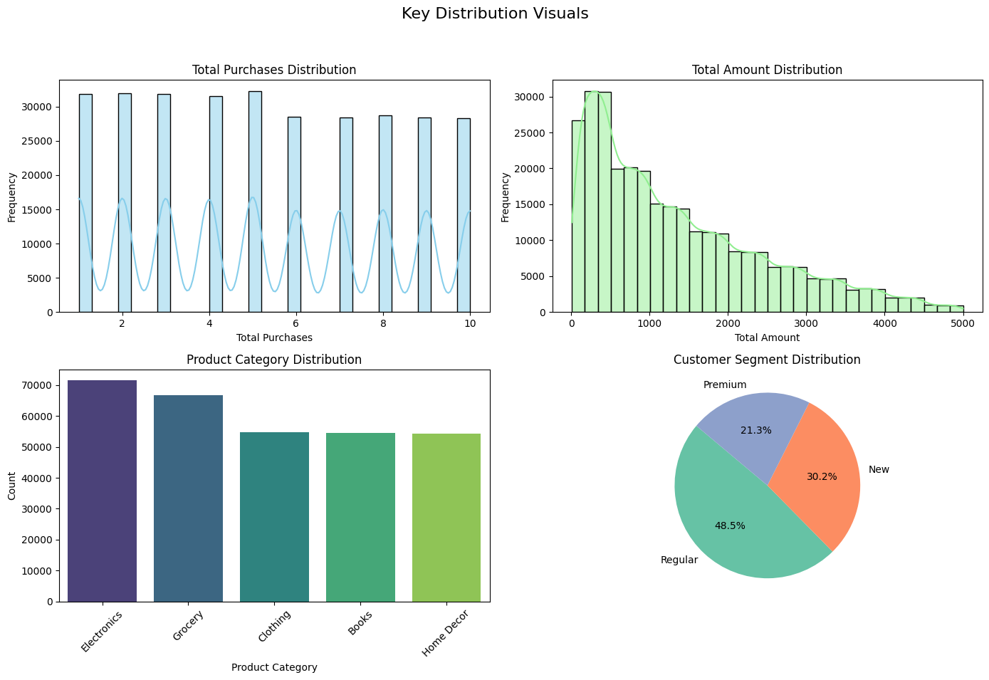
Key Distributions In The Data

Slide 10
TechRetail Sales Analytics Dashboard

Slide 11
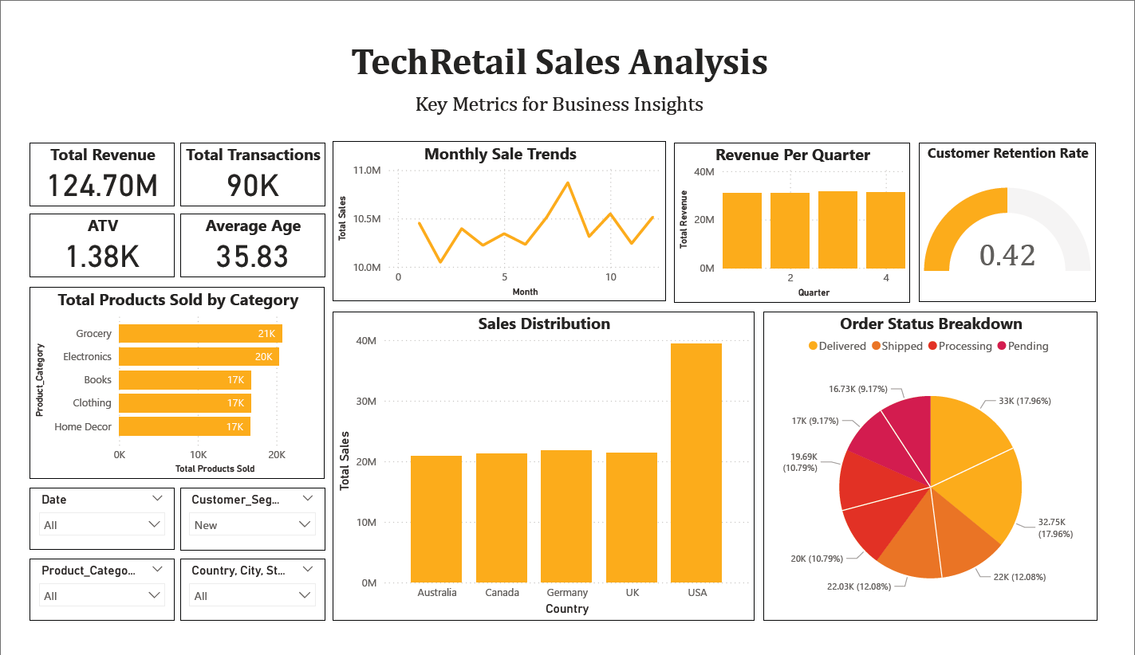

Slide 12
THANK YOU

