Slide 1

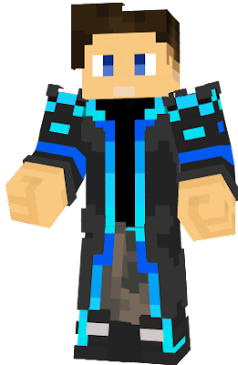
Hello !!!!!!!
Guys, hope u doing well :)

