Slide 1

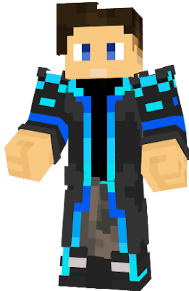
Hello !!!
Guys, hope u doing well :)

