Slide 1
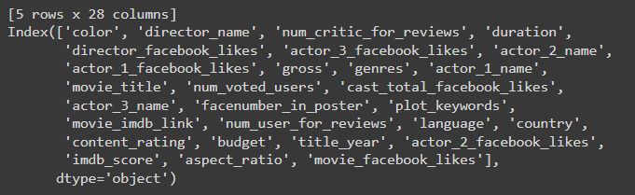
DATA SCIENCE TASK
Task:
Visualize the relation between features (you can design your own new features based on the given data)
Develop an ML model which, given the name of a director, predicts the release year of his next movie along with its probable genres
Our Data(Columns):

Slide 2
Data I considered(columns)
director_name
duration
gross
genres
movie_title
Num_voted_users (total voted users i.e critics + user)
plot_keywords
title_year
imdb_score
Total_facebook_likes (All possible likes)
user_reviews
Features engineered:
Cumulative movies (total movies made by a director over the years by grouping by the title year)
genre_counts _for_each_director
time_between_films
avg _gap_between_movie
And few others..

Slide 3
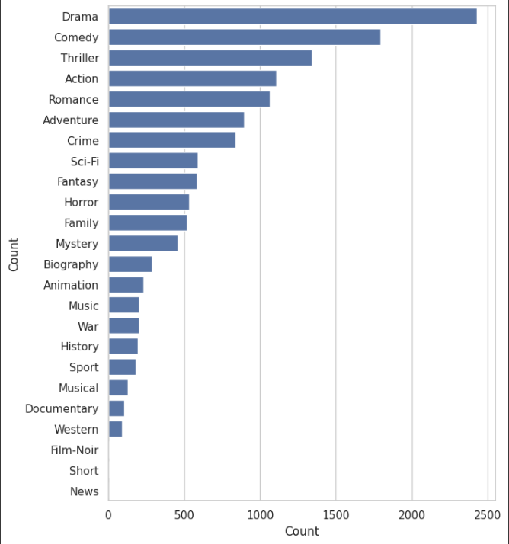
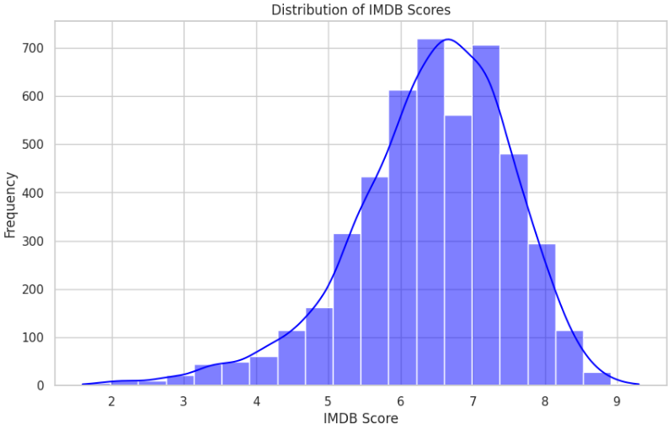
PLOTS
occurrences of each genre

Slide 4
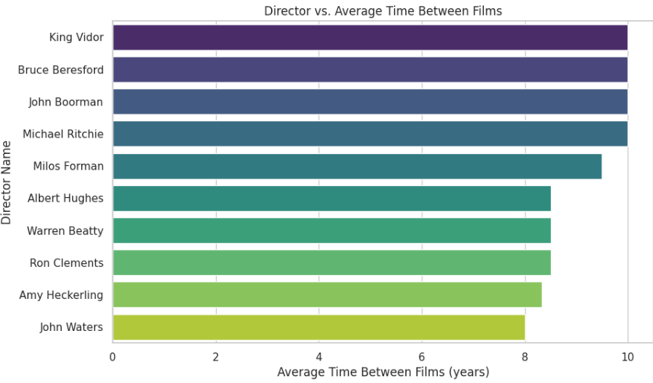
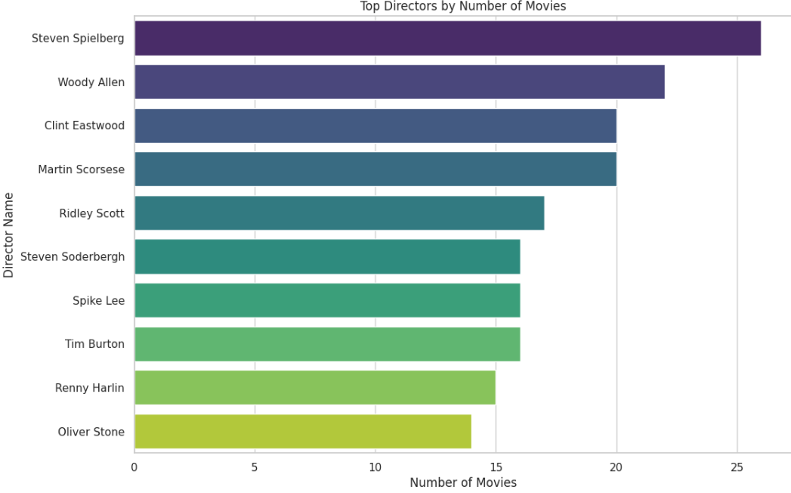
PLOTS

Slide 5
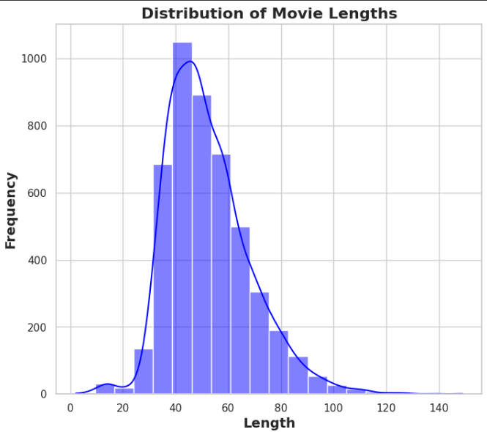
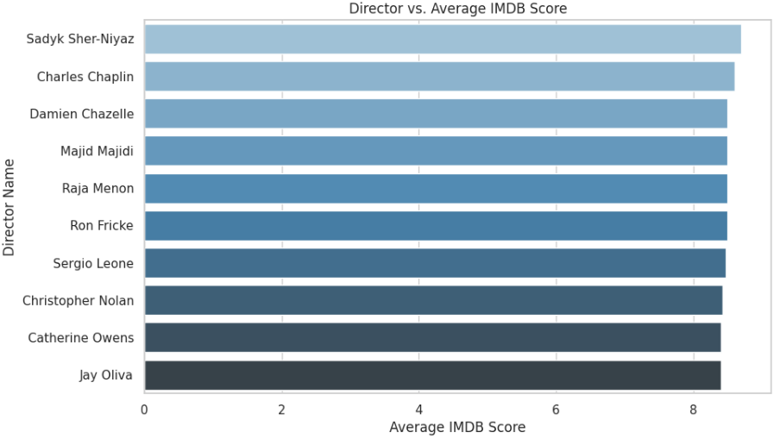
PLOTS

Slide 6
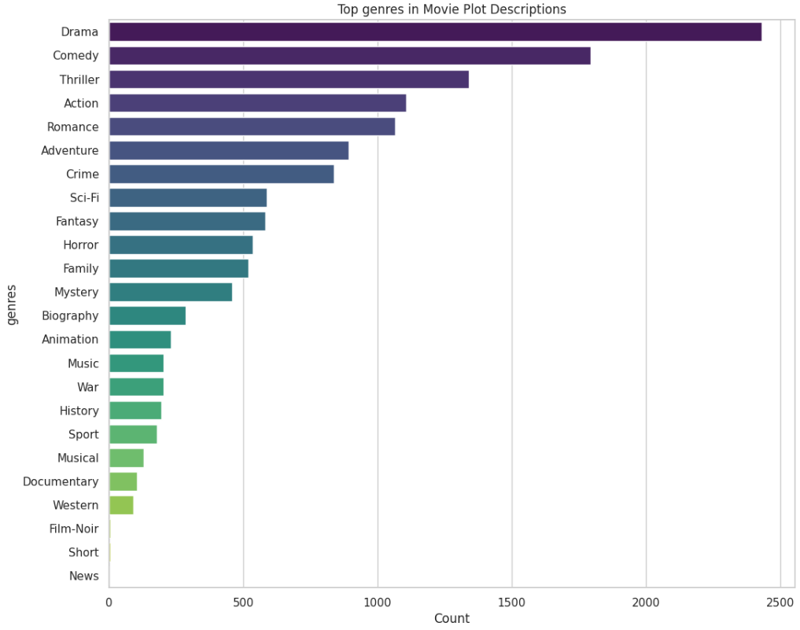
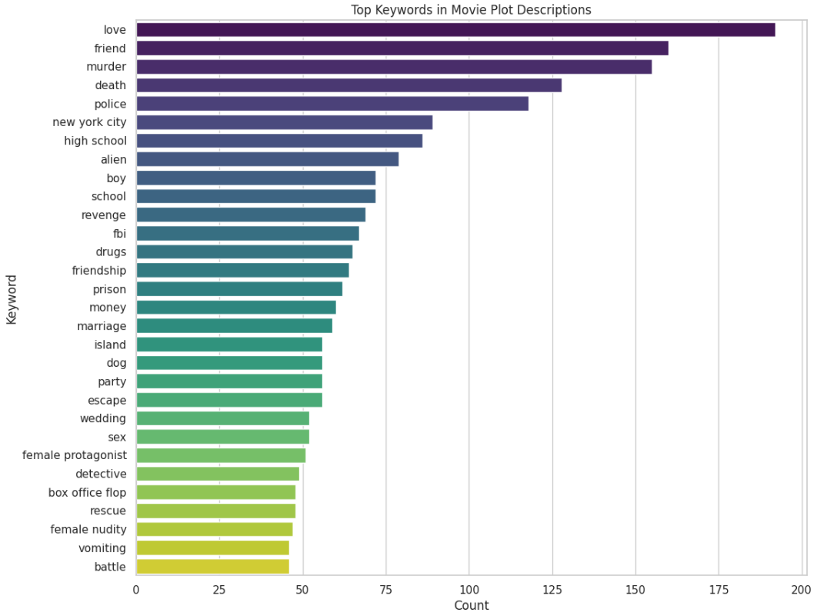

Slide 7
Model Building for genre classification
1.Preprocessing & Feature Engineering:
Used TfidfVectorizer to transform plot keywords into TF-IDF features.
Encoded director names with LabelEncoder.
Calculated interaction features like IMDb score multiplied by duration and log of number of voted users.
2.Feature & Target Preparation:
Combined TF-IDF features with encoded director names to form the feature matrix X_genres.
Used MultiLabelBinarizer to transform genres into a binary matrix y_genres.
3.Data Splitting:
Split the data into training and testing sets using train_test_split.

Slide 8
4.Model Training:
Trained a MultiOutputClassifier with a RandomForestClassifier on the training data.
Other models used:
SVM Classifier
Naive Bayes
Multiple Logistic Regressor
Evaluation:
F1 score :0.64

Slide 9
Model Building for Release Year Prediction
1.Preprocessing & Feature Engineering:
Calculated non-negative time gaps and average gaps between films.
Calculated interaction features and transform director names as done in the classifier model setup.
Calculated interaction features like IMDb score multiplied by duration and log of number of voted users.
2.Feature & Target Preparation:
Prepared feature matrix X_release_year including IMDb score, duration, interaction features, and average gap.
Set target y_release_year as current title year plus the average gap.
3.Data Splitting:
Split the data into training and testing sets using train_test_split.

Slide 10
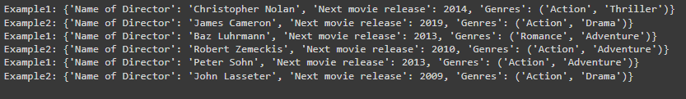

Slide 11
4.Model Training:
Trained a RandomForestRegressor
on the training data.
Other models used:
SVC Model
Multiple Linear Regressor
Evaluation:
rmse:4.17

