Slide 1

API Postman Hackathon March 2024
Team 21 - API Validators
PRESENTED BY:
Girija Kantharaj Manali Patil Shruti Bhagwatkar
Sreeja E Chandrasekharan Sandhya Devi Allipilli Debalina Chakrabarti

Slide 2

Understanding API Work Distribution
Writing and Reviewing Gherkins Validations
Peer Review
Reports & Documentation
Workflow

Slide 3
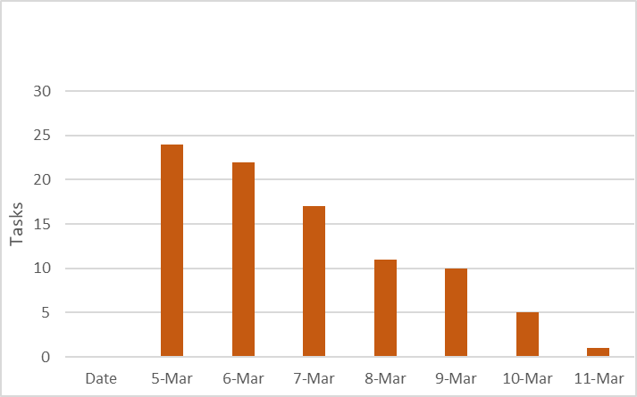
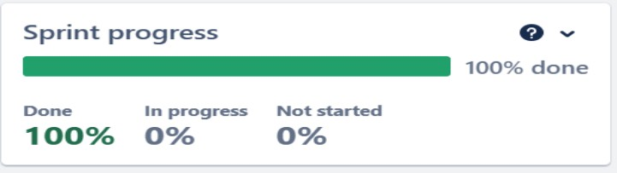

Work Progress
Agile Methodology
Sprint Planning Meeting User stories
Daily stand-up calls Reports

Slide 4

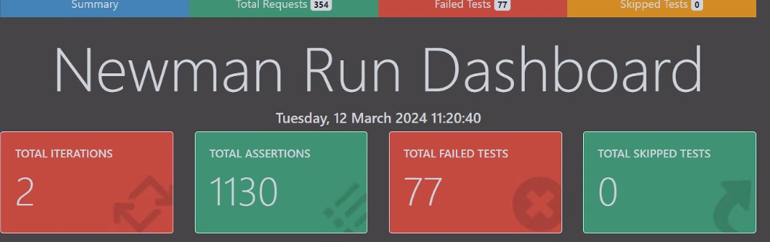
Achievements
End to End testing
Data Driven with csv file Total test cases = 201 Positive test cases = 53 Negative test cases = 148 Bugs found = 14 Validations = 1130

Slide 5

Challenges
Jira Board
Authorization
Working in Common Work Space
End to End testing (Chaining)
Data Driven
CI/CD

Slide 6

Learning
Bearer Token Authorization Report Generation
Postman Advanced Features Agile
Time management
Thank You

