Slide 1
Secure AES Encryption & Decryption
Enterprise-grade AES-256 Cryptographic Processing
Using Java Spring Boot REST APIs
Prepared by: Debanath Swain

Slide 2
Introduction
Demonstrates secure AES-256 encryption and decryption.
Implements industry-standard cryptography.
Uses Spring Boot RESTful services.

Slide 3
System Architecture
Frontend: HTML, CSS, JavaScript
Backend: Java, Spring Boot
Encryption: AES-256 (CBC, PKCS5Padding)

Slide 4
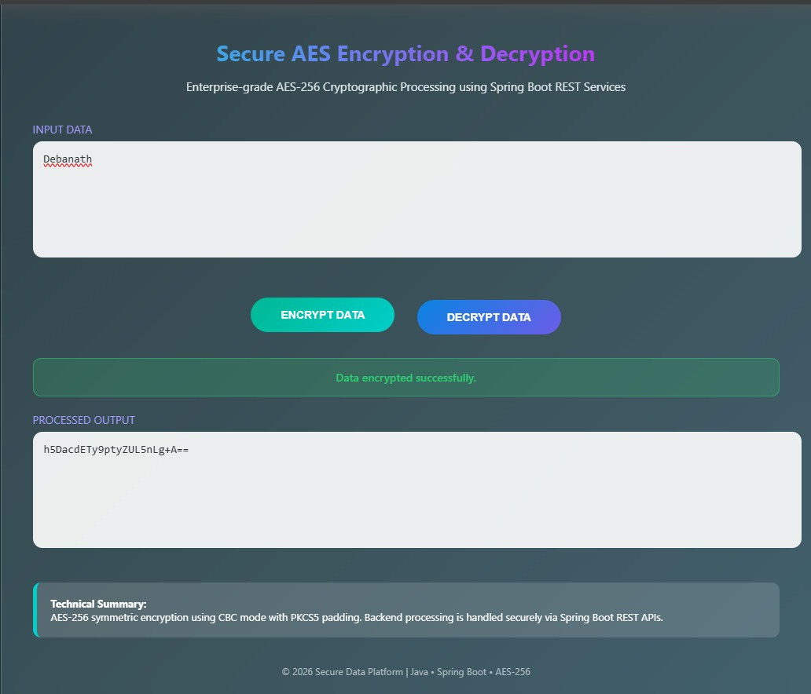
Use Case 1: Encryption Success

Slide 5
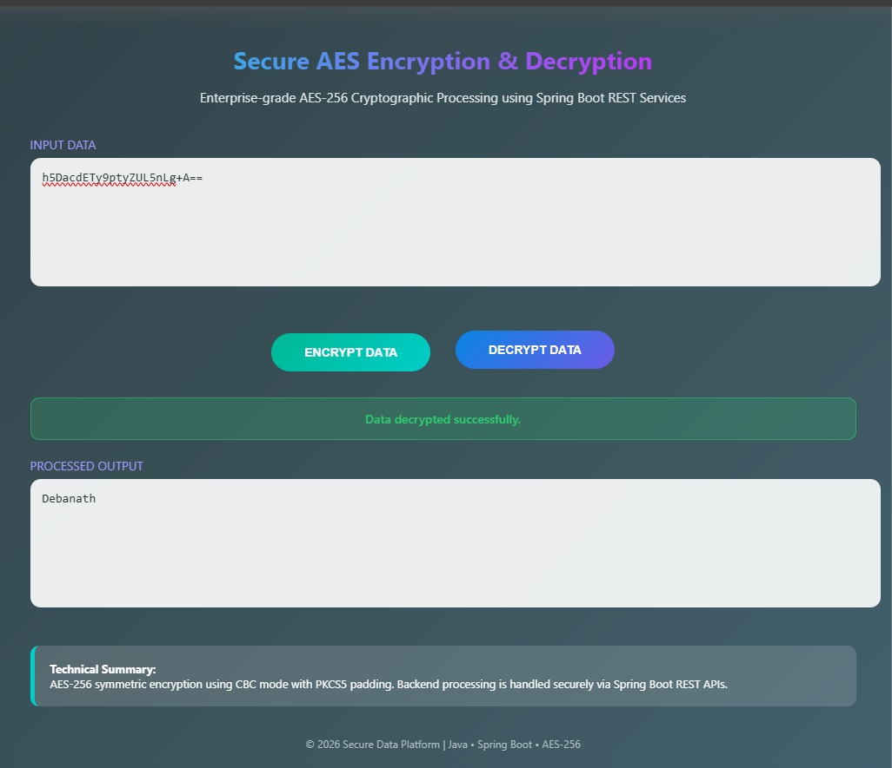
Use Case 2: Decryption Success

Slide 6
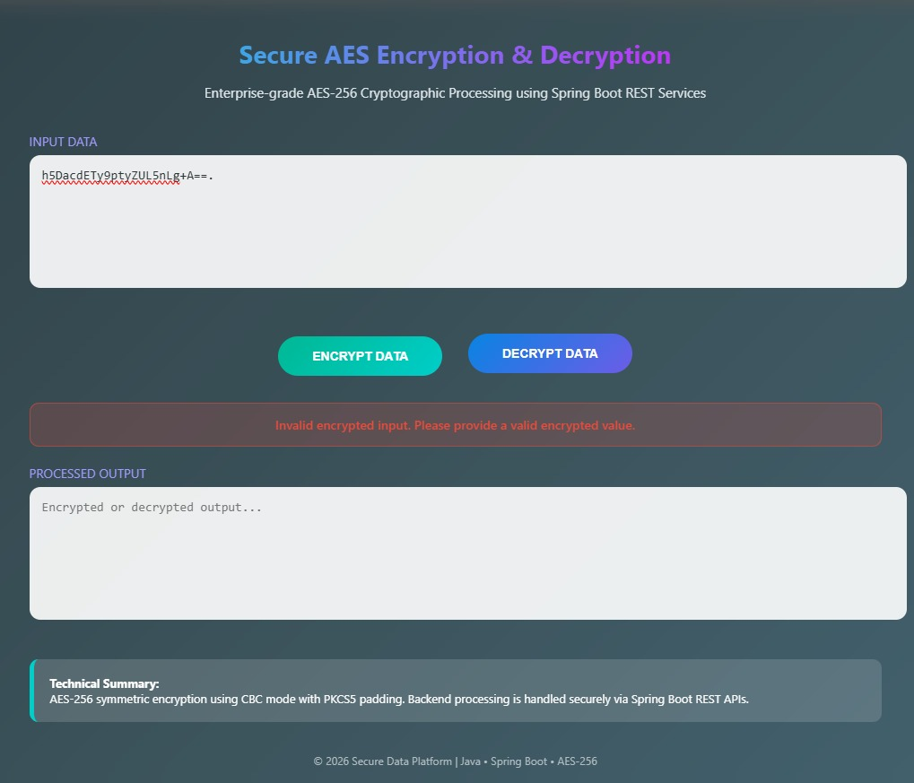
Use Case 3: Failed Decryption Handling

Slide 7
Security Highlights
Strong AES-256 symmetric encryption.
Secure CBC block chaining.
Graceful error handling without exposing internals.

Slide 8
Conclusion
Ensures confidentiality and integrity of data.
Demonstrates real-world cryptographic implementation.
Suitable for enterprise and academic use.

