Slide 1
Employee Management System
Spring Boot | Thymeleaf | Oracle Database
Developed by Debanath Swain

Slide 2
Project Objective
  Develop a web-based Employee Management System
  Implement CRUD operations using Spring Boot
  Use Thymeleaf for UI rendering
  Persist data using Oracle Database

Slide 3
Technology Stack
  Java 17
  Spring Boot & Spring Data JPA
  Thymeleaf
  Oracle Database
  Maven

Slide 4
System Architecture
  Controller Layer – Handles HTTP requests
  Service Layer – Business logic
  Repository Layer – Database interaction
  Oracle DB – Persistent storage

Slide 5
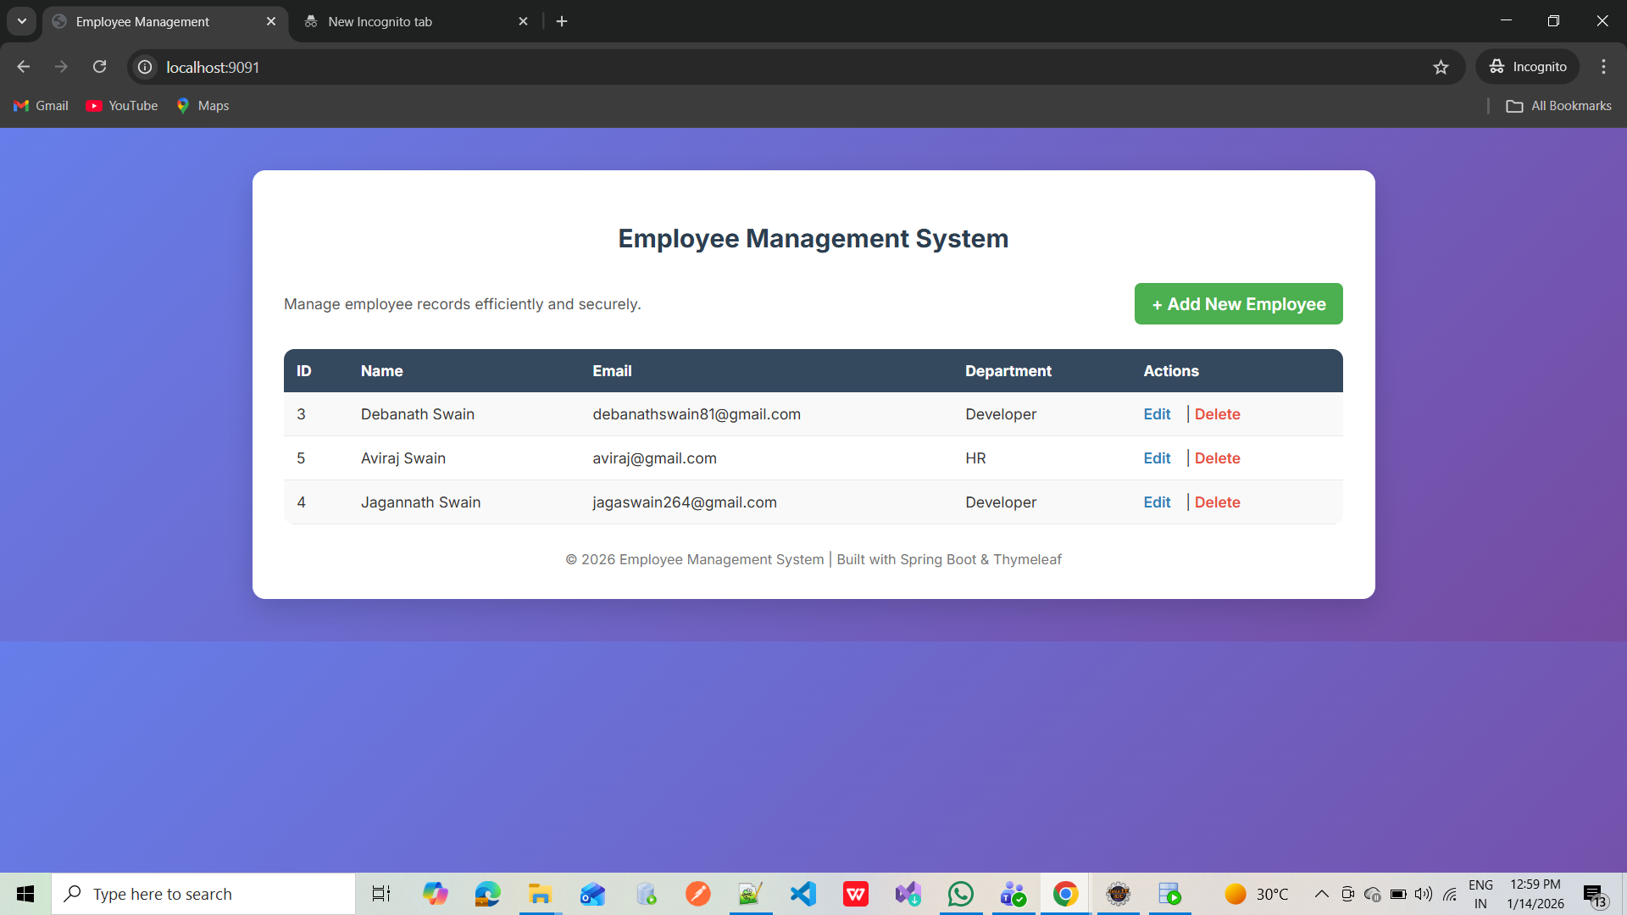
Home Page – Employee List

Slide 6
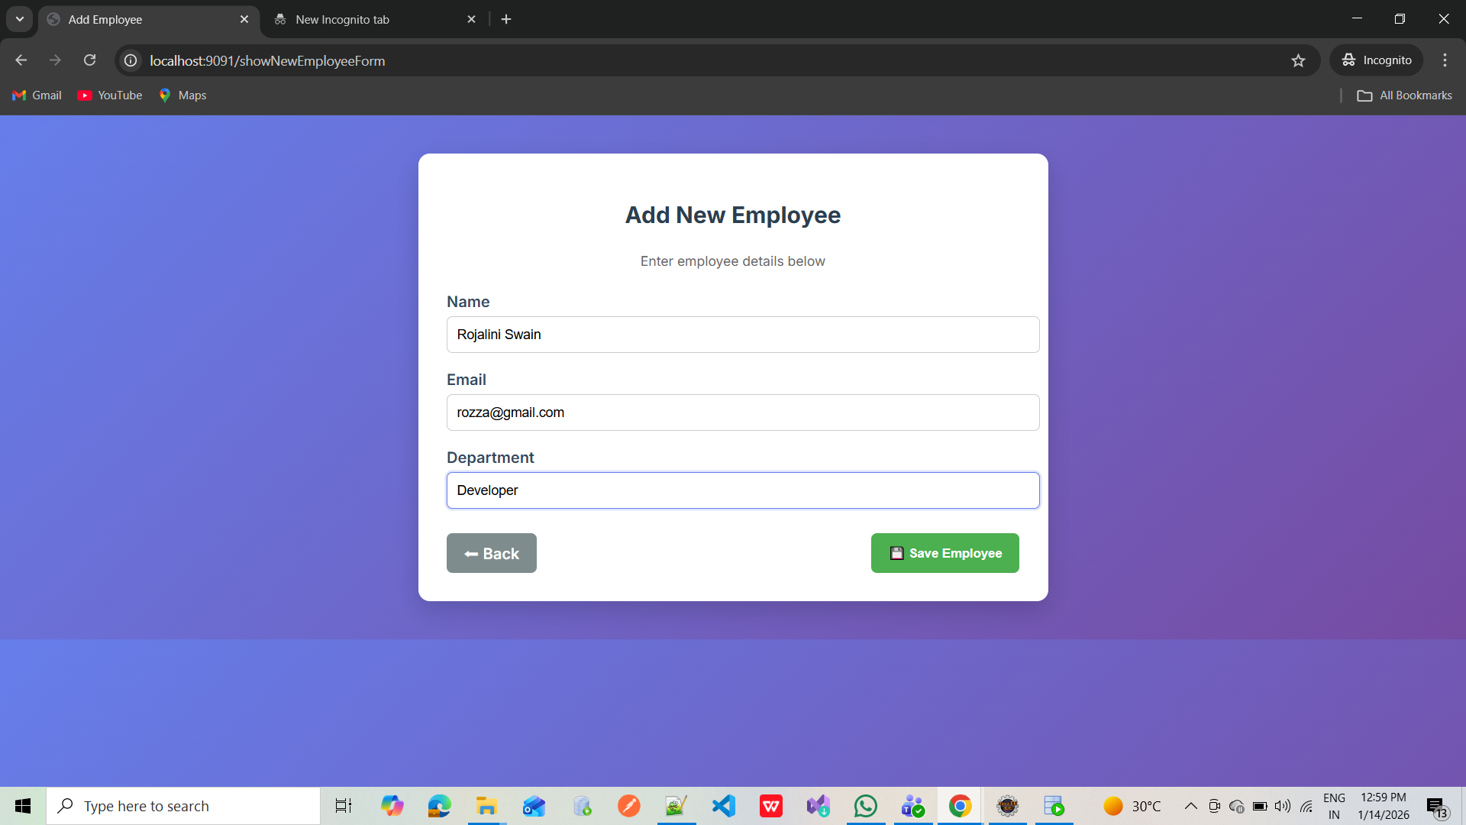
Add Employee Screen

Slide 7
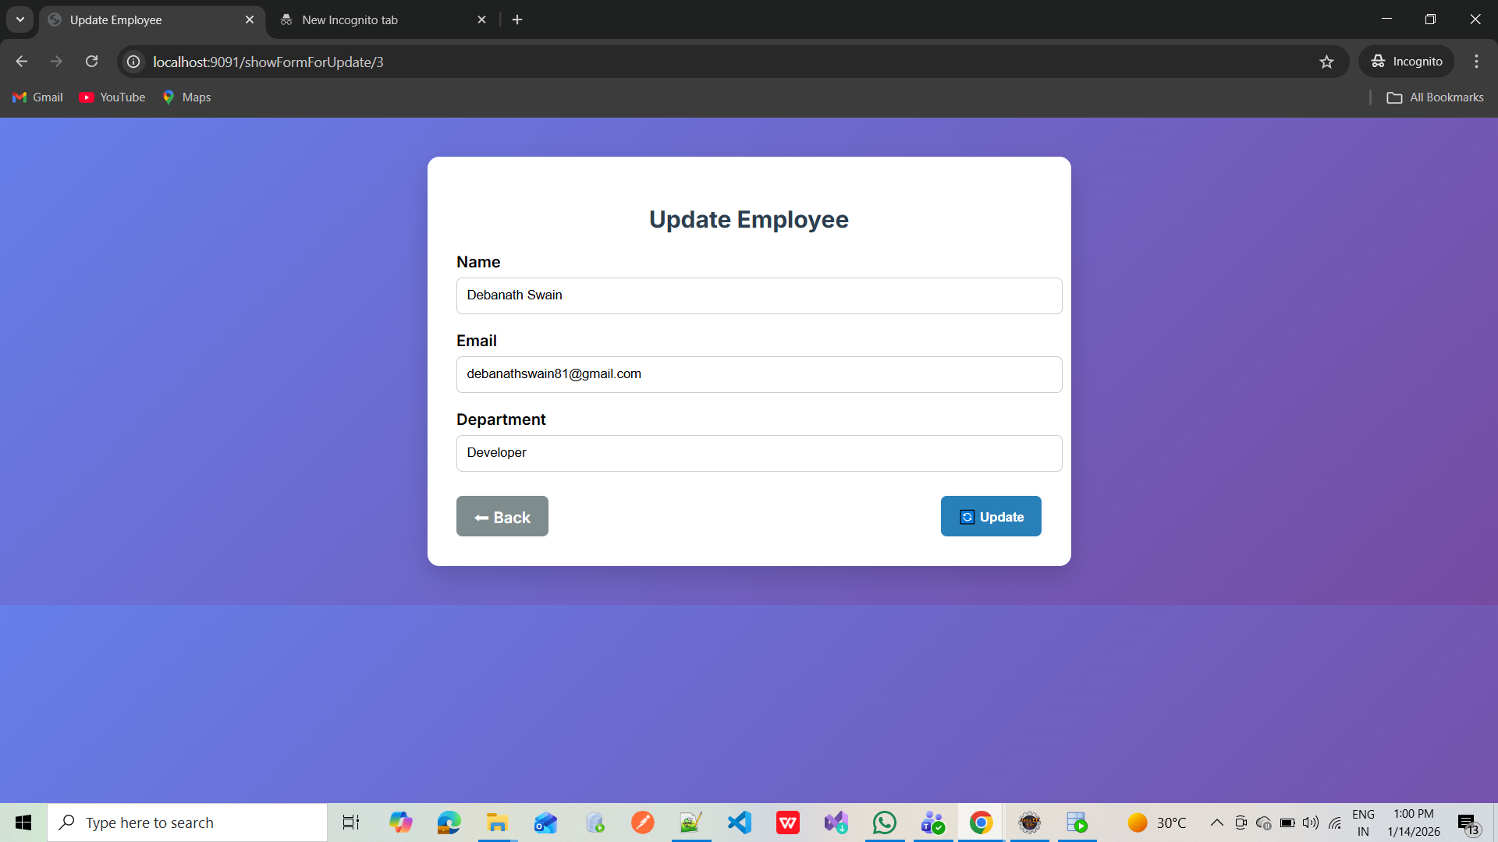
Update Employee Screen

Slide 8
Key Features
  Add new employees
  View employee list
  Update employee details
  Delete employee records
  MVC architecture

Slide 9
Future Enhancements
  Spring Security integration
  Pagination & search
  REST API exposure
  Role-based access control

Slide 10
Conclusion
  Enterprise-ready Spring Boot application
  Clean MVC design
  Oracle DB integration
  Scalable and maintainable

