Slide 1
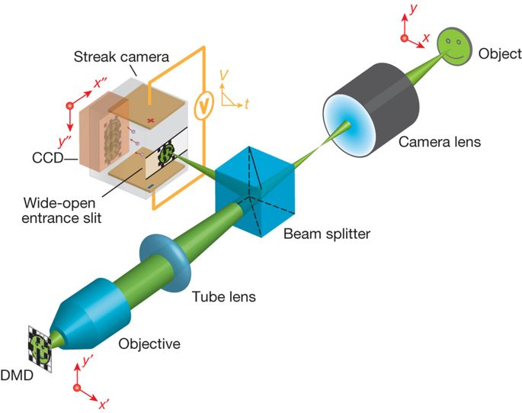
T-CUP
Components used in making T-CUP (Compressed ultrafast photography) are given below:
Streak Camera
Charged Coupled Device (CCD)
Digital Micromirror Device (DMD)
Objective
Tube Lens
Beam Splitter
Camera Lens
Object

Slide 2
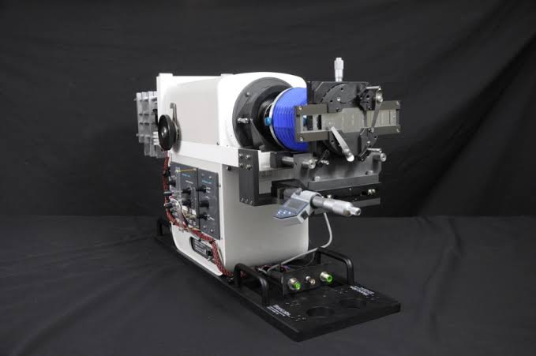
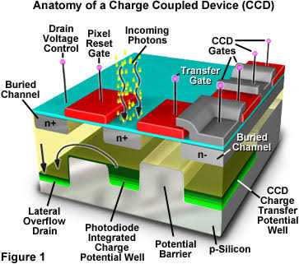
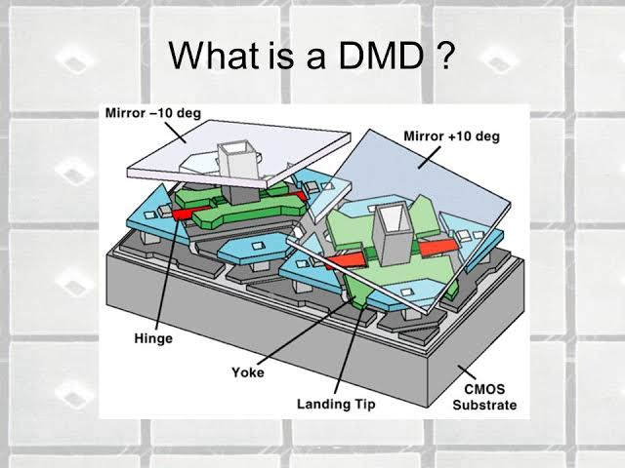
Streak Camera:
Typically the T-CUP splits the image of the laser into two devices a motion recorder and a camera that makes single exposure of the scene. By using only femtosecond streak camera, the image quality would be limited explained by Lihong Wang, Director of Caltech Optical Imaging Laboratory (COIL).
Charged Coupled Device:
A charged coupled device (CCD) is a highly sensitive photon detector. CCD is divided up into a large number of light sensitive small areas (known as Pixels) which can be used to build up an image of the scene of interest.
Digital Micromirror Device:
DMD is an micro- opto electromechanical system which is the trademark for DLP (Digital Light Processing) projection technology and this goes back to use of millions of microscopically small moving mirrors to create a video display of the type now found in digital projectors.

Slide 3
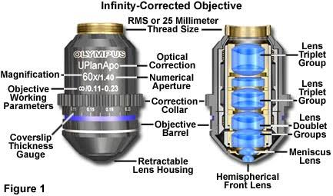
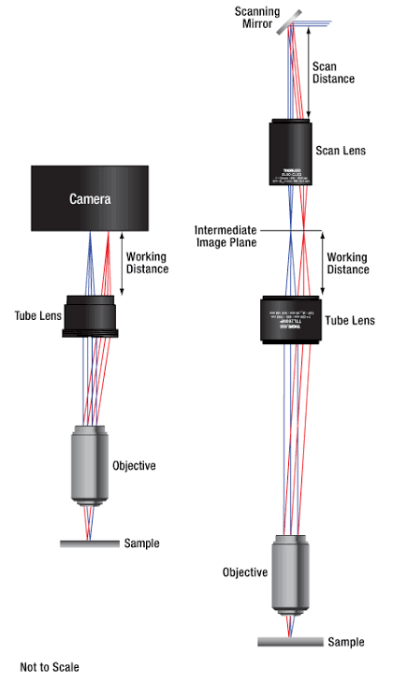
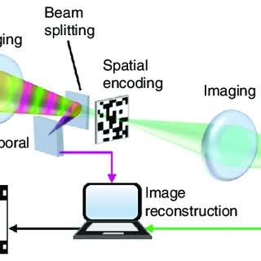
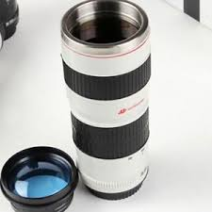
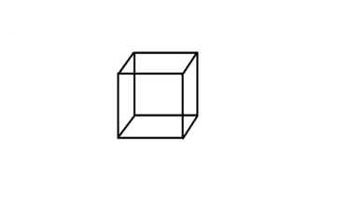
Objective:
It is an optical instrument used to view the object.
Tube Lens:
Tube lens is placed between objective and eyepiece to produce the intermediate image.
Beam Splitter:
A Beam Splitter is an optical device that splits the incident light at a designated ratio into two separate beams.
Camera Lens:
It takes all the light rays bouncing around and uses glass to redirect them to a single point and creating a sharp image.
Object:
The material which can be seen by the observer.

