Slide 1
Multimodal RAG-Based Explainable Clustering of User Behaviour
From behavioural Graphs → Image Descriptions → Query-Based Semantic Clustering

Slide 2
Motivation
Raw Features Are Not Interpretable
Feature Engineering adds Bias & Inflexibility
Lack of Contextual Semantics
Traditional clustering methods (e.g., KMeans, DBSCAN) operate on numerical similarity not semantic similarity.
They ignore natural-language descriptions or external context.
Static clustering gives one global partition.
You can’t cluster based on dynamic queries like:
“Who behaves erratically/stable during losses?”
No Explainability
Clustering results (e.g., cluster centroids) are not human-interpretable.

Slide 3
Why don’t you pass raw-json to LLM?
actor | JSON Input (Structured Text) | Graph Image (Visual Representation)
🧠 Interpretability | Requires understanding each field and its units explicitly | Humans (and LLMs) can infer trends visually
👀 Pattern Recognition | Hard to detect spikes, trends, or cycles in numbers | Visual shape conveys patterns instantly (e.g., bursts, decay)
🧩 Semantic Density | One field = one fact; lacks context of relation between fields | Graph shape encodes multiple relationships simultaneously
🧵 Temporal/Structural Relationships | Implicit; needs engineered features | Explicit in layout (e.g., time on x-axis, activity on y-axis)
💬 Natural Language Generation | LLM must be prompted to infer context from raw fields | Vision-Language LLMs directly describe graph behavior
🧱 Robustness to Feature Noise | Sensitive to noisy/irrelevant fields | Graph abstracts away less relevant details
🔄 Alignment with Query Intent | Query must map to specific fields | LLMs can match query to semantic content of image (often involves multiple fields)
🔮 Explainability | Needs post hoc analysis to generate textual summary | LLM generates descriptive summary directly from image

Slide 4
Why Multimodal-RAG
Need: Explainable, query-driven, adaptive user grouping.
Descriptions should be detailed in nature and understandable in natural languages
Able to capture local behavioural patterns rather than global patterns

Slide 5
Why Multimodal-RAG
Query: “Cluster users based on image-description such that each group will have explainability with respect to :
1. Playing Activity: Users' playing activity, focusing on their playing frequency, stake consistency, and periods of high and low activity?
2. Nudging Requirement: Users' Nudging requirement to increase activity on the platform and if yes at what dimension sould be nudged these users, is it Stake or frequency or longer sessions?
3. Recent vs. Earlier Activity: Users' playing frequency, session lengths and stake size in this recent period compare to their activity earlier in the month.
Retriever: Pull Descriptions from 4000 image-translated behavior graphs
Augment: Combine query + retrieved docs.
Generation: LLM explains each cluster in plain language.

Slide 6
Benefits
Descriptions are detailed in nature and understandable in natural languages
Query can be changed according to requirement
Able to capture local behavioural patterns based on the query

Slide 7
Segment | Description | Playing Activity | Nudging Requirement | Recent vs. Earlier Activity | Total Users
High-Value, Sustained Engagement (The VIPs) | Your most valuable players, demonstrating consistently high frequency and moderate to high stakes. Highly engaged, loyal, and show stable or growing activity, forming the core base of strong performers. | Highly consistent and frequent (often daily or near-daily), with moderate to high stakes. Some show an upward trend in frequency and/or stake size, while others maintain a consistently high level. Occasional higher spikes in stakes are common. | Low. Focus on retention, loyalty programs, VIP benefits, exclusive features/events, and personalized recognition to maintain interest and engagement. Avoid basic frequency nudges. | Consistently high activity (frequency, stake size) throughout the entire period, with stable engagement or a clear growth trend. | 1521
Growing Engagement (The Up-and-Comers) | Users who show a clear and positive upward trend in their playing frequency and/or stake sizes. They were less active or played with lower stakes earlier but are now becoming more engaged and valuable. | Noticeably increased frequency, session length, and/or stake size in the recent period compared to earlier activity. | Moderate. Nurture this positive trend. Reward increasing activity, encourage sustained play, and offer challenges or milestones that align with their growing engagement. Focus on sustaining frequency and potentially longer sessions. | Significant increase in playing frequency, session length, and/or stake sizes in the recent period compared to earlier. | 178
Strategic Moderate Players (Optimizing Engagement) | Users with consistent moderate activity who are reliable but have room for growth. This includes those with moderate frequency and moderate stakes, or those with very high frequency but consistently low stakes. The goal is to gently uplift their overall value. | Consistent moderate frequency with moderate-to-high stakes, or very high frequency with consistently low stakes. Activity is stable at a moderate level. | Medium. Aim for slight uplift in frequency or stake through loyalty bonuses, personalized offers, or new game features. For low-stake players, encourage gradual stake increases with tiered rewards. | Stable, consistent patterns throughout the period, with no significant decline or strong growth. | 427
Sporadic High-Rollers (Event-Driven High-Value) | These users play infrequently but when they do, they engage in very high-stake activities. Their engagement is episodic, characterized by clear, distinct spikes rather than sustained play. | Highly intermittent activity, but with very high stakes during active sessions. Significant gaps between play. | Low to Moderate. Focus on special events or high-value offers that align with their episodic, high-stake playing style. Nudging should be around stake or event-based frequency, highlighting new high-stake opportunities or offering incentives to return after inactivity. | Characterized by sporadic bursts of high-stakes play rather than a continuous trend. Might show a recent high-stake session after a long period of inactivity. | 684
Early Decline / At-Risk of Churn | Users who previously showed significant engagement (sometimes high-value) but have recently shown a clear and concerning decline in activity. They are at high risk of churning if not re-engaged promptly. | Significant decrease in frequency, session length, and/or stake size in the recent period compared to earlier activity. They are not entirely inactive but are showing strong signs of reduced engagement. | High. Aggressive re-engagement strategies are needed, including personalized win-back offers, strong incentives, and reminders of the platform's value. | Significantly lower playing frequency, shorter sessions, and/or reduced stake size in the recent period compared to the earlier part of the month. | 134
Largely Inactive / Churned (Re-activation Priority) | Users who show clear signs of having churned or being largely inactive. They often had initial activity, but their recent playing frequency and/or stake sizes have ceased entirely or are extremely low. These users require immediate and strong re-engagement efforts. | Characterized by a sharp decrease or complete cessation of activity in the recent period. Earlier activity might have ranged, but current engagement is non-existent or extremely low. | Very High. The primary objective is re-activation. Nudging should be aggressive and include compelling incentives such as significant free plays, substantial bonus credits, or personalized win-boost offers designed to bring them back. | Activity in the recent period is significantly lower, or non-existent, compared to earlier periods. This group shows a strong and concerning trend of decline or has been consistently low/infrequent throughout. | 545
Moderate Frequency, Mixed Stakes, Variable Engagement | These users show moderate and often fluctuating playing frequency with mixed stake sizes. Their activity is less consistent than high-frequency players but more sustained than sporadic players. | Moderate frequency, varying from low to medium stakes with occasional higher spikes. Activity shows periods of both engagement and quiet spells. | Moderate. Aim to stabilize engagement and encourage more consistent play, potentially increasing stake size or frequency with tailored offers (e.g., daily login bonuses, challenges, rewards for specific stake volumes). | Mixed trends, some maintaining moderate activity, others showing slight increases or decreases, or a shift in pattern. The overall characteristic is fluctuation rather than a clear upward or downward trend. | 319

Slide 8
Evaluation
Metric-based
LLM as Judge
Human-in-the-loop
Vision-driven

Slide 9
Table 1: Comparison of Automated Evaluation Metrics for Gaming Profiles
Metric Name | What It Measures | Category | Pros | Cons | Applicability to Gaming Profile
CLIP Score | Semantic similarity between an image and a text. | Image-Text Alignment | Fast, automated, scalable, reference-free. Good for a baseline relevance check. | Insensitive to text quality, creativity, or style. Can fail on complex compositional details. Not designed to evaluate a "persona." | Medium. Useful as a first-pass filter for relevance, but must not be used as a standalone quality metric.
DA-Score | Alignment of multiple textual assertions with an image, using a VQA model. | Image-Text Alignment | More robust for complex prompts/images than standard CLIP Score. Can verify multiple attributes. | More complex to implement than CLIP Score. Still focused on descriptive accuracy, not creative quality. | Medium. A better approach than CLIP Score for relevance if profiles are expected to capture multiple specific visual details, but still doesn't address persona or engagement.
BLEU | N-gram precision of generated text against reference texts. | N-gram Overlap (Reference-Based) | Fast, simple to calculate, widely understood. | Requires reference texts. Penalizes creativity and valid paraphrasing. Focuses on surface-level similarity, not meaning or quality. | Low. Fundamentally unsuited for creative, open-ended tasks. Using it would optimize the model for being generic and unoriginal.
ROUGE | N-gram recall of generated text against reference texts. | N-gram Overlap (Reference-Based) | Fast, simple to calculate. Focus on recall can be useful for summarization tasks. | Requires reference texts. Shares all the core limitations of BLEU regarding creativity and semantic understanding. | Low. Like BLEU, it is conceptually mismatched with the goal of generating novel and engaging content.
CIDEr | Consensus-based, TF-IDF weighted n-gram similarity against reference texts. | N-gram Overlap (Reference-Based) | Designed for image captioning, so it's more semantically aware than BLEU/ROUGE. | Still requires a large set of diverse reference captions to be effective. Highly sensitive to reference text quality. Penalizes novel phrasing. | Low. While better than BLEU/ROUGE for descriptive tasks, it still suffers from the fundamental reference-based problem and cannot evaluate the creative aspects of a persona.

Slide 10
Table 2: LLM-as-a-Judge: Prompting Strategies and Bias Mitigation Techniques
Strategy/Technique | Description | Example Implementation (Prompt Snippet) | Associated Bias/Problem Addressed
Chain-of-Thought (CoT) Prompting | Instructing the judge to provide its reasoning before the final score. instruct the judge to "think step-by-step" before delivering its final verdict. | First, provide a step-by-step evaluation of the profile against each criterion. After your reasoning, provide your final scores in a JSON format. | Improves accuracy by forcing a more deliberative process; provides interpretable feedback for developers.
Detailed Rubrics | Providing explicit definitions for each point on the scoring scale for every criterion. | For the 'Creativity' score: 5 means highly imaginative and unexpected; 3 means adequate but relies on common tropes; 1 means generic and clichéd. GEval | Reduces ambiguity and subjectivity; increases inter-rater reliability and consistency of scores.
Few-Shot Examples | Including examples of good and bad outputs with their correct evaluations in the prompt. | Here is an example of a 'Poor' profile (Score 1): [Example]. Here is an example of an 'Excellent' profile (Score 5): [Example]. Now, evaluate the following profile. | Calibrates the judge to the specific nuances of the task; helps it understand subtle quality distinctions.
Positional Bias Mitigation | Running pairwise comparisons twice, swapping the order of the two outputs. | Run evaluation with [Profile A] then . Rerun with then [Profile A]. Aggregate results. | Counters the tendency of LLMs to favor the first item presented in a list.
Verbosity Bias Mitigation | Explicitly instructing the judge in the rubric that conciseness is a positive trait. | In the 'Overall Quality' score, penalize profiles that are unnecessarily verbose or contain filler content. Reward profiles that are concise and impactful. | Counters the tendency of LLMs to prefer longer outputs, regardless of their quality.
Self-Preference Bias Mitigation | Using a judge model from a different family or provider than the generation model. | If the profile is generated by gpt-4-turbo, use claude-3-opus or gemini-1.5-pro as the judge. | Reduces the risk that the judge will unfairly favor outputs from its own model family.
Low Temperature Setting | Setting the temperature parameter of the judge model's API call to a low value. | temperature=0.1 | Increases the determinism and consistency of the judge's outputs, ensuring the same input receives the same evaluation.

Slide 11
Example Human Evaluation Rubric for Gaming Profiles
Dimension | Description | Scoring Scale (1-5) with Anchors
Image Relevance | Assesses how well the profile's text reflects the key visual elements, mood, and overall theme presented in the image. | 1 (Poor): The profile seems completely unrelated to the image or contradicts it directly. 3 (Good): The profile accurately reflects the main subject and general mood of the image. 5 (Excellent): The profile masterfully captures both the literal details and the subtle nuances (e.g., emotion, atmosphere) of the image.
Creativity & Originality | Evaluates the imagination and novelty of the profile. Does it go beyond a literal description to create an interesting and unique character concept? | 1 (Poor): The profile is generic, clichéd, or a simple, boring description of the image. 3 (Good): The profile contains some creative elements but largely relies on common genre tropes. 5 (Excellent): The profile presents a highly original, surprising, or deeply intriguing character concept that is a unique interpretation of the image.
Persona Coherence | Measures the internal consistency of the generated profile. Do the name, backstory, and described personality traits align logically and create a believable character? (Playing activity) | 1 (Poor): The profile contains clear contradictions (e.g., a cheerful description for a grim-looking character, a name that doesn't fit the backstory). 3 (Good): The profile is mostly consistent, with no major logical flaws. 5 (Excellent): All elements of the profile (name, traits, history) work together seamlessly to create a highly coherent and believable persona.
Gaming Tone Fitness | Assesses how well the profile's style, tone, and language fit within the context of a gaming application and the target genre. Is it engaging for a player? () | 1 (Poor): The tone is completely inappropriate for a game (e.g., too formal, academic, or bland). 3 (Good): The tone is acceptable for a game but feels generic. 5 (Excellent): The tone is perfectly suited to the target game genre, is highly engaging, and contains a "hook" that would make a player want to interact with or learn more about this character.
Nudging Tone Fitness | Assesses how well the nudging style, tone, and language fit within the context of a gaming application and the target genre. | 1 (Poor): The tone is completely inappropriate 3 (Good): The tone is acceptable for a user but feels generic. 5 (Excellent): The tone is perfectly suited to the target user genre
Grammatical Correctness & Fluency | Evaluates the basic linguistic quality of the text. Is it free of grammatical errors, spelling mistakes, and awkward phrasing? | 1 (Poor): The profile contains numerous errors that make it difficult to read or understand. 3 (Good): The profile has one or two minor errors but is generally well-written. 5 (Excellent): The profile is grammatically flawless and reads fluently and naturally.

Slide 12
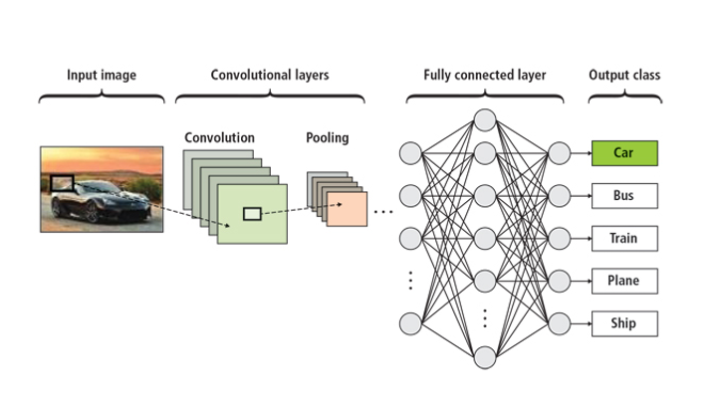
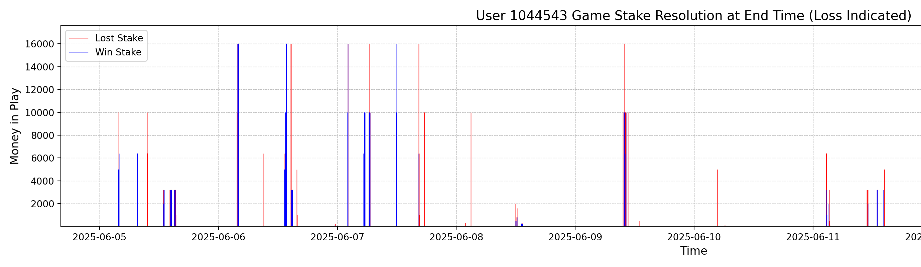
Inferencing strategy (deployment)
C1
C1
C1
C1
C1

