Slide 1
Topic Modeling Unsupervised ML
Harshit Kumar, Ph.D.
Senior Member of Technical Staff-AIOps

Slide 3
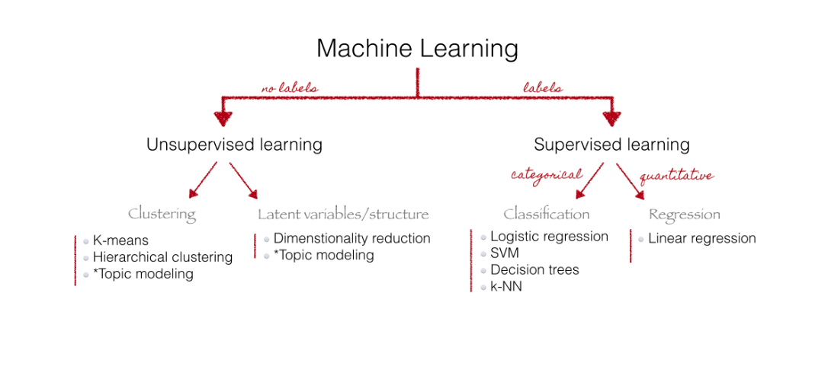

Slide 4
What is Topic Modeling
A topic model is a type of statistical model for discovering the abstract topics that occur in a collection of documents.
Topic Models are a suit of algorithms that uncover hidden thematic structure in document collections.
These algorithms help us develop new ways to search, browse and summarize large document collections.
Topic Models provide a simple way to analyze large volumes of unlabeled text.
A topic consists of a cluster of words that frequency occur together.

Slide 5
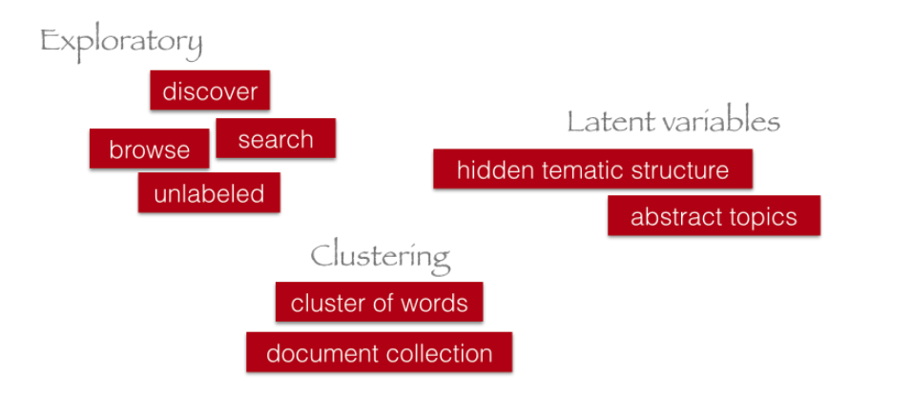

Slide 6
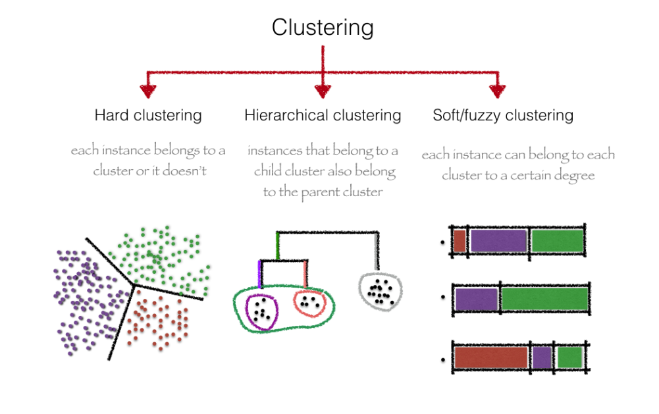

Slide 7
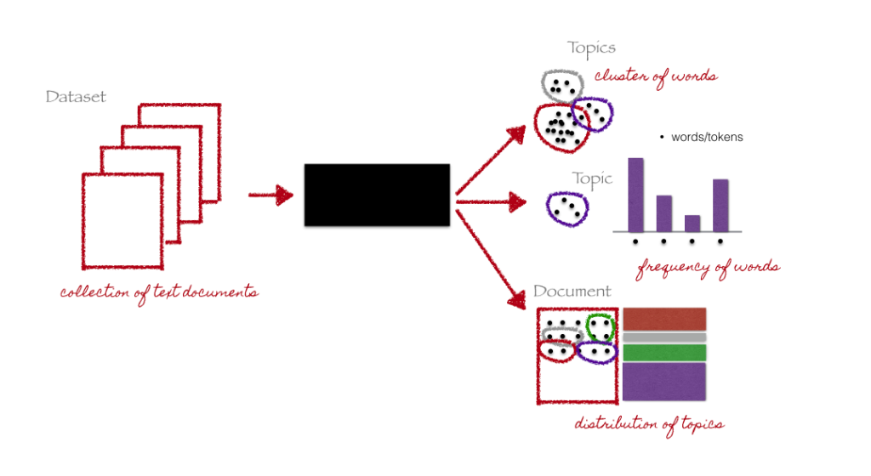
Topic Model

Slide 8

Problem
Kohli,
inaugurating,
Nike shoes,
Throw, ball,
velocity, break
glass
Release,
science
fiction ,
matrix,
wide,
screen
Find area,
perimeter,
wide
Screen,
IPL match,
Election,
speech
TOPICS
Politics
Science
Cinema
Sports
Notes:
Collection of news article. Each article is on a particular topic, for ex: politics, science, cinema, sports

Slide 9
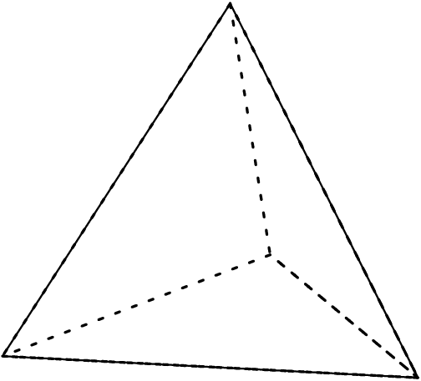
Topic Modeling – Latent Dirichlet Analysis (LDA)
Politics
Election,
speech
Release, science
fiction , matrix
Cinema
Kohli,
inaugurating,
Nike shoes,
Wide Screen,
IPL match,
Throw, ball,
velocity, break
glass
wide,
screen
Find area,
perimeter,
Sports
Science

Slide 10



Analogy - Party

Slide 11
Analogy - Party
At the Beginning

Slide 12
Analogy - Party
2 hours into the party

Slide 13
Analogy - Party
5 hours into the party

Slide 14



Analogy – Party and Danger

Slide 15

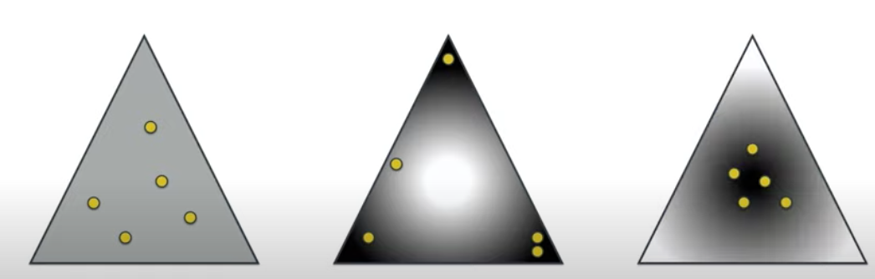



Dirichlet Distribution
$$α=1$$
$$α< 1$$
$$α> 1$$

Slide 16

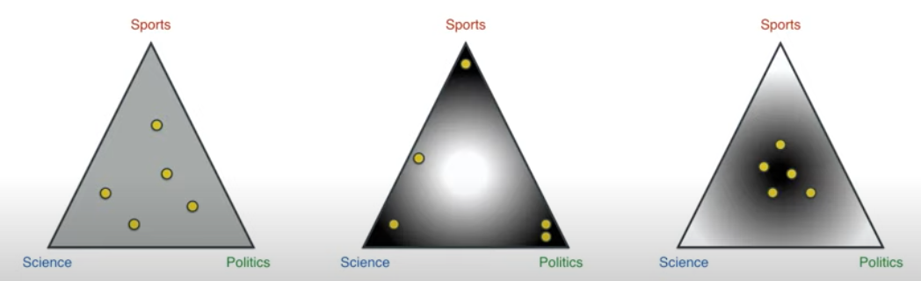
Articles and Topic Distribution
Dots are articles
Vertices are topics
Which one is the Dirichlet distribution for articles w.r.t topics?

Slide 17

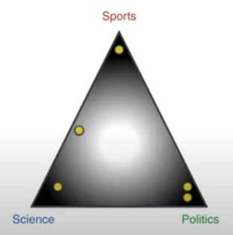




Dirichlet to Multinomial Distribution Topics w.r.t Documents
Topics:
Sports
Science
Politics
Distribution of Distributions

Slide 18

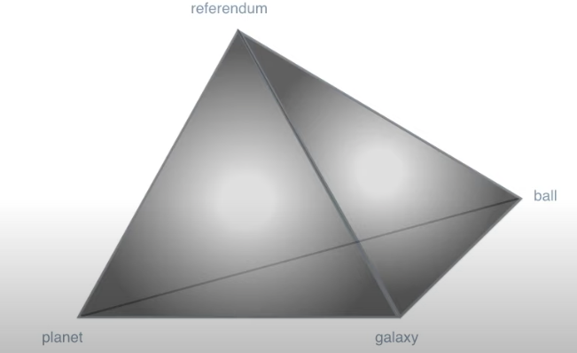


Dirichlet to Multinomial Distribution Topics w.r.t Words
Vocabulary from articles:
Referendum
Planet
Galaxy
ball
Topics:
Science
Sports
Politics
A distribution of distributions

Slide 19
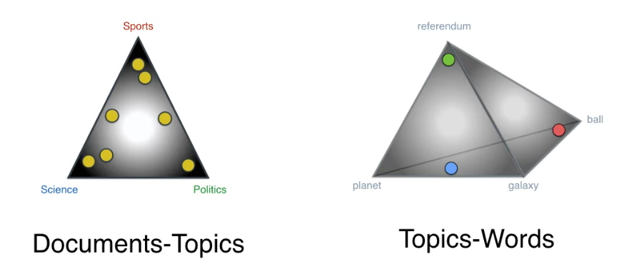
Two Dirichlet Distributions

Slide 20

A Machine that Generates Documents
Actual Document
Topics vs Terms
Distribution
Topics vs Document
Distribution
Most Likely
Similar
Less Likely
Similar
Generated Document - 1
Generated Document - 2

Slide 21

Best LDA Model

Slide 22
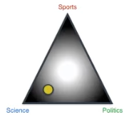

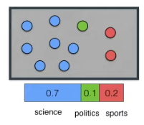
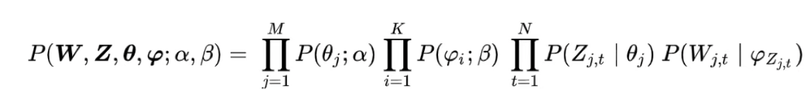

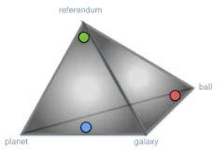

Probability of Generating a Document
Topics of words in our article
Randomly select topics with the following distribution
70% of words come from science topic, and so on
Dirichlet distribution – topics w.r.t documents
Selecting a random point to be one of our documents
Distribution is heavy over corner,
Note: close to science
Words selected here
Probability of generating
a document
Dirichlet distribution – topics w.r.t words
Dots represent topics, vertex represent words
For each topic, select a word with the following distribution

Slide 23
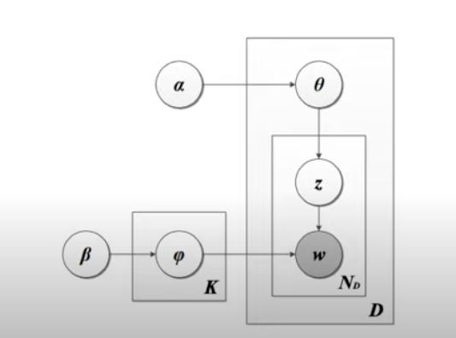
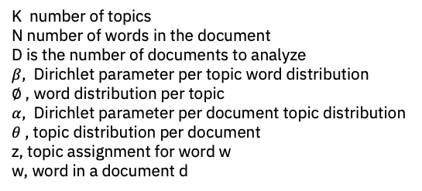
LDA Machine
Dirichlet Distribution of
Topics over Document
K number of topics
N number of words in the document
D is the number of documents to analyze
$β$, Dirichlet parameter per topic word distribution
$∅$ , word distribution per topic
$α$, Dirichlet parameter per document topic distribution
$θ$ , topic distribution per document
z, topic assignment for word w
w, word in a document d
Multinomial Distribution For
Picking Topics
Dirichlet Distribution of
Topics over Words
Generated Document
Multinomial Distribution For
Picking Words

Slide 24
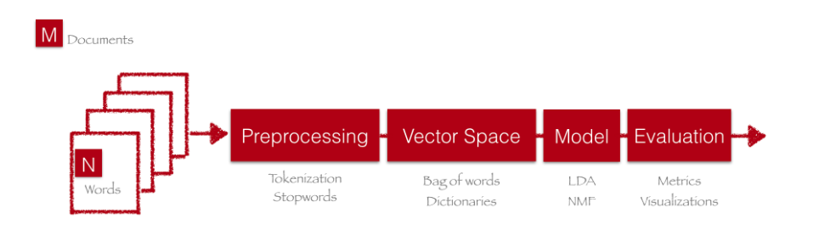
Pipeline

Slide 25
References
https://ethen8181.github.io/machine-learning/clustering_old/topic_model/LDA.html
https://hackernoon.com/nlp-tutorial-topic-modeling-in-python-with-bertopic-372w35l9
https://serrano.academy/unsupervised-learning/
https://sites.google.com/umd.edu/2021cl1webpage/
http://en.Wikipedia.org/wiki/Topic_model
http://chdoig.github.io/pygotham-topic-modeling/#/
http://www.cs.princeton.edu/~blei/topicmodeling.html
http://mallet.cs.umass.edu/topics.php
https://radimrehurek.com/gensim/

