Slide 1
Topic Modeling Unsupervised ML
Harshit Kumar, Ph.D.
Senior Member of Technical Staff-AIOps

Slide 2

Problem
Kohli,
inaugurating,
Nike shoes,
Throw, ball,
velocity, break
glass
Release,
science
fiction ,
matrix,
wide,
screen
Find area,
perimeter,
wide
Screen,
IPL match,
Election,
speech
TOPICS
Politics
Science
Cinema
Sports
Notes:
Collection of news article. Each article is on a particular topic, for ex: politics, science, cinema, sports

Slide 3
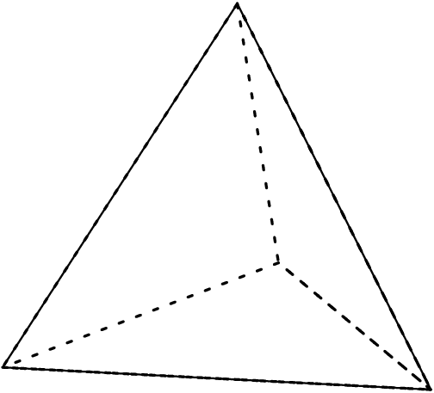
Topic Modeling - LDA
Politics
Election,
speech
Release, science
fiction , matrix
Cinema
Kohli,
inaugurating,
Nike shoes,
Wide Screen,
IPL match,
Throw, ball,
velocity, break
glass
wide,
screen
Find area,
perimeter,
Sports
Science

Slide 4



Analogy - Party

Slide 5
Analogy - Party
At the Beginning

Slide 6
Analogy - Party
2 hours into the party

Slide 7
Analogy - Party
5 hours into the party

Slide 8



Analogy – Party and Danger

Slide 9

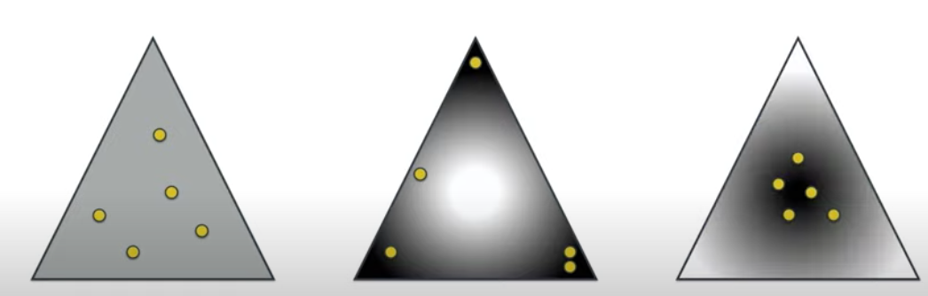



Dirichlet Distribution
$$α=1$$
$$α< 1$$
$$α> 1$$

Slide 10

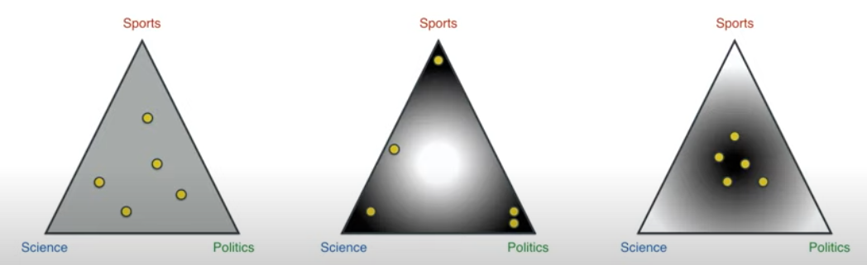
Articles and Topic Distribution
Dots are articles
Vertices are topics
Which one is the Dirichlet distribution for articles w.r.t topics?

Slide 11

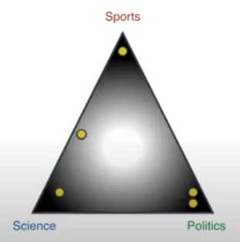




Dirichlet to Multinomial Distribution Topics w.r.t Documents
Topics:
Sports
Science
Politics
Distribution of Distributions

Slide 12

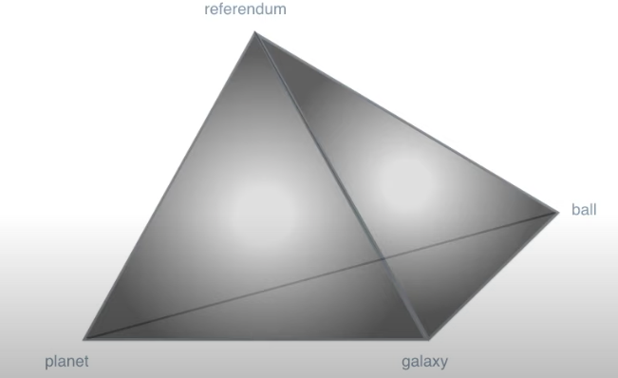


Dirichlet to Multinomial Distribution Topics w.r.t Words
Vocabulary from articles:
Referendum
Planet
Galaxy
ball
Topics:
Science
Sports
Politics
A distribution of distributions

Slide 13
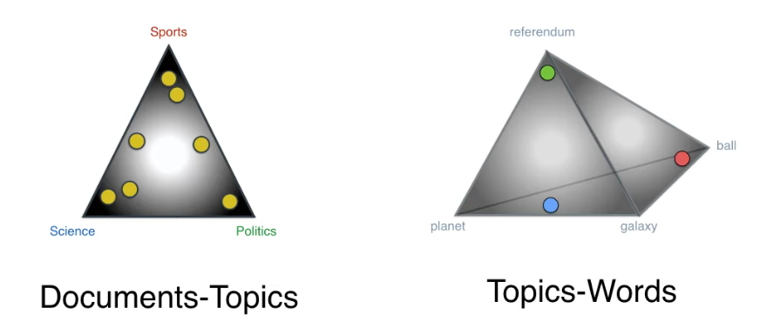
Two Dirichlet Distributions

Slide 14

A Machine that Generates Documents
Actual Document
Topics vs Terms
Distribution
Topics vs Document
Distribution
Most Likely
Similar
Less Likely
Similar
Generated Document - 1
Generated Document - 2

Slide 15

Best LDA Model

Slide 16
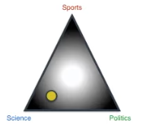

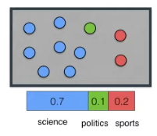
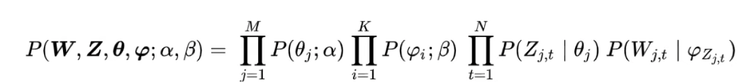

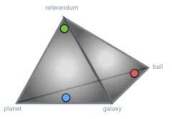

Probability of Generating a Document
Topics of words in our article
Randomly select topics with the following distribution
70% of words come from science topic, and so on
Dirichlet distribution – topics w.r.t documents
Selecting a random point to be one of our documents
Distribution is heavy over corner,
Note: close to science
Words selected here
Probability of generating
a document
Dirichlet distribution – topics w.r.t words
Dots represent topics, vertex represent words
For each topic, select a word with the following distribution

Slide 17
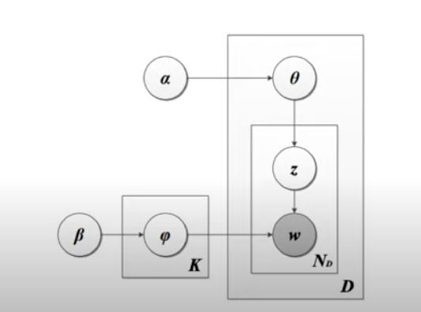
LDA Machine
Dirichlet Distribution of
Topics over Document
Multinomial Distribution For
Picking Topics
Dirichlet Distribution of
Topics over Words
Generated Document
Multinomial Distribution For
Picking Words

Slide 18
References
https://ethen8181.github.io/machine-learning/clustering_old/topic_model/LDA.html
https://hackernoon.com/nlp-tutorial-topic-modeling-in-python-with-bertopic-372w35l9
https://serrano.academy/unsupervised-learning/
https://sites.google.com/umd.edu/2021cl1webpage/

