Slide 1
Library AI Agent
IBM AICTE PROJECT
Presented By: DEBANKUR SEN
Student Name- DEBANKUR SEN
College Name- BUDGE BUDGE INSTITUTE OF TECHNOLOGY
Department- ELECTRONICS AND COMMUNICATION ENGINEERING

Slide 2
OUTLINE
Problem Statement
Problem Solution
Technology used
Wow factor
End users
Result
Conclusion
Git-hub Link
Future scope
IBM Certifications

Slide 3
Problem Statement
A Library AI Agent is an intelligent system designed to assist students in finding the right learning materials based on their academic needs. It can autonomously analyze user profiles, study topics, and course syllabus to suggest relevant books and resources. Using natural language processing, it understands student queries and matches them with the most suitable books in the library database. The agent can check real-time book availability, prioritize high-demand titles, and assist with reservation or waitlist actions. It saves time by streamlining the search process and offering personalized recommendations aligned with current academic work. Library AI Agents enhance access, engagement, and resource utilization in educational environments.

Slide 4
Proposed Solution
Intelligent Search and Retrieval: Utilizes natural language processing (NLP) to understand student queries and match them with the most suitable resources in the library database.
Personalized Recommendations: Analyzes user profiles, study topics, and course syllabus to suggest relevant books and resources, catering to individual learning needs.
Real-time Availability and Demand Prioritization: Checks real-time book availability and prioritizes high-demand titles to ensure students can access critical resources.
Streamlined Reservation and Waitlist Management: Assists with reserving books and managing waitlists, providing a more efficient and user-friendly experience.
Improved Resource Discovery and Engagement: By offering tailored recommendations and simplifying the search process, the agent aims to enhance access and engagement with library resources, potentially leading to better academic outcomes.
In essence, the Library AI Agent seeks to transform the traditional library experience into a more intelligent, personalized, and efficient system that empowers students to access the right learning materials at the right time, ultimately enhancing their learning experience and supporting their academic success

Slide 5
TECHNOLOGY USED
▪️ IBM cloud lite services
▪️ Natural Language Processing (NLP)
▪️ Retrieval Augmented Generation (RAG)
▪️ IBM Granite model

Slide 6
IBM cloud services used
IBM Cloud Watsonx AI Studio
IBM Cloud Watsonx AI runtime
IBM Cloud Agent Lab
IBM Granite foundation mode

Slide 7
WOW FACTORS
Personalized learning pathways
Unlike traditional systems offering generic recommendations, this agent analyzes user profiles, academic needs, and even course syllabus to create truly personalized learning pathways. It can suggest not just individual books but also entire sequences of resources, including articles, journals, multimedia content, and even relevant online courses. Imagine a student struggling with a particular concept – the agent proactively suggests resources tailored to their learning style and provides alternative perspectives, ensuring a truly adaptive and supportive learning journey.
Intelligent research assistance
The agent's conversational AI, built on IBM Granite, goes beyond simple keyword searches. Students can ask natural language questions like, "Find research papers on the socio-economic impact of AI in developing nations," and the agent will intelligently retrieve and summarize relevant findings, saving hours of manual research. Granite's ability for insight extraction and Retrieval Augmented Generation (RAG) ensures the information is not only relevant but also grounded in the library's trusted knowledge base. This eliminates the guesswork and frustration often associated with academic research.
Real-time resource management
:-The Library AI Agent offers a dynamic and responsive system, providing real-time information on resource availability and demand. This means no more wasted trips to the library for unavailable books or lengthy waits on reservation lists. Students can instantly see if a book is available, its location, or estimated wait times, allowing them to make informed decisions and manage their time efficiently.
Multilingual and accessible experience
Utilizing IBM Granite's language translation capabilities, the agent can cater to a diverse user base, providing descriptions, summaries, and search results in multiple languages. This inclusive approach ensures that all students, regardless of their linguistic background, can effectively access and engage with the library's resources. Furthermore, it can incorporate features like voice commands and text-to-speech to enhance accessibility for students with disabilities.
These innovative features, powered by IBM Granite's robust AI capabilities and leveraging the scalability of IBM Cloud Lite, elevate the library experience from a static repository to a dynamic and interactive learning hub.

Slide 8
End users
Academic Researchers
Research Institutions and Universities
Educators

Slide 9
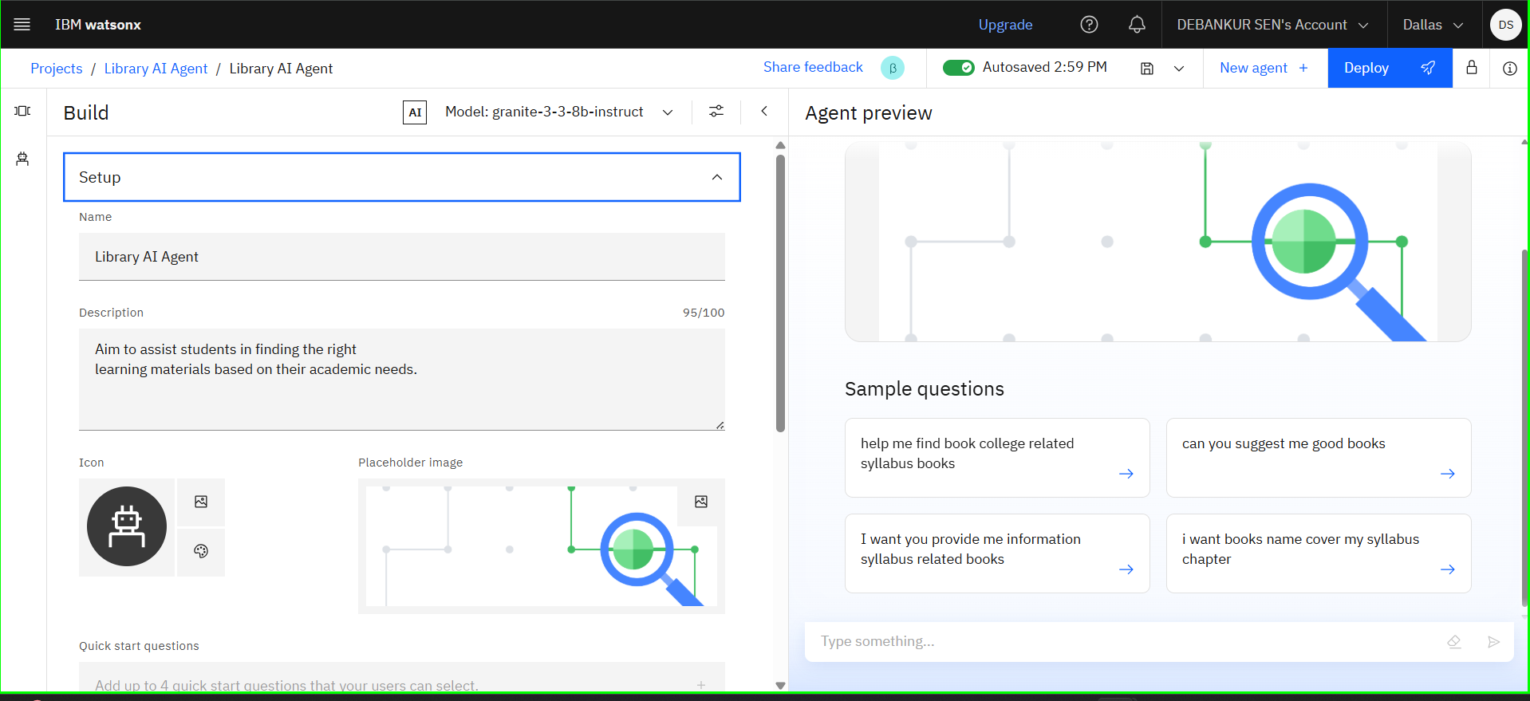
Result

Slide 10
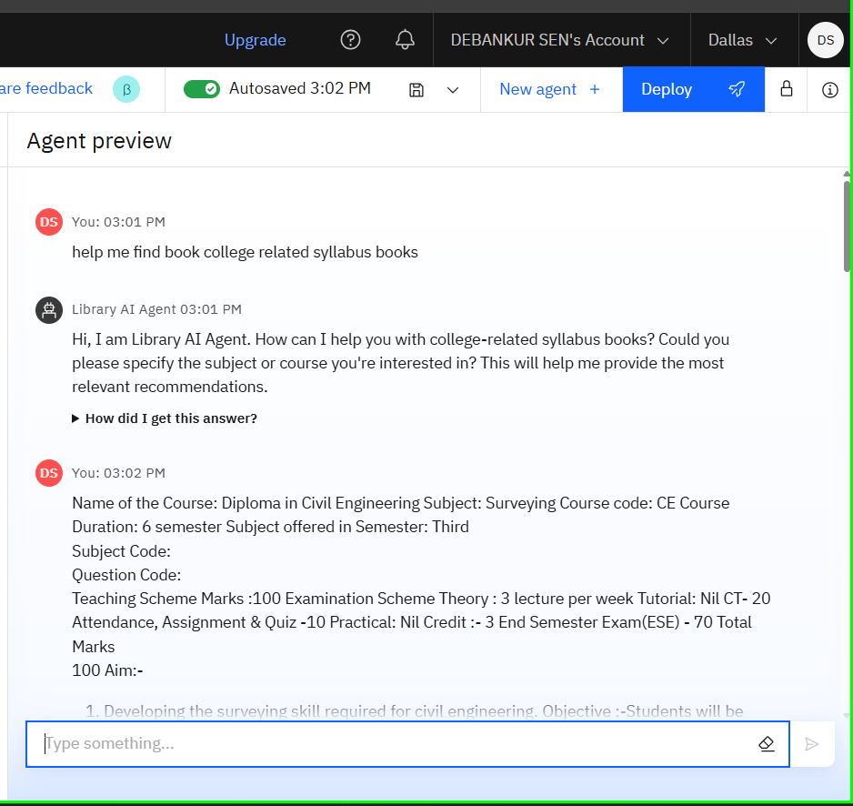
Result

Slide 11
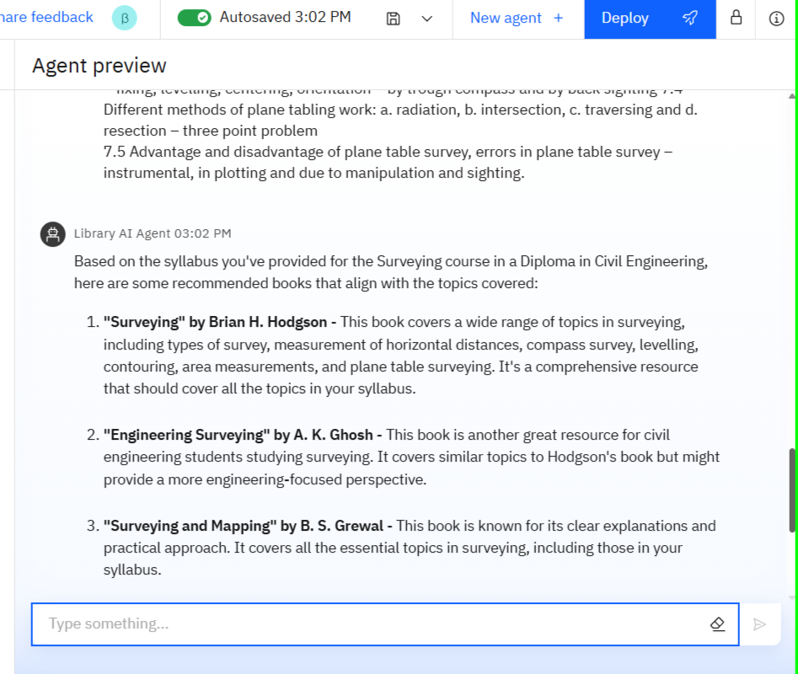
Result

Slide 12
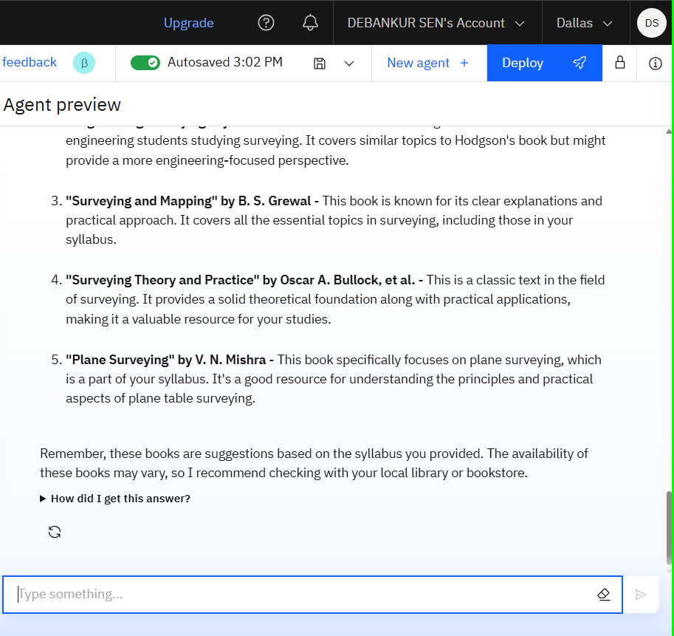
Result

Slide 13
Conclusion
The Library AI Agent, leveraging IBM Cloud Lite services and the enterprise-grade capabilities of IBM Granite, represents a significant step towards modernizing libraries. This solution combines advanced AI for understanding student needs and recommending resources with the cost-effectiveness and flexibility of a cloud platform. By focusing on NLP, recommendation engines, and real-time data analysis, it streamlines access to learning materials and offers personalized services. The use of IBM Granite ensures high performance, security, and the ability to customize for specific library requirements. The Library AI Agent transforms libraries into intelligent hubs, enhancing both resource management and the student learning experience.

Slide 14
Github link
https://github.com/Debankursen/Library-AI-Agent

Slide 15
Future scope
highly personalized, adaptive learning environments. Beyond resource recommendations, it will offer multimodal engagement, understanding user needs through text, voice, and even video. Fine-tuned IBM Granite models will provide advanced research support, including citation analysis and literature reviews. The agent will become proactive, anticipating needs and suggesting personalized learning pathways, potentially integrating with adaptive learning platforms. It will also enhance accessibility through real-time translation and features for users with disabilities. This evolution transforms libraries into intelligent, inclusive hubs for learning and research

Slide 16
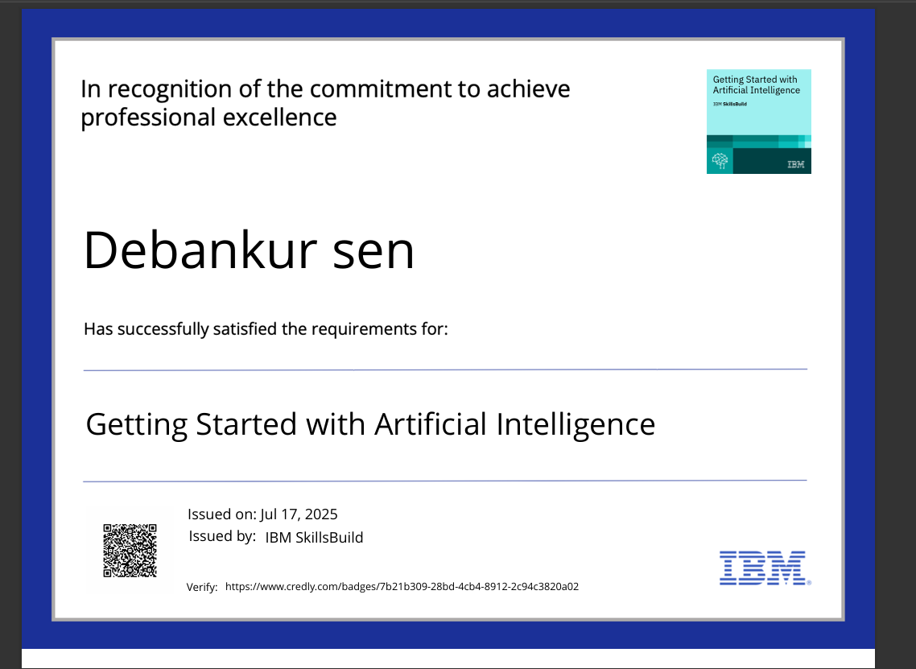
IBM Certifications

Slide 17
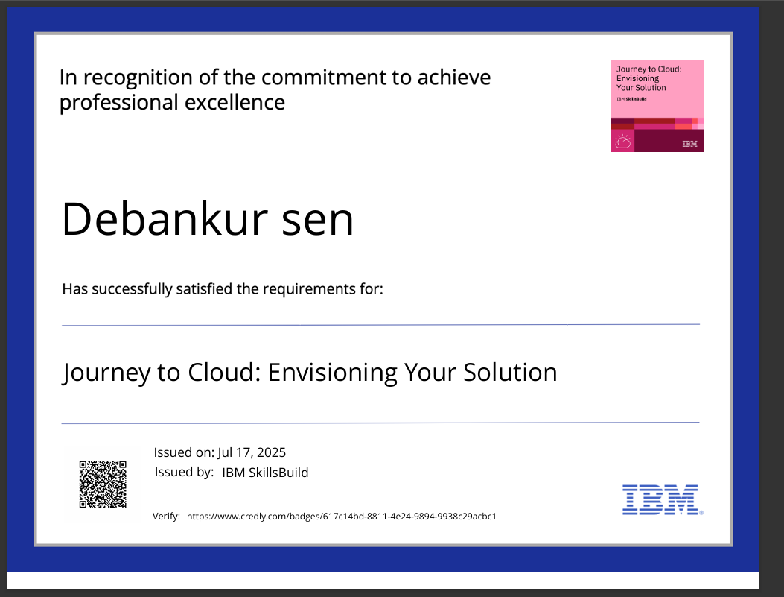
IBM Certifications

Slide 18
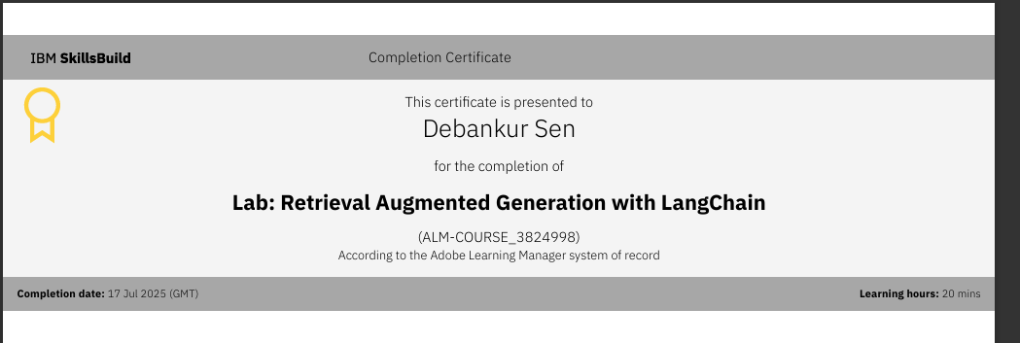
IBM lab Certificate

Slide 19
THANK YOU

