Slide 1
PROJECT REPORT ON ESTIMATION OF BILL FOR A CUSTOMER IN A SHOPPING MALL IMPLEMENTED THROUGH C LANGUAGE

Slide 2
WHAT IS C?
In computing, C is a general-purpose programming language initially developed by Dennis Ritchie between 1969 and 1973 at AT&T Bell Labs. C has facilities for structured programming and allows variable scope and recursion. C is one of the most widely used programming languages of all time, and C compilers are available for the majority of computer architectures and operating systems.

Slide 3
The C has now become a widely used professional language for various reasons:
Easy to learn.
Structured language
It produces efficient programs.
It can handle low-level activities.
It can be compiled on a variety of computer platforms.
C was invented to write an operating system called UNIX.
The language was formalized in 1988 by the American National Standard Institute (ANSI).
Today C is the most widely used and popular System Programming Language.
Most of the state-of-the-art software have been implemented using C.
Today's most popular Linux OS and RBDMS MySQL have been written in C.

Slide 4
SELECTION OF THE C-LANGUAGE
It was (and still is in some circumstances) the language of choice in Operating System Development (including all of Unix).
It allows direct control over the very low level aspects of the computer.
Many legacy programs are written in C.
Most of the things we learn with C will be directly transferable to future programming languages.
Programs that are created with C run very quickly.
C has a syntax (and some semantics) very close to Matlab, making the transition easy.
Many of the codes we will use in our future work/studies will have been written in C. We will be able to maintain, modify, and update them.

Slide 5
ABSTRACT
The estimation of bill for a customer is a menu-driven program in C which allows the customer to select items of his/her choice from MINI BAZAAR and estimate the bill before actually buying it from the respective departments.
The grand new stores of the mall are:
Kids Horizon
Food Plaza
Dress Mart
Kids Horizon- This counter allows the customer to shop for the kids. It has the following sub-departments like:
Infants(upto 1 year)
Kids(1 to 12 years)
Teenagers(13 to 19 years)

Slide 6
2. Food Plaza- This counter allows the customer to order for various delicious food items. It has the following sub-departments like:
Rolls
Chinese
South Indian
Desserts
3. Dress Mart- This counter allows the customer to choose from various fashionable dresses. It has the following sub-departments like:
Men
Women
Kids Wear

Slide 7
4. Estimated Bill- This facility provides the customer to decide finally which are the items he/she can actually afford, on the basis of a look at the roughly estimated bill he has to pay.
Objective of the project:
Our objective is to maintain the billing system of a Mini Bazaar .
We have designed a menu driven program which allows the customer to select items of his/her choice from Mini Bazaar and estimates the bill before actually buying it from the respective departments.

Slide 8
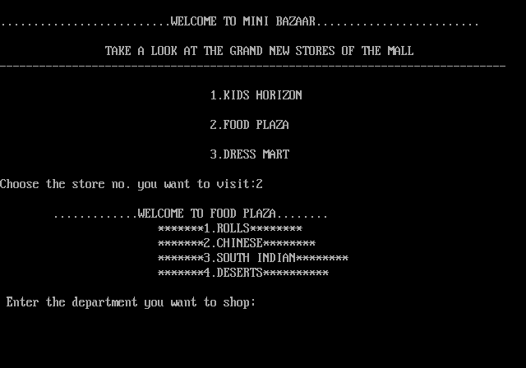
OUTPUT Screen 1

Slide 9
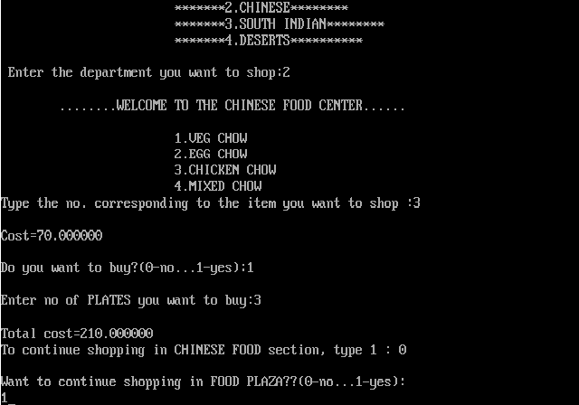
Screen 2(CONTINUED..)

Slide 10
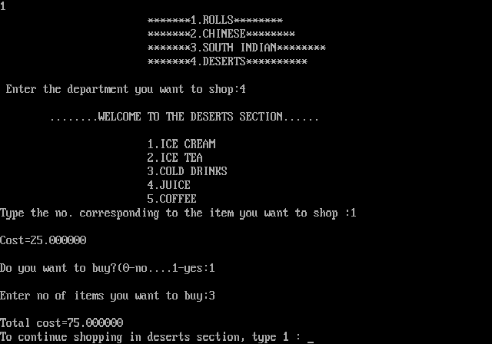
Screen 3(CONTINUED..)

Slide 11
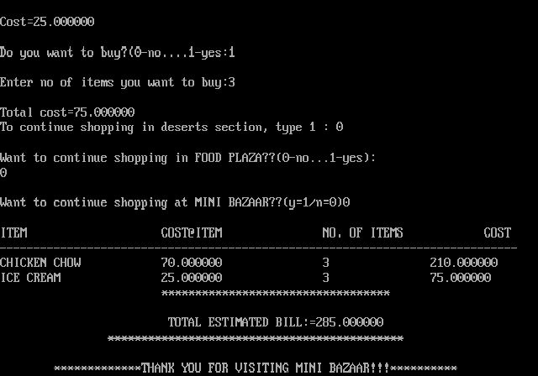
Screen 4(CONTINUED..)

Slide 12
FUTURE SCOPE
The C-language has a great importance in present day as well as a brighter promising future.
The project ESTIMATION OF BILL FOR A CUSTOMER focuses on the efficiency of C-language where tough and tedious tasks like bill estimation can be easily handled with this programming technique. This can make the billing procedure easy and accurate for the customer shopping at small shops to giant malls.
It can be used at an International level for its efficiency at different levels. It is user-friendly as well as fast. This same methodology can be used for other systems like Library Management System or Railways or Airlines Reservation System. Even though it is bit lengthy but easy to operate and logical with required C-language commands.

Slide 13
CONCLUSION
C is one of the most powerful "modern" programming language and a widely used language.
It is used in many scientific programming situations. It is the basis for the core of the modern languages Java and C++.
Further, C is a very basic language. There are no frills, no GUIs, no Matrix processing abilities, very little file I/O support, etc.
Finally it can concluded that because of these salient and useful features, C-language is chosen for the project ESTIMATION OF BILL FOR CUSTOMER which can perform all the claimed functions of bill estimation efficiently , accurately and quickly.

Slide 14
PROJECT MENTOR-NIVEDITA RAY MA’AM
GROUP MEMEBERS:
NAME | UNIVERSITY ROLL NO
DEBAPRIYA MUKHERJEE | 10900312087
INDRANI GANGULY | 10900312097
JAYETA BISWAS | 10900312098
SANCHARI MONDAL | 10900312130
SANJANA MANDAL | 10900312131

Slide 15


