Slide 1

Seasonal Agriculture
Performance Analysis
VOIS AICTE Batch 1 — Major Project
Student Name: Debapriya Nag
College Name: Indian Institute of Technology Patna
AICTE STU ID:STU6a473d675a0ff1783053671
01

Slide 2
PROBLEM STATEMENT
THE ANALYTICAL GAP
Agricultural performance changes with seasonal environmental conditions, farming practices, resource availability and market conditions. Raw farm-level data does not directly show how yield, profitability, water use and risk differ across Kharif, Rabi and Zaid. The project therefore analyzes the dataset to identify meaningful seasonal patterns, relationships, variations and unusual observations.
DATA SCALE
VARIABLES
SEASONS
4,000
28
3
farm-level records
fields across farm, environment, resources & economics
Kharif • Rabi • Zaid
Key questions: Which season performs best? Which crops and irrigation methods stand out? What relationships and regional differences matter?
02

Slide 3
PROJECT DESCRIPTION
A decision-oriented exploratory analysis of farm performance across seasons.
Explore
01
Clean
02
Engineer
03
Compare
04
Explain
05
03

Slide 4
WHO ARE THE END USERS?
Farmers & farm managers
Agricultural planners & extension teams
Compare seasonal profitability, crop choices and resource-use patterns before planning production.
Identify regions, seasons and practices that deserve deeper field investigation.
Policy makers & programme teams
Researchers & analysts
Use evidence on regional performance, water efficiency and seasonal risk for targeting.
Extend the work with multi-year weather, market and causal modelling.
04

Slide 5
TECHNOLOGY USED
Python
Pandas
NumPy
Core analysis and workflow
Data loading, cleaning,
grouping and feature
engineering
Numerical operations and
missing-value handling
Matplotlib
SciPy
Excel / Jupyter / Colab
Charts, distributions,
scatter plots and heatmaps
Kruskal–Wallis statistical test
Dataset + executed notebook workflow
GitHub
Project versioning / deliverable link
Analytical pipeline: Excel → Pandas → cleaning & feature engineering → visualization → statistical testing → recommendations
05

Slide 6
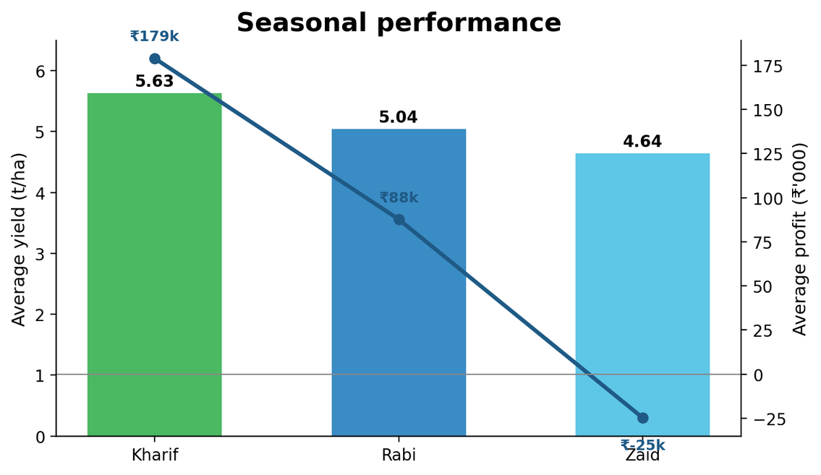
RESULTS
Seasonal performance is the central comparison
KHARIF YIELD
5.63 t/ha
Highest average yield
KHARIF PROFIT
₹178,915
Highest average profit
ZAID PROFIT
₹-24,805
Only season with negative average profit
ANALYSIS STEP
Kharif also has the highest average rainfall (849.2 mm), water efficiency (5.89 t/1,000 m³) and disease/pest risk (54.47%).
season.groupby('Season').agg(
Yield='mean', Profit='mean',
Water_Efficiency='mean')
06

Slide 7
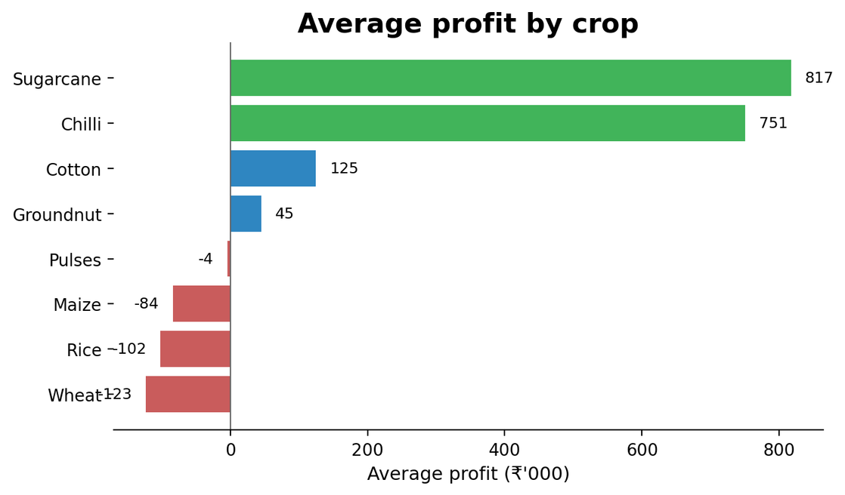
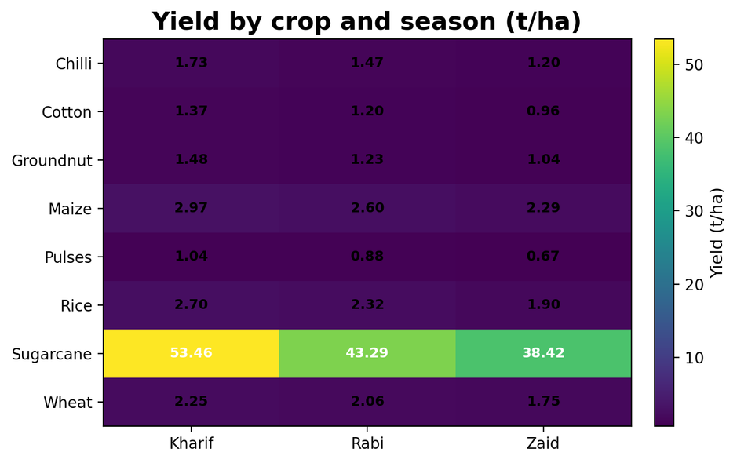
RESULTS
Crop profitability and crop × season yield
TOP PROFIT CROP
SECOND
KHARIF SUGARCANE
ANALYSIS STEP
Sugarcane
Chilli
53.46 t/ha
crop.groupby('Crop').agg(Profit='mean')
pivot_table(index='Crop', columns='Season')
Highest crop × season yield
in the table
₹817,188 average profit
₹750,878 average profit
Sugarcane is on a very different yield scale than the other crops;
interpret its yield separately from the ~1–3 t/ha crops.
07

Slide 8
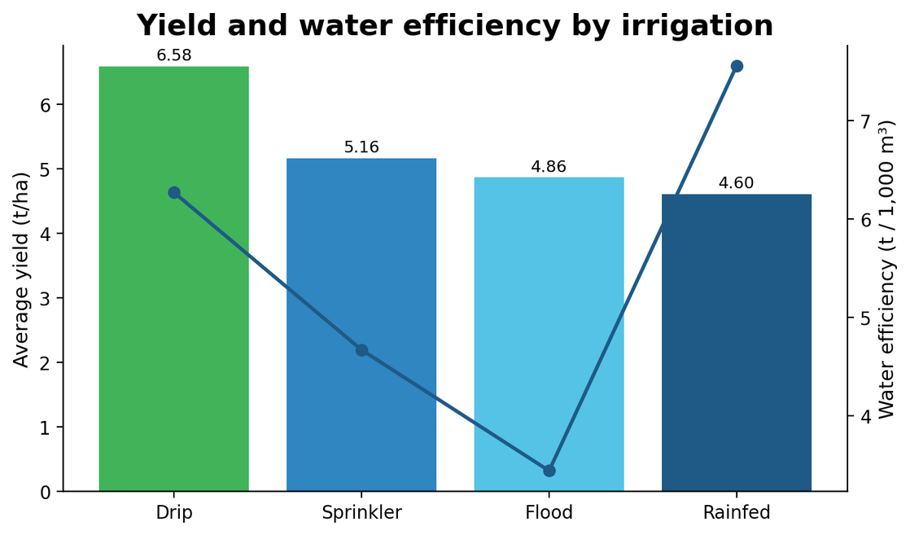
RESULTS
Irrigation method, yield and water efficiency
HIGHEST YIELD
Drip · 6.58 t/ha
Highest average yield among four methods
HIGHEST WATER EFF.
Rainfed · 7.56
Lowest average water use: 3,549.55 m³
HIGHEST WATER USE
Flood · 8,026 m³
Average water use per farm
ANALYSIS STEP
The notebook explicitly treats these comparisons as observational: crop, soil, region and season may confound method-level averages.
irrig.groupby('Irrigation_Method').agg(
Yield='mean', Water_Eff='mean')
08

Slide 9
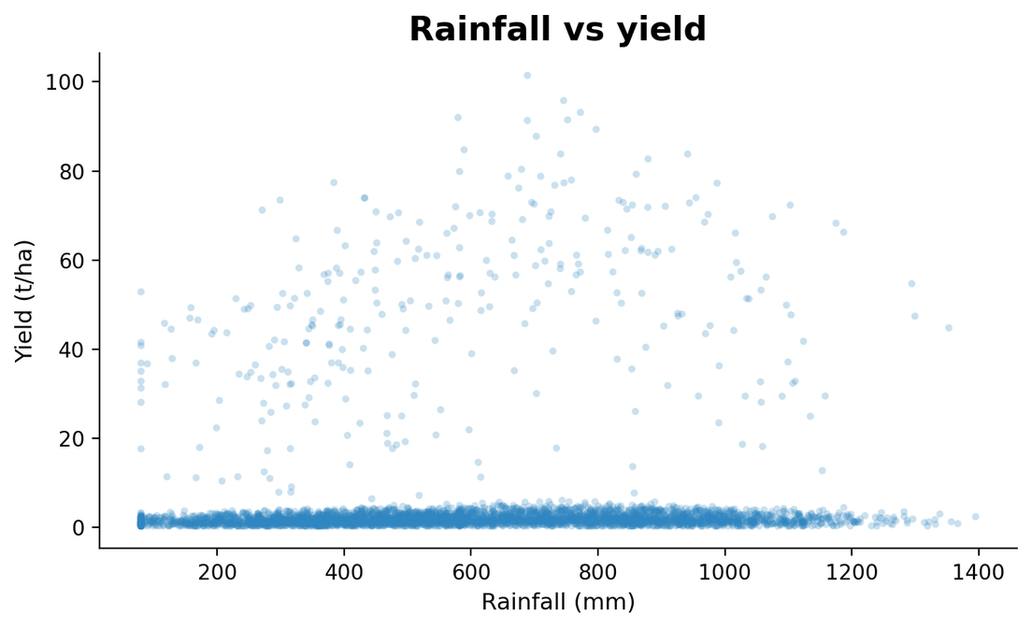
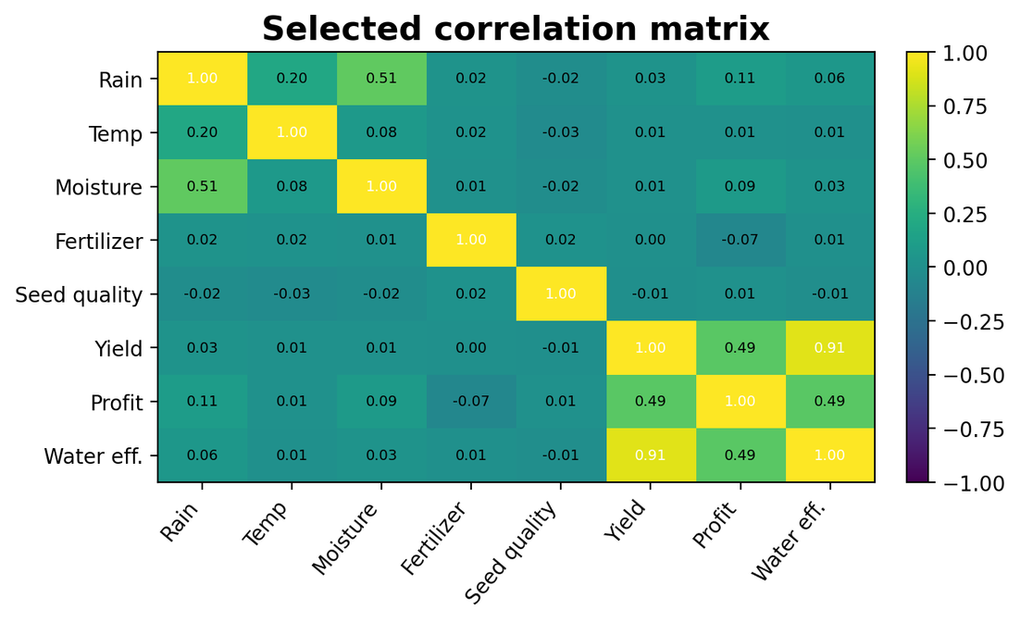
RESULTS
Environmental relationships and correlation evidence
YIELD ↔ WATER EFFICIENCY
YIELD ↔ PROFIT
RAINFALL ↔ YIELD
r = 0.91
r = 0.49
r = 0.03
ANALYSIS STEP
09

Slide 10
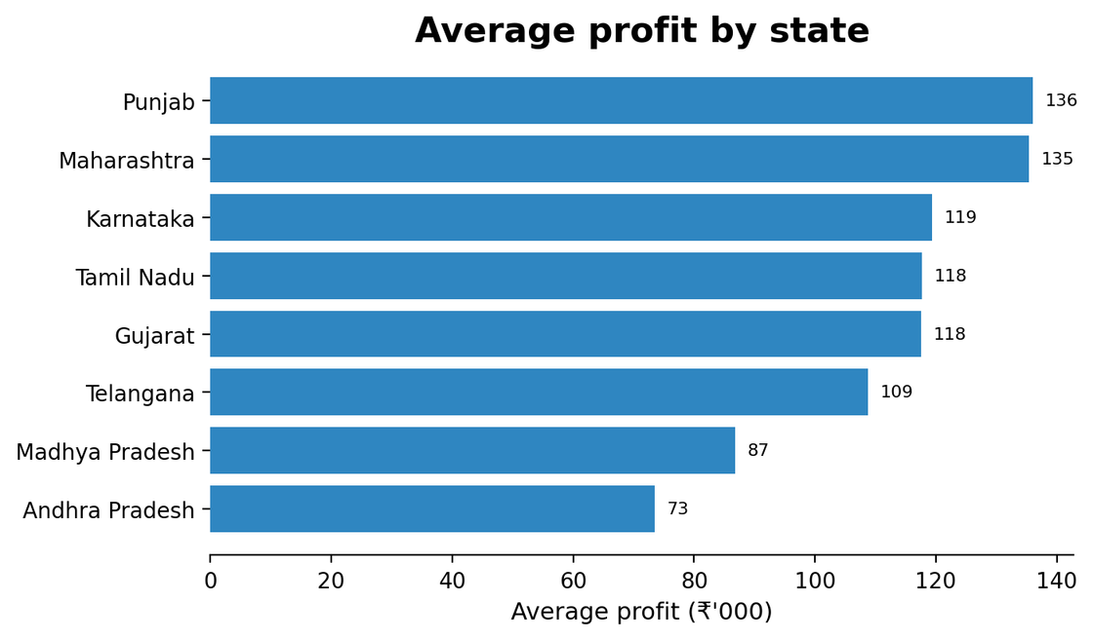
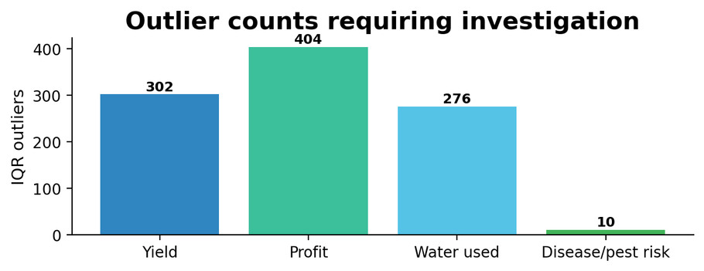
RESULTS
Regional economics, outliers and statistical evidence
PROFIT OUTLIERS
YIELD OUTLIERS
404
302
IQR-based observations
IQR-based observations
TOP STATE
KRUSKAL–WALLIS
At α = 0.05, reject H₀: the three seasonal yield distributions are not statistically identical.
Punjab
H = 68.713
₹136,026 average profit
p = 1.20 × 10⁻¹⁵
Other IQR outliers: Water used = 276; Disease/Pest risk = 10. These observations should be investigated rather than automatically removed.
10

Slide 11
FUTURE SCOPE
Multi-year forecasting
Crop-specific models
Causal analysis
Decision dashboard
Risk alerts
Priority extension: connect the analytical dataset to time-series data so recommendations can be evaluated prospectively.
11

Slide 12
GITHUB LINK
PROJECT REPOSITORY
https://github.com/Debapriya1102iitp/Seasonal-Agriculture-Performance-Analysis
This link will directly guide to the github repository
DELIVERABLE
DATA
OUTPUT
Analysis notebook
Agriculture dataset
Major project PPT
Executed project workflow
4,000 records × 28 fields
Seasonal findings & recommendations
12

Slide 13
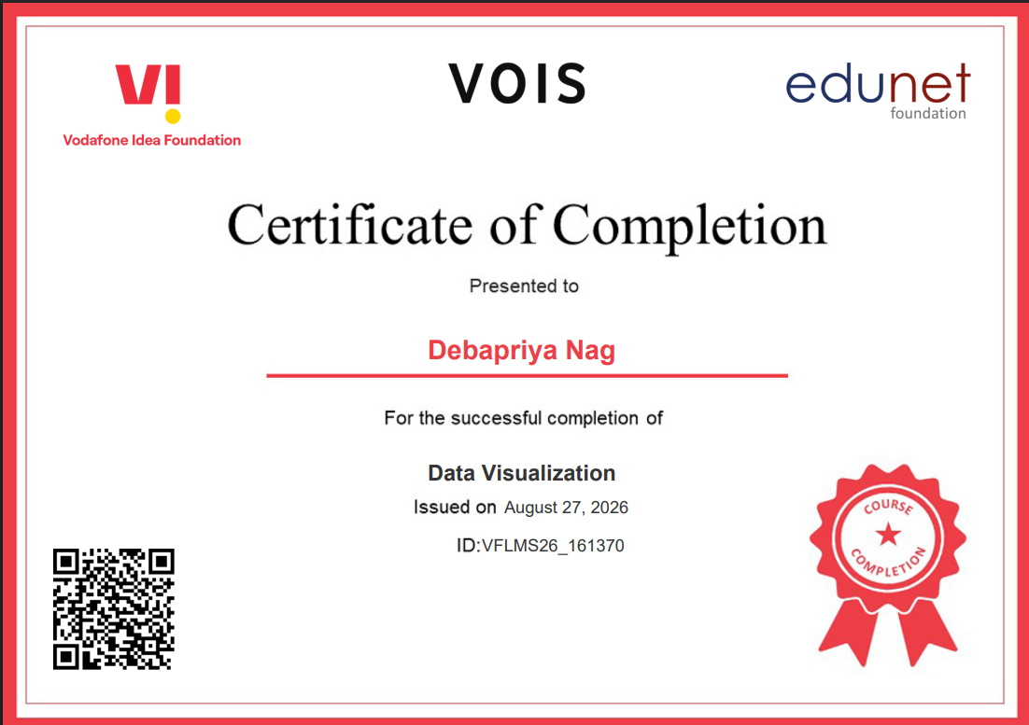
VOIS COURSE COMPLETION CERTIFICATE
for Data Visualization
13

Slide 14
Conclusion
The analysis demonstrates that agricultural performance varies across seasons, crops, irrigation methods, and regions. Kharif showed the strongest overall performance in terms of yield and profitability, while Zaid recorded comparatively lower profitability. Drip irrigation achieved the highest average yield, highlighting the importance of efficient resource management. The statistical analysis confirmed significant differences in yield across seasons. Overall, the study demonstrates how data-driven analysis can provide meaningful insights for better crop planning, resource utilization, and informed agricultural decision-making.
14

Slide 15
Thank you
14

