Slide 1
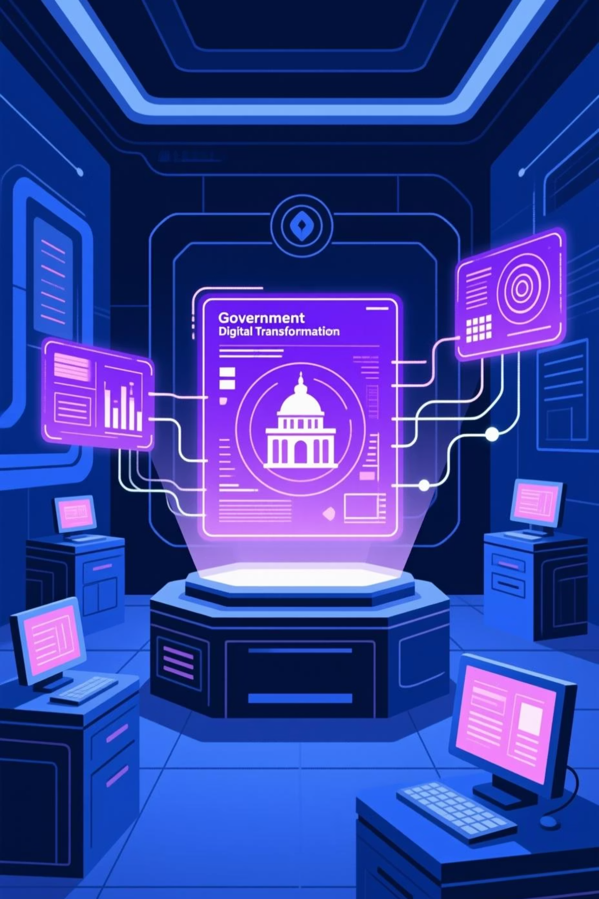
E-Governance Grievance Redressal System
A secure, citizen-centric full-stack web application transforming how government departments handle public service complaints through digital innovation and transparency.

Slide 2
BACKGROUND
The Challenge of Manual Grievance Handling
Current Pain Points
Our Solution
Manual processing creates bottlenecks and delays
A comprehensive digital platform that centralizes grievance management, enabling real-time tracking, automated department assignment, and complete transparency throughout the resolution lifecycle.
No centralized tracking of complaint status
Limited transparency in resolution process
Poor accountability across departments
Citizens left without visibility into their complaints
Built with enterprise-grade security and modern web technologies to serve citizens efficiently.

Slide 3

OBJECTIVES
Project Goals & Scope
Secure Architecture
Modern Tech Stack
Real-World Workflows
Implement JWT authentication, role-based access control, and encrypted data handling for citizen protection
Leverage Spring Boot 3.x backend with Angular frontend for scalable, maintainable enterprise application
Demonstrate CRUD operations, lifecycle management, reporting, and analytics with production-ready patterns

Slide 4

Technology Stack
Backend
Frontend
Development Tools
Java 21 with Spring Boot 3.5.9
Angular 21
Postman for API testing
Spring Web for RESTful APIs
TypeScript for type safety
JUnit 5 & Mockito
Spring Data JPA
Angular Material
Git version control
Spring Security with JWT
Reactive Forms
GitHub
MySQL database
HttpClient & Interceptors
SonarQube
Maven build system
Modular architecture
Microservices architecture

Slide 5
ACCESS CONTROL
User Roles & Responsibilities
1
2
Citizen
Department Officer
Register and submit grievances (department and category wise) online after login, track complaint status in real-time, provide feedback on resolutions, and reopen cases within allowed timeframe.
View assigned grievances, update status throughout resolution workflow, add resolution remarks, and manage department-specific complaints efficiently. The grievances submitted get auto assigned to officers.
3
4
Supervisory Officer
System Admin
Monitor grievance resolution progress, handle escalations for delayed cases, analyze the status and performance of all the grievances of all departments, and ensure accountability standards.
Manage departments and categories, access charts and visuals, maintain system settings, and oversee platform operations, dashboards and department wise efficiency. Closes the grievance after its resolved.

Slide 6
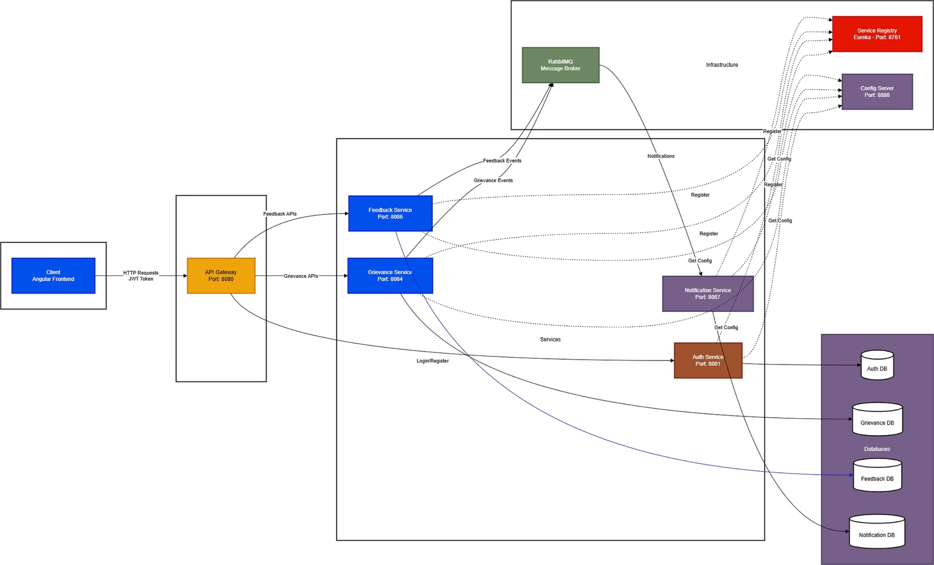
High Level Design:

Slide 7
Core System Features
Security & Authentication
Grievance Registration
JWT-based authentication, role-based access control, password encryption using BCrypt, and secure REST APIs protect citizen data and ensure authorized access only.
Citizens submit complaints with auto-generated IDs, category selection, detailed descriptions, and optional supporting documents for comprehensive tracking.
Workflow Management
Analytics & Reports
Complete lifecycle tracking from submission through assignment, review, resolution, and closure with automatic department routing and escalation handling.
Comprehensive dashboards showing grievances by category and department, resolution times, performance metrics, and actionable insights for improvement. (ADMIN)
Resolution & Feedback
Smart Notifications
Officers provide resolution remarks, citizens rate satisfaction, and provide their rating and feedback based on the quality of service delivery.
Automated acknowledgments on submission, real-time status change alerts, and updates keep all stakeholders informed throughout the process.

Slide 8





ARCHITECTURE
Backend System Design
Controllers
Services
RESTful endpoints handle HTTP requests, validate inputs, and route to services
Business logic layer processes workflows, applies rules, manages transactions
Repositories
Models & DTOs
Data access layer with JPA, JPQL queries, pagination support
Entity mapping, data transfer objects protect internal structure
Key Implementation Highlights
Global exception handling for the microservices
DTO pattern prevents entity exposure
Configuration via application.yml
Java 8+ Streams for reporting logic
Pagination and sorting on all list endpoints
MySQL database used
Total of 4 databases- one for each business service
Auth Service
Grievance Service
Feedback Service
Notification Service

Slide 9
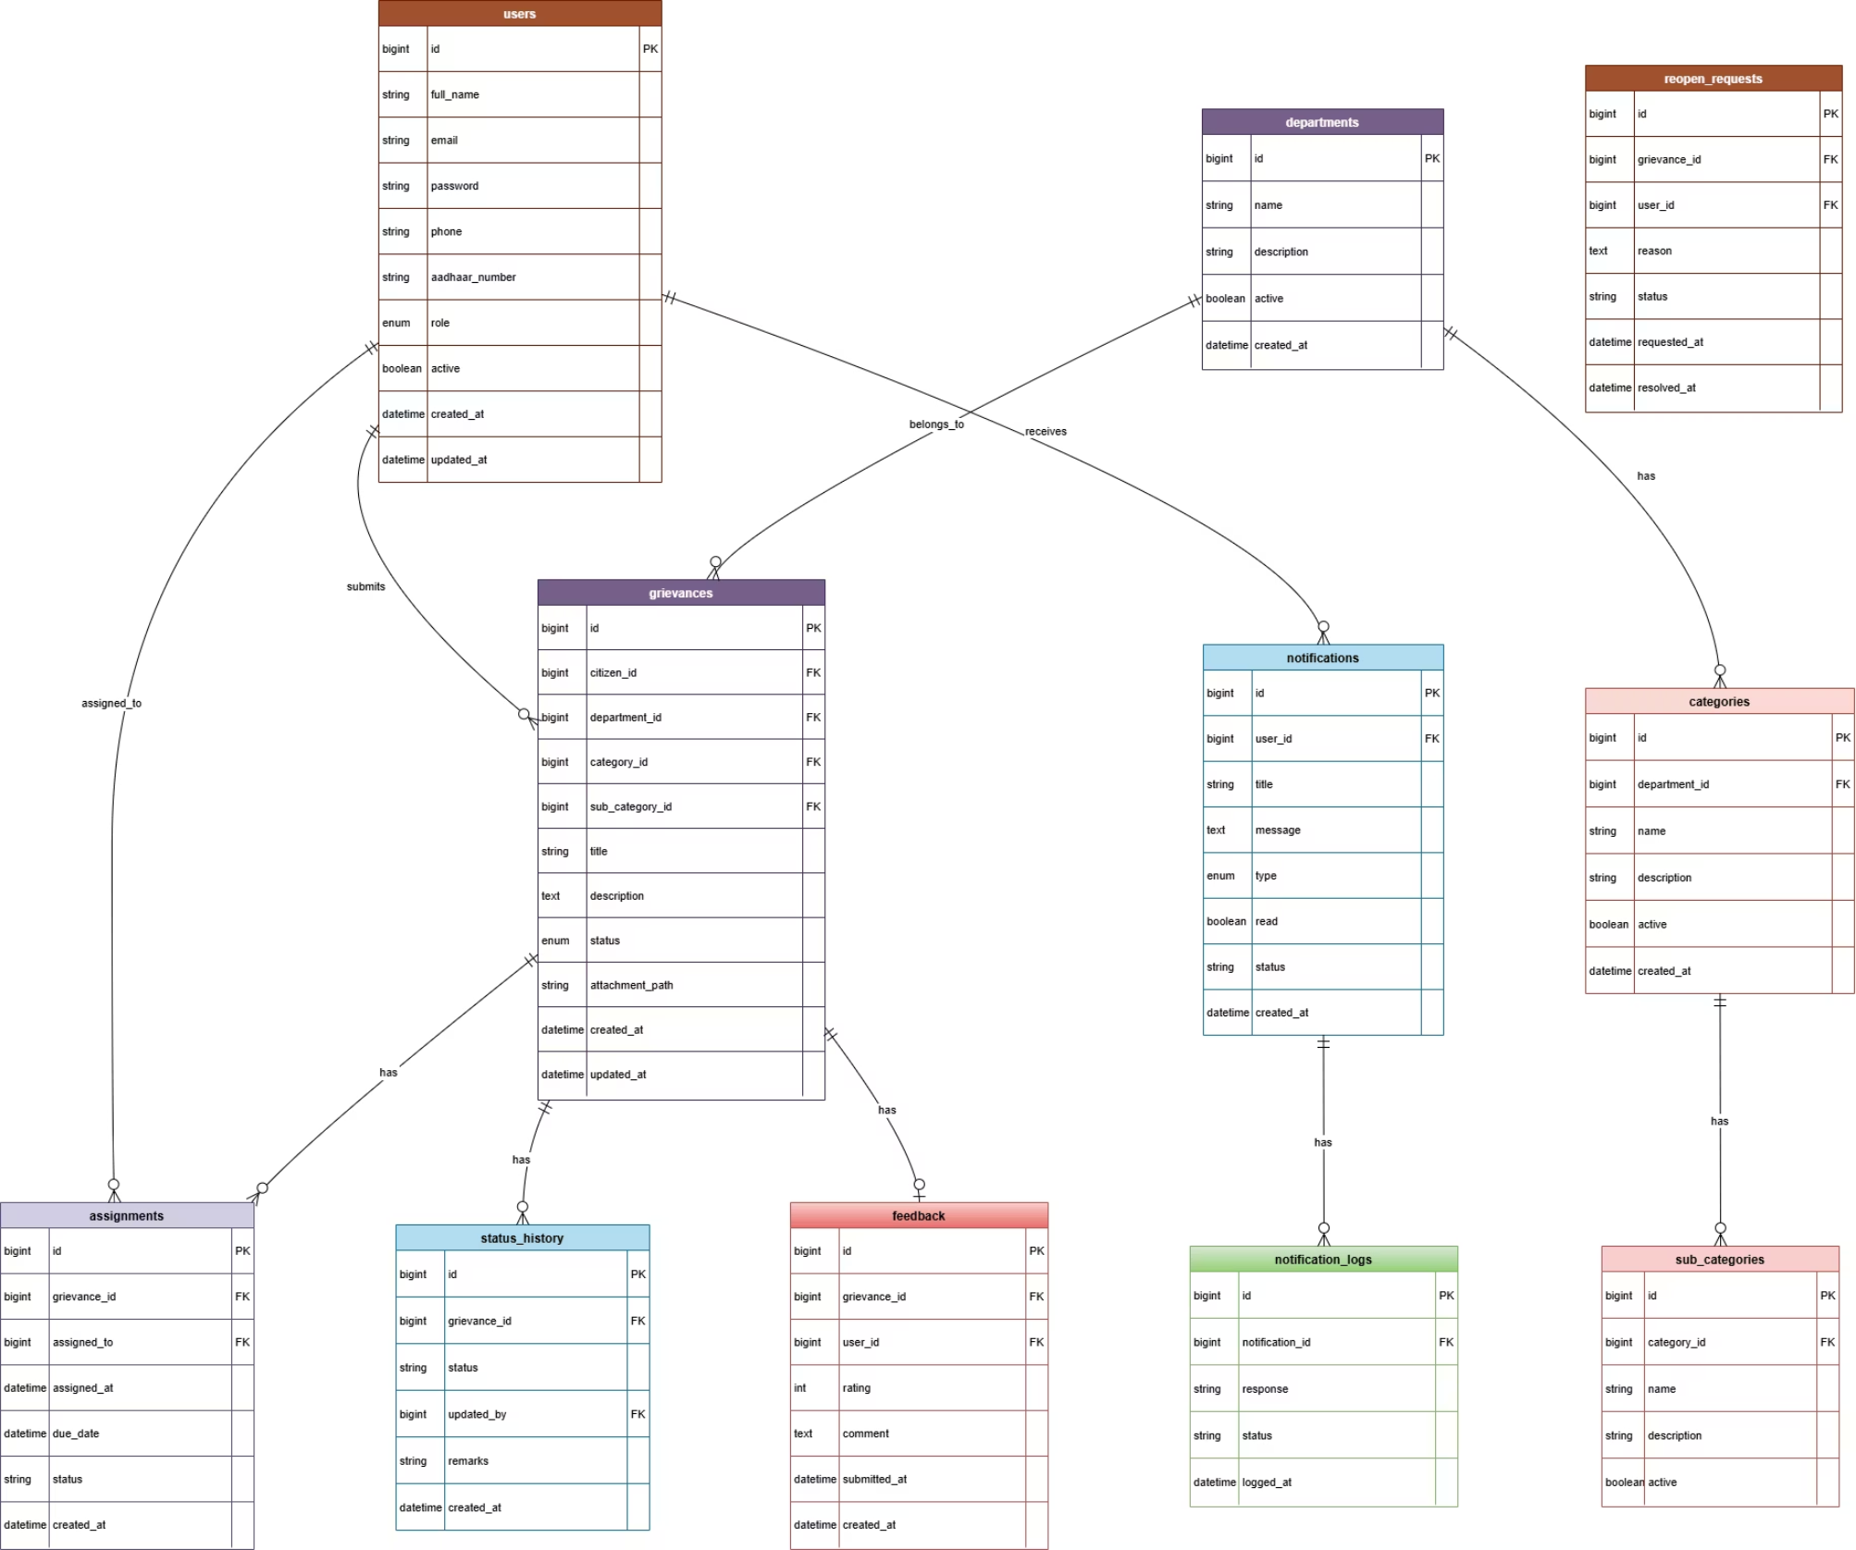
Database Schema

Slide 10
Angular Frontend Architecture
Core Module
Shared Module
Feature Modules
Authentication services, route guards, HTTP interceptors, and services used throughout the application
Reusable components, custom pipes, directives, and common utilities for consistent UI patterns
Lazy-loaded modules for Grievances, Departments, Reports, and Admin with isolated routing
Essential User Interfaces
Login & registration with validation
Department officer dashboard with assignments
Citizen dashboard with grievance overview and listings
Resolution workflow interface
Lodge grievance form with validation
Comprehensive reports with visualizations and looking into Escalated grievances(Supervisor).
My Grievances list with filtering
Detailed grievance view with timeline
Admin panel for system configuration and check department wise progress.

Slide 11
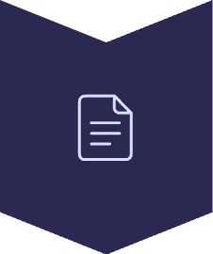




GRIEVANCE LIFECYCLE
Grievance Lifecycle Workflow
The system follows a clear, structured workflow to ensure every citizen grievance is managed efficiently from submission to resolution.
Submitted
Citizen logs a new complaint; system assigns a unique ID and acknowledges receipt.
Assigned
Complaint is automatically routed to the most relevant department and assigned to an officer.
In Progress
Officer actively investigates the issue, gathers information, and works towards a solution.
Resolved / Escalated
Officer provides a detailed resolution. Citizen can review and provide feedback. If the officer fails to resolve the issue within the SLA period, then grievance is Auto Escalated.
Closed
Grievance formally closed by admin after citizen satisfaction or within defined auto-closure period.

Slide 12

QUALITY ASSURANCE
Testing & Best Practices
01
02
Unit Testing
API Testing
JUnit 5 and Mockito for service layer testing, repository testing, and business logic validation.
Comprehensive Postman collections for all endpoints, authentication flows, and edge case scenarios
03
04
Security Testing
SonarQube Analysis
Validation of JWT flows, role-based access restrictions, and authorization rules across all protected resources
Code Quality and coverage ensured through SonarQube analysis.

Slide 13

Project Deliverables
1
Source Code Repository
Complete GitHub repository with organized backend and frontend code, clear folder structure, and comprehensive commit history
2
Documentation Package
Database schema with ER diagrams, API documentation in the report, detailed README with setup instructions, and architecture diagrams
3
Visual Demonstrations
UI screenshots showcasing all major features, user workflow demonstrations, and responsive design across devices
4
Final Presentation
Professional project presentation covering problem statement, technical approach, implementation highlights, challenges overcome, and live demonstration

Slide 14
Challenges and Learnings
Challenges Overcome
Key Learnings
Technical complexity of integrating multiple systems
Importance of robust error handling and logging
Ensuring data security and compliance requirements
Value of comprehensive testing at each development stage
Managing real-time updates across distributed components
Effective communication between frontend and backend teams
Handling high-volume concurrent grievance submissions
Scalability considerations from the project's inception
Implementing efficient search and filtering across large datasets
User feedback integration improves system usability significantly
Designing intuitive UI for diverse user groups with varying technical expertise
Documentation is critical for long-term project maintenance
Optimizing database queries for performance under load
Agile methodology enables faster iteration and problem resolution

Slide 15
Thank You
Debarghya Sikder
E-Governance Grievance Redressal System

