Slide 1
Clustering Customer Reviews For Market Research
TEAM MEMBERS:
Raj Baidya(ECE 3rd Year)
Avinaba Acharjee(ECE 3rd Year)
Debarshi Chatterjee(IT 3rd Year)
Ankan Sarkar(ECE 3rd Year)
Anirban Adhikari(ECE 3rd Year)

Slide 2

Introduction
Clustering customer reviews is a powerful technique in market research, allowing businesses to group similar reviews together to identify common themes, sentiments, and trends. This helps in understanding customer opinions and improving products or services.

Slide 3
Objective:
Import All Needed Libraries
Load The CSV File
Clean The CSV File
Unique
Value
Segmentation
Visualization The Clusters
Applying
K-Mean
Algorithm
To Find The Optimal Number Of Clusters

Slide 4
Scope:
Enhanced Customer Insights: Grouping reviews by sentiment or preference helps in understanding customer behavior and developing targeted marketing strategies.
Product Improvement: Clusters reveal common feedback themes, guiding product enhancements and early issue detection.
Market Segmentation: Helps in segmenting customers and analyzing competitors, leading to more effective marketing and positioning.
Trend Analysis: Identifies emerging trends and predicts future customer behavior.

Slide 5
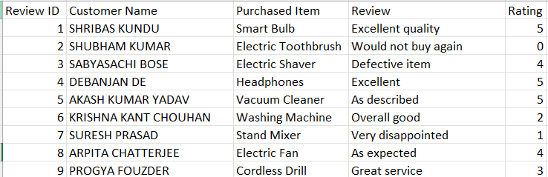
Data Description:

Slide 6

Model:
1. K-Means: k-Means clustering is an unsupervised learning algorithm. There is no labeled data for this clustering, unlike in supervised learning.
K-Means performs the division of objects into clusters that share similarities and are dissimilar to the objects belonging to another cluster.

Slide 7
Process Of K-Means: The K-means clustering algorithm works by grouping data points into clusters based on their distance from a cluster center. The algorithm uses a mathematical distance measure, usually Euclidean, to calculate the distance between each data point and the cluster centers. The data point is then assigned to the cluster with the nearest centroid. Recompute the centroid for each cluster by taking the average of all the points in that cluster.
Repeat the process until the clusters are completely different.

Slide 8
To find the distance of two data points:
d = √[(x2 − x1)² + (y2 − y1)²]

Slide 9
Inference:
Once the K-Means algorithm has completed clustering, there are several inferences you can make:
Cluster Centroids: The final positions of the centroids indicate the "center" of each cluster in the feature space. These centroids can be analyzed to understand the characteristics of each cluster.

Slide 10
Cluster Assignment: Each data point belongs to one of the K clusters. By examining the points assigned to a specific cluster, you can interpret the groupings. You may notice that certain clusters represent similar types of data points based on the features of the dataset.
Cluster Size: The number of points in each cluster can provide insights into the density or popularity of each cluster. Large clusters might represent more common or generalized behavior, while small clusters could represent niche groups or outliers.

Slide 11
Distance to Centroid: The distance of data points from their cluster centroid is a measure of the variance within the cluster. Smaller distances indicate that the points in the cluster are similar to each other, while larger distances suggest greater diversity within the cluster.
Feature Distribution: By analyzing the distribution of features within each cluster, you can draw conclusions about the differences between clusters. For example, in a dataset with customer information, while another represents older, budget-conscious individuals.

Slide 12
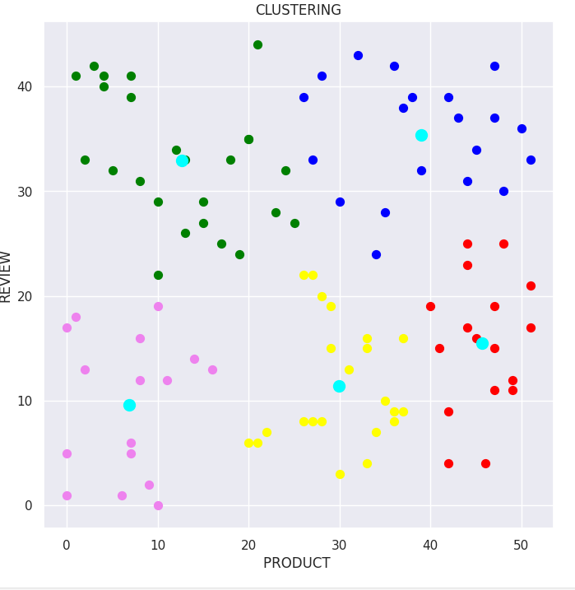
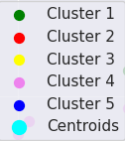
Screenshot:

Slide 13
Future Scope of Improvements:
Handling Text Data More Effectively:
Advanced Text Embeddings: Instead of using traditional methods like Bag-of-Words or TF-IDF, using pre-trained language models such as BERT (Bidirectional Encoder Representations from Transformers) or Word2Vec can better capture the semantic meaning of the reviews, handling nuances and context more effectively.
Contextual Embeddings: Pre-trained models like BERT, GPT, or RoBERTa generate dynamic embeddings that take into account the context of words in a sentence, making them more suitable for capturing sentiment and topics in customer reviews.

Slide 14
Improving the Choice of K (Number of Clusters):
Automated K Selection: Incorporate techniques like the Elbow Method, Silhouette Score, or Gap Statistic to automatically select the best K. Alternatively, more advanced methods like Hierarchical Clustering or DBSCAN (Density-Based Spatial Clustering of Applications with Noise) could be used in conjunction with K-means to identify an optimal number of clusters.
Dynamic Clustering Models: Use algorithms that allow for dynamic determination of the number of clusters, such as Gaussian Mixture Models (GMM), or integrate K-means with a clustering stability framework, which measures the stability of the clusters as K changes.

Slide 15
Conclusion:
In conclusion, optimizing market insights through clustering customer reviews is vital for strategic growth. Future directions include leveraging AI and machine learning for deeper insights and more reﬁned analysis techniques.

Slide 16


T h a n k s !

