Slide 1
SmartDrive – 3D Self-Driving Car Simulator
A Web-Based Autonomous Driving Simulation Platform
Under the Guidance of
Mr. Biplab Kumar Mondal Assistant Professor Department of Information Technology
Presented By:
Ayan Kundu
Debarshi Chatterjee
Moupiya Das
Rohit Saha

Slide 2
Introduction
Developing and testing autonomous driving systems on real roads is expensive, time-consuming, and potentially unsafe.
There is a need for a lightweight, modular, and cost-effective simulation platform that combines all major autonomous driving components in a single environment.
SmartDrive – 3D Self-Driving Car Simulator is a web-based autonomous driving simulation platform designed to demonstrate intelligent vehicle navigation in a realistic 3D environment.
The system integrates Artificial Intelligence (AI), A* path planning, LiDAR-based obstacle detection, and real-time vehicle control to simulate autonomous driving.
It is developed using Three.js for 3D visualization, Python Flask for backend services, and Vite for frontend development.
The simulator includes roads, traffic signals, pedestrians, and dynamic vehicles to create realistic urban driving scenarios.
It provides a safe, cost-effective, and educational platform for learning, testing, and evaluating autonomous driving technologies without requiring physical vehicles.
Existing simulators often require high-end hardware or lack important features such as realistic vehicle physics, intelligent route planning, obstacle detection, traffic management, and telemetry analysis.
SmartDrive integrates A path planning, LiDAR sensing, and autonomous navigation in a realistic 3D simulator

Slide 3
Problem Statement
1.
Developing and testing autonomous driving systems on real roads is expensive, time-consuming, and potentially unsafe.
2.
There is a need for a lightweight, modular, and cost-effective simulation platform that combines all major autonomous driving components in a single environment.
3.
Existing simulators often require high-end hardware or lack important features such as realistic vehicle physics, intelligent route planning, obstacle detection, traffic management, and telemetry analysis.
4.
SmartDrive integrates A* path planning, LiDAR sensing, and autonomous navigation in a realistic 3D simulator

Slide 4
Objectives
Develop a 3D web-based autonomous driving simulator for safe and realistic vehicle navigation.
Implement the A * path planning algorithm to generate the shortest and most efficient route.
Integrate LiDAR-based obstacle detection for real-time detection of vehicles, pedestrians, and road obstacles.
Enable autonomous driving with intelligent steering, speed control, obstacle avoidance, and traffic signal compliance.
Record telemetry data such as speed, steering angle, braking events, and route completion for performance analysis.
Provide a lightweight, modular, and cost-effective platform for education, research, and future development of autonomous driving technologies.

Slide 5
Technology Used
Technology | Purpose
Three.js | 3D Visualization
Python Flask | Backend Server
Vite | Frontend Development
JavaScript | Frontend Logic
HTML/CSS | User Interface
Python | Backend & AI
Tech Stack
Frontend: Three.js, Vite, HTML, CSS, JavaScript
Backend: Python Flask
AI: A*, Random Forest, Reinforcement Learning
Sensor: LiDAR (Ray Casting)

Slide 6
System Architecture
User
│
▼
Frontend (Three.js + Vite)
│
REST API Communication
│
▼
Backend (Python Flask)
│
┌────────────────────
▼ ▼ ▼
A* Route LiDAR & AI Telemetry
Planning Decision Analysis
│
▼
Autonomous Vehicle Control
│
▼
3D Simulation Environment
User Interface: Allows users to select the source, destination, and simulation settings.
Frontend (Three.js + Vite): Renders the 3D environment, roads, vehicles, and animations.
Backend (Python Flask): Handles route generation, telemetry processing, and communication with the frontend.
AI Modules: Perform A* path planning, LiDAR-based obstacle detection, and autonomous driving decisions.
Telemetry Module: Records speed, steering angle, braking, collision count, and route completion for performance evaluation.

Slide 7
Flow of Work
Start
System Initialization: Load the 3D environment, road network, traffic, pedestrians, and autonomous vehicle.
Route Generation: The A* algorithm computes the shortest path between the selected source and destination.
Autonomous Navigation: The vehicle follows the planned route using the Pure Pursuit steering controller.
LiDAR Detection: Continuously scans for vehicles, pedestrians, traffic signals, and obstacles.
AI Decision Making: Adjusts steering, acceleration, braking, and speed to ensure safe driving.
Telemetry Collection: Records vehicle speed, steering angle, braking events, collisions, and route completion.
Performance Analysis: Evaluates navigation accuracy, obstacle avoidance, and overall system performance.
System Initialization
Select Source & Destination
A* Route Planning
Autonomous Navigation
LiDAR Sensor Detection
Vehicle Movement
AI Decision Making
(Steering • Speed • Braking)
Telemetry Collection
.
Performance Analysis
End

Slide 8
Key Features
A (A-Star) Algorithm* Calculates the shortest and most efficient route.
🚗 Autonomous Navigation – Automatically drives the vehicle from the selected source to the destination.
🗺️ A* Path Planning– Computes the shortest and most efficient route through the road network.
📡 LiDAR-Based Obstacle Detection – Detects vehicles, pedestrians, road boundaries, and obstacles in real time.
🚦 Traffic Management – Supports traffic signals, dynamic traffic vehicles, and pedestrian crossings.
📊 Real-Time Telemetry – Monitors vehicle speed, steering angle, braking events, travelled distance, and route completion.
🌐 3D Web-Based Simulation – Built using Three.js and Python Flask with a modular client-server architecture for realistic visualization and easy scalability.
LiDAR (Ray Casting) Detects obstacles, pedestrians, and nearby vehicles.
Telemetry Analysis Monitors speed, steering, braking, and overall vehicle performance.
Pure Pursuit Algorithm Ensures smooth steering and accurate path following.
Reinforcement Learning (Q-Learning) Learns and improves driving decisions over time.
Random Forest Predicts driving actions and steering corrections.

Slide 9
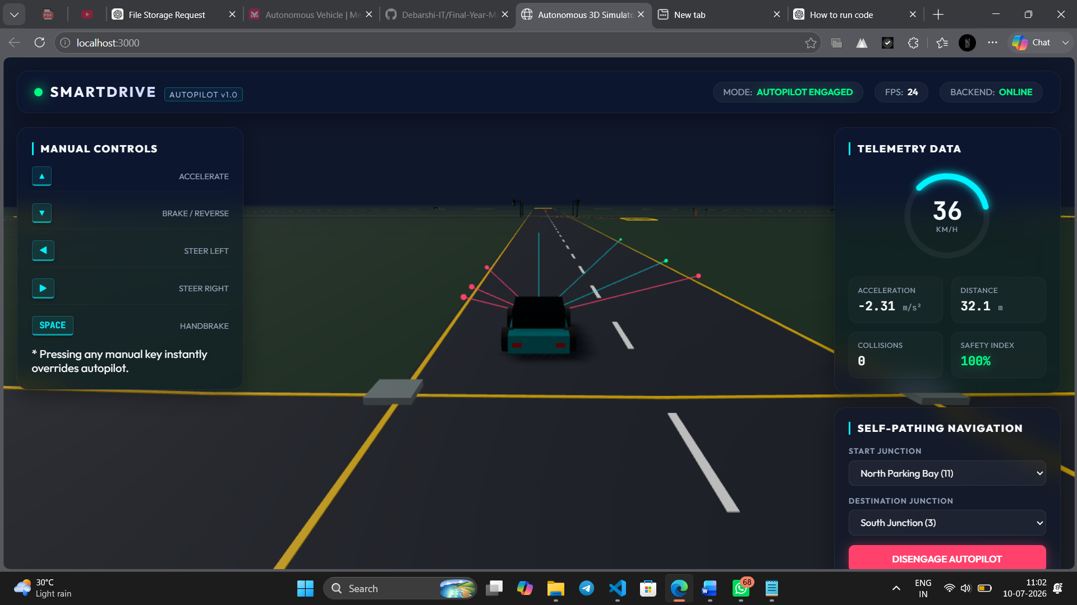
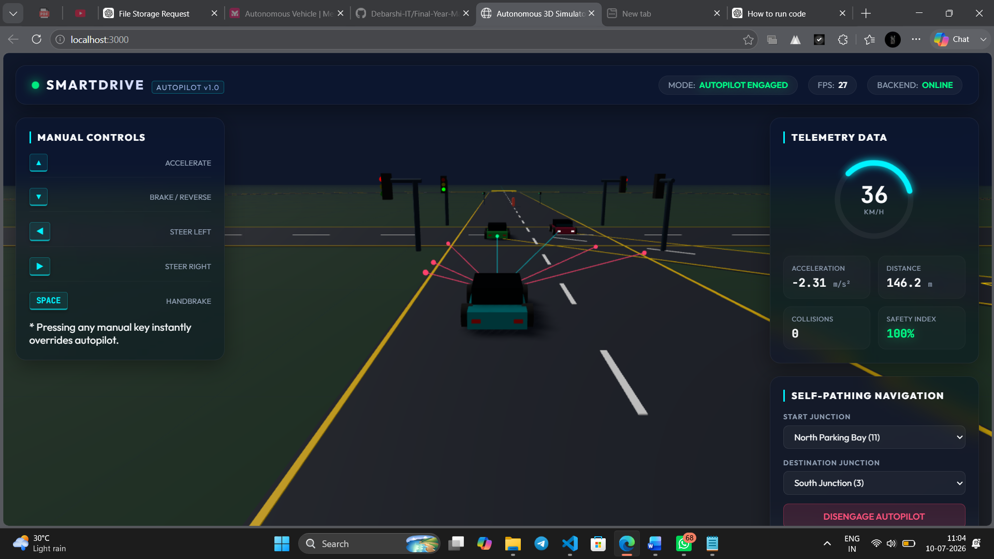
Algorithm & AI Techniques
1.
A* (A-Star) Algorithm Calculates the shortest and most efficient route.
2.
LiDAR (Ray Casting) Detects obstacles, pedestrians, and nearby vehicles.
3.
Pure Pursuit Algorithm Ensures smooth steering and accurate path following.
4.
Telemetry Analysis Monitors speed, steering, braking, and overall vehicle performance.
5.
Random Forest Predicts driving actions and steering corrections.
6.
Reinforcement Learning (Q-Learning) Learns and improves driving decisions over time.

Slide 10
Results & Performance
⚠️Limitation
Operates only in a simulated environment.
Limited real-world sensor accuracy and weather simulation.
AI models require further training for complex traffic scenarios..
✅Advantages
Lightweight and web-based simulator.
Efficient A* path planning for optimal navigation.
Real-time LiDAR-based obstacle detection.
Modular client-server architecture for easy maintenance.
Telemetry analysis for performance evaluation.
100% Route Completion 📍 Successfully reached the destination in all test scenarios.
Accurate Obstacle Detection 📡 LiDAR reliably detected vehicles, pedestrians, and obstacles.
Safe Autonomous Navigation 🚗 Followed the planned route while complying with traffic rules.
Efficient Route Planning 🗺️ A* algorithm generated the shortest navigation path.
Real-Time Telemetry 📊 Recorded speed, steering angle, braking, and vehicle performance.

Slide 11
Advantages & Limitations
✅Advantages
Lightweight and web-based simulator.
Efficient A* path planning for optimal navigation.
Real-time LiDAR-based obstacle detection.
Modular client-server architecture for easy maintenance.
Telemetry analysis for performance evaluation.
⚠️Limitation
Operates only in a simulated environment.
Limited real-world sensor accuracy and weather simulation.
AI models require further training for complex traffic scenarios..

Slide 12
Future Scope
Integrate Computer Vision for advanced object and lane detection. Apply
Deep Learning to improve autonomous driving decisions.
Support Vehicle-to-Everything (V2X) communication for smart transportation.
Add realistic weather and road conditions for better simulation.
Enhance the system with cloud-based monitoring and analytics.

Slide 13
THANK YOU

