Slide 1
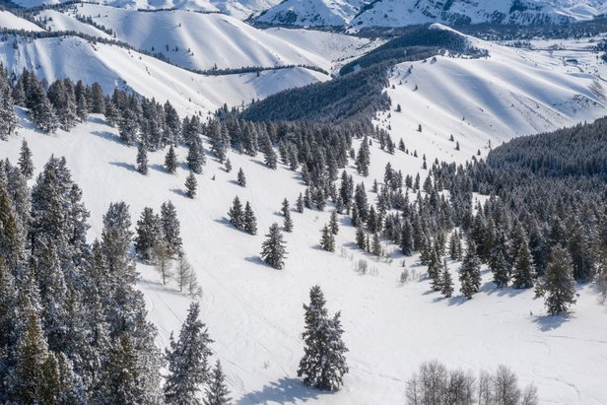
Ticket Price Prediction for Big Mountain Resort
Debarshi Datta
Springboard, January 2021 cohort

Slide 2
Problem Identification
What is the optimal ticket price for Big Mountain Resort, Montana given its unique set of features and the price-associations of features at other resorts nationwide?
What features could be increased to support a higher ticket price, and could anything be removed without undermining ticket price?
Are there viable improvements to increase revenue,
or safe expenditure cuts that would not undermine ticket price?

Slide 3
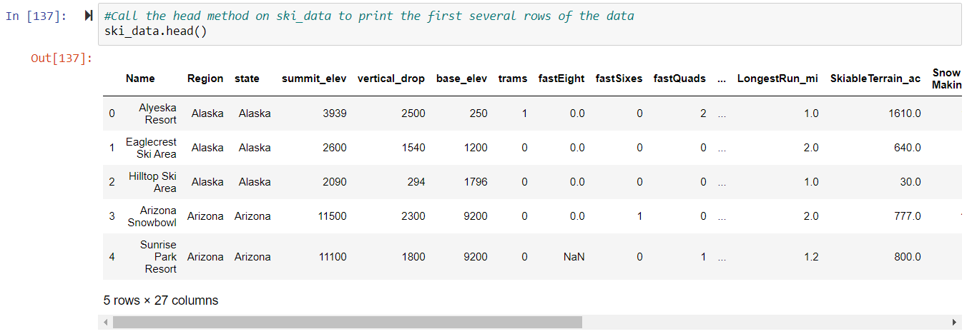
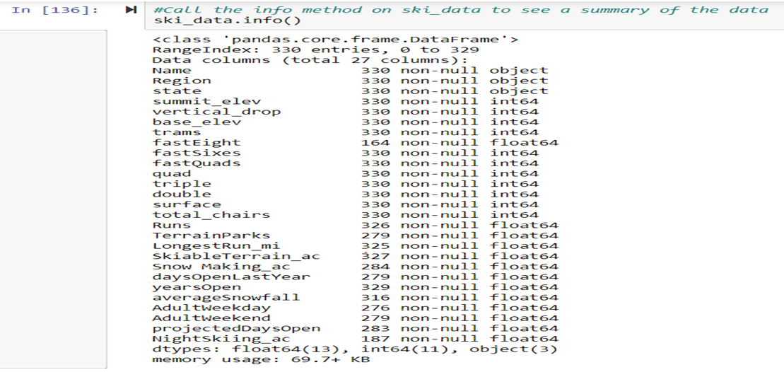
Start with Data…
‘ski_resort_data.csv’, containing 330 rows and 27 columns.

Slide 4
Start with Data…
fastEight column was dropped because half the values were missing.
AdultWeekday column was dropped in favor of modeling the AdultWeekend column as the model’s target variable.
All rows not containing AdultWeekend price values were dropped, leaving a shape of 277 rows (including Big Mountain Resort) and 25 columns.

Slide 5
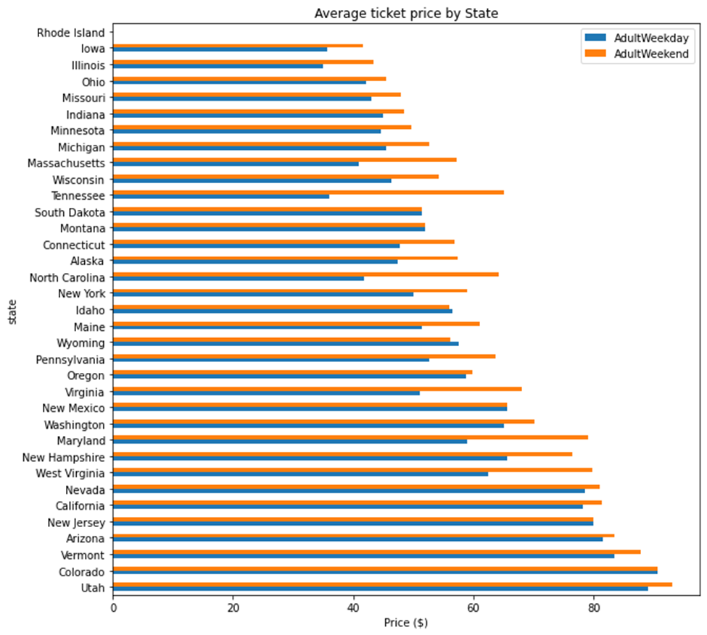
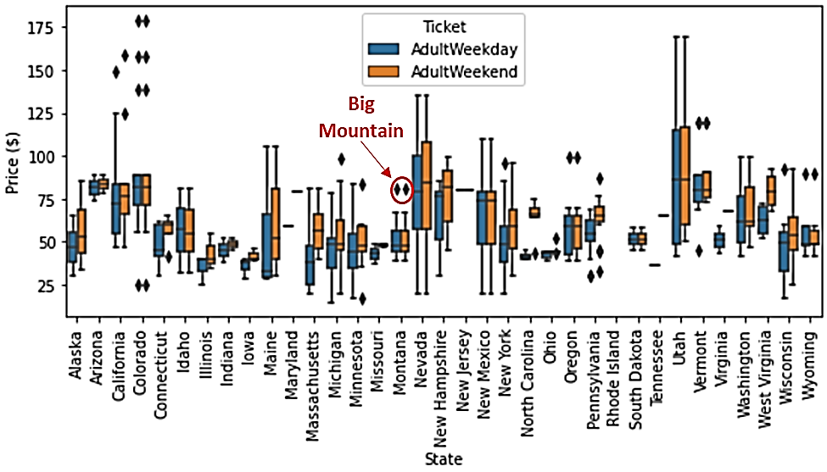
Ticket prices in context
Ticket prices grouped by state
Aside from some relatively expensive ticket prices in California, Colorado, and Utah, most prices appear to lie in the range of around 25 to over 100 dollars.

Slide 6
Ticket prices in context
Ticket prices grouped by state
Montana and South Dakota both show fairly small variability as well as matching weekend and weekday ticket prices. Nevada and Utah, on the other hand, show the most range in prices. North Carolina and Virginia, have weekend prices far higher than weekday prices.

Slide 7
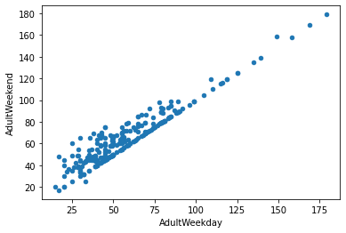
Ticket prices in context
A few potential groupings of resorts, those with low spread, those with lower averages, and those that charge a premium for weekend tickets.

Slide 8
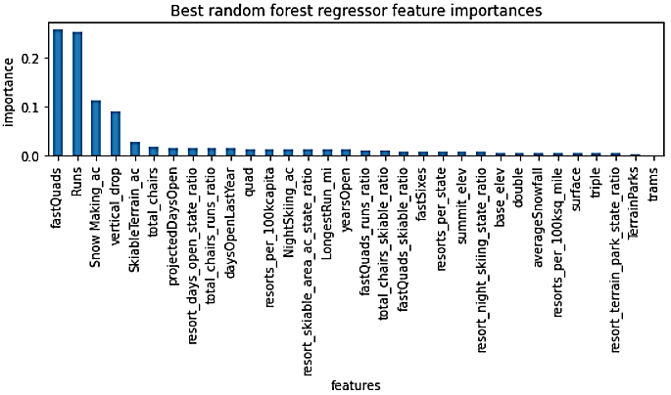
Price-predictive features
Most reliable model was a random forest model
Using 32 total features to predict ‘AdultWeekend’ price
Including resort data and state-level data
Best predictors of price:
Number of Fast Quad chairlifts
Number of Runs
Acres of snow-making
Vertical drop distance
Skiable acres
Total chairs

Slide 9
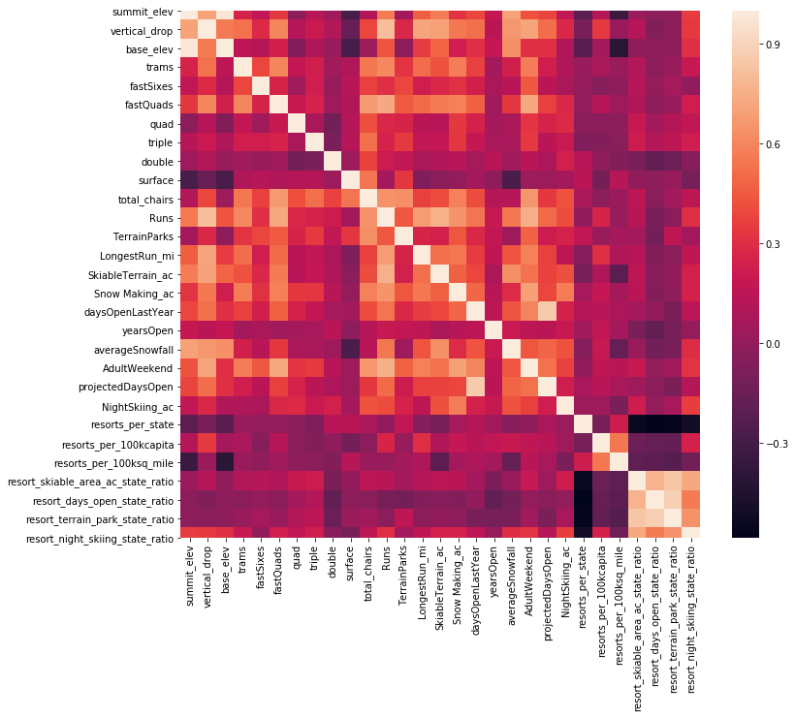
Multicollinearity
Summit and base elevation are quite highly correlated.
Increase the number of resorts in a state, the share of all the other state features will drop for each.
Positive correlation between the ratio of night skiing area with the number of resorts per capita.
In other words, it seems that when resorts are more densely located with a population, more night skiing is provided.

Slide 10
Multicollinearity
4. AdultWeekend ticket price, we see quite a few reasonable correlations.
5. fastQuads stands out, along with Runs and Snow Making_ac.
6. Visitors would seem to value more guaranteed snow, which would cost in terms of snowmaking equipment, which would drive prices and costs up.

Slide 11
Multicollinearity
6. Runs, total_chairs is quite well correlated with the ticket price. The more runs we have, the more chairs we'd need to ferry people to them.
7. The total skiable terrain area is not as useful as the area with snowmaking. People seem to put more value in guaranteed snow cover rather than more variable terrain area.

Slide 12
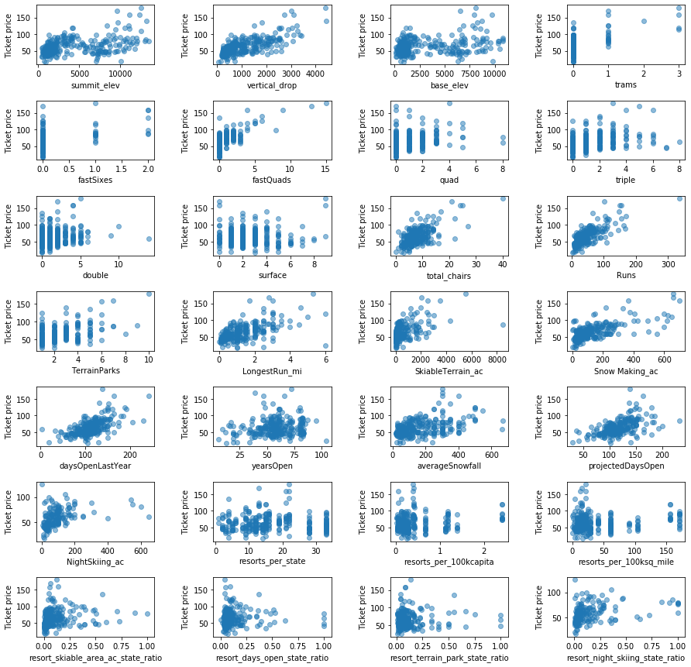
Correlations with Ticket Price
Notes:
Strong positive correlation with vertical_drop, fastQuads.
Runs and total_chairs appear quite similar and useful.
Resorts_per_100kcapita shows correlation. When the value is low, there is quite a variability in the ticket price, although it's capable of going quite high.
Ticket prices may drop a little before then climbing upwards as the number of resorts per capita increases. Ticket price could climb with the number of resorts serving a population because it indicates a popular area for skiing with plenty of demand.
The lower ticket price when fewer resorts serve a population may similarly be because it's a less popular state for skiing.
The high price for some resorts when resorts are rare (relative to the population size) may indicate areas where a small number of resorts can benefit from a monopoly effect. It's not a clear picture, although we have some interesting signs.

Slide 13
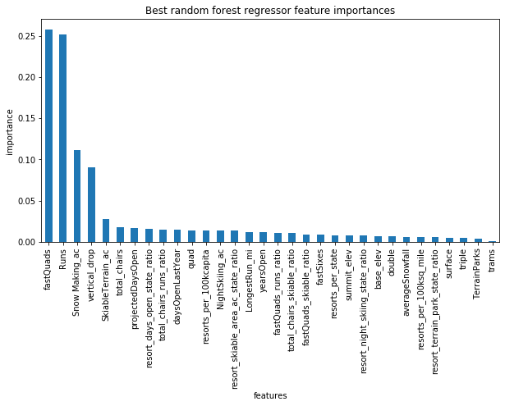
Top Features
The dominant top four features are in common with your linear model:
fastQuads
Runs
Snow Making_ac
vertical_drop

Slide 14
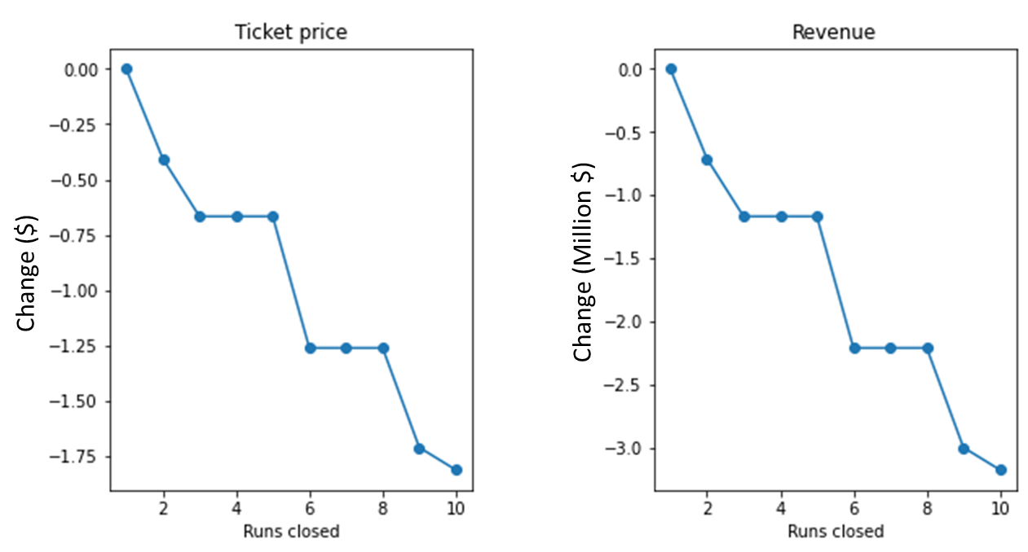
Scenario 1 – Close up to 10 runs
Loss of up to -$1.81 per ticket and -$3.17 Million in annual revenue.
One run could probably be closed without undermining price

Slide 15
More scenarios
Scenario 2 – Add a run and a chair lift to extend vertical drop by 150 ft
Estimated gain of $1.99 per ticket and $3.47 Million in annual revenue.
Scenario 3 – As above plus 2 acres of snow-making to cover new run.
Same gain as Scenario 2. No added benefit of snow-making.
Scenario 4 – Increase longest run by 0.2 miles and add 4 acres snow-making.
No gain.

Slide 16
Conclusions
Current price of $81.00 is underestimating the true value when compared with ski resorts nationwide.
We recommend a ticket price of $95.87 (Range: $85.48 - $106.26)
Of the short-listed improvement scenarios, scenario 2 (extending the vertical drop) is the best option for supporting a higher ticket price.

