Slide 1
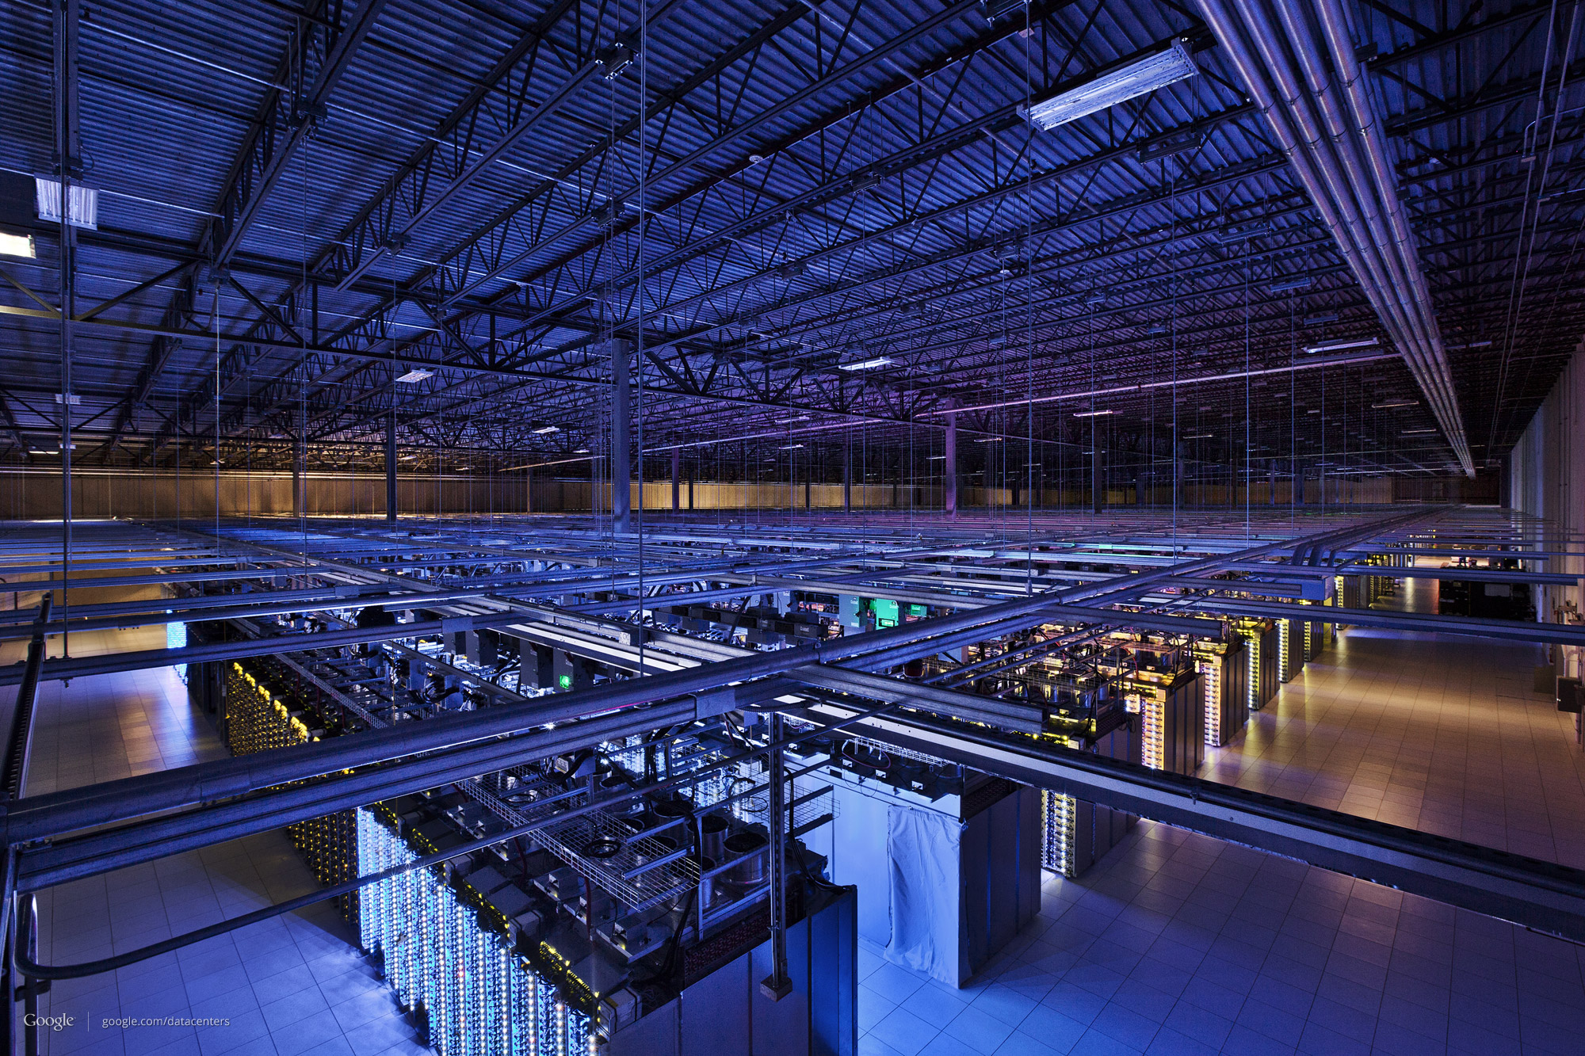
Cloud Curriculum M2 - Java

Slide 2
Monday | Tuesday | Wednesday | Thursday | Friday
Microservice Architecture | Cloud Foundry Basics | Logging & Tracing | Security | Testing Strategy
Spring Basics | Exercises | Exercises | Exercises | Continuous Delivery
Exercises
Lunch break
Create REST Controller | Connect Database | Service2Service Communication | Exercises | Spring Boot
Exercises | Exercises | Exercises | Multi Tenancy | Demos
 |  |  |  | Q & A
Legend:
Theory
Exercise

Slide 3
Monday | Tuesday | Wednesday | Thursday | Friday
Intro & Expectations | Cloud Foundry Basics | Logging & Tracing | Security (ask Robert) | Continuous Delivery (Demo)
Microservice Architecture | Exercise 6 | Exercises 12 – 13 [+14]
Spring Basics (DI) | Connect Database |  | Exercise 22 – 24 | Demo or Exercises
REST / Spring Web MVC /Spring MVC Test | Exercise 7 | Kibana Demo
Lunch break
Domain | Connect Database: JPA / EclipseLink / CRUD Repository | Service2Service Communication / Hystrix |  | Spring Boot Intro
Exercises 1 – 4 [+ 5]
 | Exercises 8 – 10 [+ 11] | Exercises 16 – 18 [+ 19] | Testing Strategy | Demos: HANA, AOP, [Redis]
 |  | Hystrix Dashboard Demo, MQ Demo | JMeter Demo, System Test Demo [Exercise 25 + 26] | Q & A
 |  | [MQ Exercises 20 – 21]
End-of-day discussion |  |  |  | Your Feedback…
Legend:
Theory Block
Practical Block (Development)

Slide 6
The Grid
Headline area
White space
Drawing area

